Slide 1
The National Gallery

Slide 2
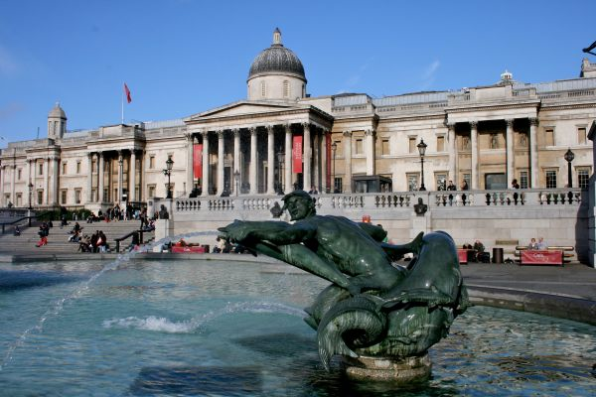
The National Gallery is an art museum on Trafalgar Square in London

Slide 3
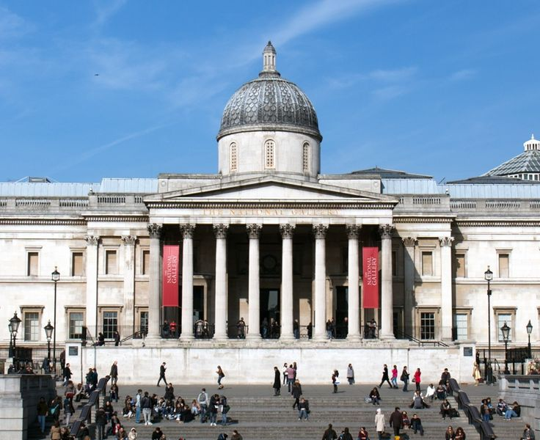

Slide 4
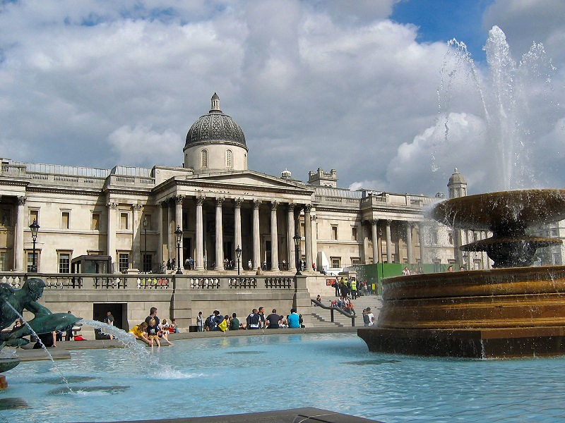

Slide 5
This Gallery contains a collection of over 2,300 paintings dating from the mid-13th century to 1900

Slide 6
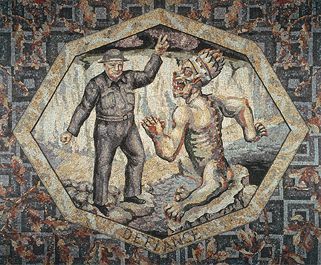
"Awakening of the Muses" marble mosaic founded in 1933 by a native Russian artist Boris Anrepom (1885-1969)

Slide 7
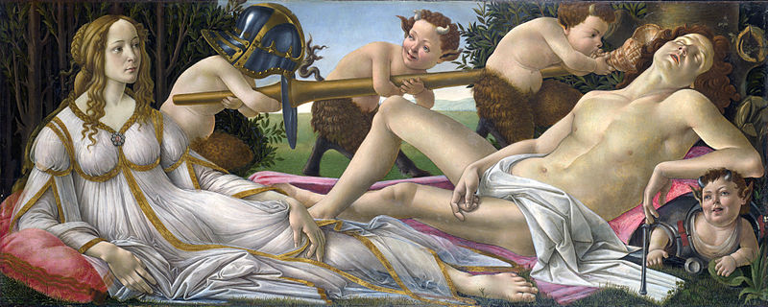
Sandro Botticelli - Venus and Mars (1485)

Slide 8
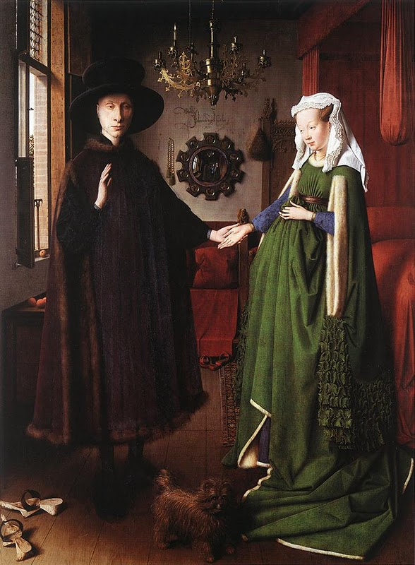
Portrait Arnolfiny. Jan van Eyck. 1434

Slide 9
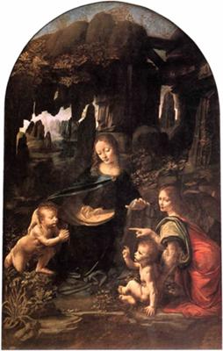
Leonardo da Vinci - The Virgin of the Rocks (1495-1508).

Slide 10
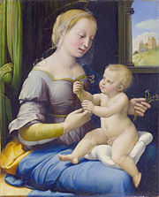
Raphael, The Madonna of the Pinks (1506-07).

Slide 11
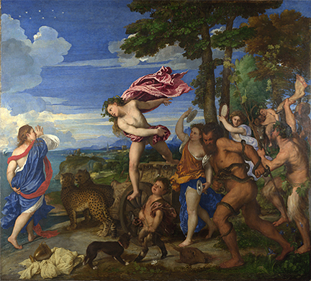
Titian - Bacchus and Ariadne(1520-23)

Slide 12
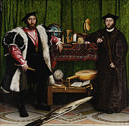
Hans Holbein the Younger, The Ambassadors (1533).

Slide 13
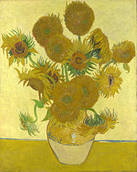
Vincent van Gogh, Sunflowers(1888).

Slide 14
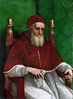
Raphael - Portrait of Julius II(1511)

