Slide 1
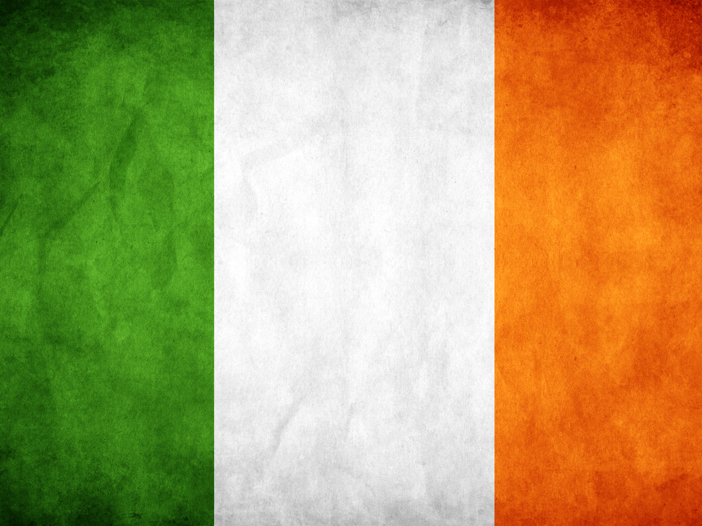
Famous people of Ireland

Slide 2
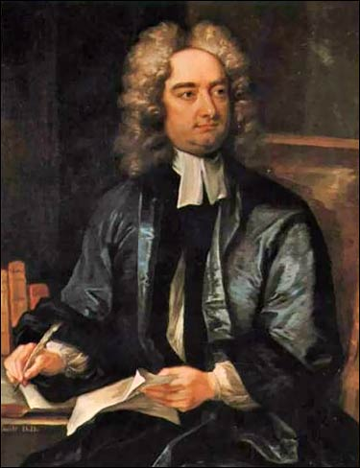
Jonathan Swift was an Irish author and satirist. Best known for writing Gulliver's Travels, he was dean of St. Patrick's Cathedral in Dublin.

Slide 3
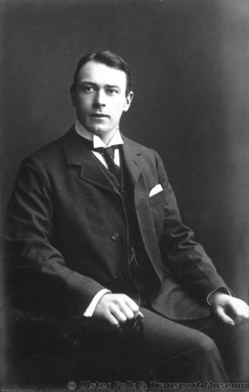
Thomas Andrews was the principal architect for the infamous RMS Titanic. He died in the sinking, on April 15, 1912.

Slide 4
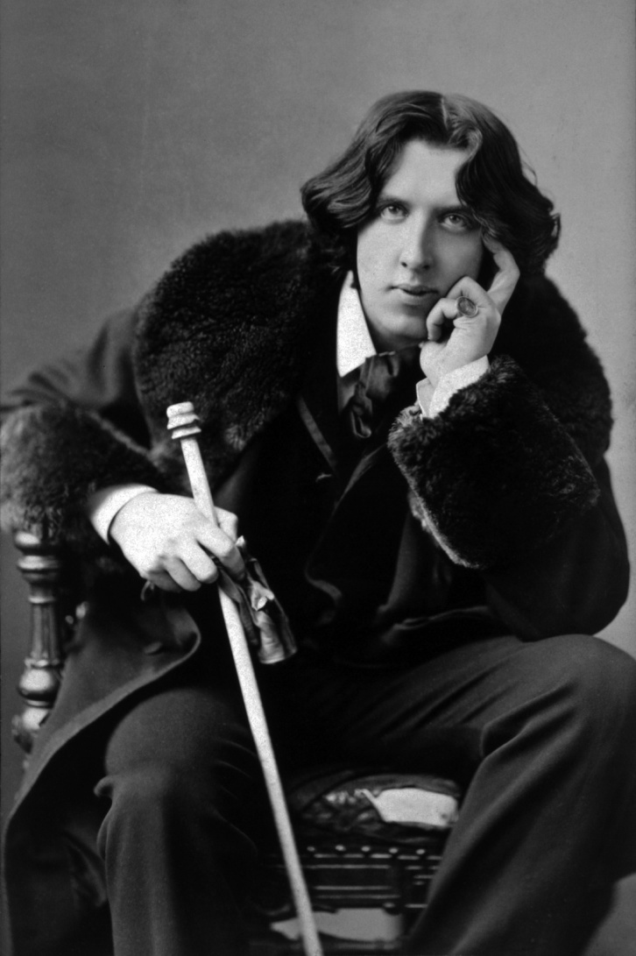
Irish playwright, poet, and novelist who is best known for The Importance of Being Earnest and The Picture of Dorian Gray. He is also famous for his memorable, witty epigrams.

Slide 5
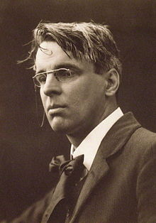
William Butler Yeats was one of the greatest English-language poets of the 20th century and received the Nobel Prize for Literature in 1923.

Slide 6
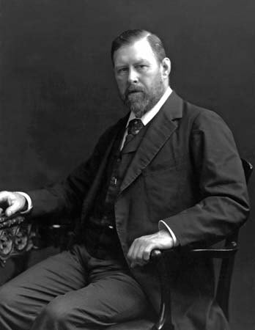
Irish writer Bram Stoker is best known for authoring the classic horror novel Dracula (1897).

Slide 7
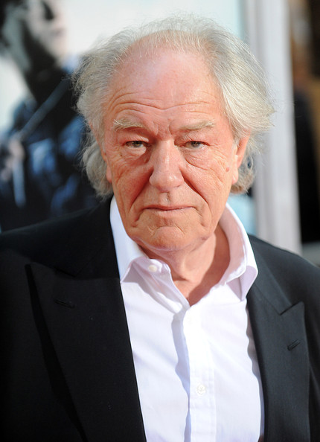
Irish actor Michael Gambon is best known for his role as Albus Dumbledore in five of the seven J.K. Rowling Harry Potter films. Prior to his role as Dumbledore, Gambon was known as one of the leading thespians of his generation.

Slide 8
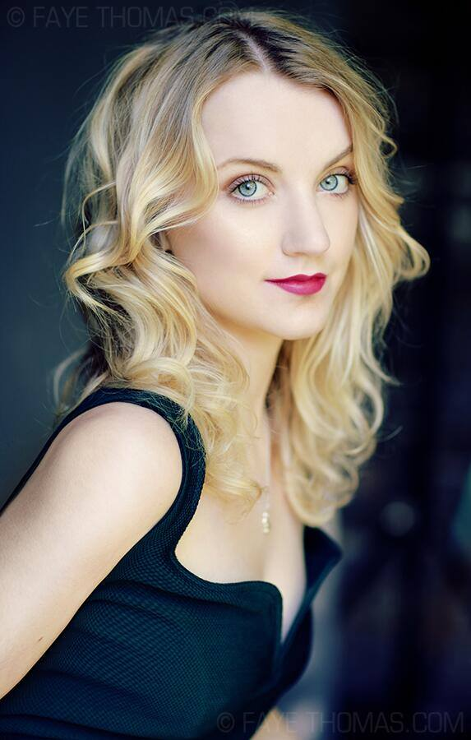
She played Luna Lovegood in the last four installments of the Harry Potter film franchise. She received additional recognition for her appearances in G.B.F. and It Don't Come Easy.

Slide 9
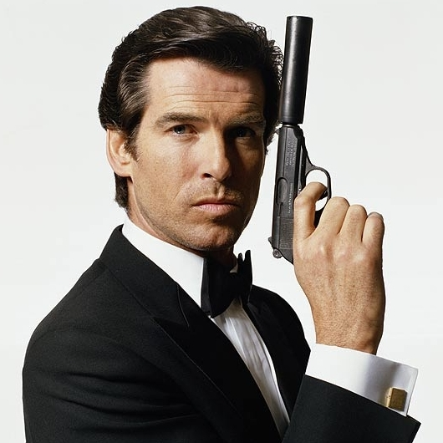
Irish actor Pierce Brosnan is best known for his recurring role as British spy James Bond in the popular James Bond film series.

Slide 10
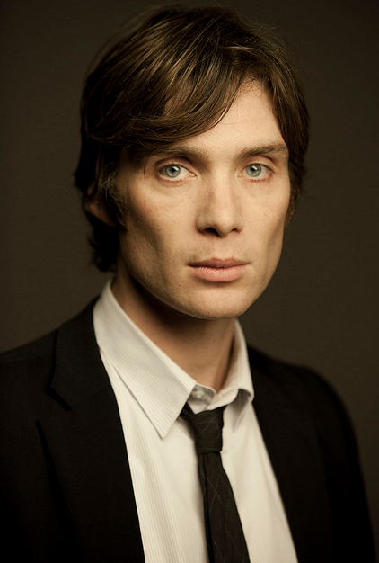
Cillian Murphy is an Irish movie actor known for the diversity of his roles in films ranging from Breakfast on Pluto to Batman Begins.

Slide 11
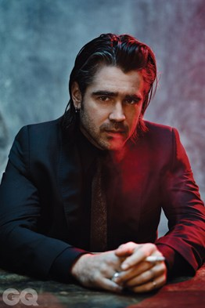
Irish actor Colin Farrell's gained stardom with his part in the movie Tigerland, which lead to his leading roles in numerous films, including American Outlaws.

Slide 12
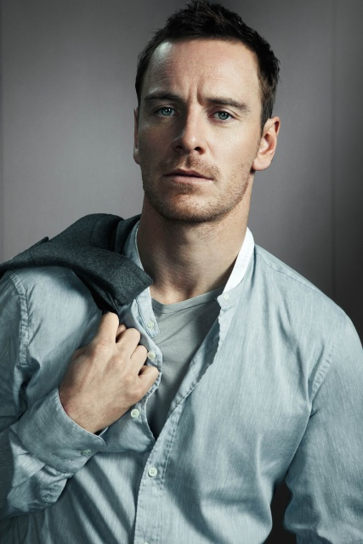
Actor Michael Fassbender has starred in the films 300, Inglorious Basterds, Centurion, Dangerous Method, Prometheus and the comic-book-based X-men: First Class.

Slide 13
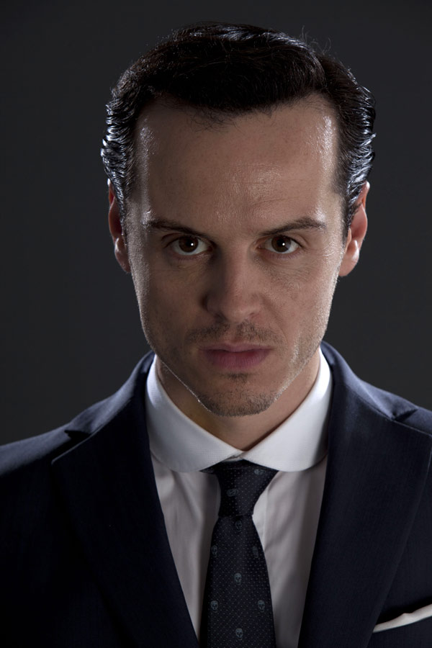
Irish actor who received an IFTA award for his role in Dead Bodies. He began playing Jim Moriarty in the BBC series Sherlock in 2010.

