Slide 1
Ideal school

Slide 2
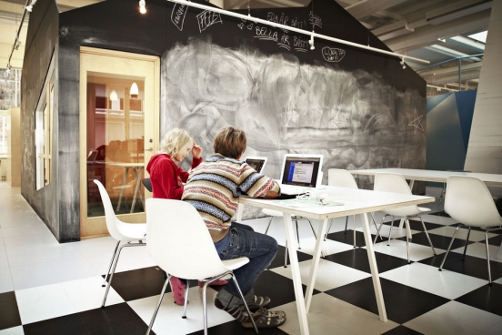
For an experimental school in Stockholm office Rosan Bosch has created interiors provide the easy assimilation of knowledge and enjoyment. Even lazy and bad students, getting them to the school, visited him with pleasure.

Slide 3
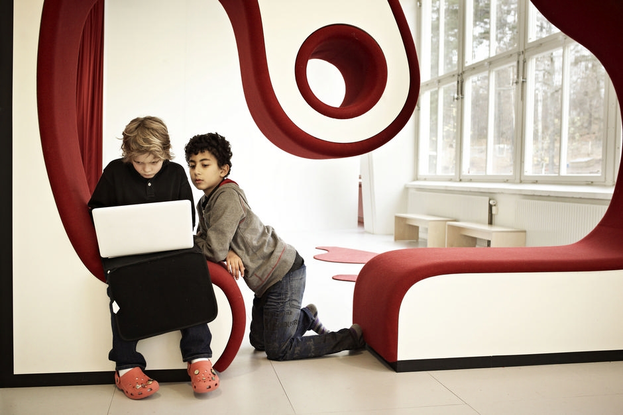
What's special education Vittra is that children do not separate objects, and the solution of specific learning situations that require knowledge of various kinds.

Slide 4
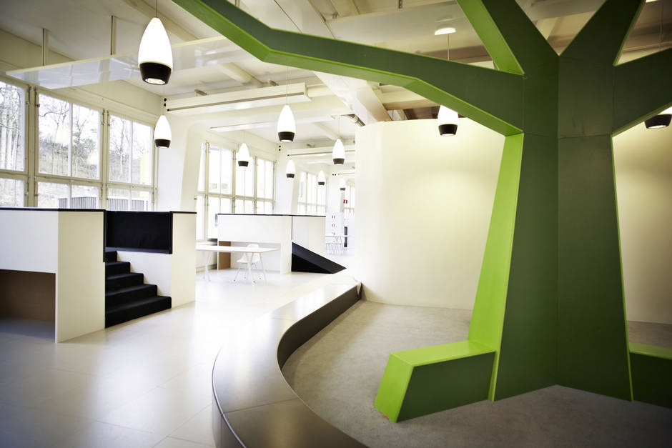
Accordingly, students are divided into groups based on their personal characteristics, aptitudes and volume of basic skills.

Slide 5
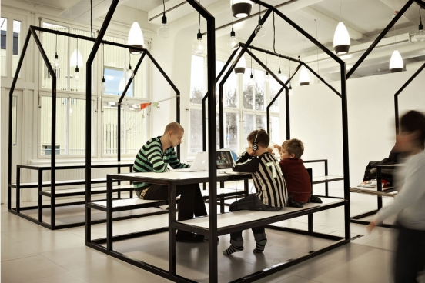
Area schools is about 1,900 sq.m. There is not the usual classes with tables and chairs.

Slide 6
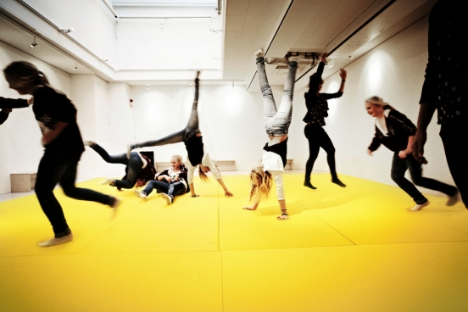
The so-called laboratory - are areas designated for learning and communication in small groups of 3-4 people. Between them there is no deaf walls, furniture themselves are resonating elements. In schools Vittra widely used digital technology and, of course, it could not affect the design.

Slide 7
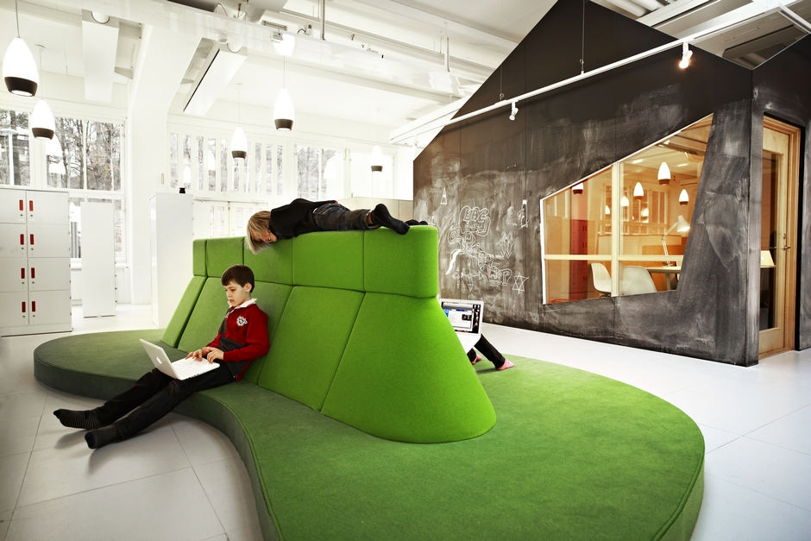
For example, popular with students of the island enjoys a green object designed to work on lap-tops.

Slide 8
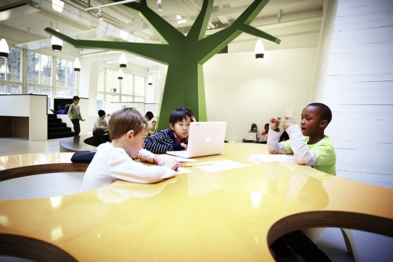
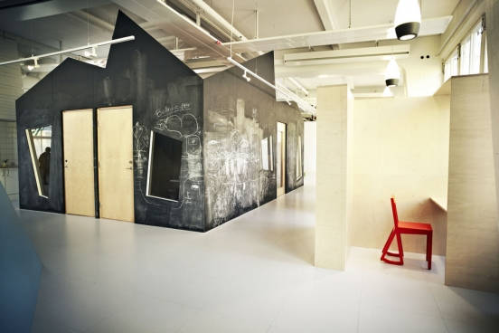
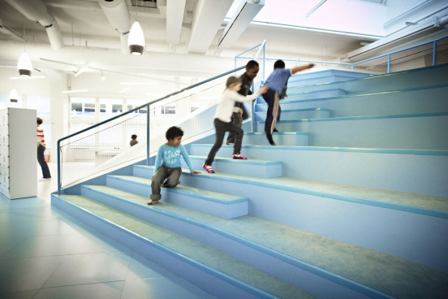
Thus, the interior design has really become an additional tool for education.

Slide 9
Thank you
for attention!

