Slide 1
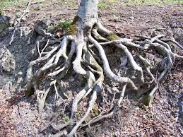
Root Words
Erica Nelson, Pavlo Wert Cody Houghton, Nikki Wert

Slide 2
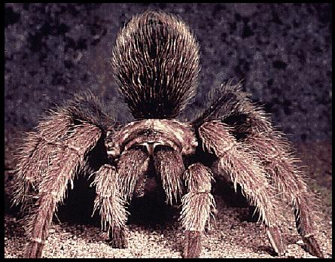
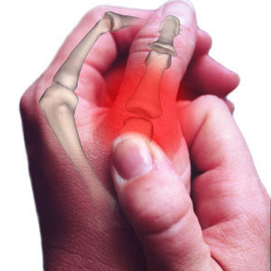
PREFIX “Arthro-”
Indicating a joint
Examples:
Arthropod - a invertebrate having jointed limbs and a segmented body with an exoskeleton made of chitin.
Arthropathy - any joint disease
Ar thro pod
Ar th r o p o d

Slide 3
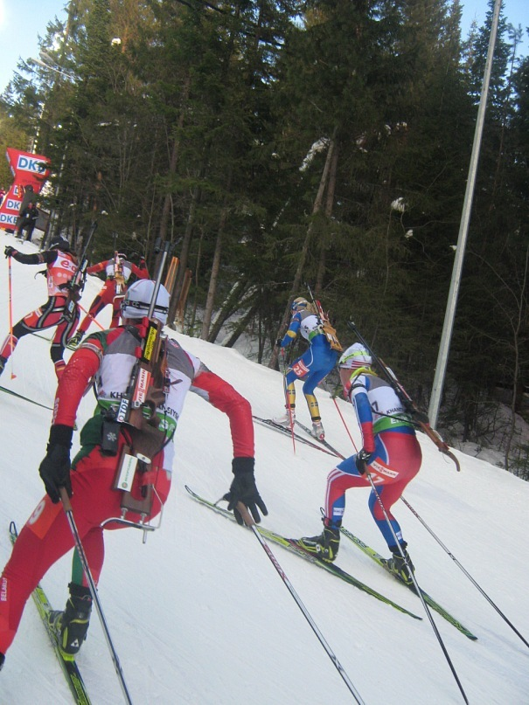

PREFIX “Bi-”
Two or twice
Biquadratic – an equation of the fourth degree.
Biathlon – a sport, which include skiing and shooting.
Bi ath lon
B i a th l o n

Slide 4
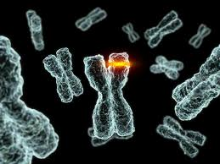

PREFIX “Bio-”
Life
Biology – the science of life and of living organisms.
Biolysis – a destruction of tissues under
the influence of organisms.
Bi o lo gy
B i o l o g y

Slide 5
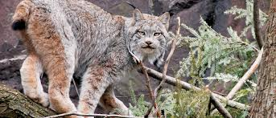
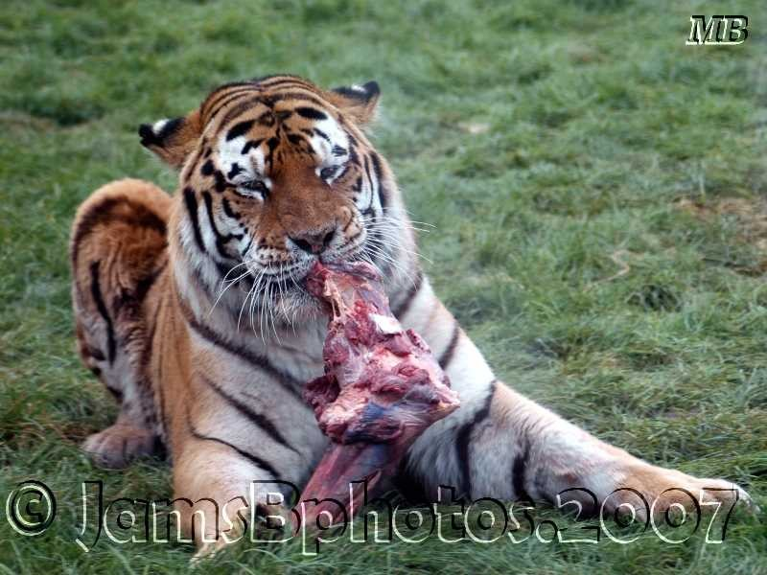
PREFIX “Carne-”
Flesh
Carnivore – a flesh-eating animal.
Carnage – massive slaughter, as in war.
Carn ni vore
C a r n i v ore

Slide 6
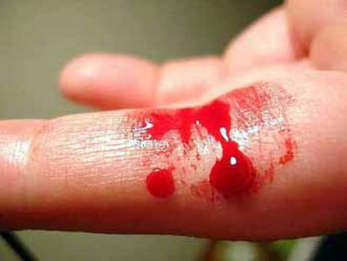
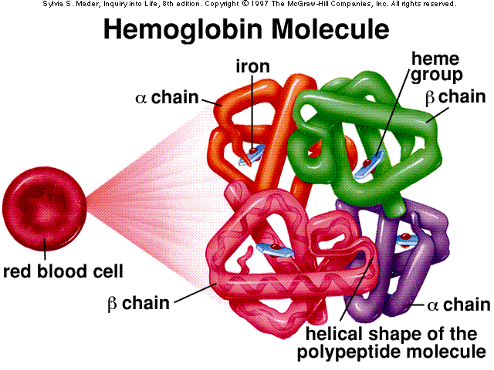
PREFIX “Hemo-”
Blood
Hemoglobin – the oxygen carrying pigment of red blood cells.
Hemophilia – any of several hereditary blood-coagulation disorders in which the blood fails to clot normally because of a deficiency or abnormality of one of the clotting factors.
He mo glo bin
H e m o g l o i n

Slide 7


PREFIX “Hyper-”
Extra, big
Hyperactivity – having behavior characterized by over activity.
Hyperacidity – containing excessive acid; excessively acidic.
Hy per ac ti vi ty
H y p er a c t i v i t y

Slide 8
Bibliography
http://www.thefreedictionary.com/arthro-
http://www.memidex.com/arthropods
http://www.thefreedictionary.com/biquadratic+equation
http://www.morewords.com/word/biolysis/
http://www.scrabblefinder.com/starts-with/carne/
http://www.thefreedictionary.com/carnivore
http://dictionary.reference.com/browse/hemoglobin
http://www.thefreedictionary.com/hyperactivity
http://www.thefreedictionary.com/hyperacidity

