Slide 1
Organization of the world

Slide 2
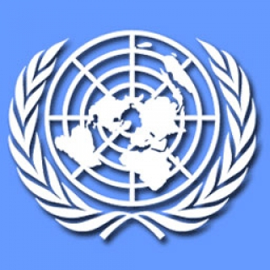
UN
(United Nations)

Slide 3
The United Nations (U.N.) is a intergovernmental organisation established on 24 October 1945 to promote international cooperation. It replaced the League of Nations and the organisation was created following World War II to prevent another conflict. At the time it was founded, the UN had 51 member states; there are now 193. Most nations are members of the U.N. and send people to the headquarters to hold meetings and pass resolutions (make decisions) about global issues.

Slide 4
The goals of the United Nations are:
to keep world peace
to help countries get along
to improve living conditions for people all over the world and to make the world a better place.

Slide 5
Member States of the UN
Membership:192 member States
Headquarters: New York, USA with Additional offices: Geneva, Switzerland Vienna, Austria
Nairobi, Kenya
Type of organization: international organization
Official languages: English, Arabic, Chinese, English, French
The Secretary-General :Ban Ki-Moon(The Republic Of Korea )

Slide 6
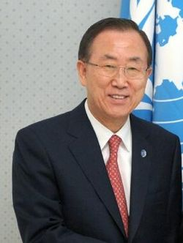
Ban Ki-Moon

Slide 7
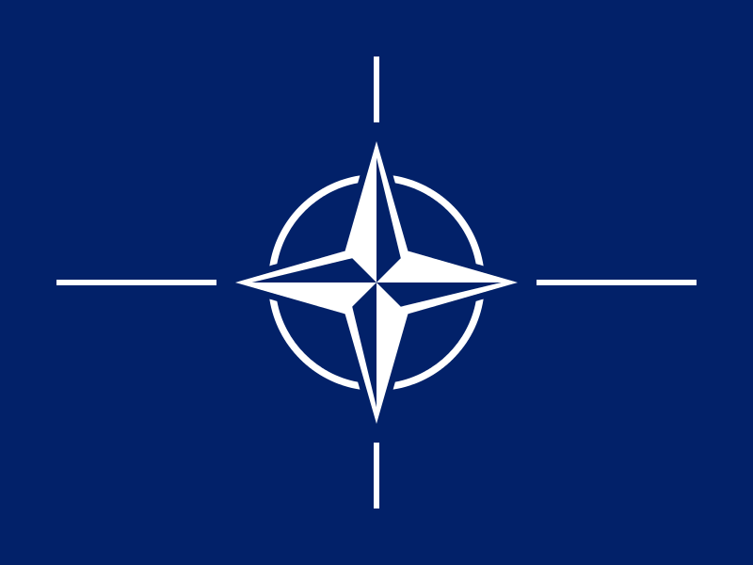
NATO
(North Atlantic Treaty Organization)

Slide 8
The North Atlantic Treaty was signed on 4 April 1949 in Washington state.
NATO is international military-political organization established on April 4, 1949. Today, 28 countries are members of NATO. The main principle of the organization is the system of collective defence, that is, a joint concerted action of all its members in response to the attack from the outside.

Slide 9
Types of members:28
Official languages:French,English
Headquarters:Brussels, Belgium
Chief :Anders Fogh Rasmussen

Slide 10
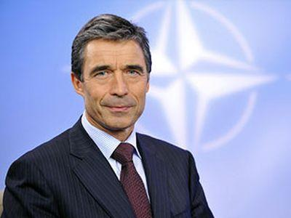
Anders Fogh Rasmussen

Slide 11
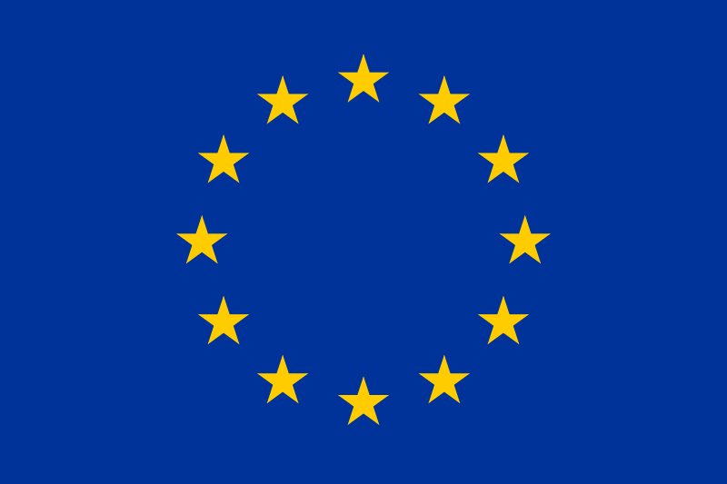
EU
( European Union)

Slide 12
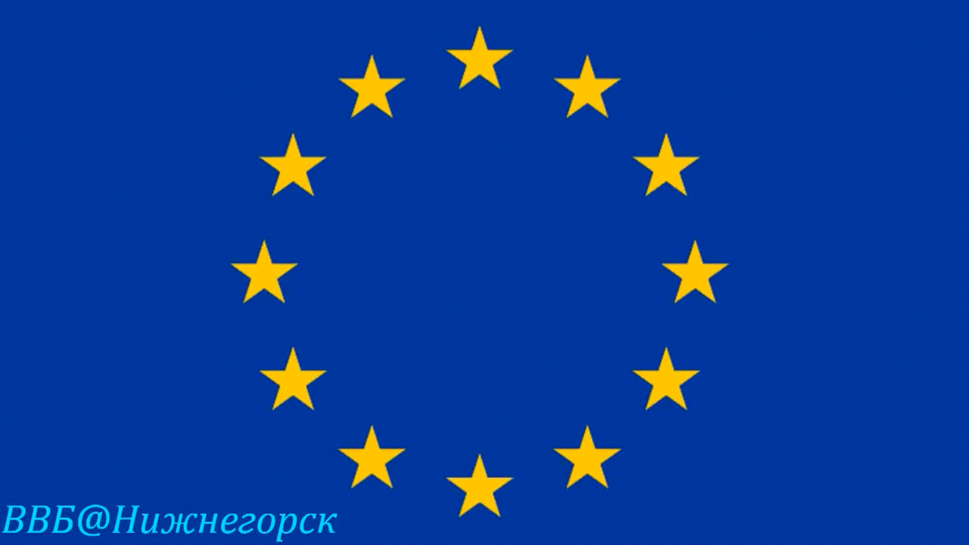

Slide 13
The European Union is an economic and political Union of 28 European States, aimed at their regional integration. Legally this Union was enshrined by the Treaty of Maastricht, which entered into force on 1 November 1993, on the principles of the European communities. The EU combines five hundred million people.
The European Union is a unique international education: it combines the features of international organizations and States, but not formally neither the one nor the other. The Union is not a subject of international public law, however, has the authority to participate in the international relations and plays an important role.
The European Union is the Association of the European States participating in the process of European integration.

Slide 14
Political centres in Brussels,Luxembourg,Strasbourg
Member States :28
Official languages: 24(
Guide:
-European Council Herman Van, Rompuy
- Commission Jose Manuel
- Parliament Barroso
- The Council of Ministers Martin Schulz
(Greece)

Slide 15
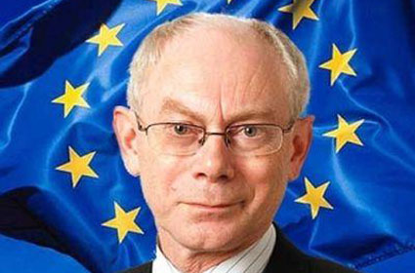
Herman van Rompuy

Slide 16
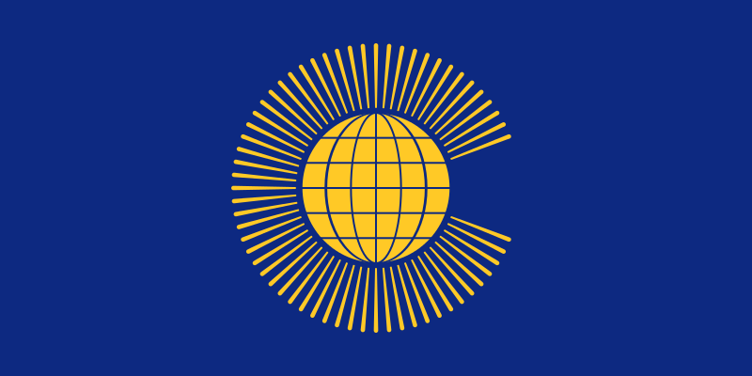
Commonwealth of Nations

Slide 17
Commonwealth of Nations
is voluntary intergovernmental organization of sovereign States, including the United Kingdom and almost all of its former dominions, colonies and protectorates. In addition, members of the Commonwealth are Mozambique and Rwanda.

Slide 18
The Members Of The Commonwealth
Membership: 53 member state
(membership Fiji suspended, 02.10.2013 Gambia left the organization)
Headquarters: Westminster, London
Official language: English
The Head Of The Commonwealth:Elizabeth II
Base :1926 / 1931 / 1949

Slide 19
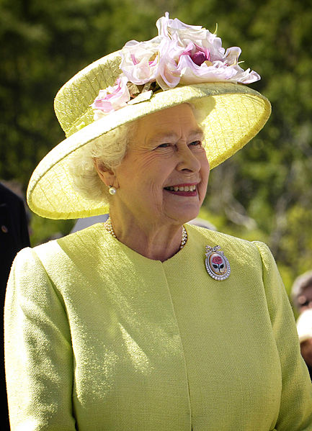
Elizabeth II

Slide 20

GPI
(Greenpeace International)

Slide 21
Greenpeace is a non-governmental environmental organization with offices in over forty countries and with an international coordinating body in Amsterdam, the Netherlands. Greenpeace states its goal is to "ensure the ability of the Earth to nurture life in all its diversity" and focuses its campaigning on world wide issues such as global warming, deforestation, overfishing, commercial whaling, genetic engineering, and anti-nuclear issues.

Slide 22
Type: international non-governmental organization;
Year of foundation: 1917;
Location :Amsterdam, Netherlands (Greenpeace international, in 1989 - Astoria);
Sphere of activity:Environmental protection, Pacifism;
Number of participants: 3 million;
Executive Director : Kumi Naidoo

Slide 23
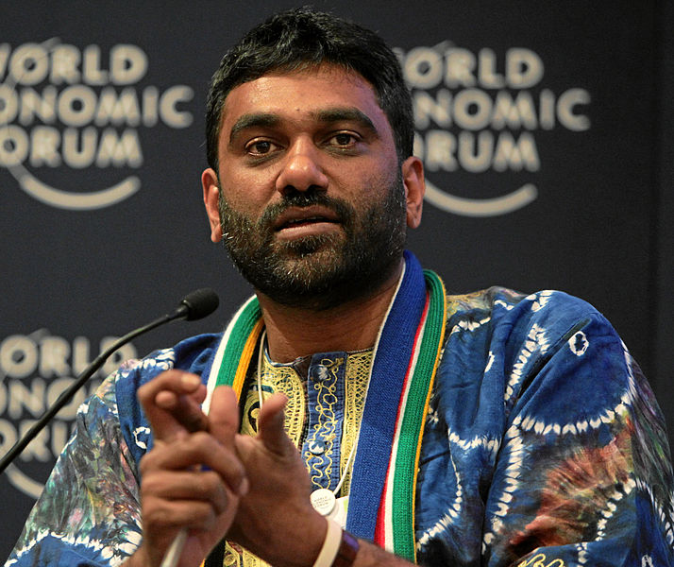
Kumi Naidoo

Slide 24

WWF
(World Wide Fund for Nature)

Slide 25
The World Wide Fund for Nature (WWF) is an international non-governmental organization working on issues regarding the conservation, research and restoration of the environment, formerly named the World Wildlife Fund, which remains its official name in Canada and the United States. It is the world's largest independent conservation organization with over 5 million supporters worldwide, working in more than 100 countries, supporting around 1,300conservation and environmental projects. WWF is a foundation, in 2010 deriving 57% of funding from individuals and bequests, 17% from government sources (such as the World Bank, DFID, USAID) and 11% from corporations.

Slide 26
The group says its mission is "to stop the degradation of the planet’s natural environment and to build a future in which humans live in harmony with nature."[6] Currently, much of its work focuses on the conservation of three biomes that contain most of the world's biodiversity: oceans and coasts, forests, and freshwater ecosystems. Among other issues, it is also concerned with endangered species, pollution and climate change.

Slide 27
Type:Charitable trust
Founded:April 29, 1961
(First office opened on September 11, 1961 in Morges, Switzerland)
Founder(s):Prince Bernhard of Lippe-Biesterfeld,Julian Huxley ,Max Nicholson,Peter Scott,Guy Mountfort,Godfrey ,A. Rockefeller
Headquarters:Gland, Vaud, Switzerland
Key people:Yolanda Kakabadse
(President)

Slide 28
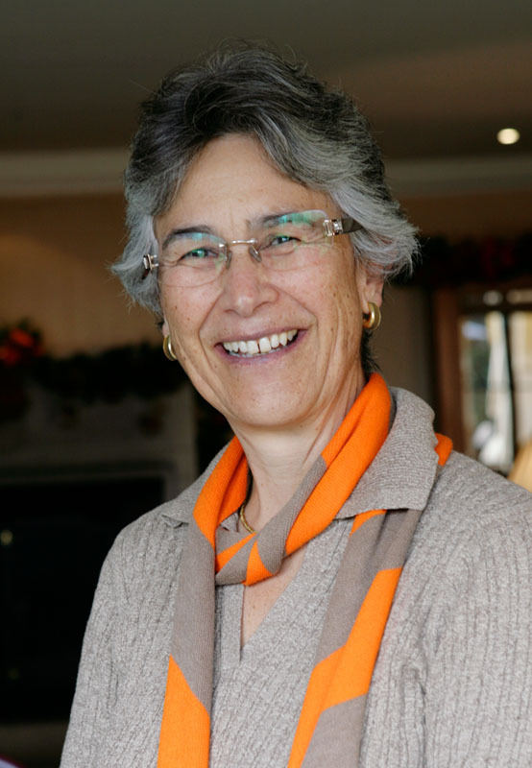
Yolanda Kakabadse

