Slide 1
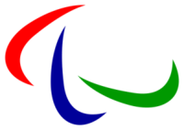
Paralympics games

Slide 2
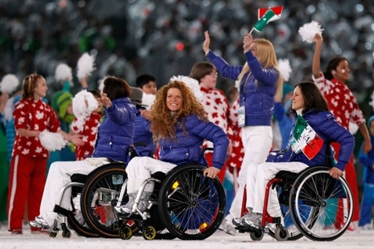
Paralympics games-
international sports competitions
for peoplewith disabilities. Tradi-
tionally hold after the Olympic
Games, they hold in 1992 - in same arenas as the Olympic Games. 2001 this practice fixed by agreement between the IOC and the International Paralympics Committee (IPC). Summer Paralympics games held in 1960, and winter Paralympics games – in 1976 intervals in 4 years. The last events held in Vancouver, Canada 2010. There are 20 sports in the Paralympics programme.

Slide 3
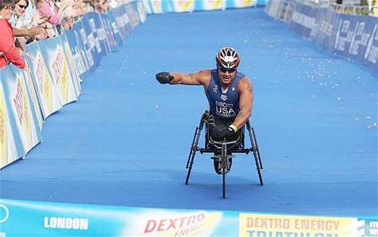
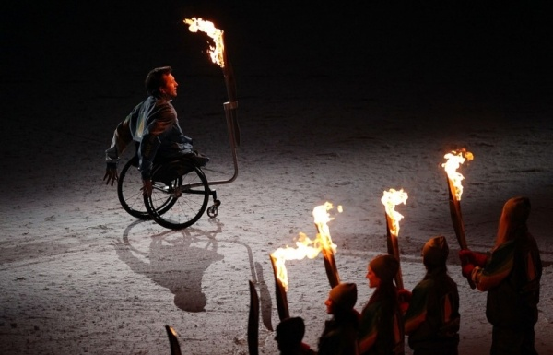
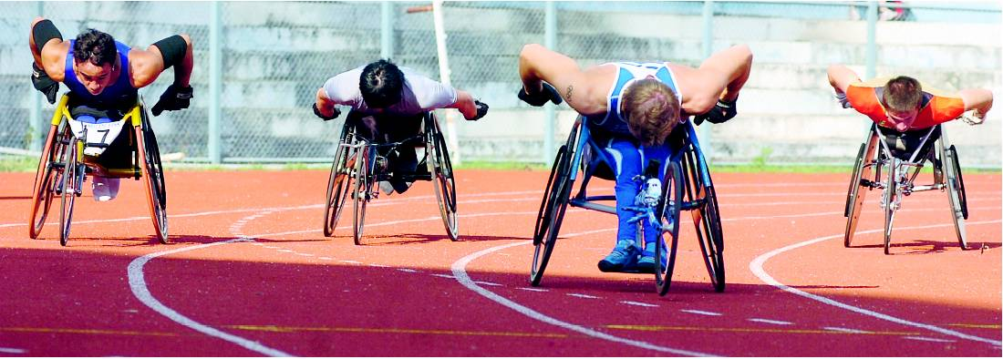

Slide 4
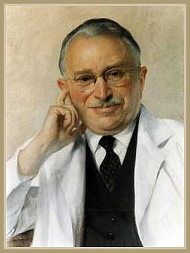
History of Paralympics games
The emergence of sports in which people can participate with disabilities associated with the name of an English neurosurgeon Ludwig Guttman, who, overcoming age- old stereotypes against people with disabilities, introduced the sport in the rehabilitation process of patients with spinal cord injury. He proved in practice that sport for people with disabilities, creating conditions for a successful life, restores mental balance, allowing return to normal life. During the Second World War at the Stoke-Mandevylsk English town hospital in Aylesbury, he established the Center for treatment of spinal injuries.
28th July 1948 group of invalids at first time of all history of sport take sport equipment. There were 16 paralyzed women and men in this group.
In 1956 Ludwig Gutman developed a Charter of athletes, creates a foundation on which further develops sports people with physical disadvantages. Goal Stoke Mandevylskyh games was paralyzed unite men and women from all parts of the world in the International Paralympics Movement. Stoke Mandevylskyh games was awarded the Fearnley Cup.

Slide 5
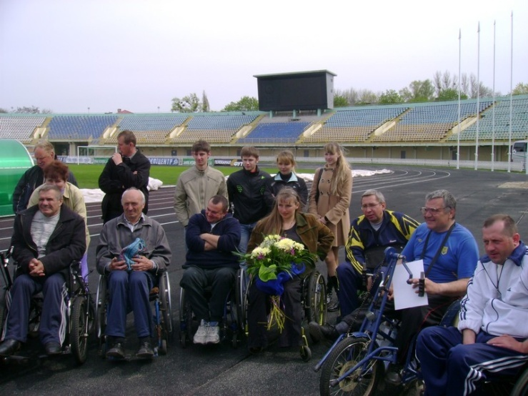
Formation
In 1960 in Rome held international competition invalids. There took part 400 sportsmen from 23 coun- tries. Games later received the name of "Paralympics".
With each games increased number of participants, expanding the geography of countries grew, the number of sports. In athletes with spinal injuries athletes join other nosology.
In 1998 in international games in Seul sportsmen-invalids received access to sports facilities the host city. From this time games became “Paralympics”. Graphic symbol of the world Paralympics movement became red, blue and green hemispheres, which symbolizes the mind, body, stubborn spirit.

Slide 6
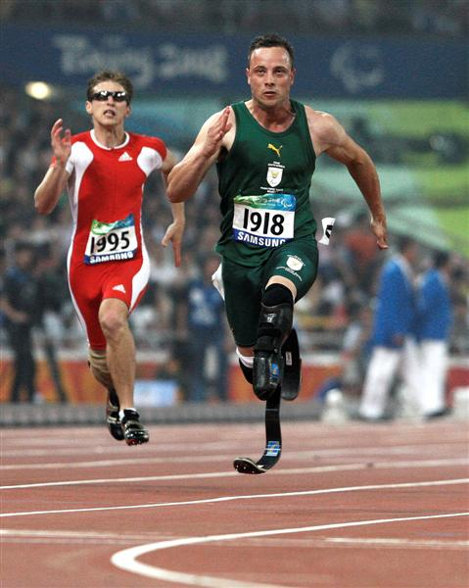
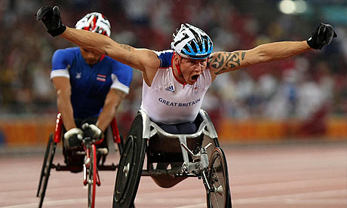
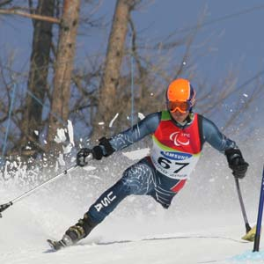
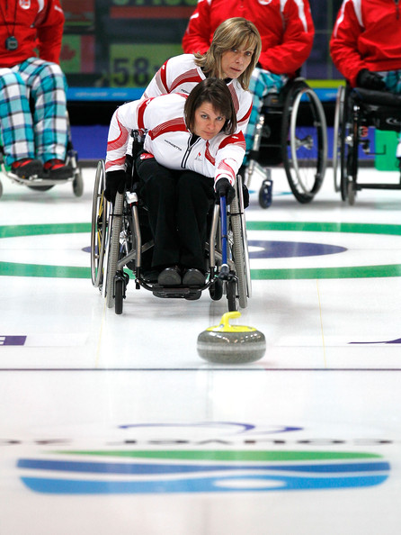
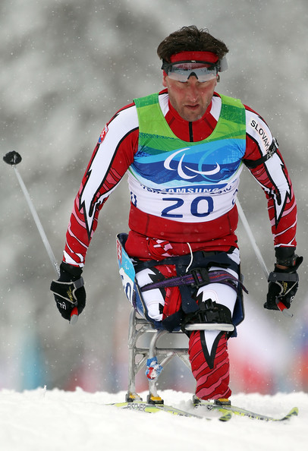
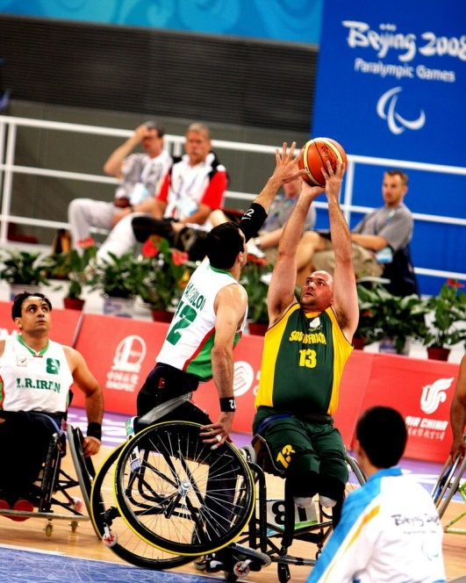
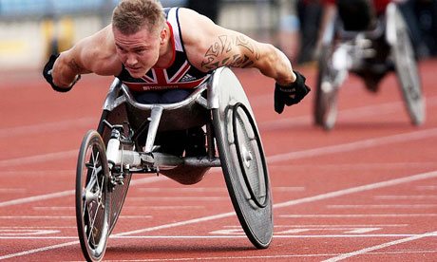

Slide 7
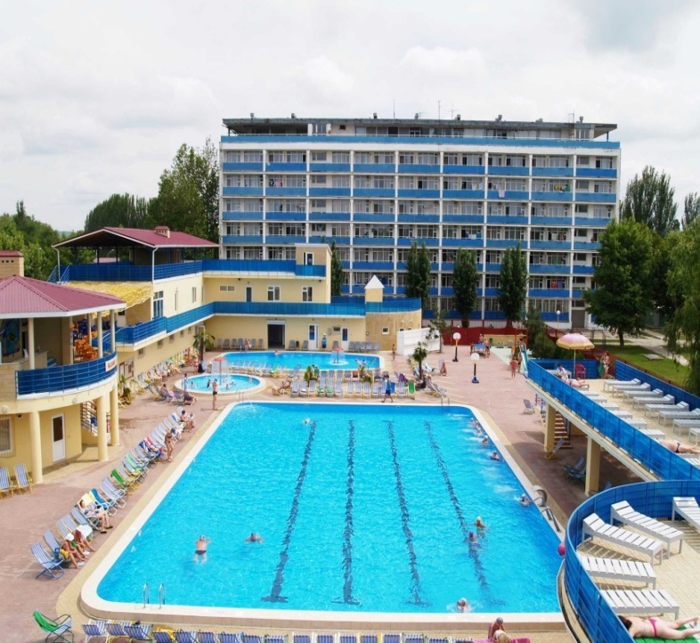
Paralympics movement in Ukraine
19 Ukrainian sportsmen-invalids took part in the 10th winter Paralympics games to be held from 12 to 21 March 2010 in Vancouver, Canada. At previous Games in Turin among 39 teams of the National Paralympics team of Ukraine took third place in 2006, she participated in two competitions in sports. Shortly before the Ukrainian Games paralympics take part in a series of international competitions - the World Cup. They will be held from 25 January to 8 February 2010 in France and Germany.
To prepare invalids to the Paralympics Games and their rehabilitation in the Ukraine was the sanatorium complex “Юний ленінець”. Centre take up 50 hectares and is located on the beach, with beach area 1200 m. Its territory is situated a beautiful lake. It was the first national level object without barriers for people with diseases of hearing, vision, musculoskeletal apparatus in Ukraine.
The center will be training with the national teams and Deaflympic kinds of sports to participate in world championships, European and Paralympic and Deaflympic games.

Slide 8
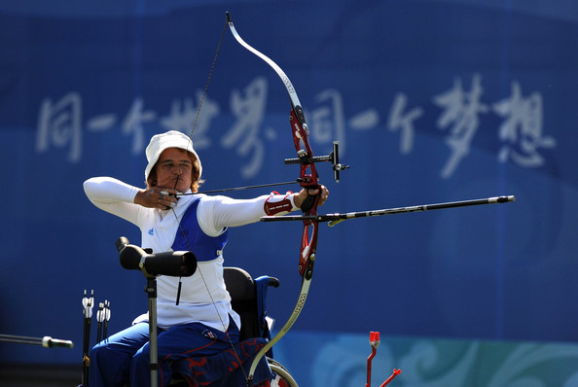
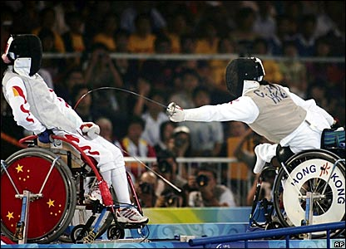
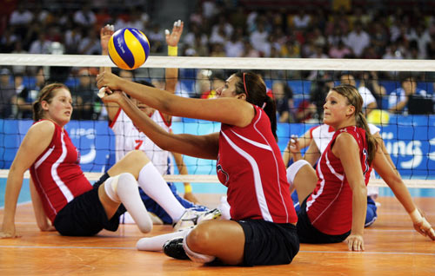
Summer kinds of sport
Weightlifting (powerlifting);
Athletics;
Archery;
Swimming;
Judo;
Cycling;
Tennis in wheelchairs;
Fencing;
Soccer 7h7;
Soccer 5x5;
basketball in wheelchairs;
Dressage;
Shooting;
Volleyball;
Rugby in wheelchairs;
Dancing Inna wheelchairs;
Holbol;
Table Tennis;
rowing;
Sailing

Slide 9
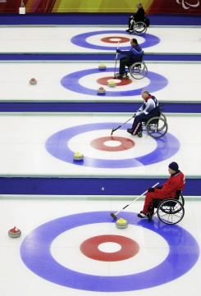
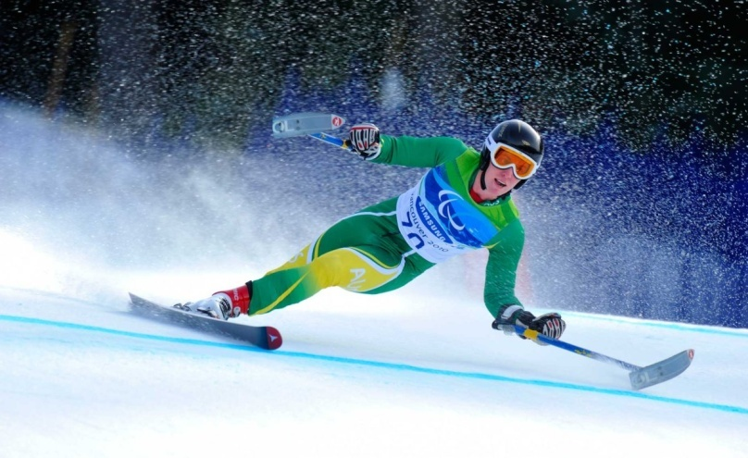
Winter kinds of sport
Ski Race
Biathlon
Hockey
Ski
Curling

Slide 10
Makarenko Galina 8-A

