Slide 1
Scientific inventions
Presentation
of the student from 10-A
School №44
Kovalenko Artem
Giniyatullin Vlad

Slide 2
Television (1920s)
The invention that swept the world and changed leisure habits for countless millions was pioneered by Scottish-born electrical engineer John Logie Baird. It had been realised for some time that light could be converted into electrical impulses, making it possible to transmit such impulses over a distance and then reconvert them into light.

Slide 3
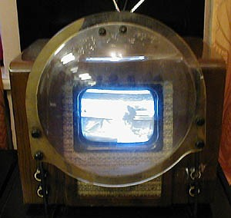
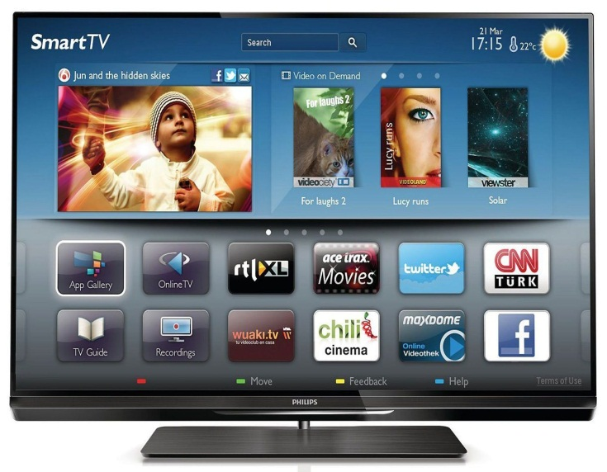
The first model of the TV
Modern TV(Samsung Smart TV)

Slide 4
Motor Car (Late 19th Century)
With television, the car is probably the most widely used and most useful of all leisure-inspired inventions. German engineer Karl Benz produced the first petroldriven car in 1885 and the British motor industry started in 1896. Henry Ford was the first to use assembly line production for his Model Т car in 1908. Like them or hate them, cars have given people great freedom of travel.

Slide 5
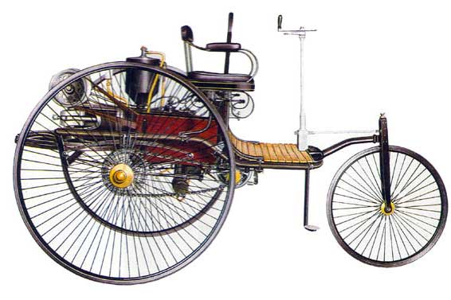
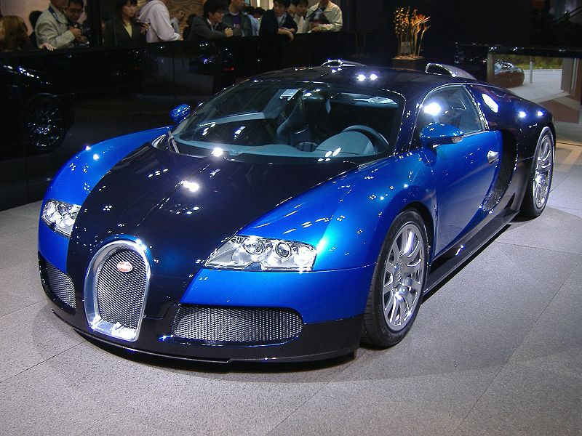
The first car in the world
The fastest car in the world - Bugatti Veyron

Slide 6
Electricity
The name came from the Greek word for amber and was coined by Elizabeth I's physician William Gilbert who was among those who noticed that amber had the power to attract light objects after being rubbed. In the 19th century such great names as Michael Faraday, Humphry Davy, Alessandro Volta and Andre Marie Ampere all did vital work on electricity.

Slide 7
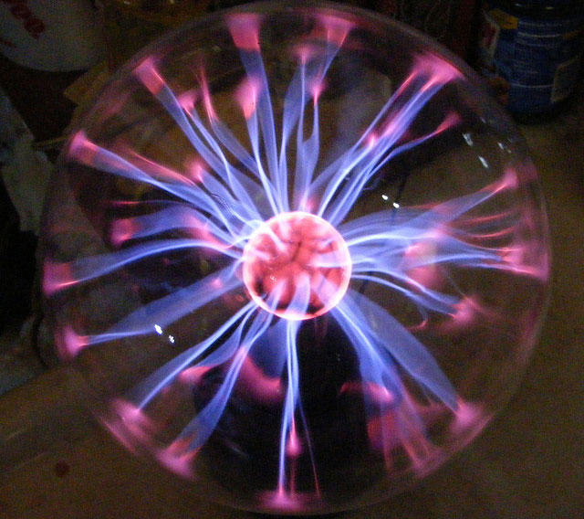
Without electricity, you can not imagine the world today.

Slide 8
Photography (Early 19th Century)
Leonardo da Vinci had described the camera obscura photographic principle as early as 1515. But it was not until 1835 that Frenchman Louis Daguerre produced camera photography. The system was gradually refined over the years, to the joy of happy snappers and the despair of those who had to wade through friends' endless holiday pictures.

Slide 9
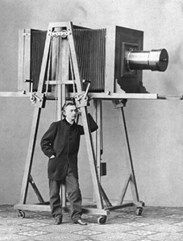
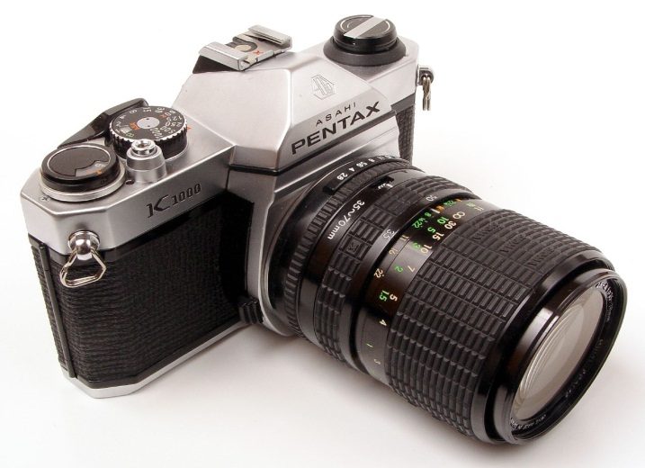
The first model of the camera.
SLR cameras with a fixed mirror

Slide 10
Telephone (1876)
Edinburgh-born scientist Alexander Graham Bell patented his invention of the telephone in 1876. The following year, the great American inventor Thomas Edison produced the first working telephone. With telephones soon becoming rapidly available, the days of letter-writing became numbered.

Slide 11
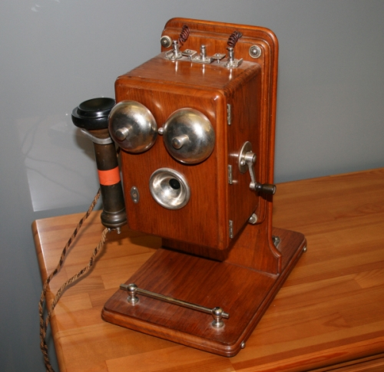
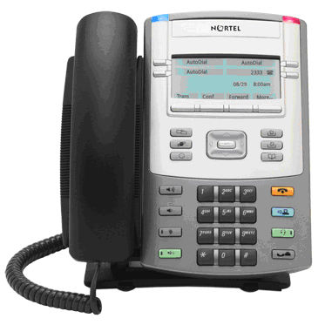
One of the first phones.
IP-Phone 1100 Series - modern phones.

Slide 12
Computer (20th Century)
The computer has been another life-transforming invention. British mathematician Charles Babbage designed a form of computer in the mid-1830s, but it was not until more than a century later that theory was put into practice. Now, a whole generation has grown up with calculators, windows, icons, computer games and word processors, and the Internet and e-mail have transformed communication and information.

Slide 13
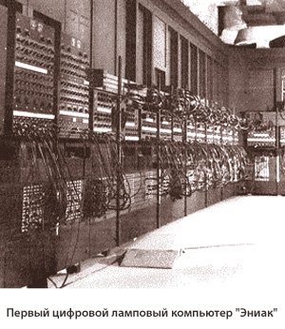
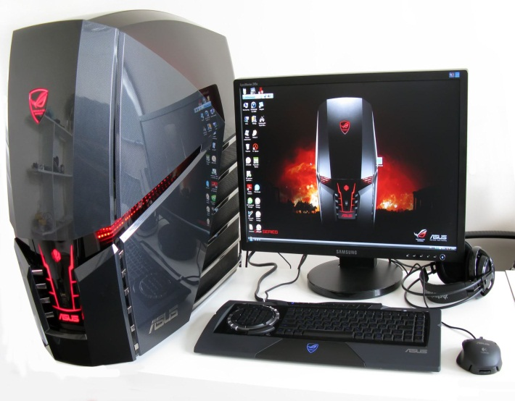
The first digital computer lamp.
Modern powerful gaming computer.

Slide 14
Aeroplane
The plane was the invention that helped shrink the world and brought distant lands within easy reach of ordinary people. The invention of the petrol engine made flight feasible and the American Wright brothers made the first flight in 1903.

Slide 15
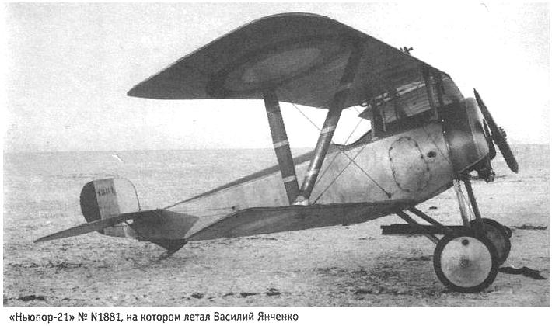
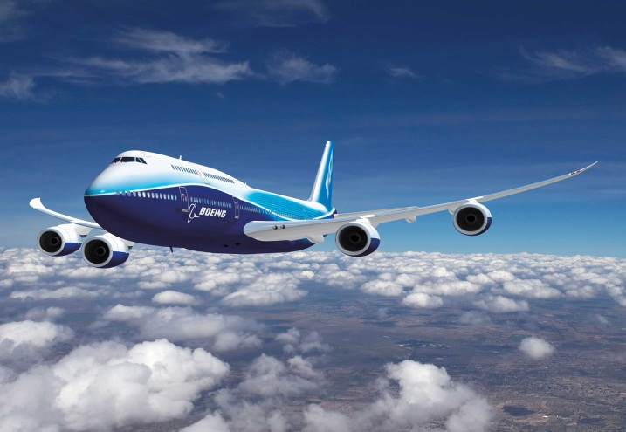
"Nieuport - 21" № 1881, which flew Basil Yanchenko.
Boeing presented the eighth version of the legendary liner - Boeing 747. The plane was named 747-8 Intercontinental.

