Slide 1
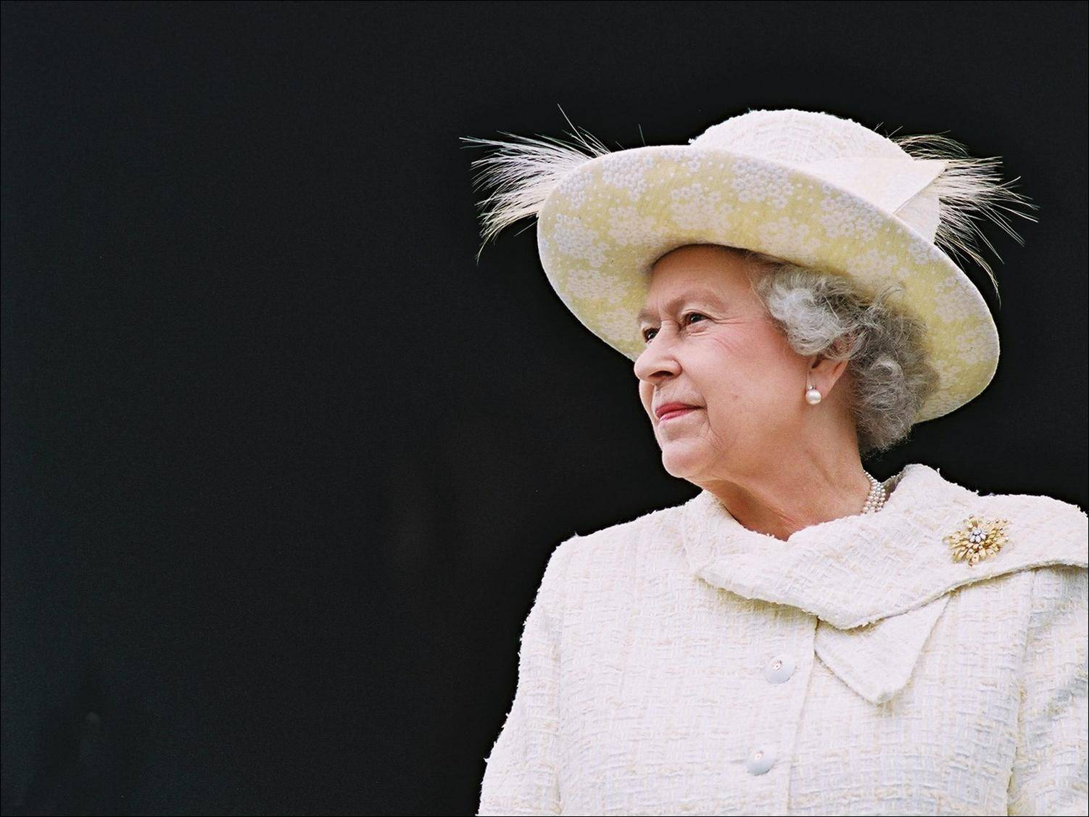
Her Majesty The Queen
Elizabeth II
The presentation is
made by
Liliya Hreskiv
class 10-B

Slide 2
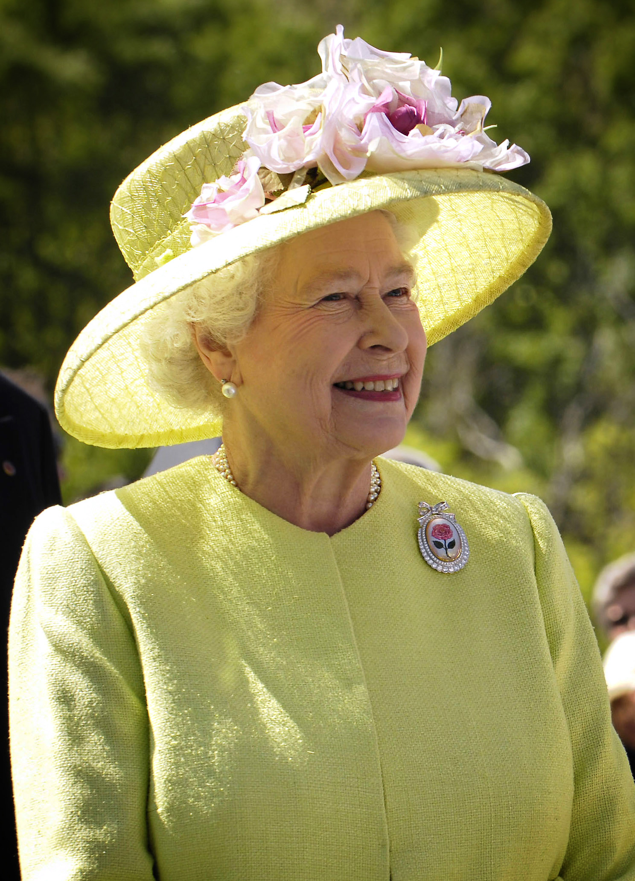
The Queen is Head of State of the
UK and 15 other
Commonwealth realms.
The elder daughter of King George VI
and Queen Elizabeth,
she was born in 1926 and became
Queen at the age of 25, and has
reigned through more than five
decades of enormous social change
A nd development.
The Queen is
married to Prince Philip,
Duke of Edinburgh and has
four children and eight
grandchildren.

Slide 3
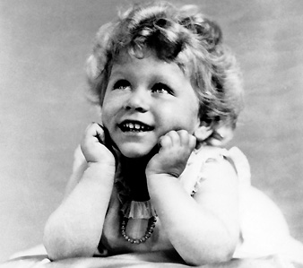
The Queen was born at
2.40am on
21 April 1926 at 17 Bruton
Street in Mayfair, London.
She was the first child of
The Duke and Duchess of York,
who later became King George
VI and Queen Elizabeth.
At the time she stood third in
line of succession to the throne
after Edward, Prince of Wales (later King Edward VIII),
and her father, The Duke of York.
But it was not expected that her father would become King, or that she would become Queen.

Slide 4
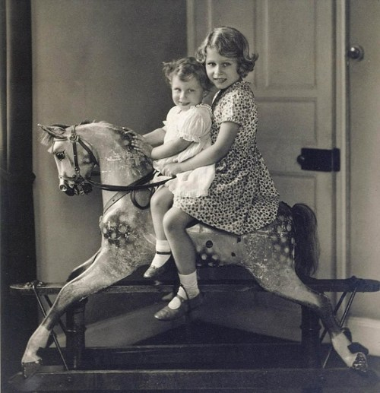
Princess Elizabeth was educated at home with Princess Margaret, her younger sister.
After her father succeeded to the throne in 1936 and she became heir presumptive, she started to study constitutional history and law as preparation for her future role.
She received tuition from her father, as well as sessions with Henry Marten, the Vice-Provost of Eton. She was also instructed in religion by the Archbishop of Canterbury.
Princess Elizabeth also learned French from a number of French and Belgian governesses. It is a skill which has stood The Queen in good stead, as she often has cause to use it when speaking to ambassadors and heads of state from French-speaking countries, and when visiting French-speaking areas of Canada.
Princess Elizabeth also studied art and music, learned to ride, and became a strong swimmer. She won the Children's Challenge Shield at London's Bath Club when she was thirteen.

Slide 5
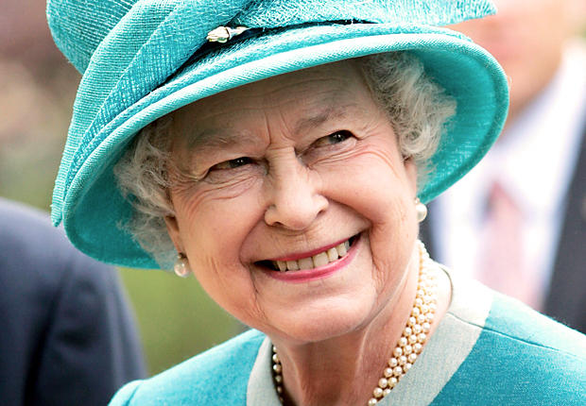
An animal lover since childhood,
The Queen takes a keen and highly knowledgeable interest in horses.
Other interests include walking in the countryside and working her Labradors, which were bred at Sandringham.
A lesser known interest is
Scottish country dancing.
Each year during her stay
at Balmoral Castle, The Queen
gives dances known as
Gillies' Balls,
for neighbours,
estate and Castle
staff and
members of the
local community.

Slide 6
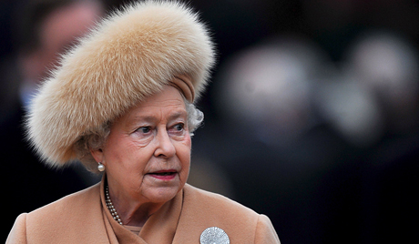
An important part of the work of
The Queen is to support and encourage public and voluntary service.
One of the ways in which Her Majesty does this is through involvement with
charities and other
organisations.
The Queen has over
600 patronages.
These cover every area of the
charity and voluntary sector,
from opportunities for young people,
to preservation of wildlife and
the environment.
Involvement with these organisations helps
to recognise their achievements,
and helps to recognise the contributions of many different sectors of public life.

Slide 7
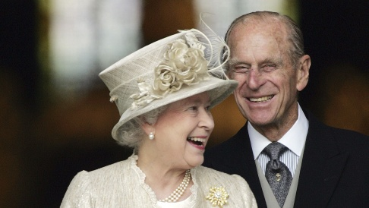
The Queen and The Duke of Edinburgh celebrated their 64th wedding anniversary on 20 November 2011.
They have four
children, eight
grandchildren
and three
great-grandchildren..
Family life has been an essential support to The Queen throughout her reign. The family usually spends Christmas together at Sandringham in Norfolk, attending church on Christmas Day.
And in the summer of 2006, The Queen celebrated her 80th birthday by taking a cruise with all her family through the Western Isles of Scotland.

Slide 8
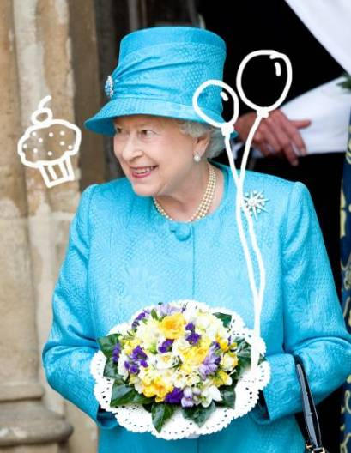
The queen marks her birthday twice a year: privately on the actual birthday which is on the 21st April
and officially with the "Trooping the Colour" ceremony held in June, when the weather is better.

Slide 9

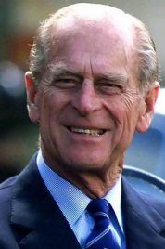
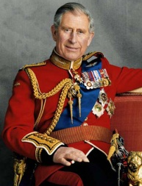
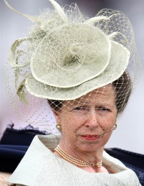
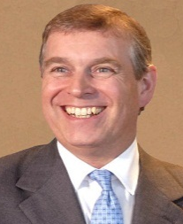
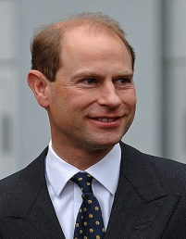
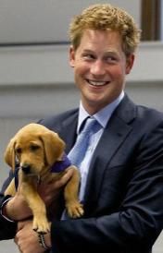
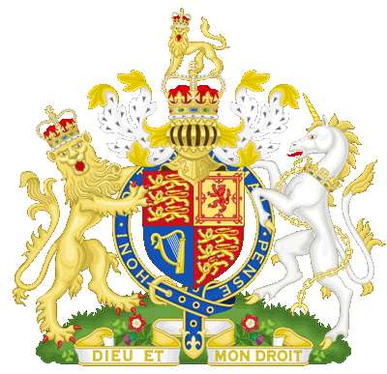
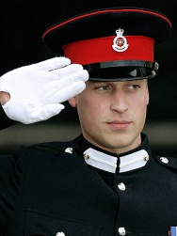
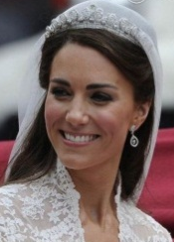
Elizabeth
II
Prince
Philip
Charles
Anne
Andrew
Harry
William
Kate
Middleton
THE ROYAL FAMILY

Slide 10
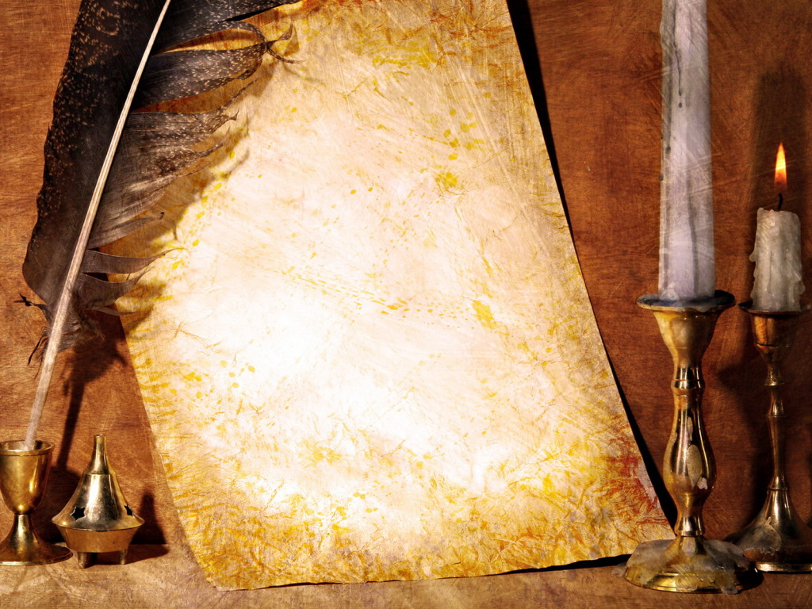
You can write to Her Majesty
at the following address:
Her Majesty The Queen
Buckingham Palace
London SW1A 1AA
If you wish to write a formal letter, you can open with 'Madam' and close the letter with the form 'I have the honour to be, Madam, Your Majesty's humble and obedient servant'.
This traditional approach is by no means obligatory. You should feel free to write in whatever style you feel comfortable.

