Slide 1
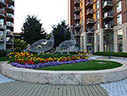
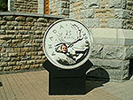
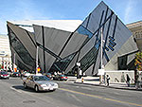
English-speaking countries.
Canada
Anna Pavlichenko

Slide 2
Geography
Canada occupies a major northern portion of North America, sharing land borders with the contiguous United States to the south and the U.S. state of Alaska to the northwest, stretching from the Atlantic Ocean in the east to the Pacific Ocean in the west; to the north lies the Arctic Ocean. By total area (including its waters), Canada is the second largest country in the world—after Russia—and largest on the continent. By land area, it ranks second.
The population density, 3.5 inhabitants per square kilometre (9.1/sq mi), is among the lowest in the world

Slide 3
The Great Lakes are a collection of freshwater lakes located in eastern North America, on the Canada – United States border. Consisting of Lakes Superior, Michigan, Huron, Erie, and Ontario, they form the largest group of freshwater lakes on Earth.

Slide 4
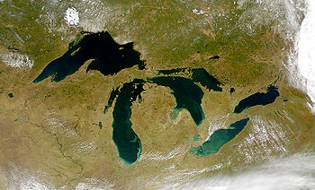
A satellite image of the Great Lakes

Slide 5
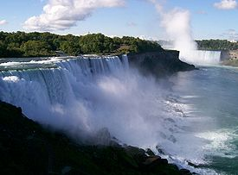
Niagara Falls

Slide 6
History
First Nation and Inuit traditions maintain that
indigenous people have resided on their lands since the
beginning of time, while archaeological studies support
a human presence in the northern Yukon from 26,500
years ago, and in southern Ontario from 9,500 years ago.
Europeans first arrived when the Vikings settled briefly at
L'Anse aux Meadows around AD 1000; following the
failure of that colony, there was no further attempt at North
American exploration until 1497, when John Cabot
explored Canada's Atlantic coast for England, followed by
Jacques Cartier in 1534 for France.

Slide 7
Name of Canada
The name Canada comes from a St. Lawrence Iroquoian word, kanata, meaning "village" or "settlement". In 1535, indigenous inhabitants of the present-day Quebec City region used the word to direct French explorer Jacques Cartier towards the village of Stadacona. Cartier later used the word Canada to refer not only to that particular village, but also the entire area subject to Donnacona (the chief at Stadacona); by 1545, European books and maps had begun referring to this region as Canada.

Slide 8
History
The English established fishing outposts in Newfoundland around 1610 and colonized the Thirteen Colonies to the south. A series of four Intercolonial Wars erupted between 1689 and 1763. Mainland Nova Scotia came under British rule with the Treaty of Utrecht (1713); the Treaty of Paris (1763) ceded Canada and most of New France to Britain following the Seven Years' War.

Slide 9

Motto: A Mari Usque Ad Mare (Latin)
"From Sea to Sea"
Canadian Flag

Slide 10
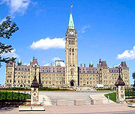
Parliament Hill, Ottawa

Slide 11
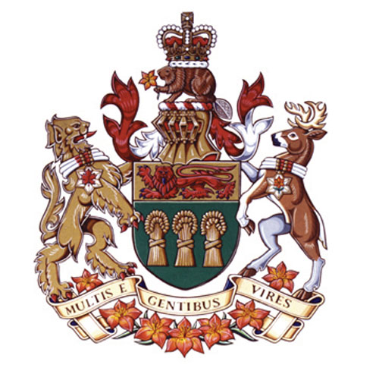
Saskatchewan
Coat of arms

Slide 12
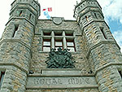
Ottawa
The Parliament Building
The Royal Canadian Mint

Slide 13
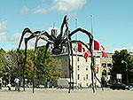
Ottawa
This spider is in front of
The Art Gallery. It cost
more than 3 million
Dollars to build it

Slide 14
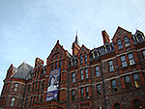
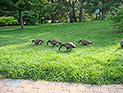
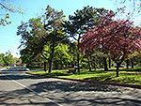
TORONTO

Slide 15
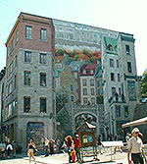
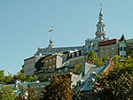
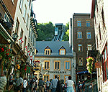
Quebec City

