Slide 1

How to choose
your
future career

Slide 2
“Choose a job you love, and you will never have to work a day in your life…”
Confucius

Slide 3


Choosing the right career can be difficult, but having a defined career direction will help you with getting a job. But with a little hard work, some planning, and some serious self-reflection, you can set yourself on a path towards a fruitful, fulfilling career that can provide for you and your family.

Slide 4





Consider your dream career

Slide 5

There is an old saying that if you’re trying to choose a career, you should think about what you would do if you didn’t have to work. If you had a million dollars and you could do anything, what would you do? Your answer to that question, while maybe not literally the best career choice for you, may give you insight into what you should do:
If you want to be a music star, consider going into audio engineering or music composition. These careers are easier to pursue and you will be much more likely to succeed and provide for yourself in the future.
If you want to be an actor, consider going into media broadcasting. You can get a degree in communications or work your way up the chain of command in a local news or other television studio.
If you want to travel the world, consider becoming an airline steward or stewardess. This is a great way to make a living and pursue your dream of traveling the globe.

Slide 6


Consider your hobbies

Slide 7

It is very easy to turn your hobbies or something you love doing into a future career. Many hobbies correspond to real world needs and positions. Consider what you like to do and how that might fit into a career:
For example, if you like playing video games, consider becoming a video game designer, programmer, or QA specialist.
If you like drawing or art, consider becoming a graphic designer.
Іf you like sports, consider going into teaching and getting certified as a coach.

Slide 8




Consider what skills you excel in

Slide 9
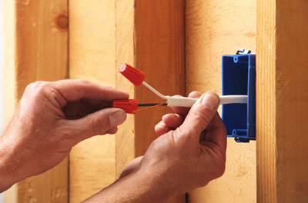

If you are particularly good at certain skills, such as fixing things or making things, this can provide you with a great future career. Schooling may or may not be necessary, but skilled labor is often in demand and you will find it fairly easy to find work:
For example, carpentry, auto repair, construction, and electrical work all benefit from people who are good at fixing things or working with their hands. These also tend to be stable, well-paying jobs.
Other skills, such as a skill for cooking, can also be easily turned into a career.

Slide 10
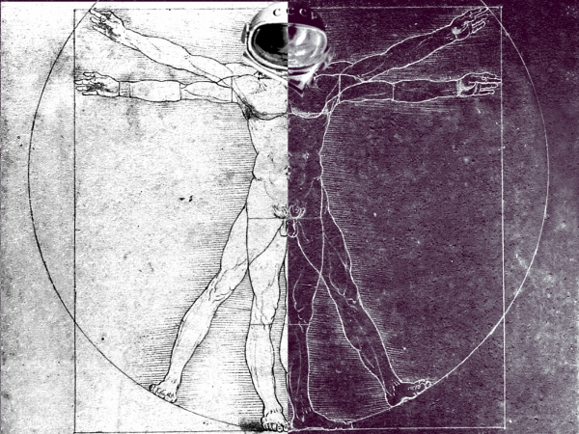
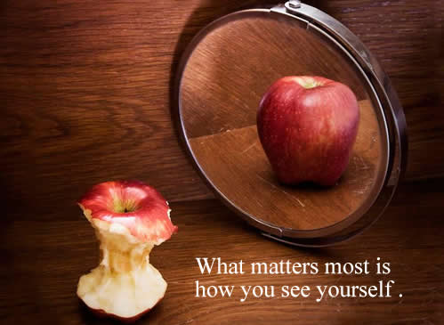
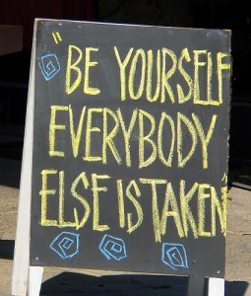
Explore yourself

Slide 11

Figuring out what you should do with your life may sometimes require you to get to know yourself better. If you want a career that will really make you happy, you have to have a very good understanding of what you want and what you enjoy. For some people, this means taking some time off to decide what’s important to them:
There is nothing wrong with this, so don’t feel bad. It’s more important that you figure your life out as early as possible, rather than getting knee deep in a career which makes you hate your life.

Slide 12


Slide 13
Khudobchuk Yana
Didkivska Olga
Form 10-V

