Slide 1

Education in Australia

Slide 2

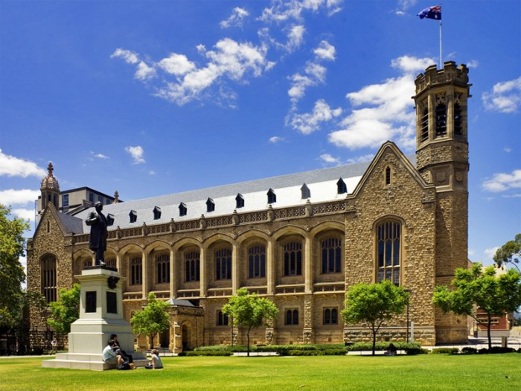
University of Adelaide - Australia State University, one of the oldest in the country. The main campus is located in the heart of Adelaide. Member of the Group of Eight and the Sandstone universities.

Slide 3

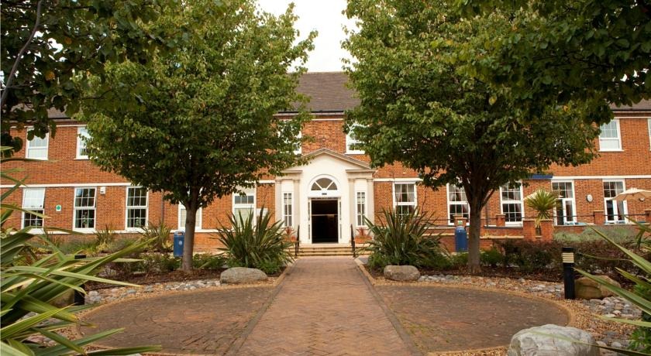
Cranfield University - French-British research university, the largest center of applied research, development and design in Europe.

Slide 4

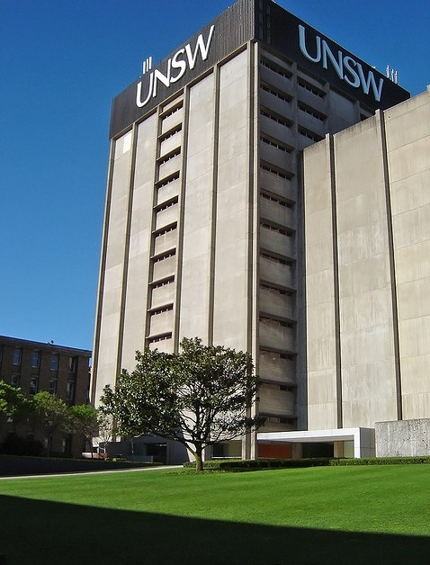

The University of New South Wales-Australia State University. The University is one of the best universities in Australia. Member of the prestigious Group of Eight Australian universities. Considered to be one of the leaders in higher education in Australia.
The motto "Science hands and minds"

Slide 5

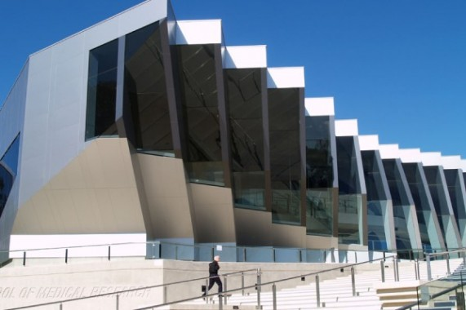
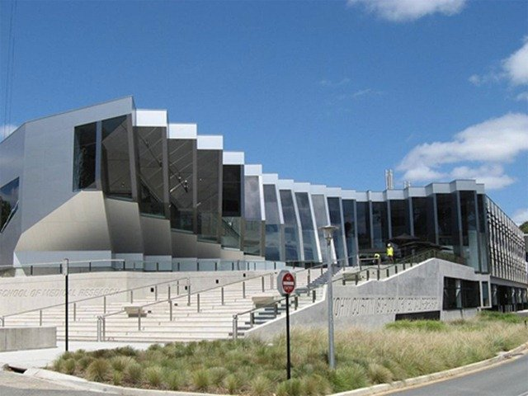
The Australian National University-State University, located in Canberra. Originally specialized in the research work. Soon teamed up with the University College of Canberra and also started providing higher education.

