Slide 1
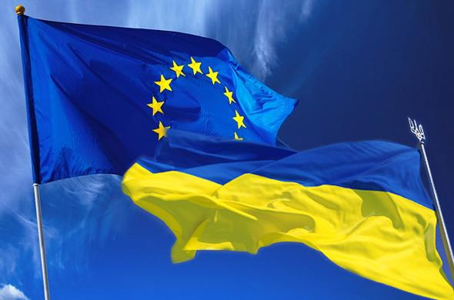
Euromaidan

Slide 2
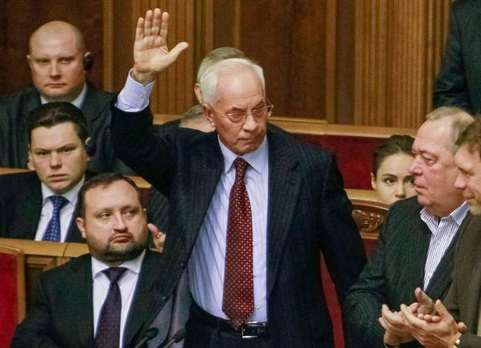
Ukraine protests
Opposition deputies throw pieces of paper towards Ukraine's Prime Minister Mykola Azarov and members of his government as he gestures during a session of parliament in Kiev on Nov. 22.

Slide 3
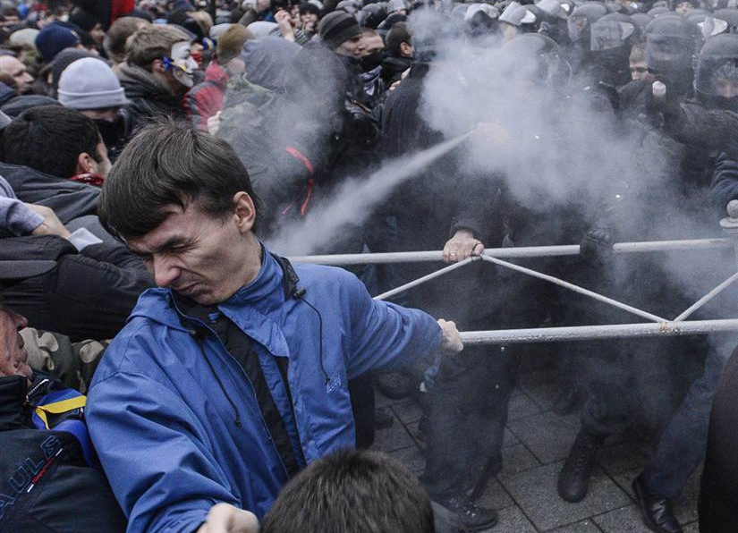
Ukraine protests
Opposition protesters and riot police fight in front of the Ukrainian Cabinet of Ministers in Kiev, on Nov. 24.

Slide 4
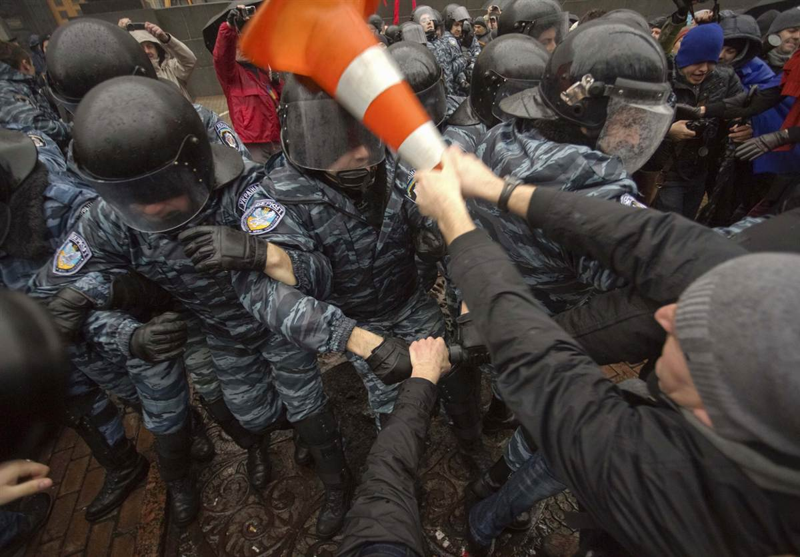
Ukraine protests
A protester clashes with riot police during a rally supporting EU integration in front of the Ukrainian cabinet of ministers building in Kiev on Nov. 25.

Slide 5
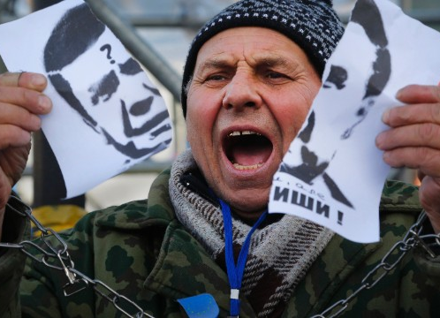
Ukraine protests
A demonstrator holds a torn portrait of Ukrainian President Viktor Yanukovych on November 29.

Slide 6
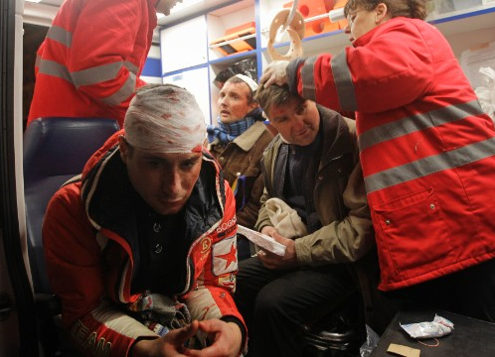
Ukraine protests
Injured protesters receive medical help in an ambulance after riot police broke up a rally on November 30.

Slide 7
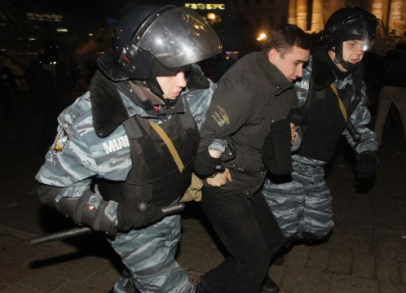
Ukraine protests
Ukrainian riot police officers detain a protester on November 30.

Slide 8
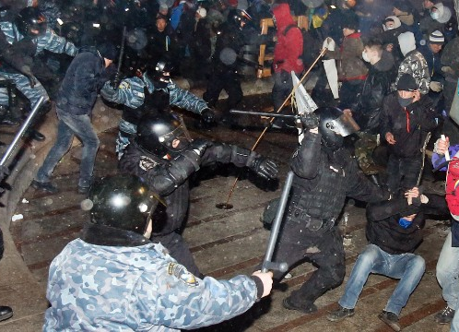
Ukraine protests
Dozens of protesters were wounded in a clash with police in Kiev on November 30.

Slide 9
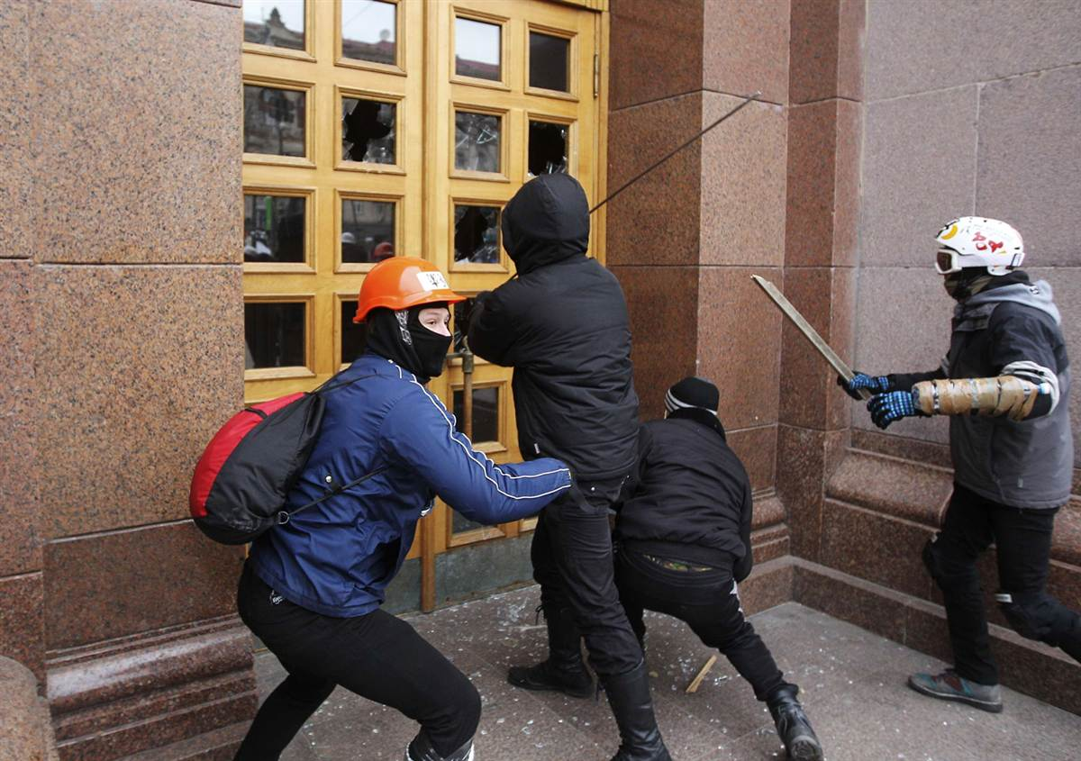
Ukraine protests
Protesters break the door of the Kiev City State Administration building during a rally held by supporters of EU integration in Kiev, on Dec. 1.

Slide 10
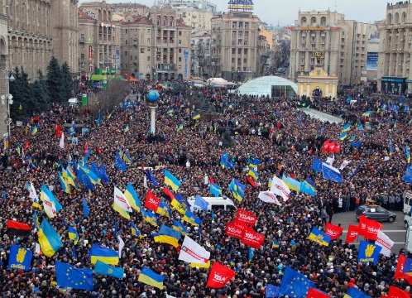
Ukraine protests
Demonstrators gather in downtown Kiev on December 1.

Slide 11
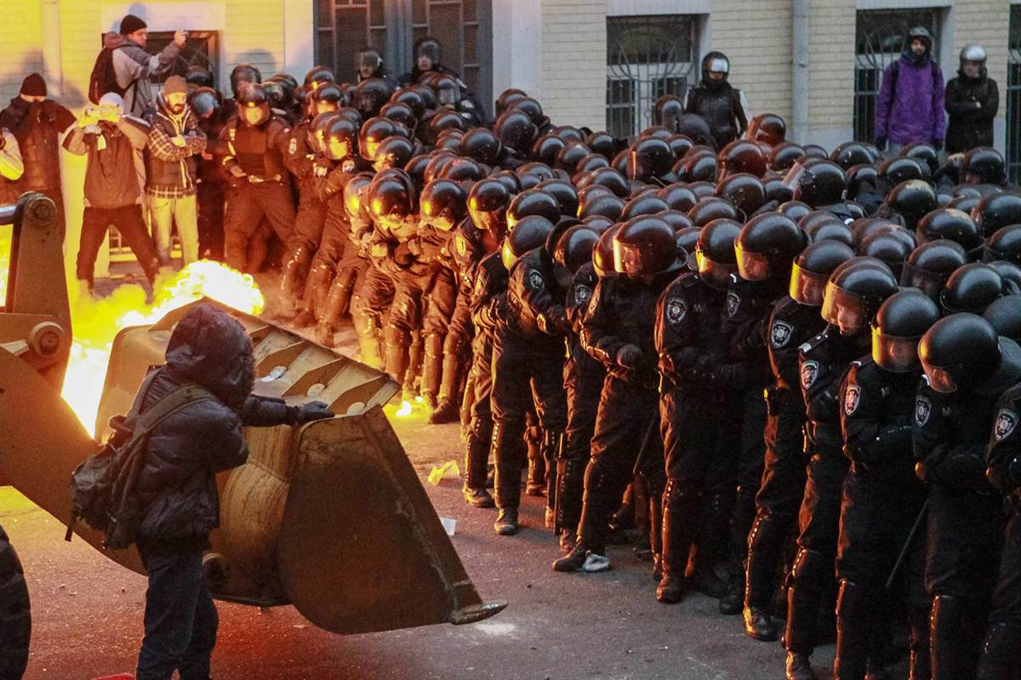
Ukraine protests
Protesters try to break through police lines near the presidential administration building during a rally held by supporters of EU integration in Kiev, on Dec. 1.

Slide 12
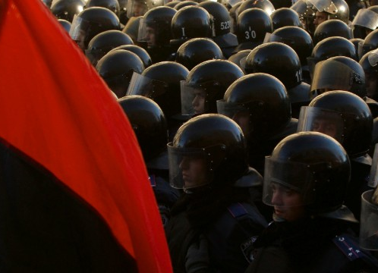
Ukraine protests
Police stand guard outside the parliament in Kiev on December 3.

Slide 13
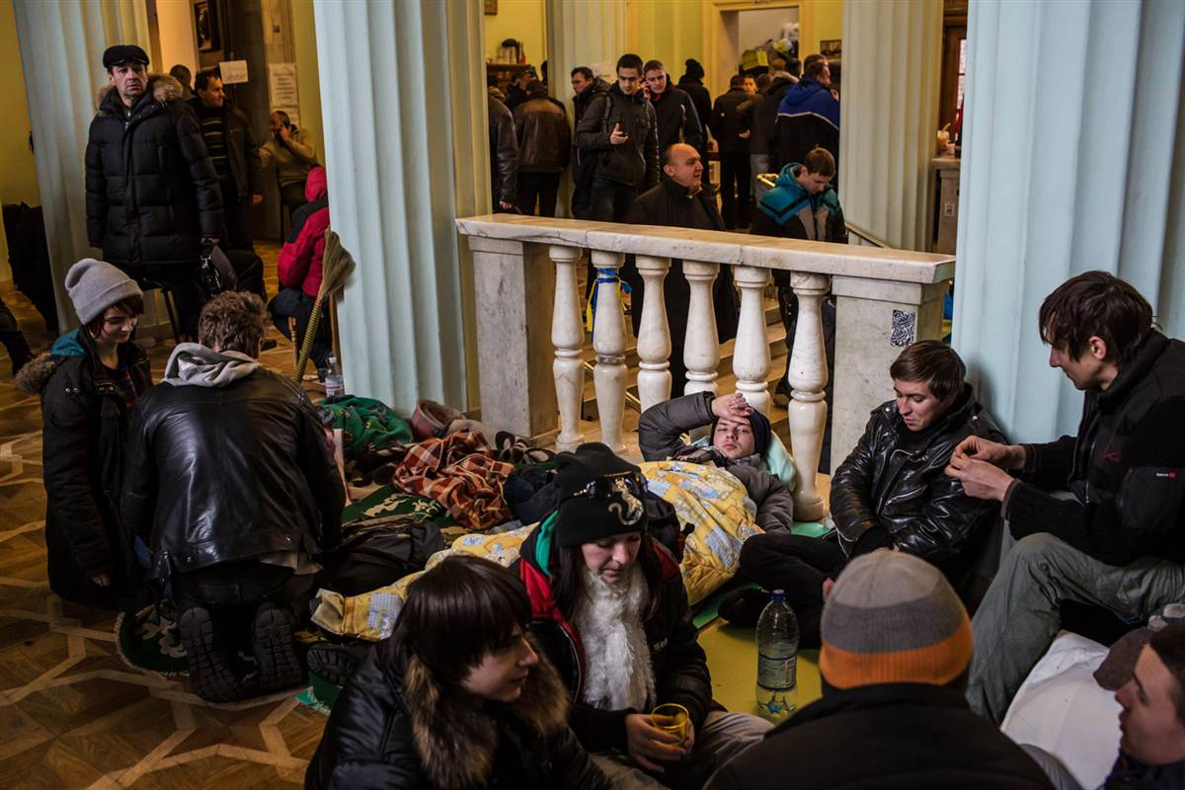
Ukraine protests
Anti-government protesters occupy the floor of City Hall on Dec. 4, in Kiev, Ukraine.

Slide 14
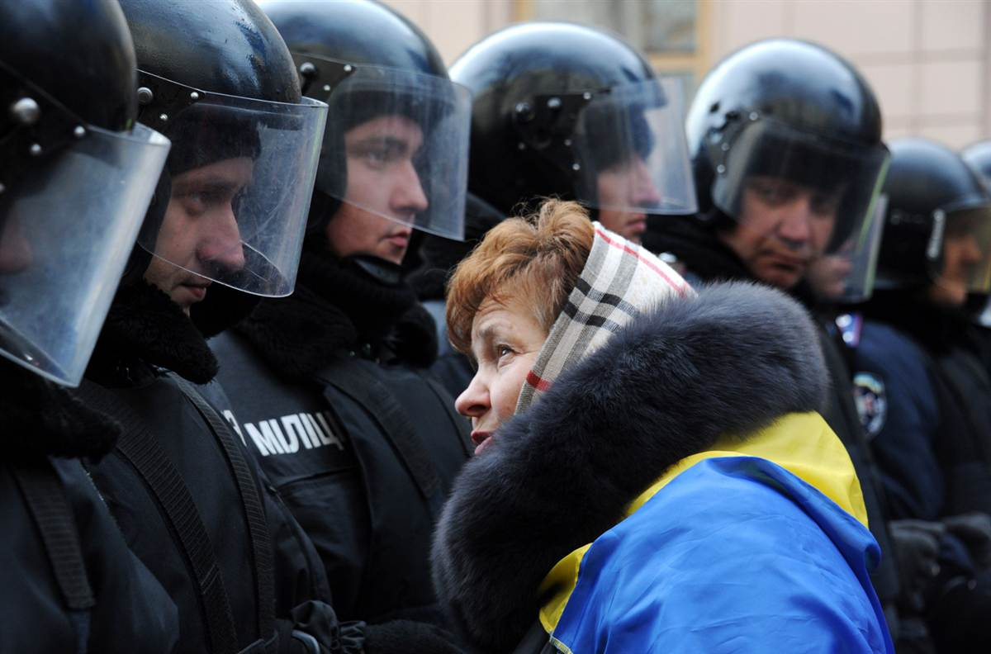
Ukraine protests
A protester faces riot police on Dec. 3, as thousands rallied outside the Ukrainian parliament in Kiev.

Slide 15
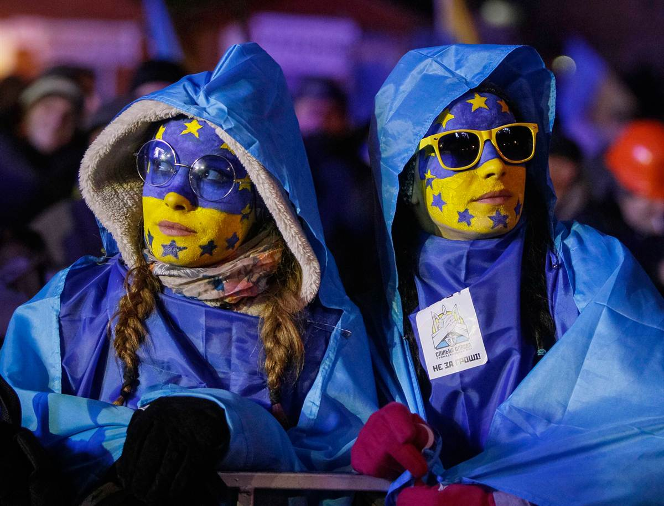
Ukraine protests
People supporting EU integration attend a rally at Independence Square in Kiev on Dec. 4.

Slide 16
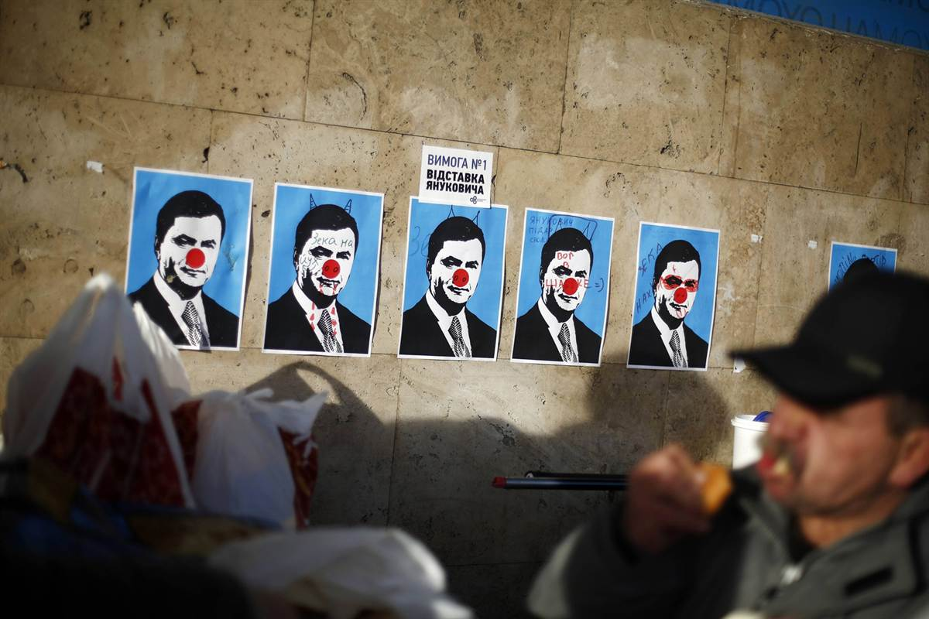
Ukraine protests
Ukraine's prime minister warned protesters blockading government buildings that anybody guilty of violating the constitution and laws would face punishment. The sign in white reads: "Requirement Number 1: Resignation of Yanukovich"

Slide 17
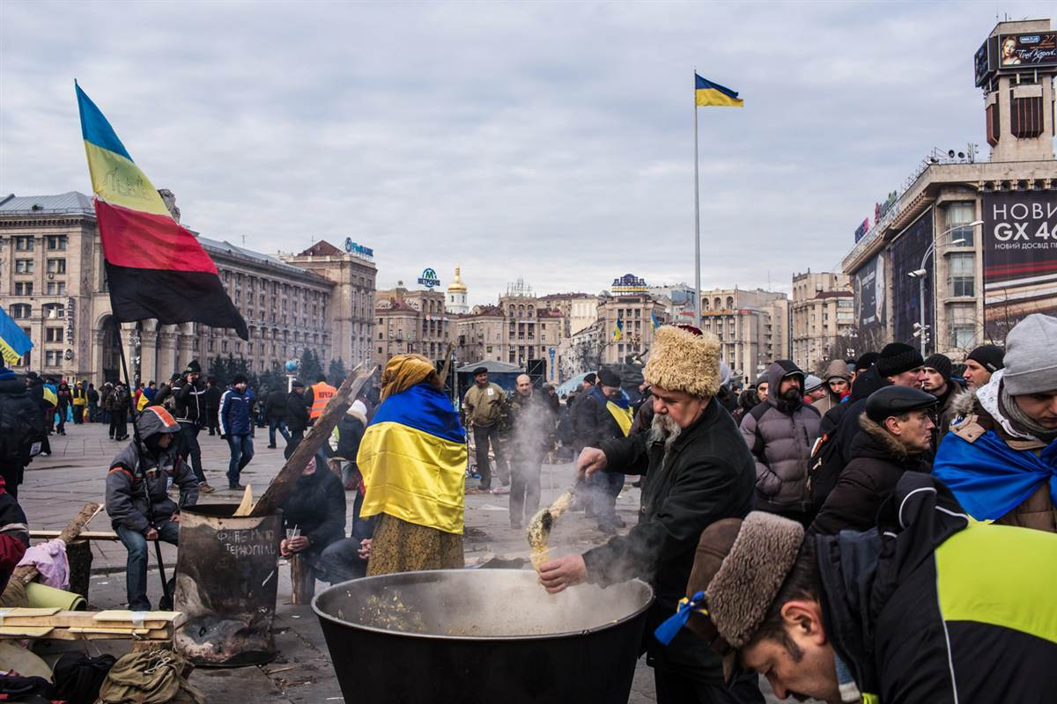
Ukraine protests
Thousands of people have been protesting against the government since a decision by Ukrainian president Viktor Yanukovych to suspend a trade and partnership agreement with the European Union in favor of incentives from Russia.

Slide 18
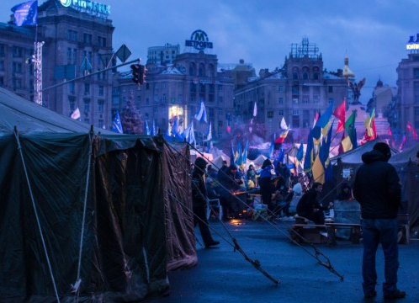
Ukraine protests
Anti-government protesters camp in Independence Square early in the morning on December 8.

Slide 19
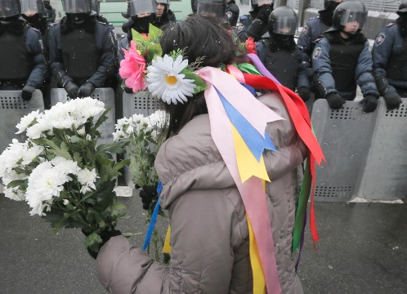
Ukraine protests
A pro-EU activist offers flowers to police officers at the presidential office in Kiev, on December 8.

Slide 20
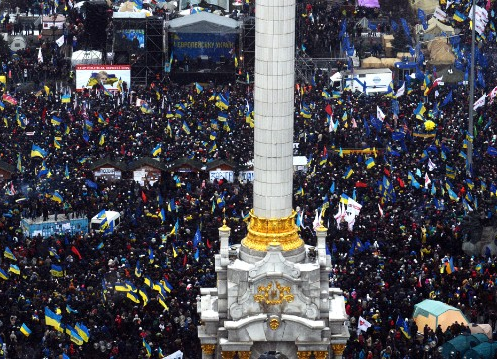
Ukraine protests
Demonstrators gather in Independence Square during a mass rally on December 8.

Slide 21
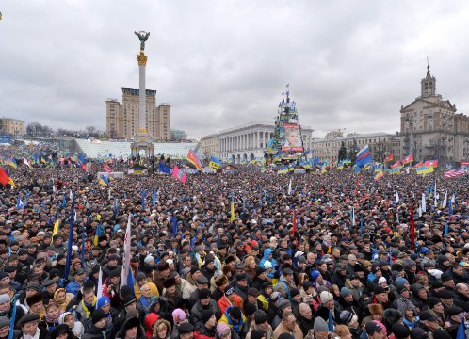
Ukraine protests
A large rally is held in Kiev's Independence Square on December 8.

Slide 22
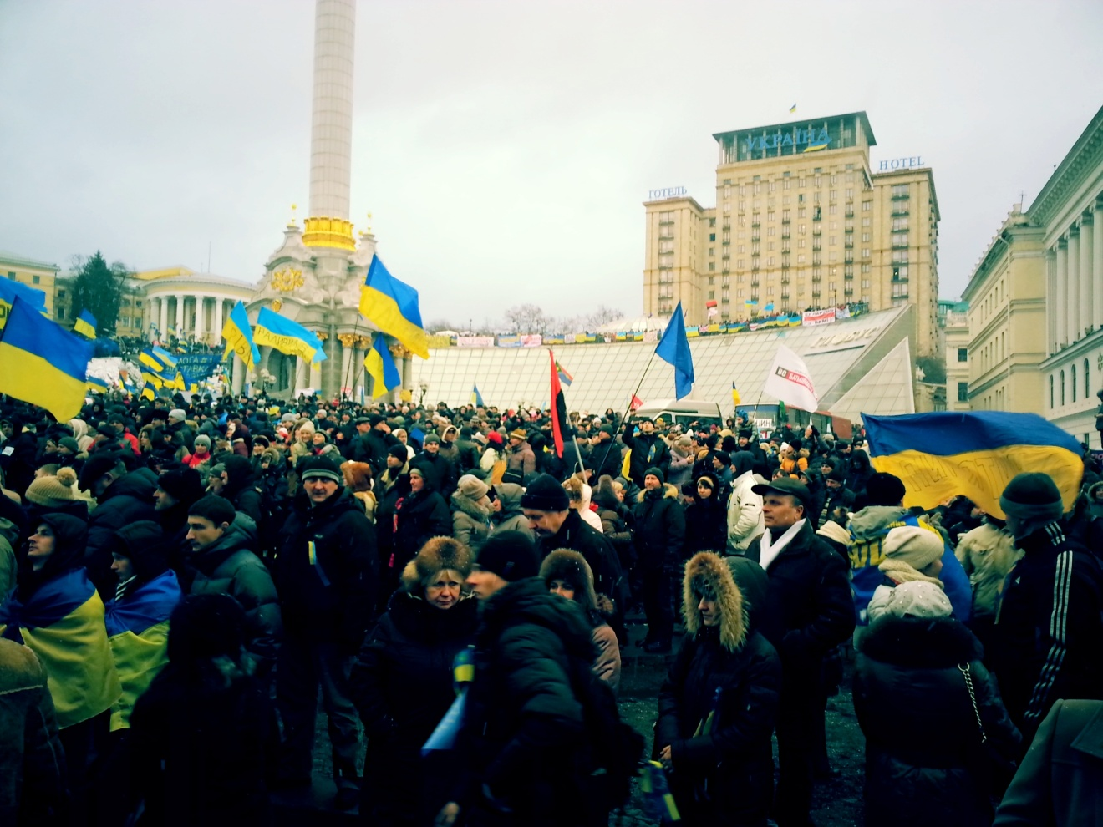
Thank you for your attention!
Kuchmynda Oleksiy 11-A

