Slide 1
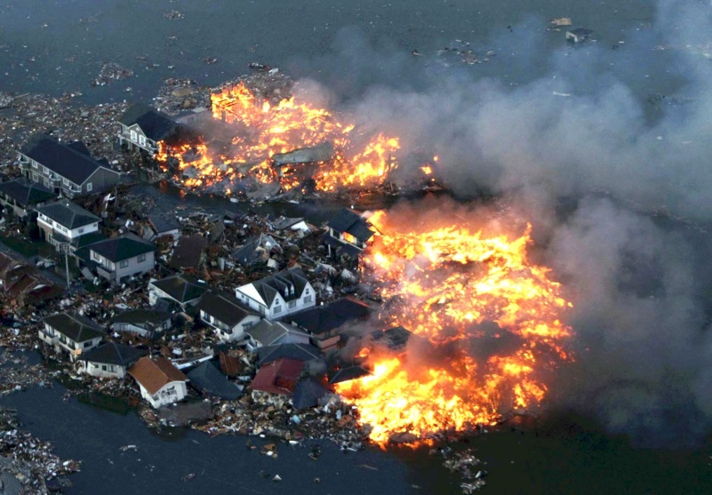
Natural disasters Ukraine

Slide 2
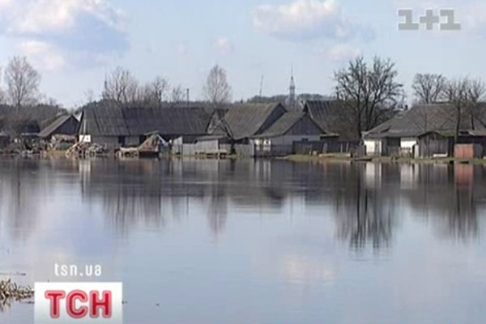
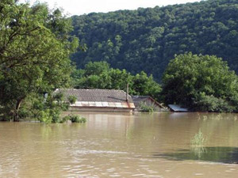
Flood
In Ukraine, Often flooding. They arise as a result of going beyond its limits rivers. Floods occur mainly in Western Ukraine.

Slide 3
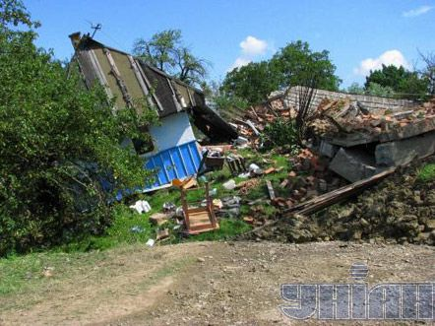
Landslides
Landslides in Ukraine are extremely rare, but there are cases in the 20s century in Central and Western Ukraine.

Slide 4
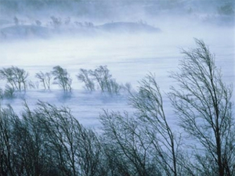
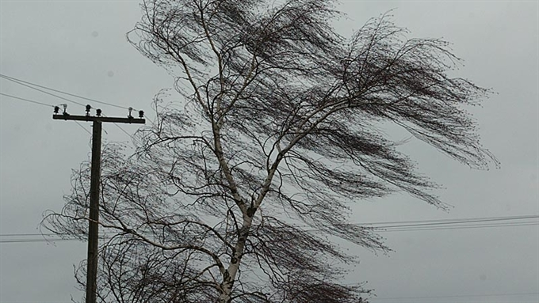
Winds
Winds in Ukraine`s most popular natural disaster. They are all in the country.

Slide 5
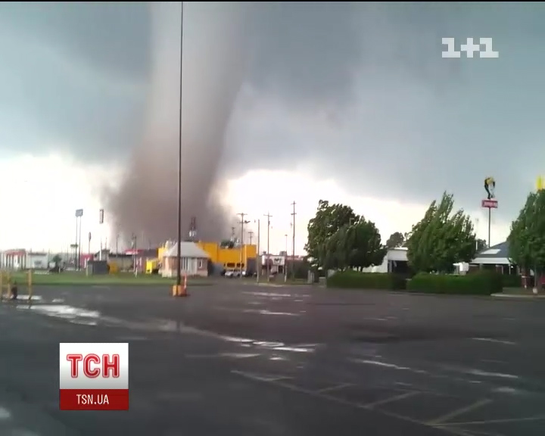
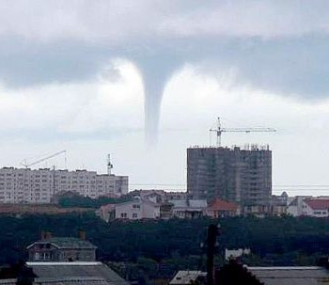
Twister
Twister is rare, but almost all the inhabitants of the country are occasionally observed.

Slide 6
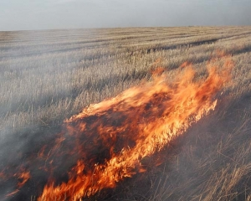
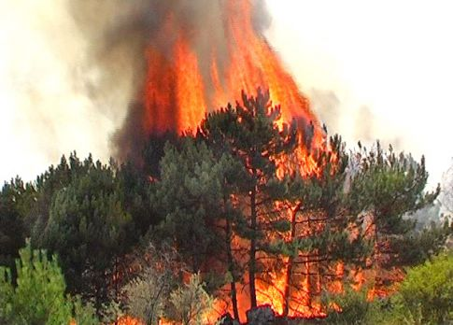
Fire
Fire often causes hot weather that is summer.

Slide 7

Thank you for your attention!

