Slide 1
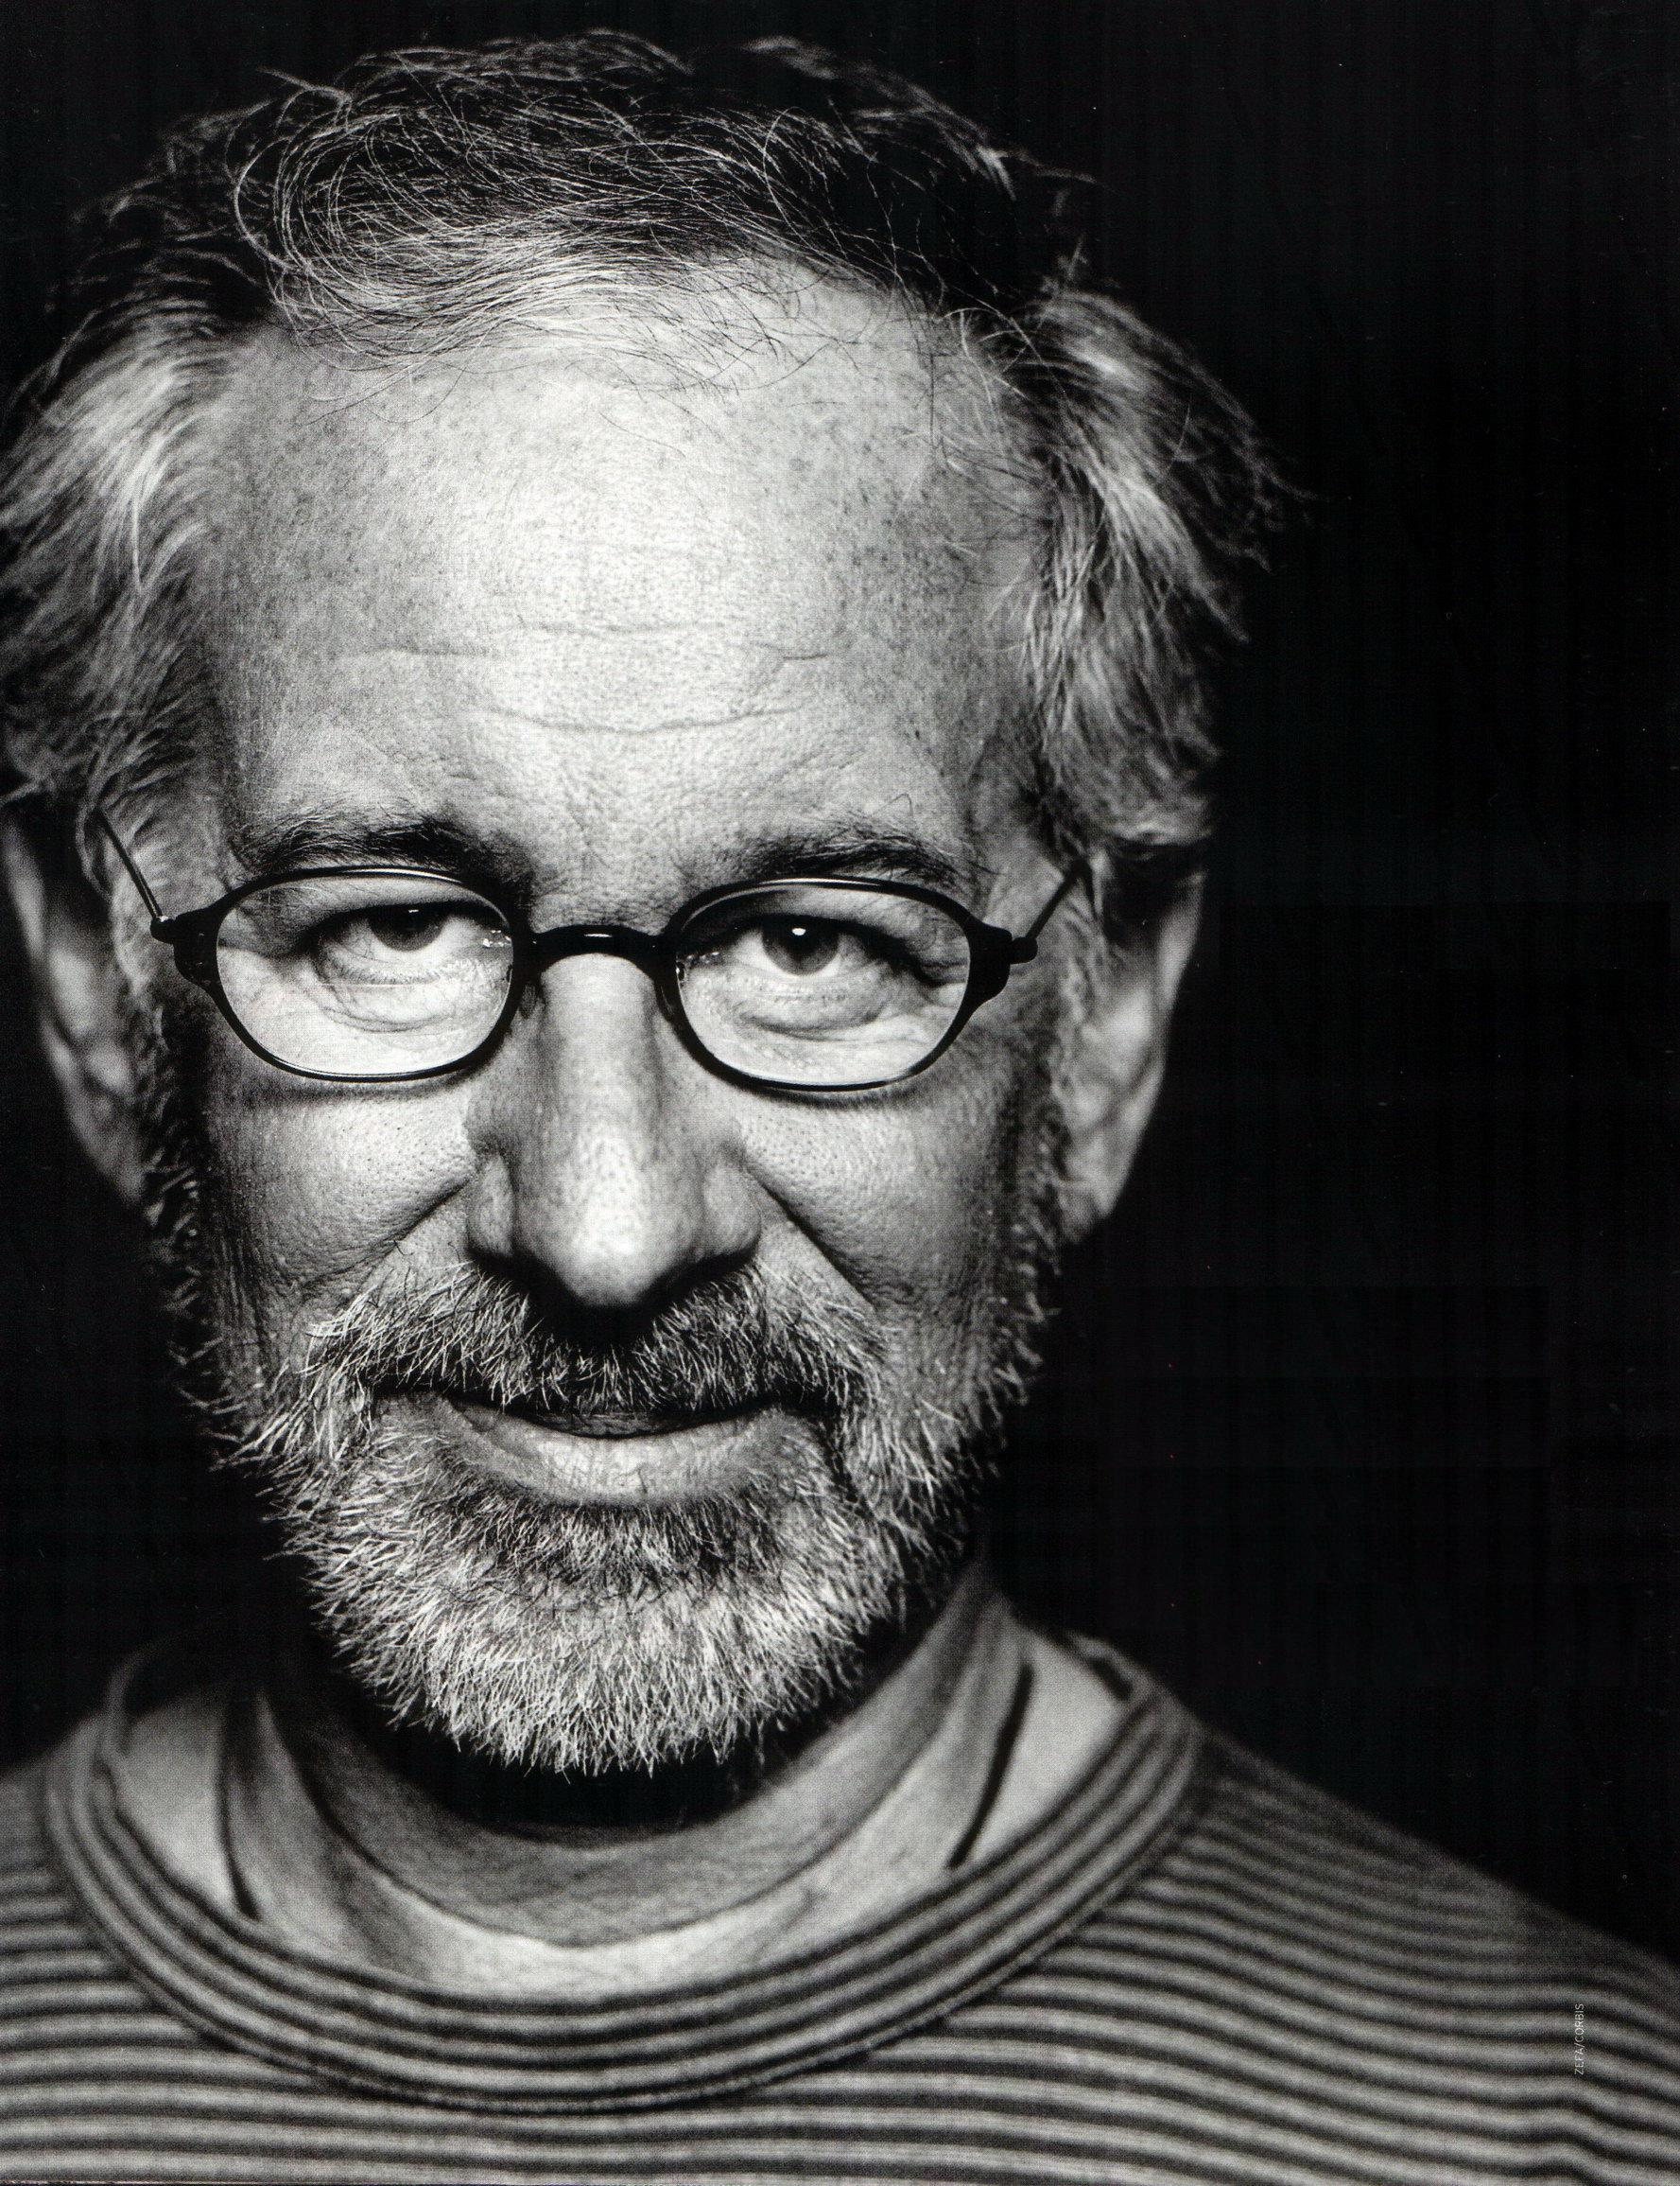
Steven Allan Spielberg

Slide 2
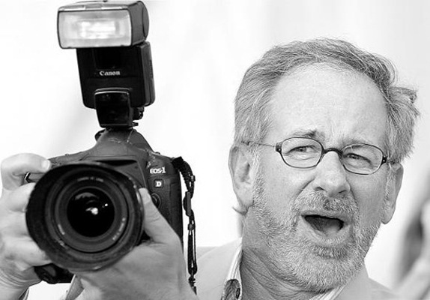
Steven Allan Spielberg (born December 18, 1946) is an American film director, screenwriter, producer, and business magnate.

Slide 3
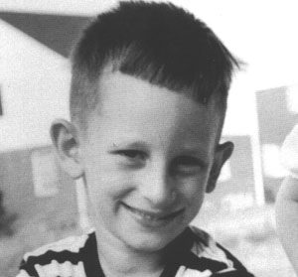
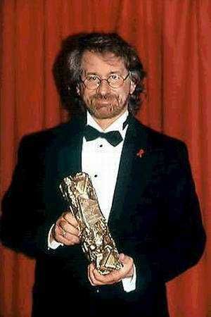
Spielberg was born in Cincinnati, Ohio, to an Orthodox Jewish family. His mother, Leah Adler Posner (born 1920), was a restaurateur and concert pianist, and his father, Arnold Spielberg (born 1917), was an electrical engineer involved in the development of computers.

Slide 4
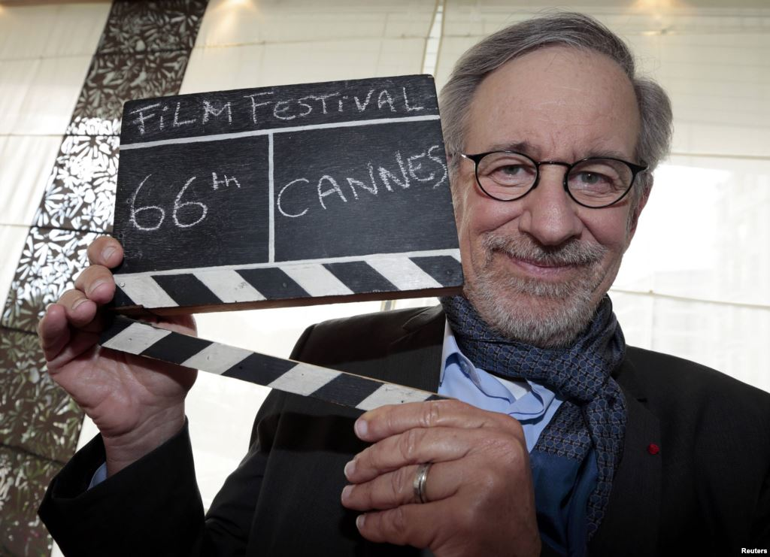
In 1958, he became a Boy Scout and fulfilled a requirement for the photography merit badge by making a nine-minute 8 mm film entitled The Last Gunfight.

Slide 5
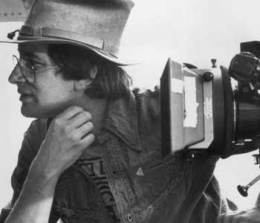
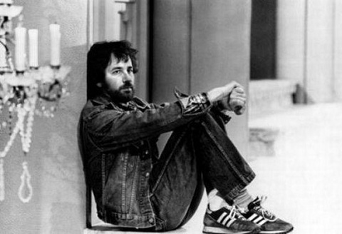
Following his parents' divorce, Spielberg moved to Saratoga, California with his father. His three sisters and mother remained in Arizona.

Slide 6
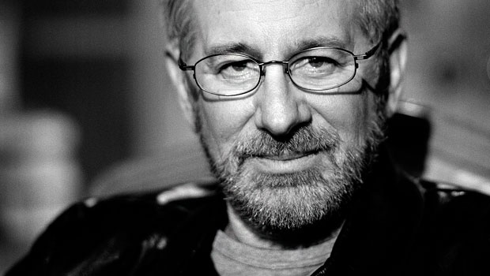
As a child, Spielberg faced difficulty reconciling being an Orthodox Jew with the perception of him by other children he played with.

Slide 7
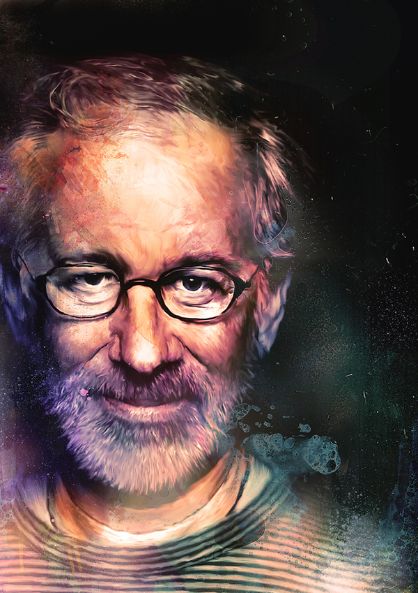
After moving to California, he applied to attend the film school at University of Southern California School of Theater, Film and Television two separate times, but was unsuccessful.

Slide 8
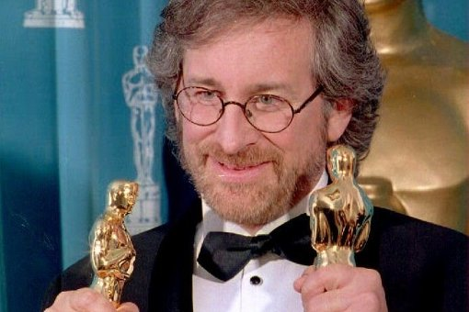
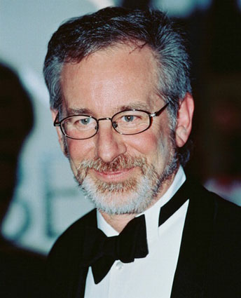
His first professional TV job came when he was hired to direct one of the segments for the 1969 pilot episode of Night Gallery.

Slide 9
Filmography
Firelight (1964)
Slipstream (1967)
Amblin' (1968)
"L.A. 2017 (1971)
Duel (1971)
Something Evil (1972)
Savage (1973)
The Sugarland Express(1974, also wrote)
Jaws(1975)
Close Encounters of the Third Kind (1977, also wrote)
1941 (1979)
Raiders of the Lost Ark (1981)
E.T. the Extra-Terrestrial (1982)
Twilight Zone: The Movie ("Kick the Can" segment, 1983)
Indiana Jones and the Temple of Doom (1984)
The Color Purple (1985)
Empire of the Sun (1987)
Indiana Jones and the Last Crusade (1989)
Always(1989)
Hook (1991)
Jurassic Park (1993)
Schindler's List (1993)
The Lost World: Jurassic Park (1997)
Amistad (1997)
Saving Private Ryan(1998)
A.I. Artificial Intelligence(2001, also wrote)
Minority Report(2002)
Catch Me If You Can(2002)
The Terminal (2004)
War of the Worlds (2005)
Munich(2005)
Indiana Jones and the Kingdom of the Crystal Skull(2008)
The Adventures of Tintin(2011)
War Horse (2011)
Lincoln (2012)
St. James Place(2015)
The BFG(2016)

Slide 10
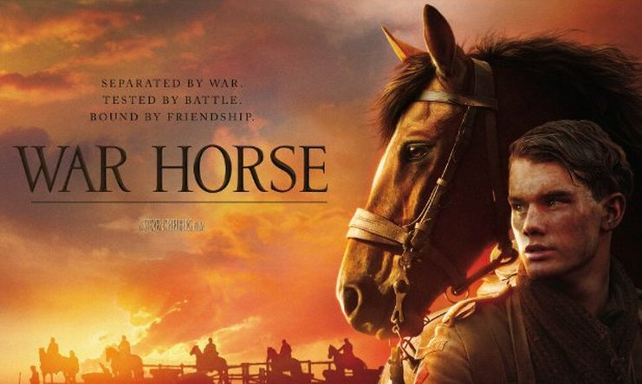
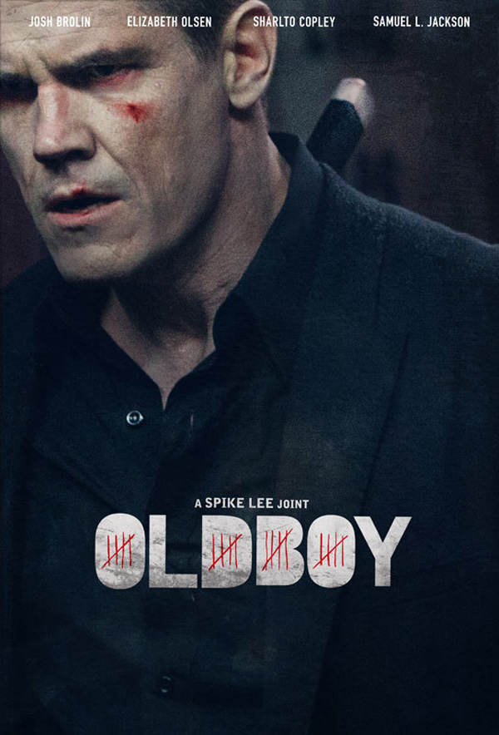


Slide 11
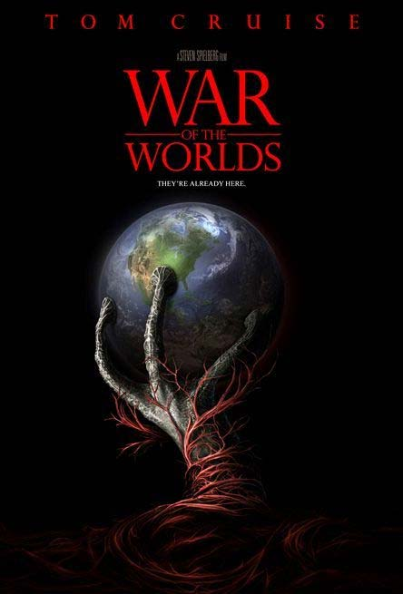


Slide 12
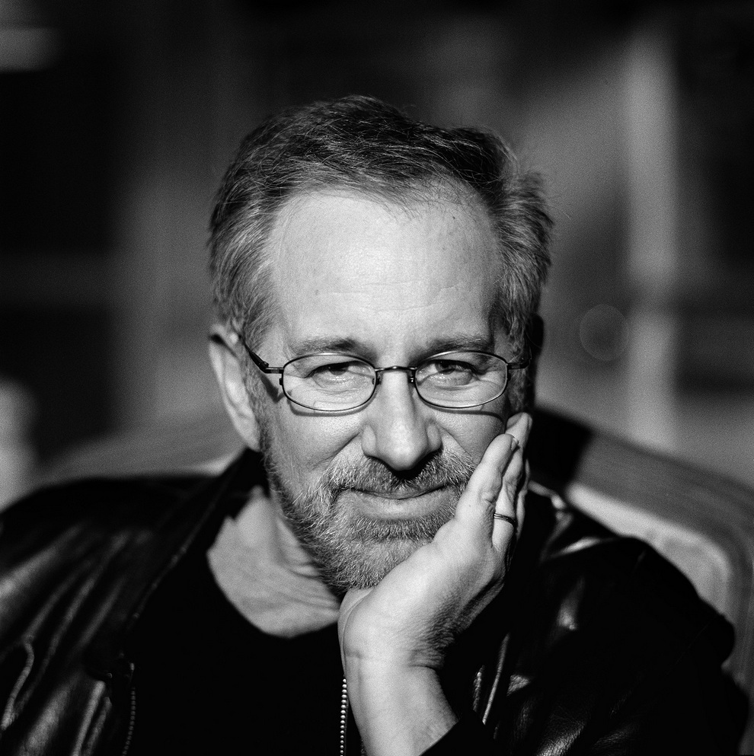
Thank you for attention!

