Slide 1

Restaurant
«GREEN APPLE»

Slide 2
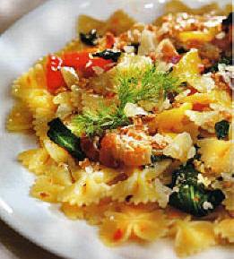
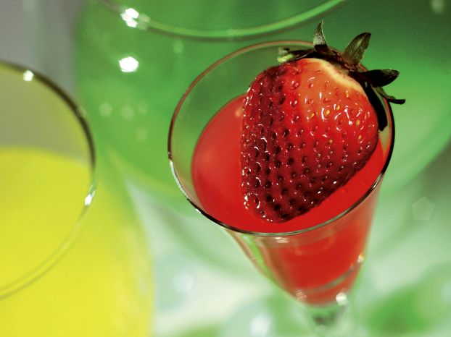
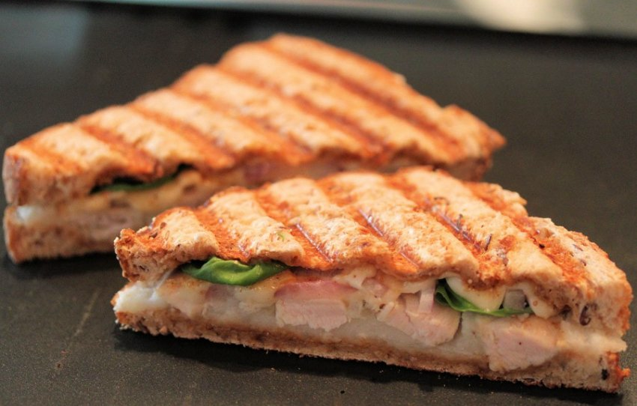
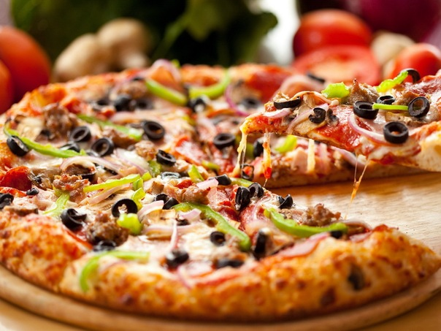
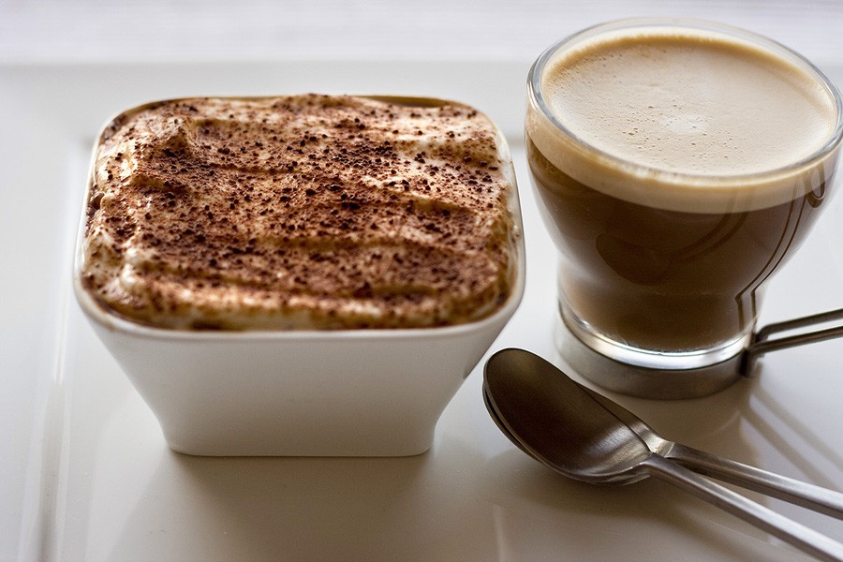
Our restaurant - famous for delicious Italian food.

Slide 3
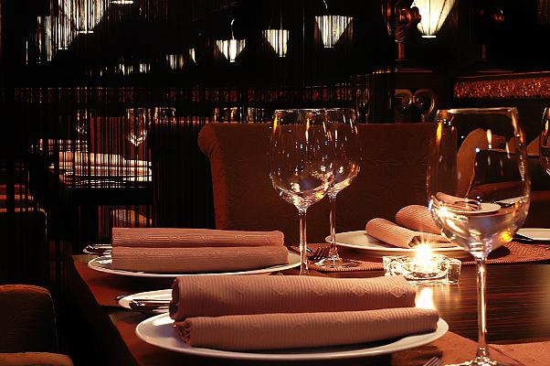
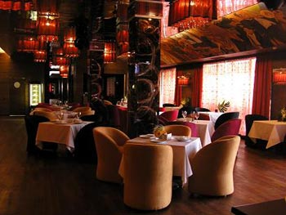
Apple-green is a stylish restaurant with plenty of mirrors, massive chandeliers, comfortable tables with full chamber serving. Here is stunning at the same time a very cozy atmosphere.

Slide 4
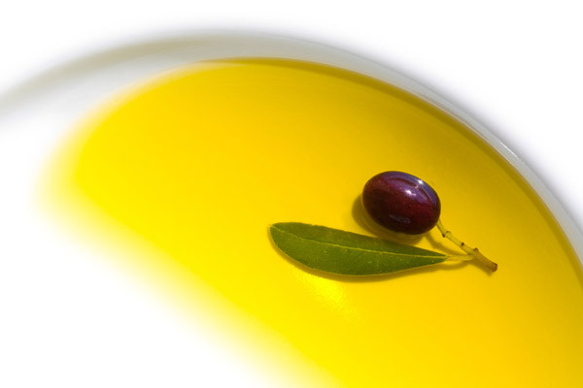
In our menu, lots of variety of Italian dishes, but I can recommend the most popular and delicious of them:

Slide 5
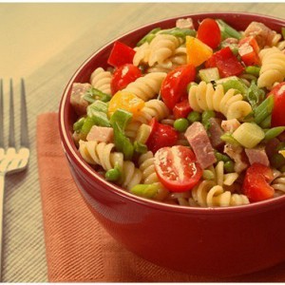
Italian salad with ham, cheese and vegetables.

Slide 6
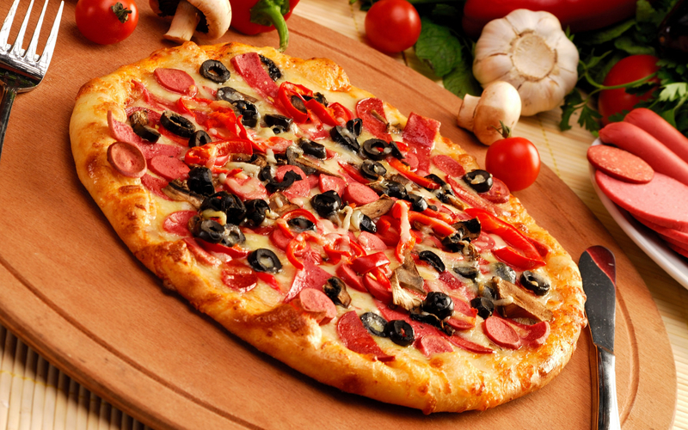
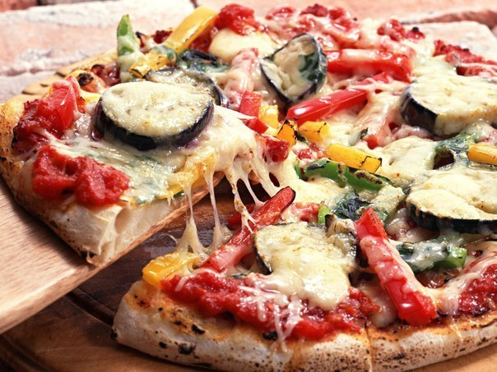
Pizza - it can be called a national food Italians, which is an open cake covered with tomatoes and melted cheese.

Slide 7
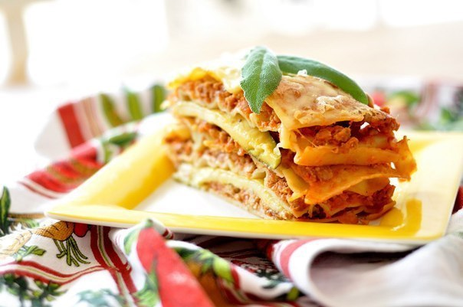
Lasagna - another traditional dish of Italy. It is made of several layers of dough with layers of stuffing on top of all this pudding filled with bechamel sauce. Filling can be minced, vegetable stew, tomatoes, spinach, cheese and much more.

Slide 8
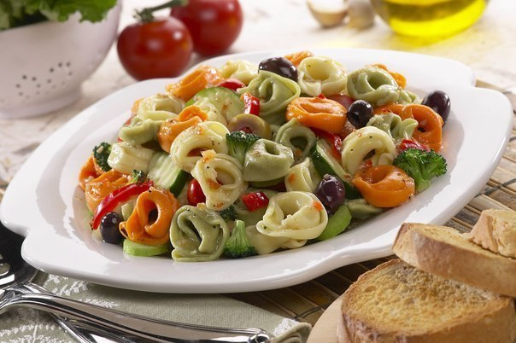
Tortellini - are Italian dumplings that are made from unleavened dough with meat, vegetables and cheese.

Slide 9
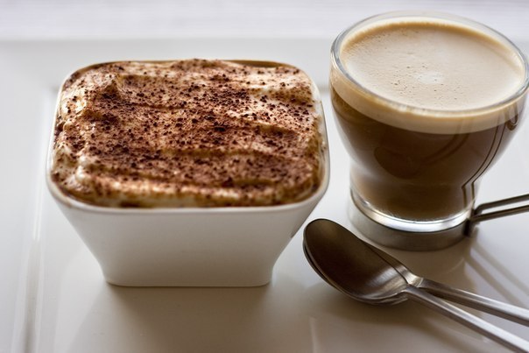
Tiramisu - is the most popular dessert around the world. It consists of coffee, eggs, mascarpone cheese and biscuits.

Slide 10
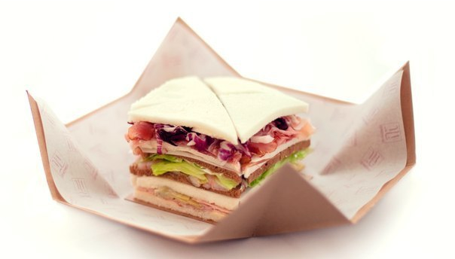
Tramezzino - this triangular sandwich or sandwich. Popular filling for him considered tuna, prosciutto and olives.

Slide 11
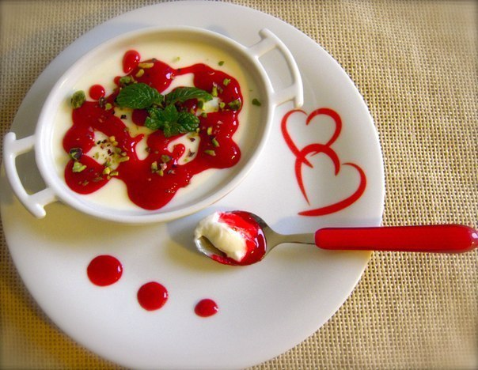
Panna cotta - an Italian dessert of cream, vanilla and sugar.

Slide 12
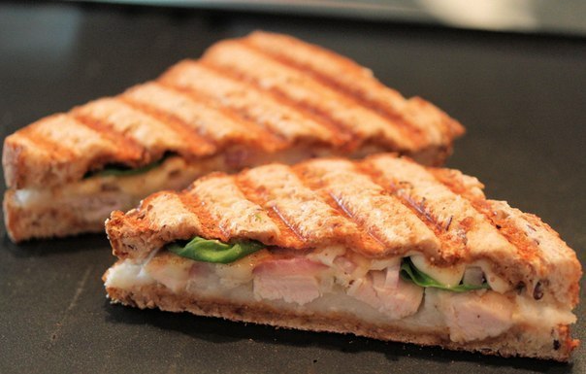
Panini - Italian sandwich or closed sandwich. It is made from white bread, most of baguette and served hot. Classic filling for him was mozzarella, ham, pesto and tomatoes.

Slide 13
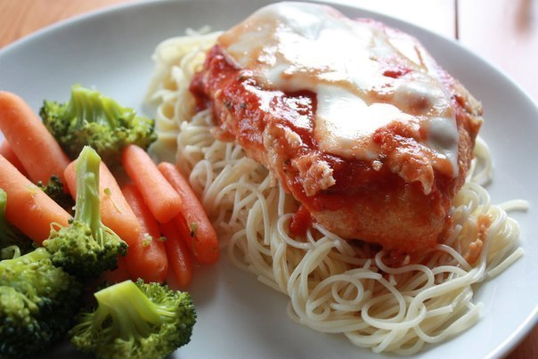
Chicken Parmigiana - baked chicken breast with parmesan cheese and tomato sauce. This is especially popular dish in Sicily.

Slide 14
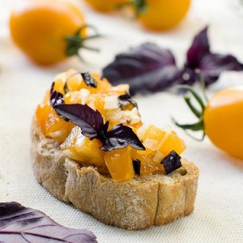
Bruschetta - classic Central Italian dish that can be attributed to the snacks. A distinctive feature of bruschetta is that pre-deep fried slices of bread.

Slide 15
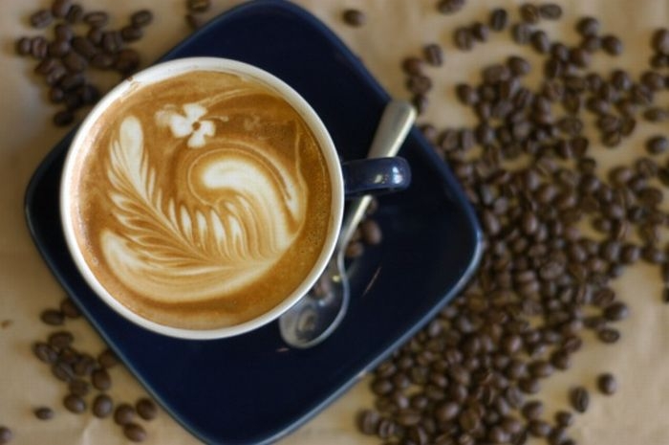
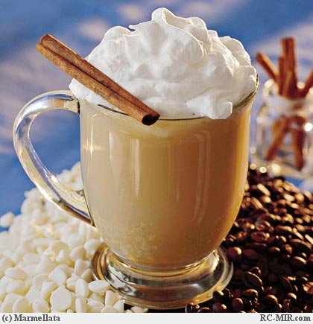
Scrolls of beverage can offer "LATTE" - coffee the most popular drink in Italy.

Slide 16
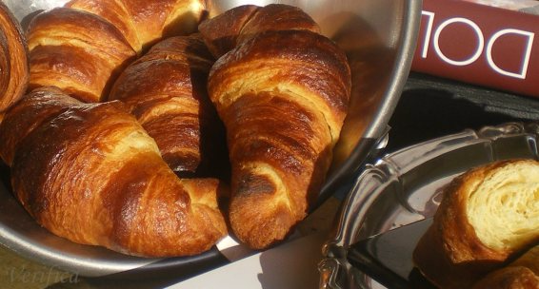
Great addition to coffee are Italian croissants!

Slide 17
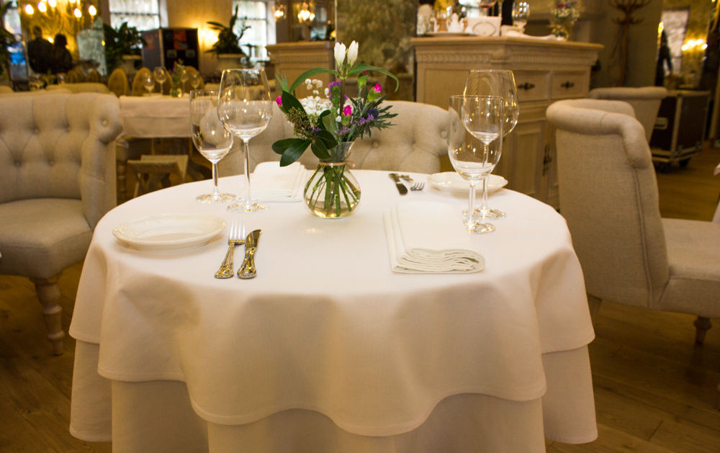
In our cozy restaurant, you can feel at home: you can order everything that is indicated in our menu, any dish or drink. So do we have free wireless "Wi fi". Our "paradise" will always welcome you.

Slide 18
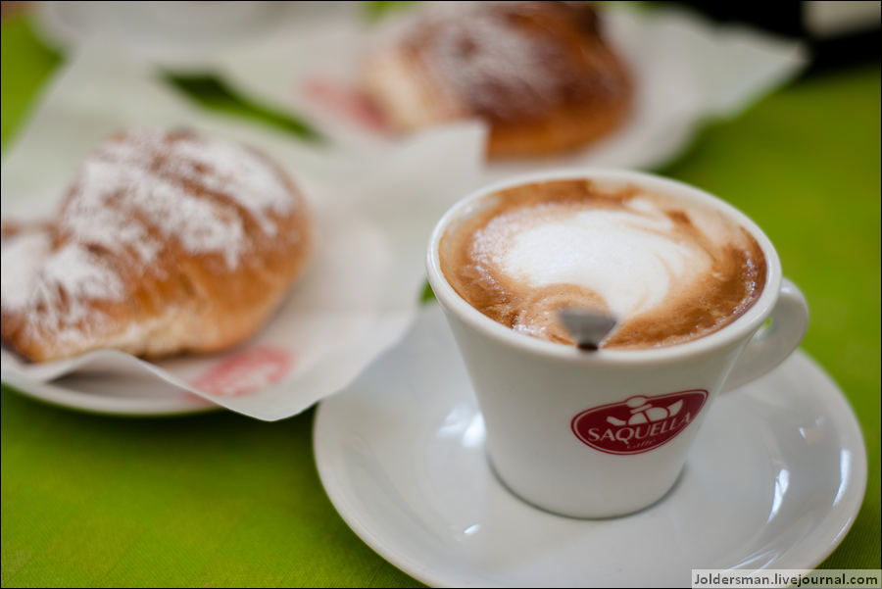
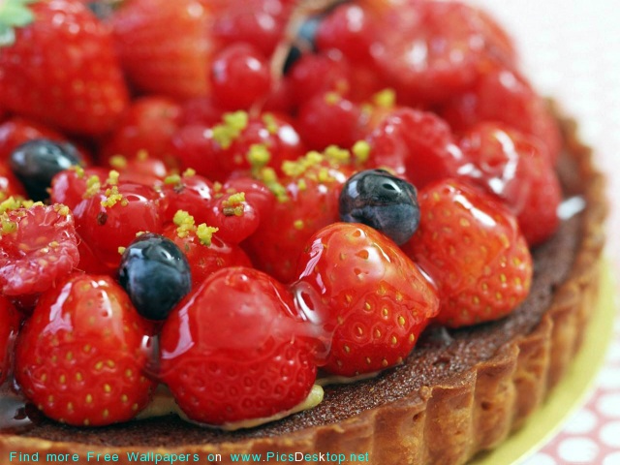
Have a good time!

