Slide 2
THE MEDIA
The mass media play an important part in our lives. Nowadays information is the most necessary thing. That is why there are so many sources of getting it: the press, the radio, the Internet, TV, advertisement. Information about different events in the world can be broadcast on the radio and TV or published in newspapers or magazines.

Slide 3
All types of Media are related to each other.

Slide 4
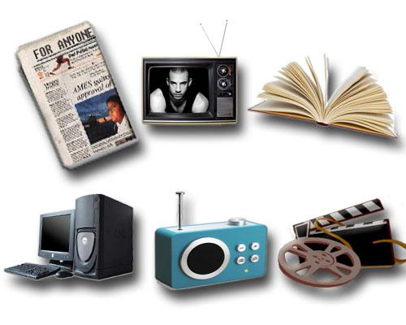

Slide 5
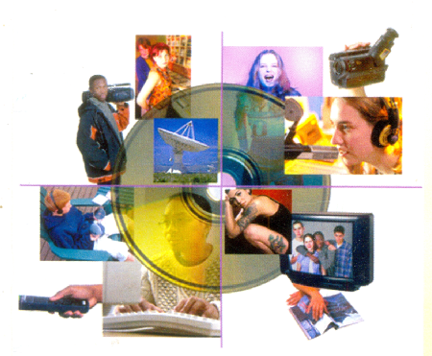

Slide 6
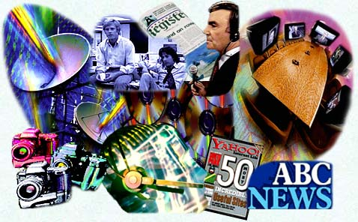

Slide 7
TV
It is almost impossible to imagine our life without TV. It plays a great and a very important role in the life of modern man. There is practically no family that doesn't have a TV set. TV has a lot of channels and everybody can watch the programs he likes. TV keeps people informed; we can learn a lot of information watching TV. We can choose programs that we like, because TV provides programs for all interests. Sometimes we can relax, entertain ourselves when we are tired. When we watch TV we learn about the world, famous people and global or recent news.

Slide 8
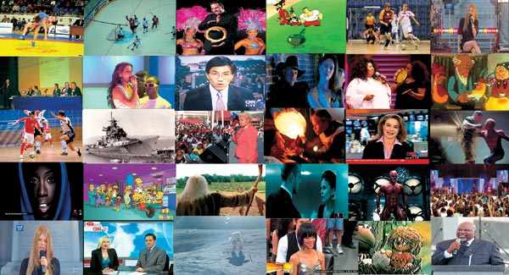

Slide 9
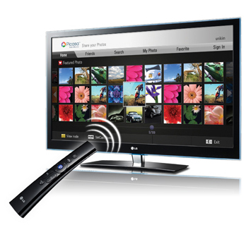
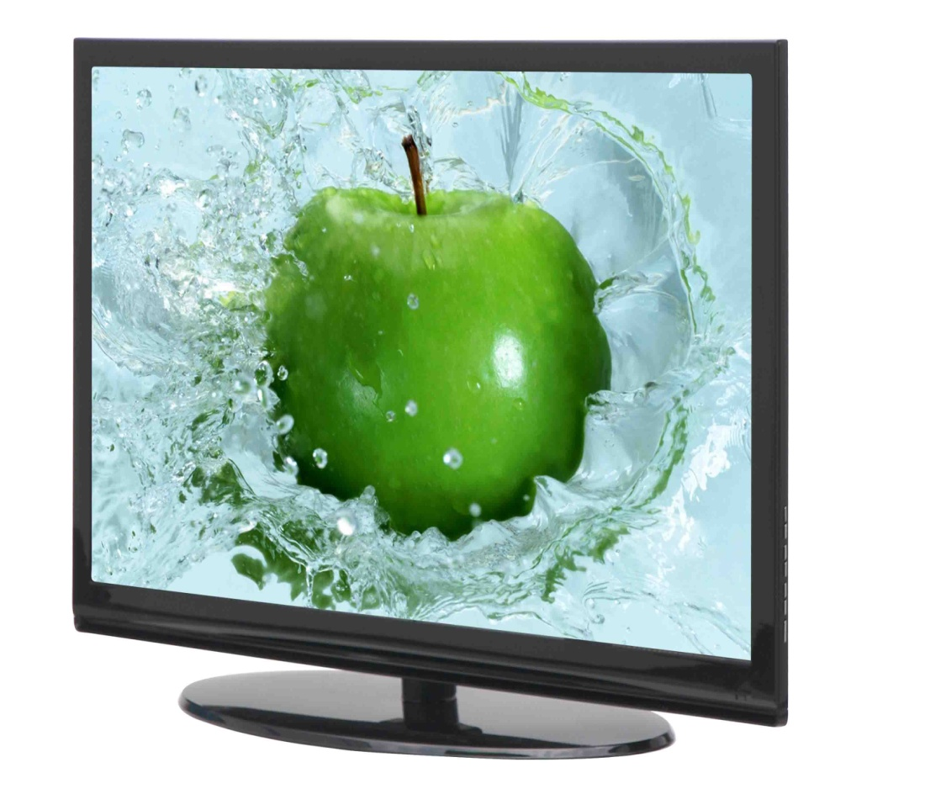
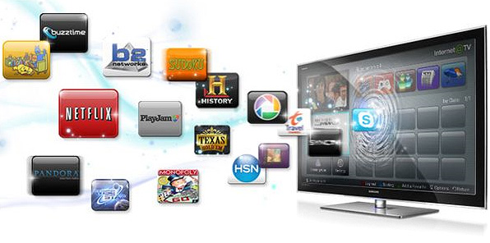

Slide 10
RADIO
The radio is turned on most of the time creating a background noise. You can listen to the radio doing some work about the house, reading a book or doing something else. On the radio you can hear music, news, poetry, various commentary and discussions. Radio programs attract a large audience. Radio brings into our homes not only entertainment and news but also cultural and educational programs. Radio is widely used in today’s world. It is the quickest mean of spreading news and the information. Radio keeps us informed about current events. So it gives us a lot of useful information.

Slide 12
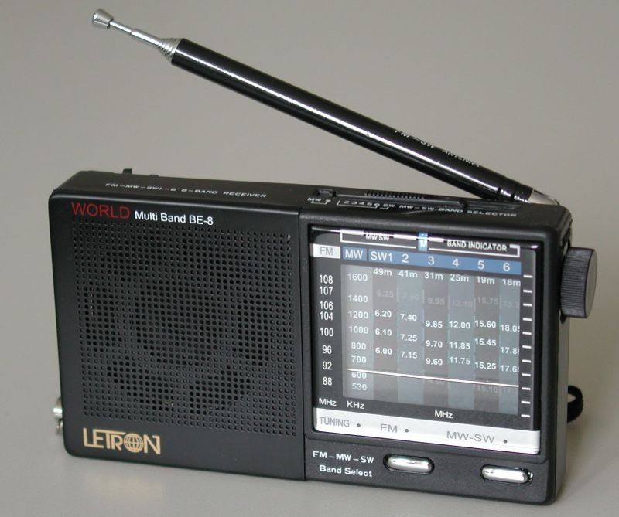
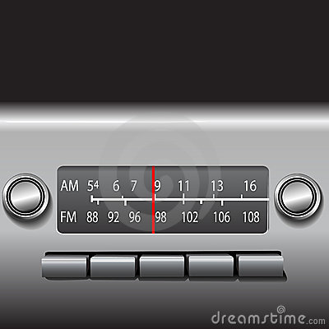
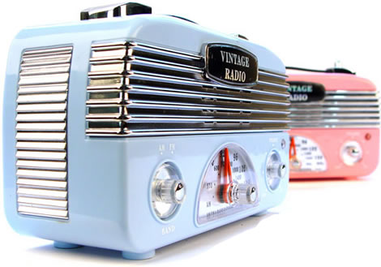
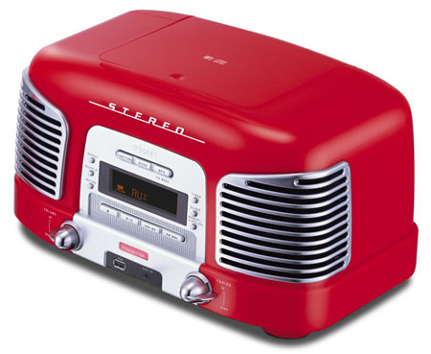

Slide 13
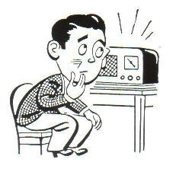

Slide 14
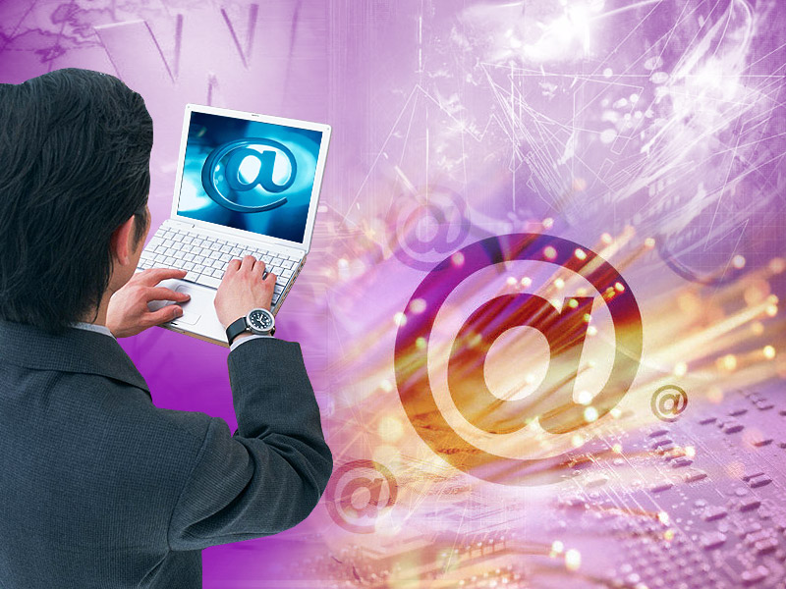
INTERNET
Now we cannot imagine our life without the Internet. The Internet is necessary for each person. All people use the Internet on different purposes: for communicating, for searching the information, for work, for studying, for fun and entertainment, for downloading pictures or music. We can order clothes, things, furniture, ; we can find a work or work there, for example, designing web-sites. By means of the Internet it is possible to meet new friends, to communicate with them. You can find any information, learn main news.

Slide 18
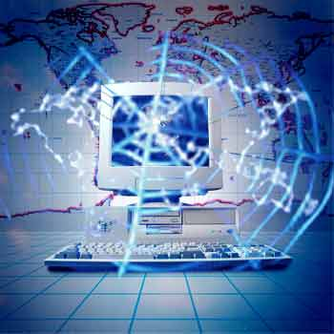
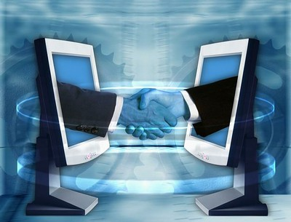

Slide 19
MUSIC
In all times people expressed their feelings and emotions with the help of Music. We can hear music everywhere: in the streets and at home, over the radio and on TV, in the shops and in the parks. People all over the world are fond of music. They listen to music, they dance to music, and they learn to play musical instruments. Music is an art which reflects life.

Slide 22
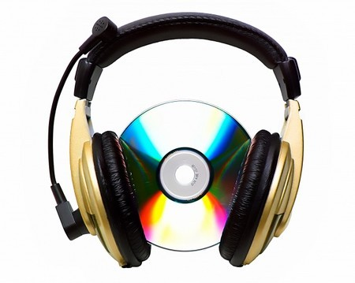

Slide 24
THE PRESS
The press keeps people informed on all topical issues of the day. You can get a lot of useful information from newspaper reports. If you are a regular reader of the press you will be well informed about all matters. Most newspapers come out daily. The reader's questions, opinions and suggestions, which they send in letters to the editor, help to improve the newspaper and make it more interesting.

Slide 25
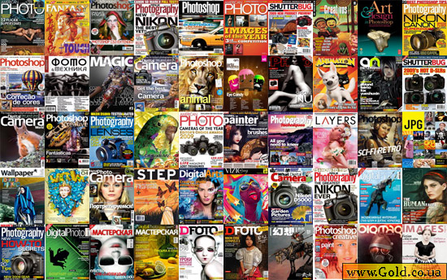

Slide 26
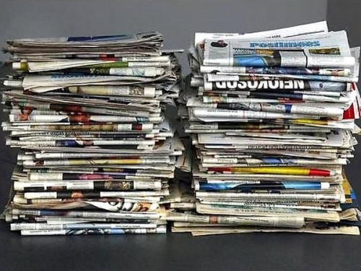
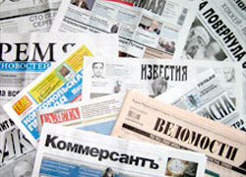
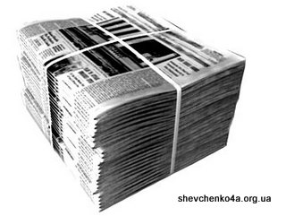

Slide 27
