Slide 1
Progect
Fashion

Slide 2
Fashion
Fashion clothes
Representatives from the world of fashion

Slide 3
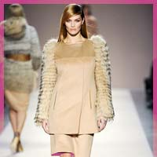
Fashion clothes
Fashion clothes - a change shapes and designs clothes that occurs during relatively short periods chasu.Istorychnyy development is inseparable from fashion apparel, mainly because these concepts are identified. Fashion in clothing associated with the visual appearance of the approach to the ruling body ideals. For example, in China and Japan, it was fashionable to deform girls feet, limiting their growth, which was considered a sign of aristocracy, and in Europe deformed cast the entire torso. Crinolines emphasized the dignity and social status, generally high consumption of tissue, such as a cable or a dress was an indicator of belonging to a particular state.

Slide 4
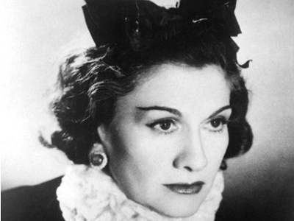
Coco Chanel
Gabriel Boehner Chanel (born Gabrielle Bonheur Chanel), which was nicknamed Coco Chanel (19 August 1883 - 10 January 1971) was a leading French fashion designer whose modernism was inspired by men's fashion, and that compliance with the expensive simplicity of the created clothes made ​​from it perhaps the most important figures in the history of fashion XX-th century. Chanel brought in female fashion fitted jacket and little black dress. Coco Effect of high fashion was so strong that it - the only fashion history - the magazine "Time" made ​​the list of one hundred most influential people in XX stolittya.U 1912 Coco opened her first fashion house in Deauville, but World War II interrupted its activities. In 1919, Chanel opened a fashion house in Paris in the street Cambon. By this time Chanel has had clients worldwide. Many wore her flannel blazers, skirts free cut, long sweaters from Jersey, matrosky the famous suit (skirt jacket). Coco herself had her hair short, wore little hats and sunglasses.

Slide 5
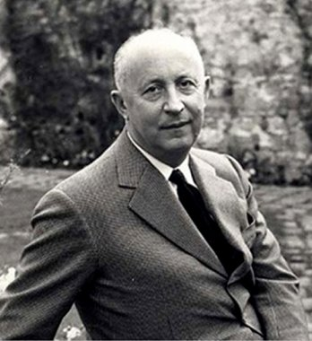
Christian Dior
Christian Dior '(Fr. Christian Dior, 21 January 1905, Granville, Normandy - 24 October 1957, Montecatini Terme, Tuscany) - French fashion designer.
In his very first collection 1947 Dior creates a totally new concept New Look. It was "a romantic line," with a new version crinolines, thin waist and adjacent bodice. This silhouette he embodied their own idea of ​​femininity, which lacked the era of wars with its uniforms and "national service" for women. Initially, the new designer reacted with fear, but a year later the whole of Europe and America adopted a new style.
Due to its optimism and acute instinct that allows him to guess you postwar France, Dior became one of those who helped turn postwar Paris fashion capital of the world status.
Dior was a pioneer of active synthesis haute couture («high fashion") and scenography: a costume designer in several productions ("School for Scandal" by Richard Sheridan (Richard Sheridan) at the Theater de Matyurin, 1940, a number of productions Roland Petit ( Rolan Petit), 1950) and films (directed by Claude Otan-Lara (Claude Autant-Lara), Alfred Hitchcock (Alfred Hitchcock) and others). Created scenic toilets for such pop stars and movie screens, like Edith Piaf and Marlene Dietrich , The Beatles.

