Slide 1
25 Greatest Maritime Disasters In History

Slide 2
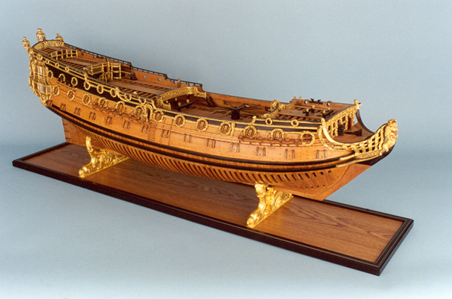
The Sussex was lost in a severe storm on 1 March 1694 off Gibraltar. There were only two survivors out of a crew of 500.
№25
HMS Sussex

Slide 3
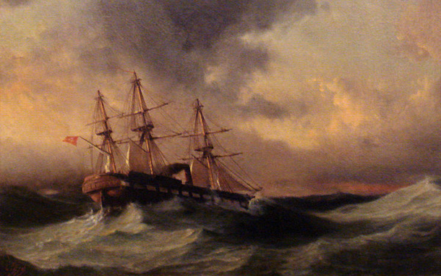
Sank on 18 September 1890 after striking a reef during a typhoon off Kushimoto, Japan. The maritime accident resulted in the loss of 533 sailors including Admiral Ali Osman Pasha.
№24
Ottoman frigate Ertuğrul

Slide 4
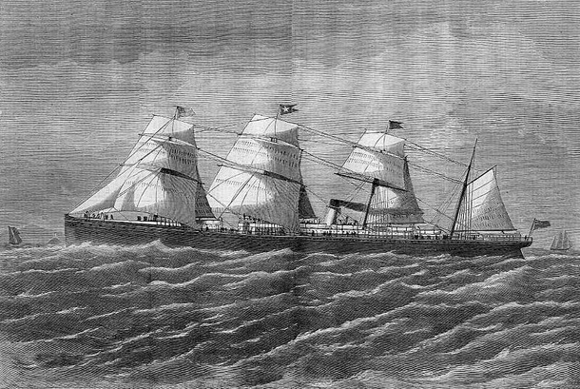
During the ship’s 19th voyage, on 1 April 1873, it ran onto rocks and sank off the coast of Nova Scotia, killing 535 people.
№23
RMS Atlantic

Slide 5
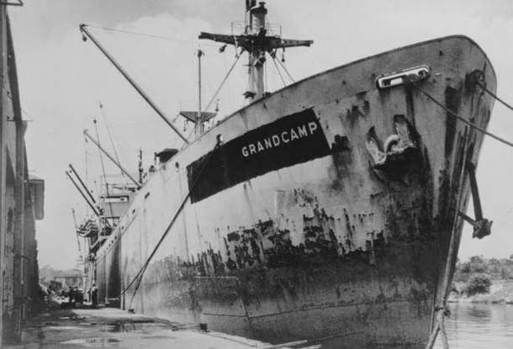
16 April 1947, the French registered ex-liberty ship caught fire and exploded dockside while being loaded with ammonium nitrate at Texas City, Texas. In what came to be called the Texas City Disaster an estimated 581 people, including 28 firefighters, were killed and 5,000 were injured.
№22
SS Grandcamp

Slide 6
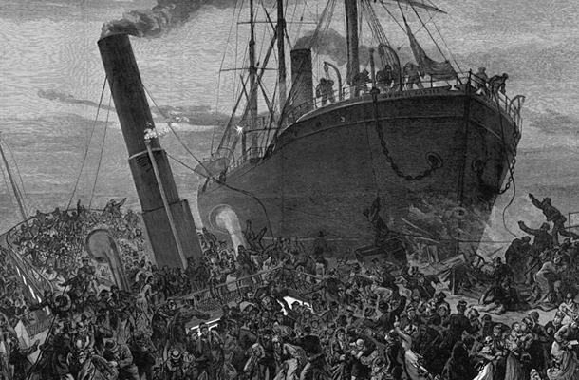
3 September 1878 the Princess Alice was sunk in a collision on the River Thames with the collier Bywell Castle off Tripcock Point in 1878. Over 650 people died making it the greatest loss of life in any Thames shipping disaster.
№21
SS Princess Alice

Slide 7
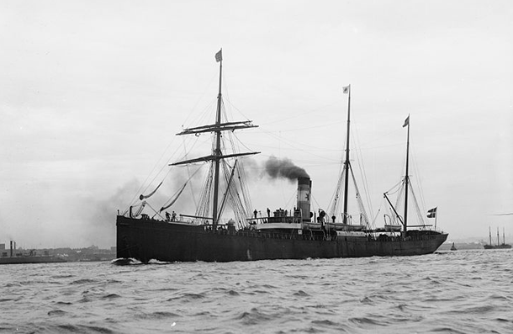
28 June 1904 the Norge ran aground close to Rockall on St. Helen’s Reef. The final death toll was 635 with 160 survivors who spent up to eight days in open lifeboats before rescue.
№20
SS Norge

Slide 8
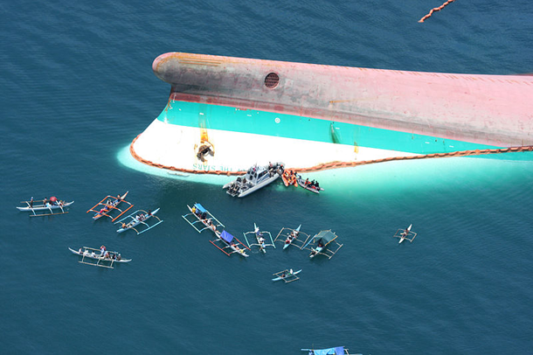
21 June 2008, the ferry Princess of the Stars capsized and sank in Typhoon Fengshen off the coast of San Fernando, Romblon, in the Philippines. Of the estimated 747 people aboard, only 57 survived.
№19
MV Princess of the Stars

Slide 9
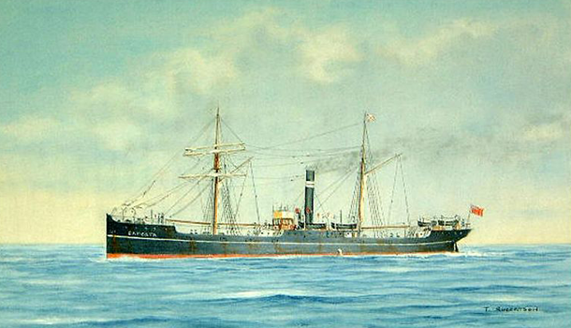
The Camorta was caught in a cyclone and sank in the Irrawaddy Delta on 6 May 1902 with the loss of all 655 passengers and 82 crew. She was en route from Madras, India, to Rangoon, Burma, across the Bay of Bengal.
№18
SS Camorta

Slide 10
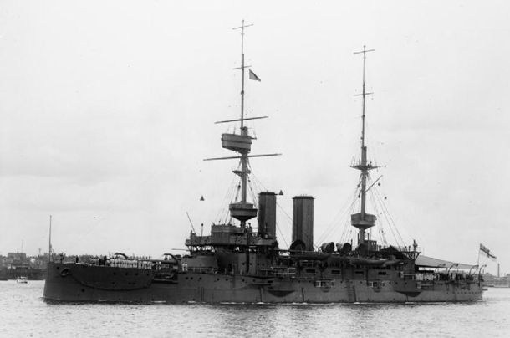
26 November 1914, a powerful internal explosion ripped the Bulwark apart in the River Medway estuary. All of her officers were lost, and out of 750 sailors only 14 sailors survived.
№17
HMS Bulwark

Slide 11
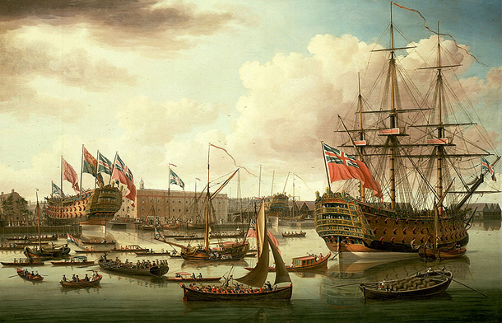
While moored at Portsmouth in August 1782 the ship heeled too far and began taking water in through the gun ports before sinking. More than 800 lives were lost.
№16
HMS Royal George

Slide 12
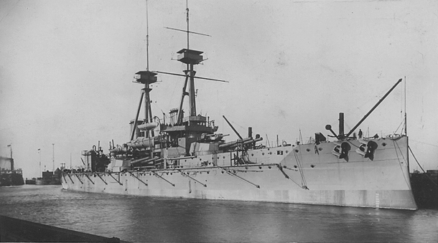
Just before midnight on 9 July 1917 at Scapa Flow, HMS Vanguard suffered an explosion and sank almost instantly, killing an estimated 843 men and leaving only two survivors.
№15
HMS Vanguard

Slide 13
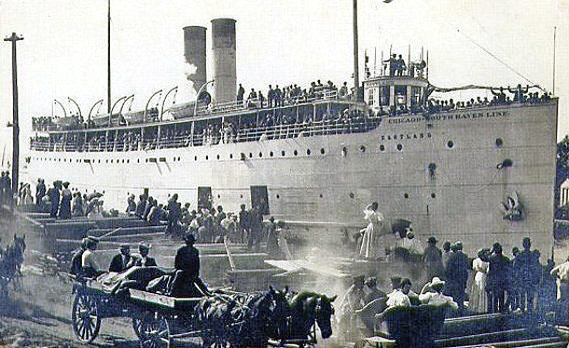
24 July 1915, while moored to the dock in the Chicago River, the capacity load of passengers shifted to the river side of the ship causing it to roll over, killing 845 passengers and crew.
№14
SS Eastland

Slide 14
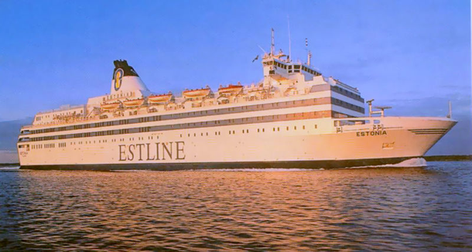
The MS Estonia sank in heavy Baltic seas on 28 September 1994 claiming 852 lives.
№13
MS Estonia

Slide 15
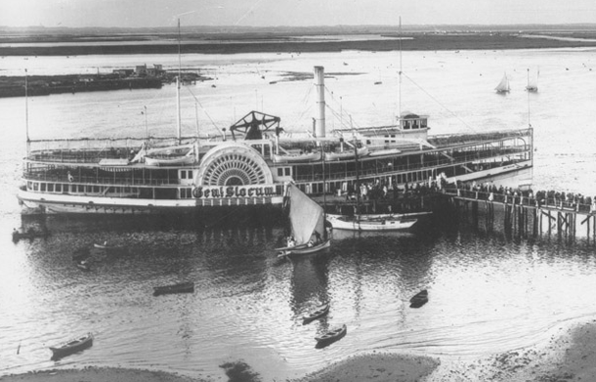
The General Slocum caught fire and sank in New York’s East River on 15 June 1904 killing over 1,000 people and making it New York City’s worst loss-of-life incident until the September 11, 2001 terrorist attacks.
№12
PS General Slocum

Slide 16
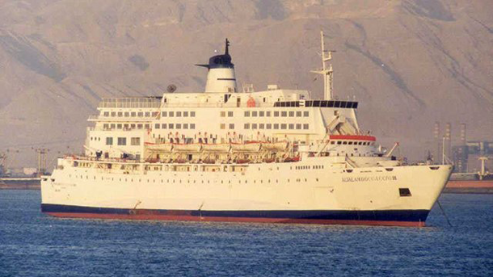
3 February 2006, the passenger ferry Al Salam Boccaccio 98 sank in the Red Sea carrying 1,312 passengers and 96 crew members. Only 388 people survived.
№11
MS al-Salam Boccaccio 98

Slide 17
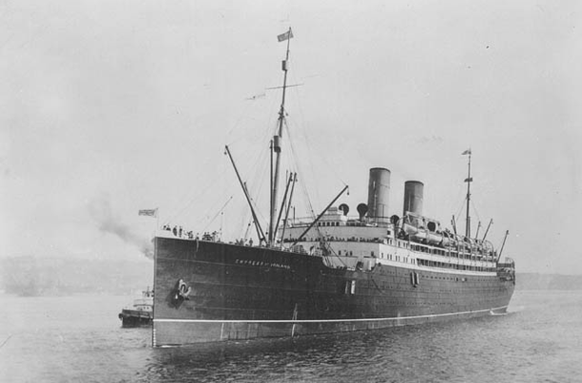
29 May 1914, the Empress of Ireland sank after colliding with SS Storstad on the Saint Lawrence River claiming 1,012 lives.
№10
RMS Empress of Ireland

Slide 18
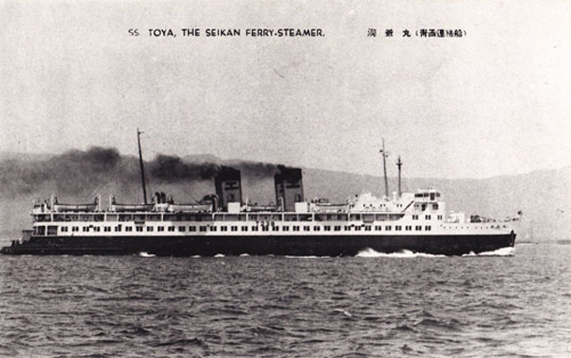
This Japanese passenger ferry that sank during Typhoon Marie in the Tsugaru Strait between the Japanese islands of Hokkaido and Honshu on 26 September 1954 lead to an estimated 1,500 deaths.
№9
Tōya Maru

Slide 19
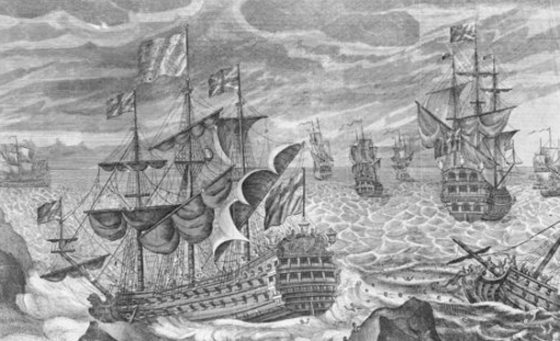
Аn October night in 1707 a Royal Navy fleet made several fatal miscalculations as they attempted to sail through dangerous reefs west of the Isles of Scilly. Overall four ships sank leaving nearly 2,000 sailors dead.
№8
Scilly naval disaster of 1707

Slide 20
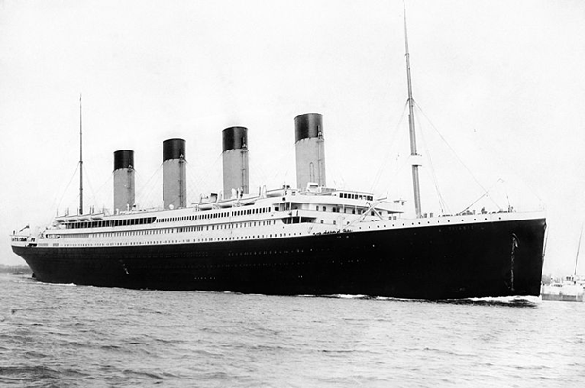
Possibly the most well known maritime accident in history, the RMS Titanic was supposedly unsinkable but after striking an iceberg en route to New York City it left 1,523 people dead
№7
RMS Titanic

Slide 21
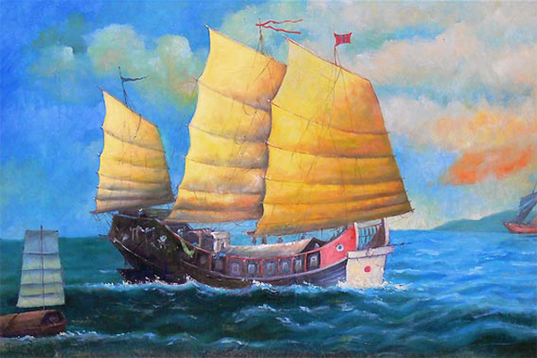
Referred to as the “Titanic of the East” this Chinese junk struck a reef near Indonesia and sank on 6 February 1822, leaving an estimated 1,600 dead.
№6
Tek Sing

Slide 22
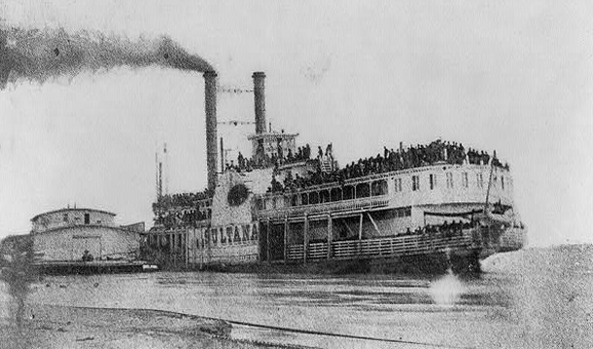
The SS Sultana was a steamboat paddlewheeler that exploded on April 27, 1865 and has been called the greatest American maritime disaster in history with over 1,600 lives lost.
№5
SS Sultana

Slide 23
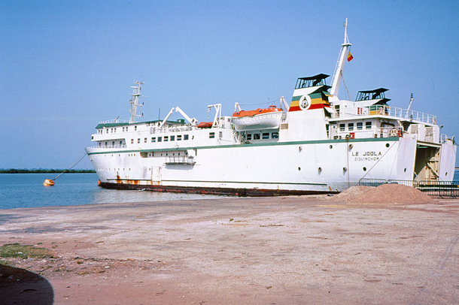
This Senegalese government-owned ferry capsized off the coast of Gambia on September 26, 2002 and led to a death toll of nearly 4,000.
№4
MV Le Joola

Slide 24
Responsible for the infamous Halifax Explosion of 1917 this French ammunition freighter exploded in Halifax Harbor, Nova Scotia after colliding with another ship. The blast killed over 2,000 people and injured 9,000 more.
№3
SS Mont-Blanc

Slide 25
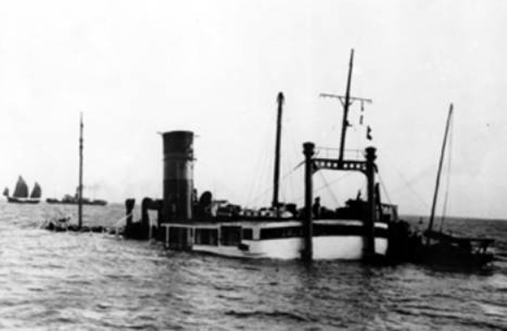
This Chinese steamship exploded upon striking a mine (probably left by the Japanese navy) on the Huangpu River in 1948. It was packed with refugees from the Chinese Civil War so the exact death toll is not known but some estimates put it near 4,000.
№2
SS Kiangya

Slide 26
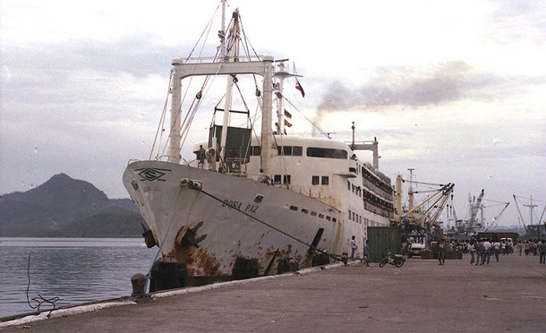
Called the greatest peace time maritime disaster in history, in 1987 the sinking of the MV Doña Paz led to 4,341 deaths with only 24 survivors. The ferry was en route to the capital of the Philippines when it collided with an oil tanker leaving both ships and the surrounding ocean to light up in flames.
№1
MV Doña Paz

