Slide 1

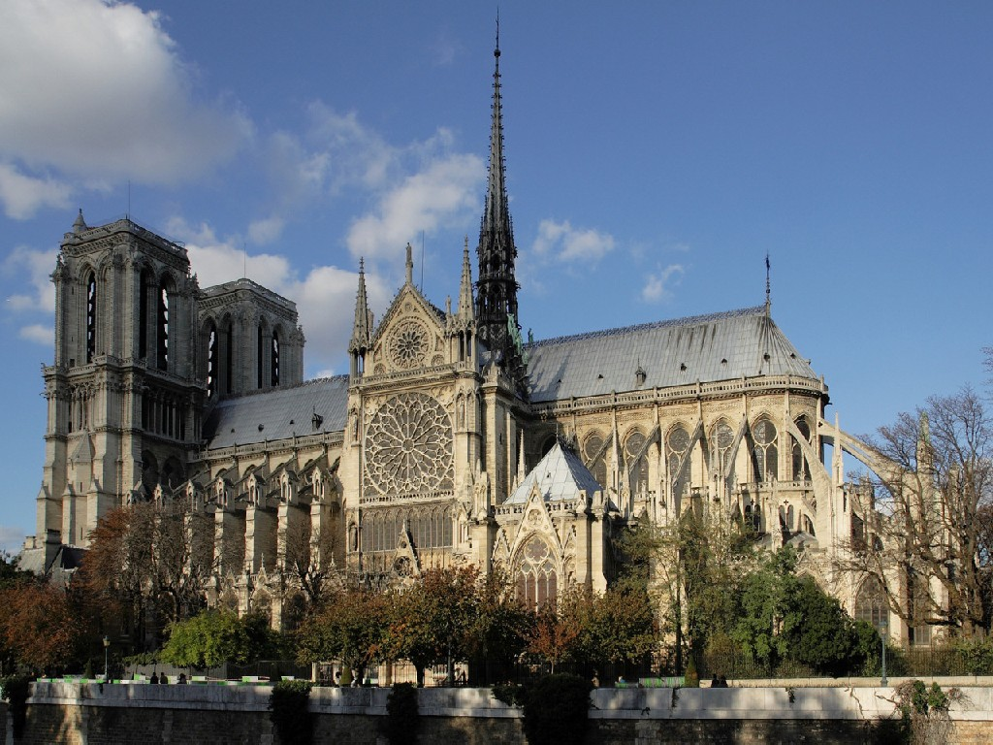
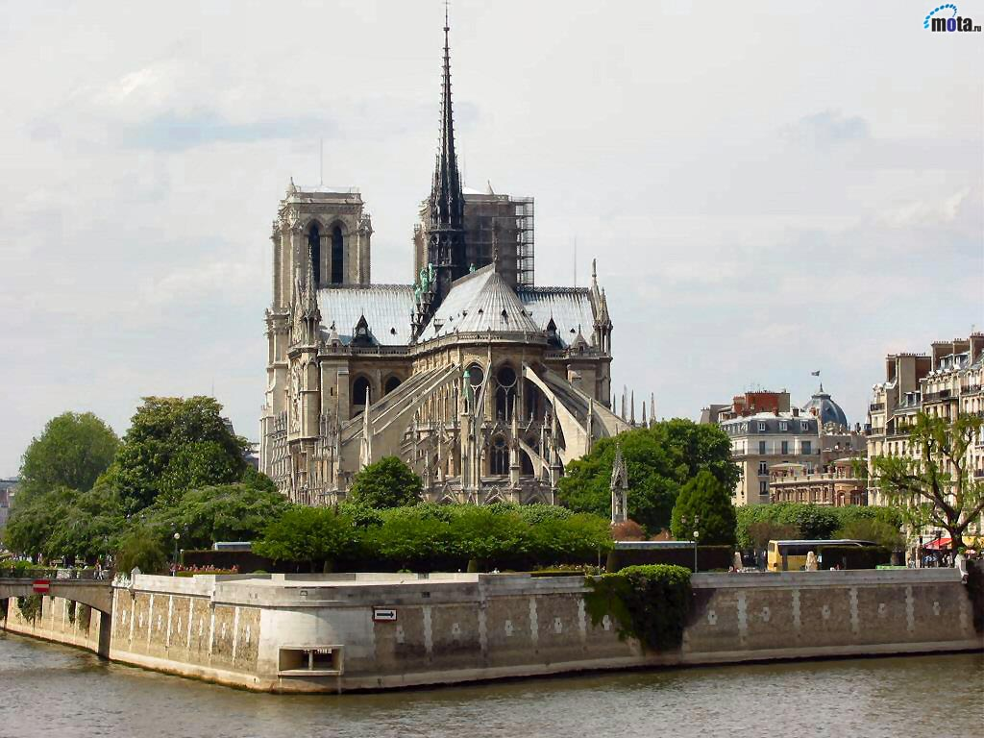
Cathedral of Notre-Dame de Paris
Made by
Helen Koval

Slide 2
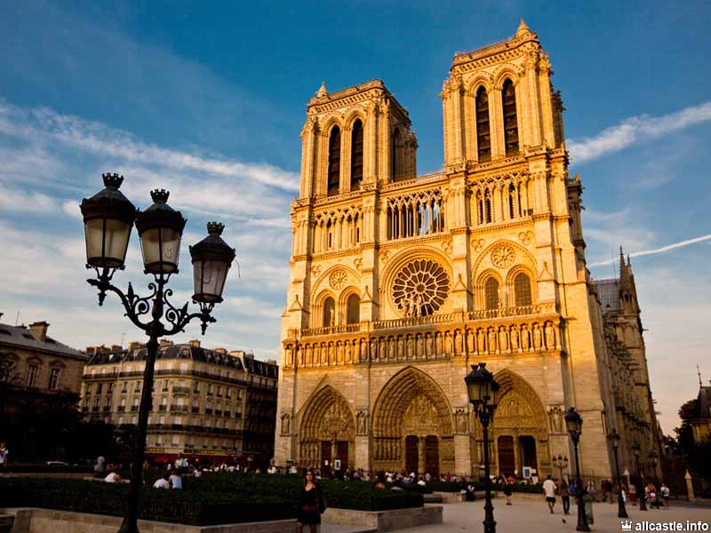
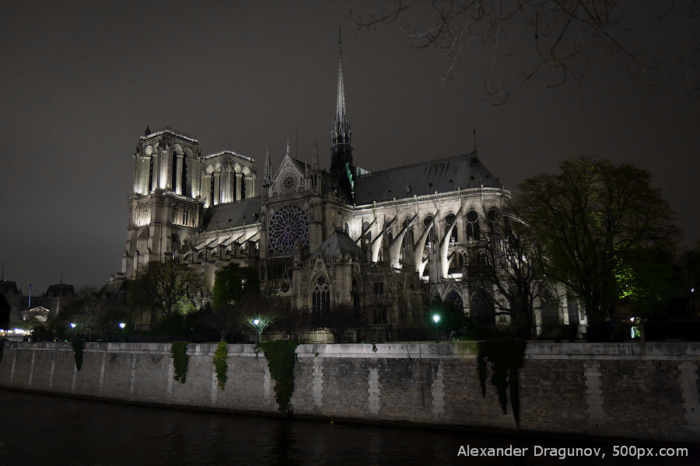
The history of creation
History of the Cathedral of Notre Dame de Paris goes back centuries. Now it is almost 850 years old, and it was built on the site of the cathedral called Saint-Etienne, which was razed to the ground. The building of the cathedral began to be built in 1160. Notre Dame Cathedral has built for 170 years. Construction began in the 12th century, when the Romanesque style of architecture. The transition from Romanesque to the Gothic style was reflected in the appearance of the building. Its architecture is dominated by arches and vertical lines without a hint of direct . The main creators of Notre Dame considered two architects - Jean de Chelles and Pierre de Montreuil.

Slide 3
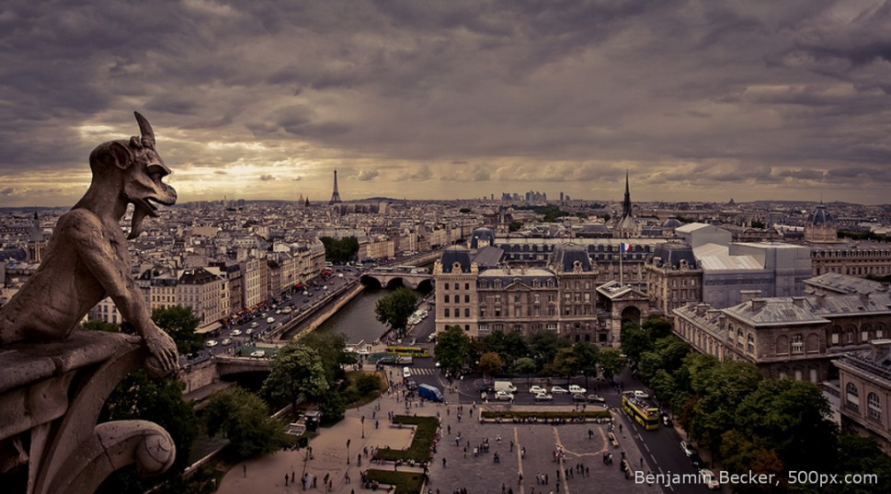
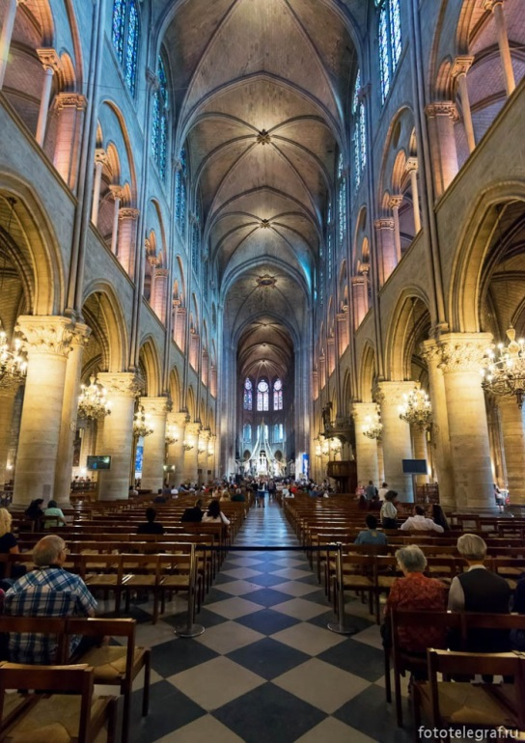
The interior of the cathedral
Mural painting at Notre Dame is not, as well as in other Gothic cathedrals. Stained glass windows are the only source of light, animating gray interior. Rainbow colored hues fills the wall space, penetrating through the stained glass lancet windows. The images correspond to the medieval canons, their subjects are scenes from the life of Jesus Christ, the Virgin Mary, the fragments of the lives of saints, biblical patriarchs and apostles.
On the right side there is a chapel of the cathedral, where you can see sculptures and paintings by different artists. They bring a gift of his works every year on the first day in May, it is a tradition.
The observation deck is located on the roof, here tend to get most of the tourists, it needs to go through the moat arches, pass the gallery, stretching along the western towers and overcome the 378 steps. Surrounded by gargoyles and mascarons you can overlook the panorama opened in Paris. In clear weather perfectly visible quarter skyline, the Eiffel Tower and the Seine river bends.

Slide 4
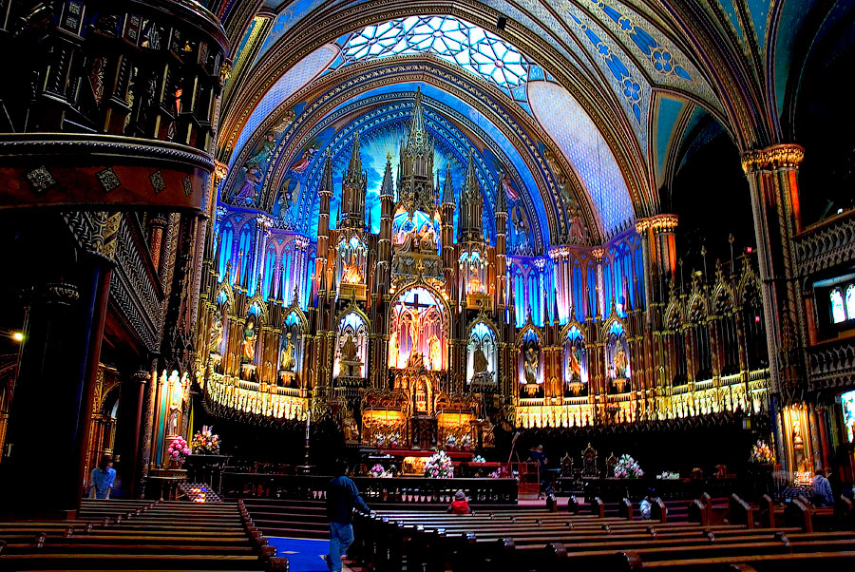
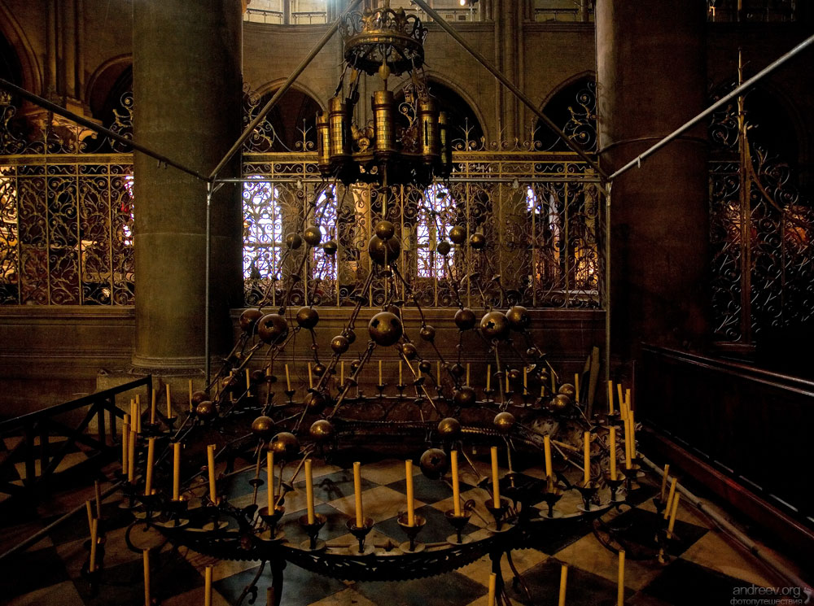
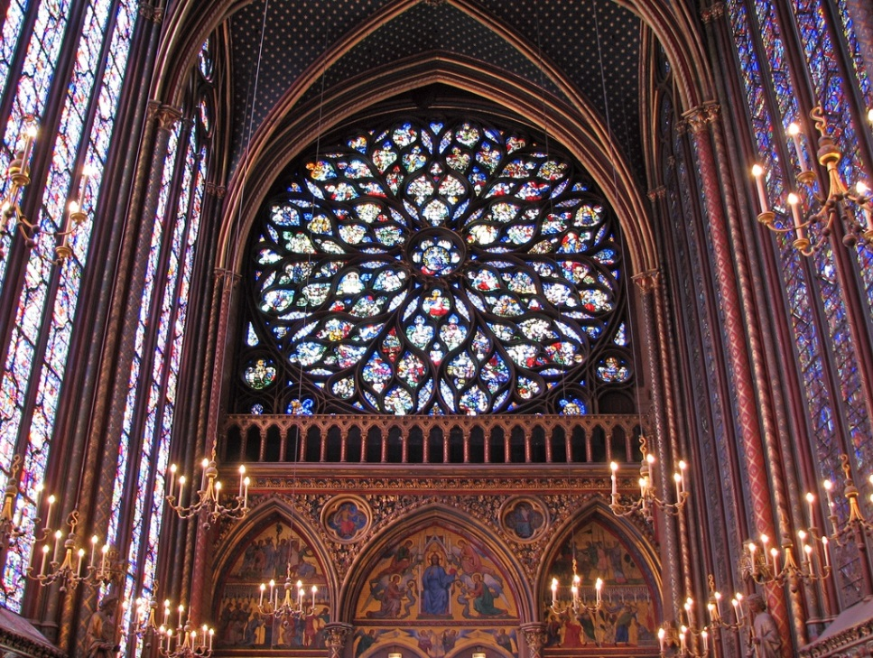
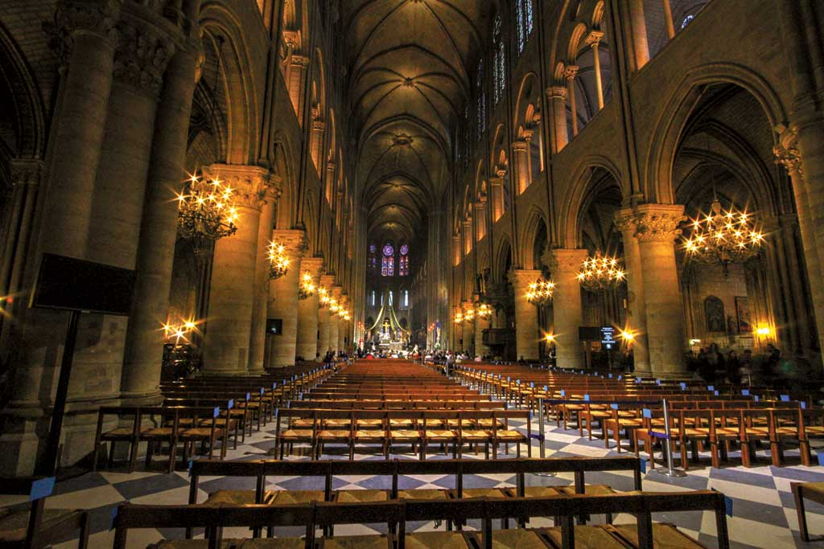

Slide 5
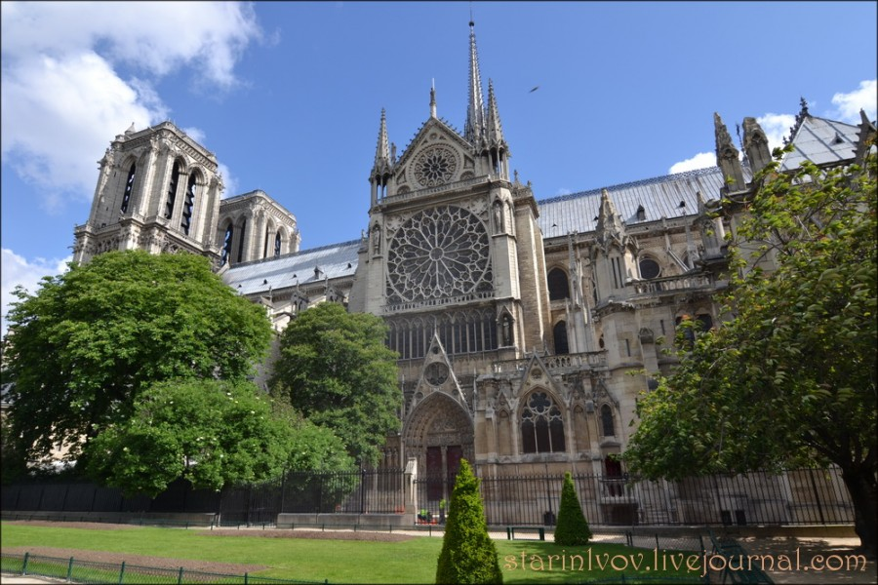
Interesting
Notre Dame can be called the heart of France.

Slide 6
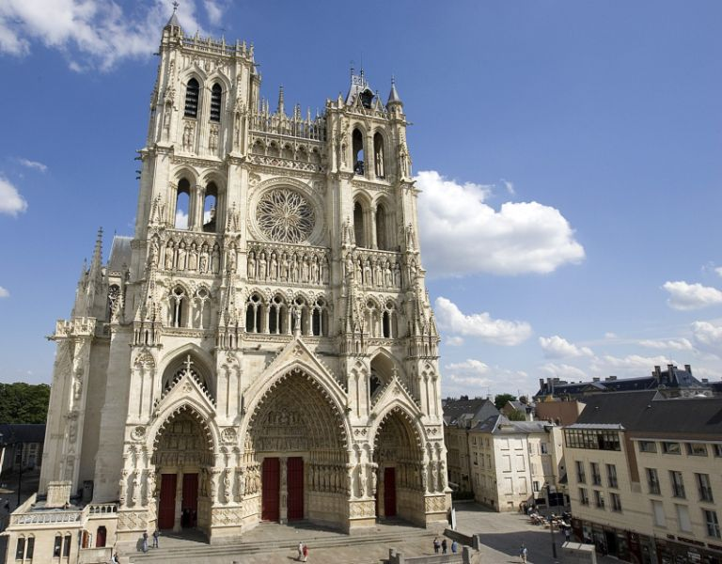
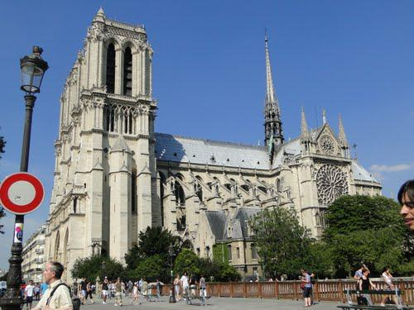
On the square before the cathedral set sign "zero kilometer", it is from this point are counting all the roads of the country.

Slide 7
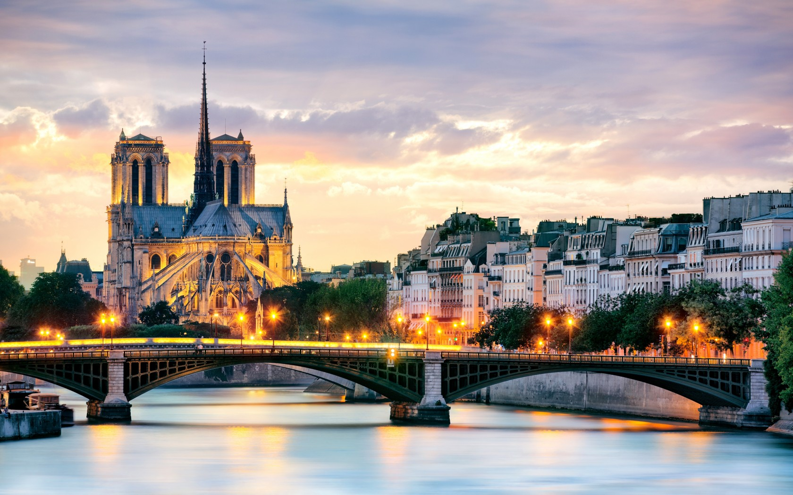
It is built on the island Cite, which is also called the "cradle of Paris."

Slide 8
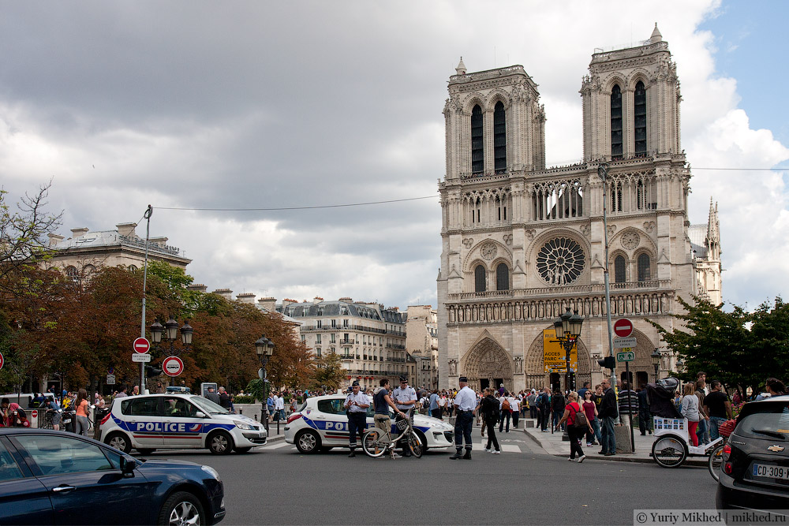
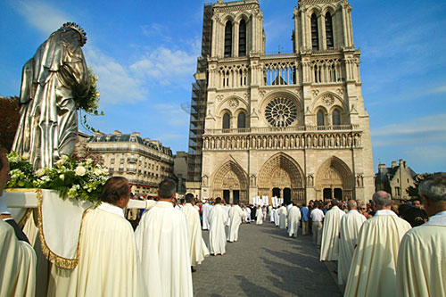
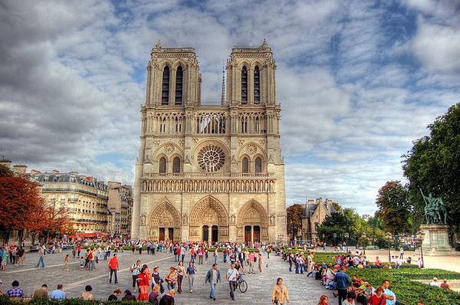
Now the population of Paris increased dramatically, but the Notre-Dame de Paris is still ready to take on its premises for more than nine thousand people.

Slide 9
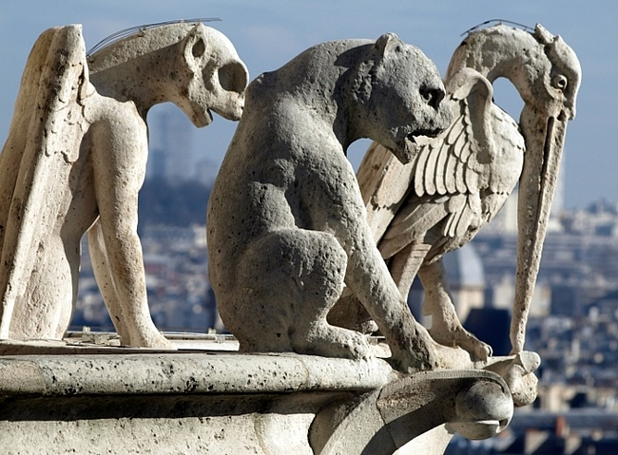
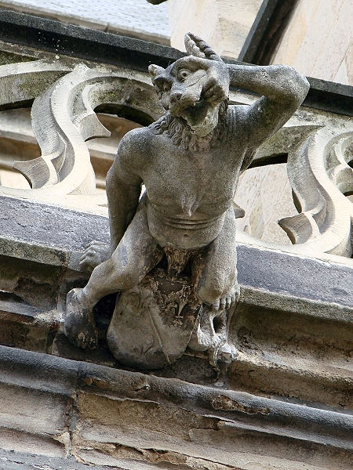
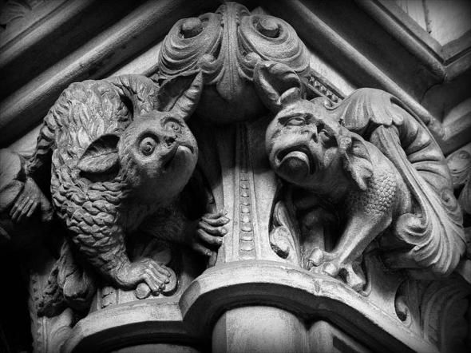
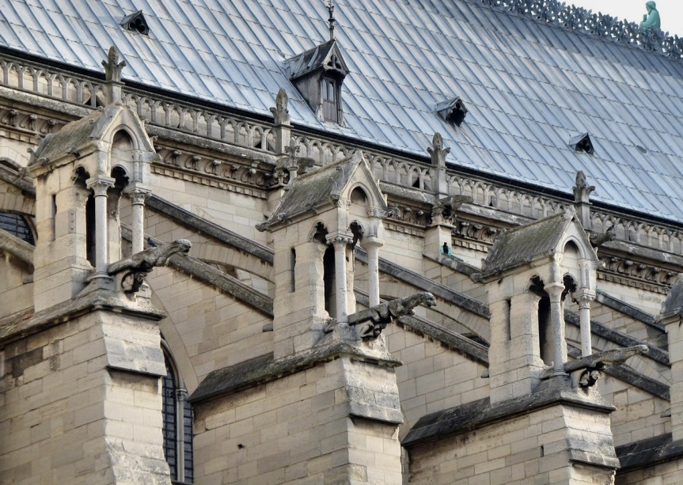
Three pointed arches serve as inputs. Near them are statues of saints, prophets and angels. Also statues stand in the niches of the cornice. This statue of the biblical kings.

Slide 10
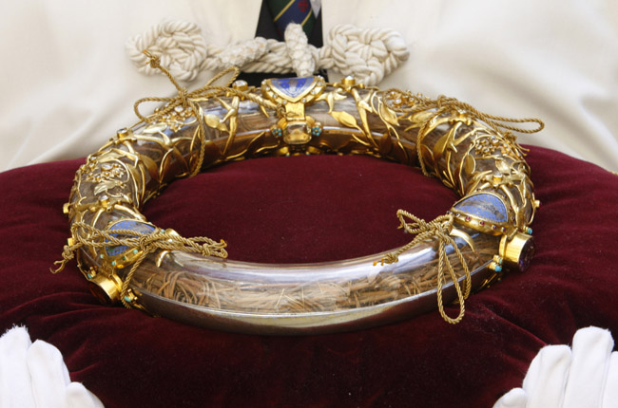
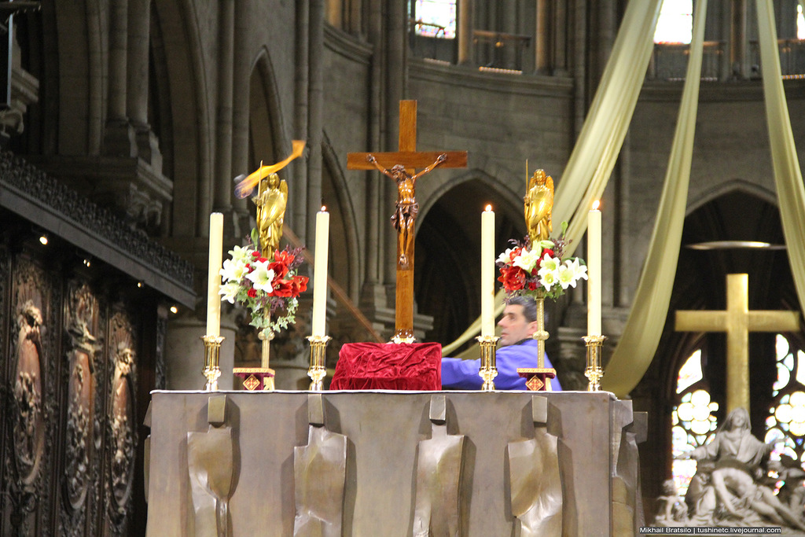
The cathedral has one of great Christian relics - Crown of Thorns of Jesus Christ.

Slide 11
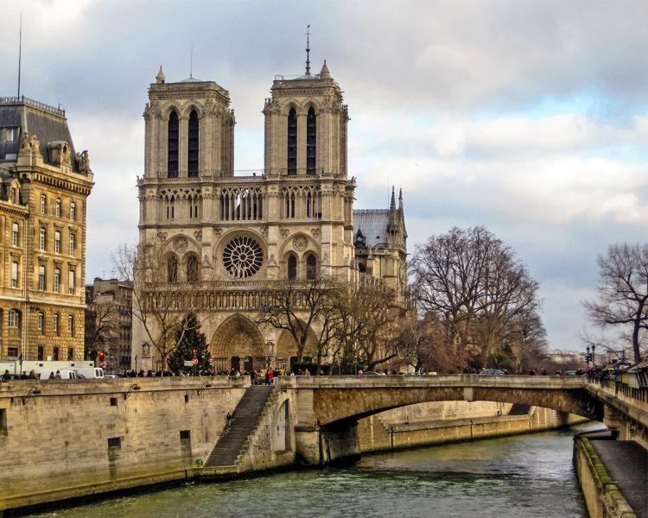
Cathedral visit annually 14 million people, it is one of the most famous monuments in Europe.

Slide 12
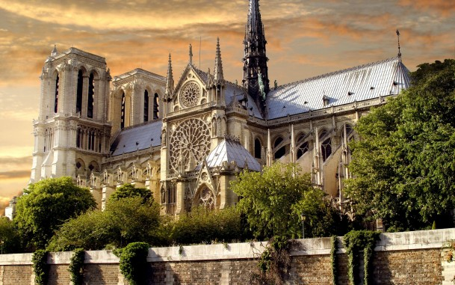
North and South portals have their own names, the north - in honor of the Virgin Mary, and the south - in honor of Saint Anne.

Slide 13
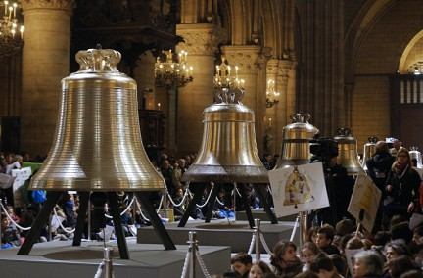
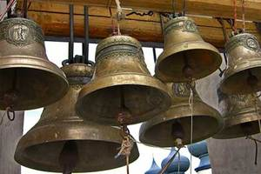
The bells have names:
Angelique Francoise, weighs 1765 kg, the tone C sharp.
Antoinette Charlotte, weighs 1158 kg, D-sharp tone.
Hyacinthe Jeanne, weighs 813 kg, F tone.
Denise David, weighs 670 kg, the tone in F-sharp.

Slide 14
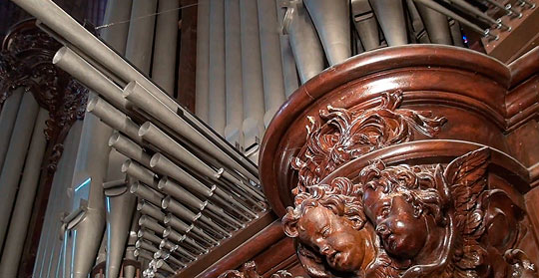
And every Sunday Mass is held in the Cathedral. At Mass you can enjoy the sounds of the biggest organ in the country.

Slide 15
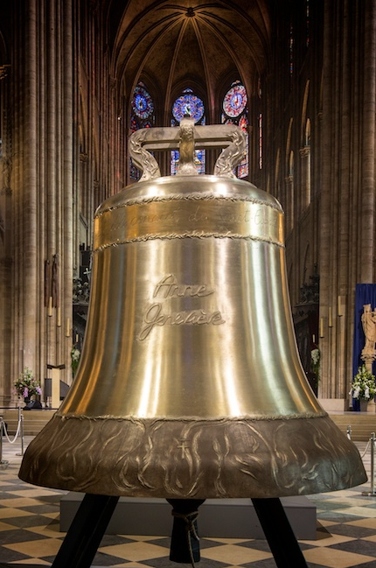
It is here that you will see twelve ton bell named Emmanuel, which sounds only on special occasions - during major religious holidays and after the terrible catastrophe, when all the people joined in the general grief and compassion.

Slide 16
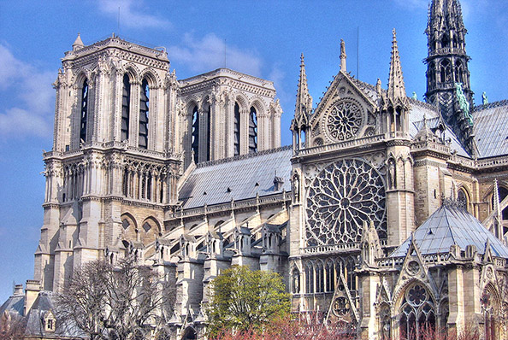
Notre Dame, without a doubt, the most famous in Europe. For centuries, Notre Dame Cathedral was the main center of urban life: here were crowned emperors and met the first parliament of France, held the royal wedding and the funeral service, the rich passed here deposited their values. Now it is annually visited by 13 million tourists - more than the Palace of Versailles and the Mont Saint-Michel together.

