Slide 1
School subjects
Prepared by:
pupil of 11-B form
Ishchenko Inna

Slide 2
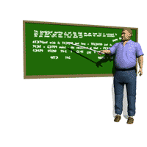
We learn a lot at school
English
Ukrainian and literature
Biology
Geography
History
Сhemistry
Mathematics
Physics

Slide 3
School subjects
Ukrainian language - the official language of our country. This subject is obligatory in schools of Ukraine. Students learn it to improve the knowledge of their native language. So all Ukrainians and foreigners living in the country should know the Ukrainian language.
English is an international language. This school subject includes listening, reading, speaking and grammar. More than 60 countries are using it as the official state language, and many organizations are using it as official business language. So almost all school students learn English. This international language is to be taught in the first class.

Slide 4
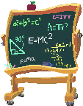
Biology - the science of life, the structure of various organisms. Students in the biology class receive information about the features of living organisms.
Mathematics - the science of computation of spatial relations. It requires humanity for calculations, calculations, measurements and more.
History - the science that helps studying specific information about the past of mankind. This information is contained in the sources of the study of history. Students learn the history of development of human society in different areas.

Slide 6
Mathematical group of subjects are geometry, algebra, physics, computer science.
Humanities subjects are the Ukrainian language and literature, world literature, English,
history, psychology.
Natural subjects are chemistry, biology and ecology.

Slide 7
The level of knowledge of groups of subjects

Slide 8
The activity of our class in school subjects

Slide 9
questions
Are you surprised by any of the search?
What subjects are more interesting for you? Why?
Who knows the subjects better in our class (girls or boys)?
What subjects does the Humanities group include?
What are the Mathematical subjects?
What are the Natural subjects?
Who knows any of these subjects better?

Slide 10
Thanks for your attention!!!

