Slide 1
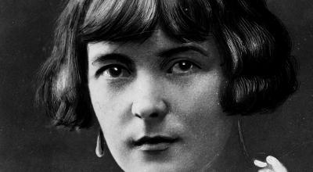
Katherine Mansfield
1888 - 1923

Slide 2
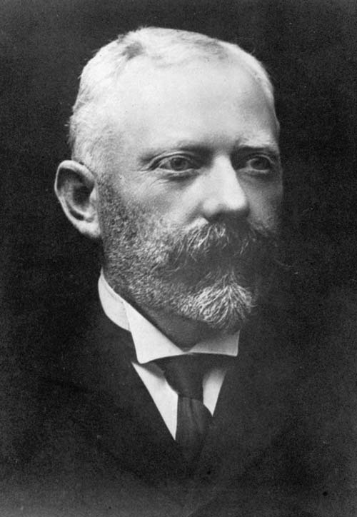
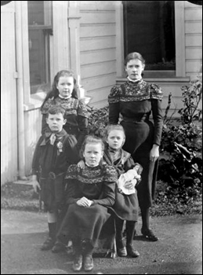

Slide 3
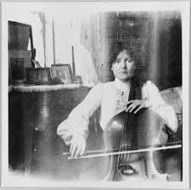
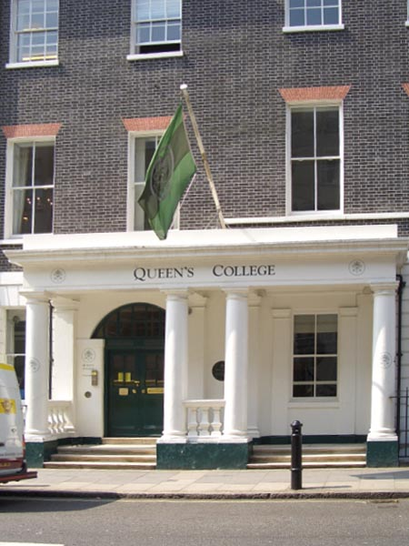
In 1903 she moved to London, where she attended Queen's College along with her sisters.

Slide 4
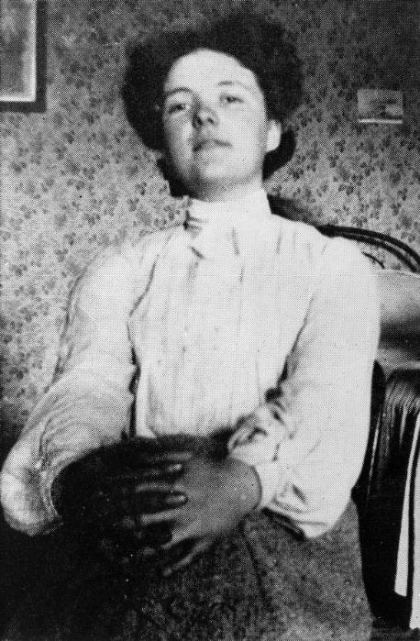
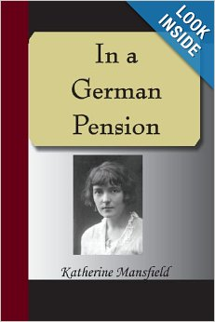

Slide 5
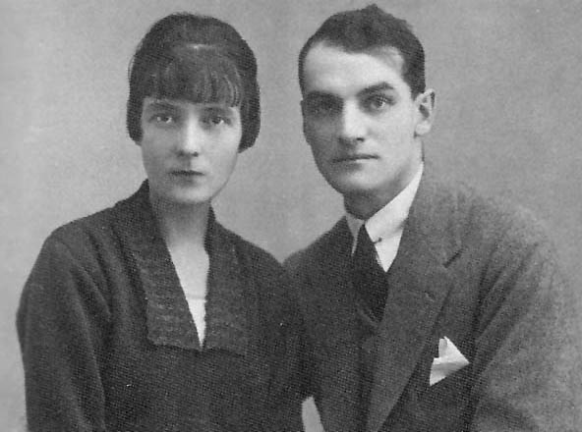
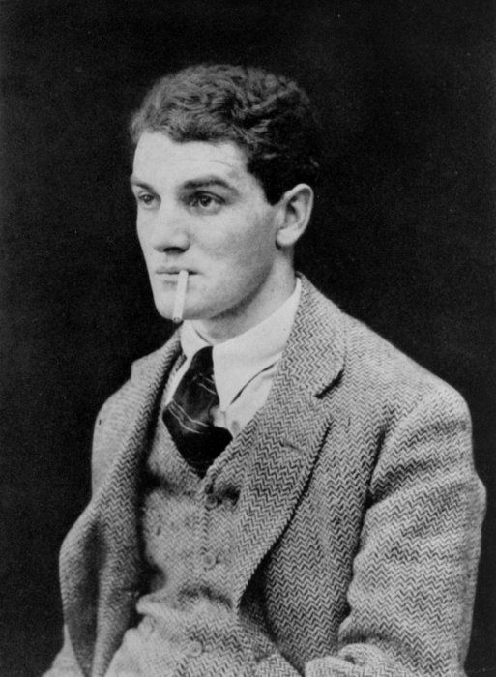
In 1911 she met John Middleton Murry, the critic and editor of Rhythm, and eventually married him in 1918 after divorcing her former husband.

Slide 6
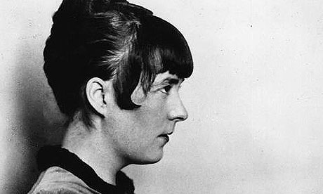
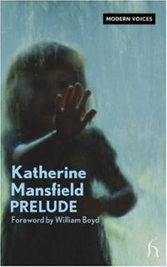
The death of Mansfield’s beloved younger brother in World War | in 1915, struck heavily on her and made her divert to her childhood as a renewed source of inspiration.

Slide 7
