Slide 1

New Year and Christmas

Slide 2
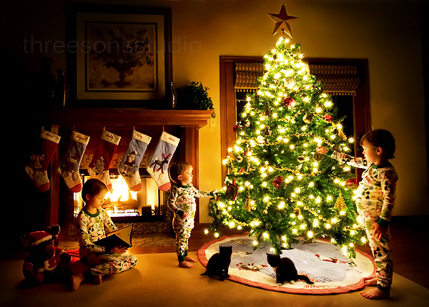
Decorating New Year’s tree

Slide 3
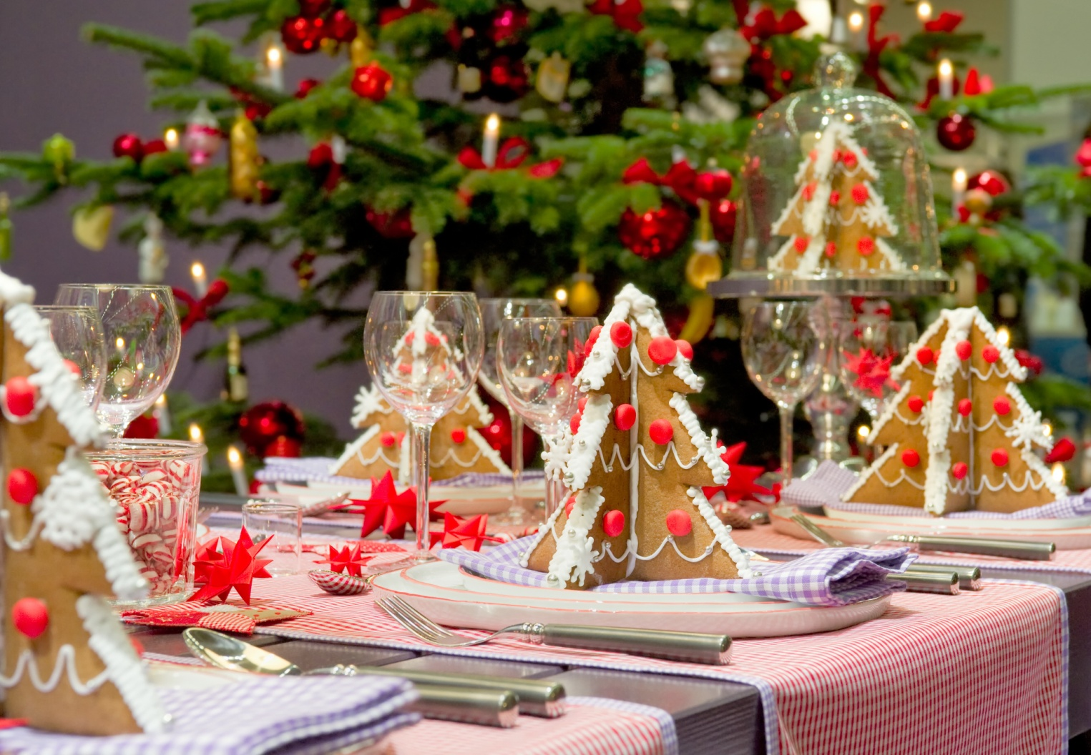
The New Year’s dinner

Slide 4
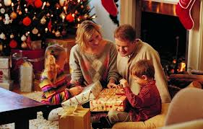
Exchange presents

Slide 5
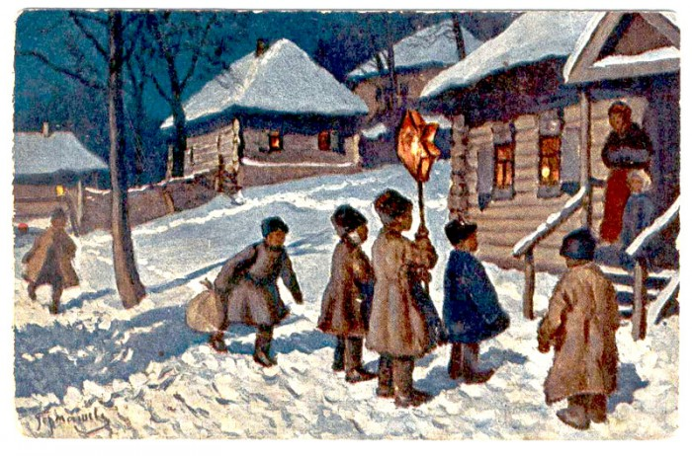
Kolyadka

Slide 6
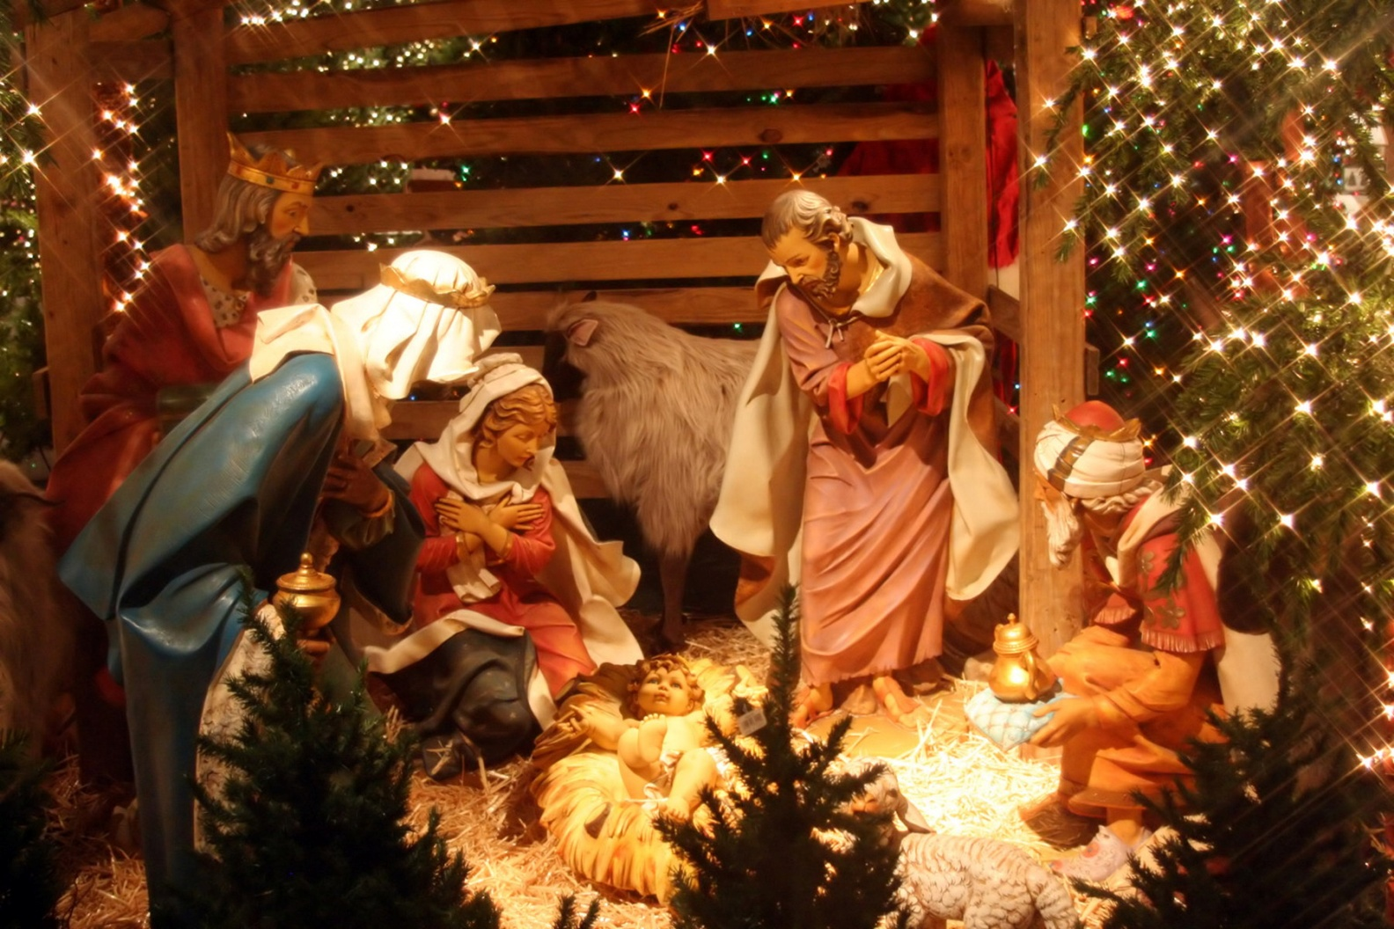
Christmas

Slide 7
Thank you for your attention

