Slide 1
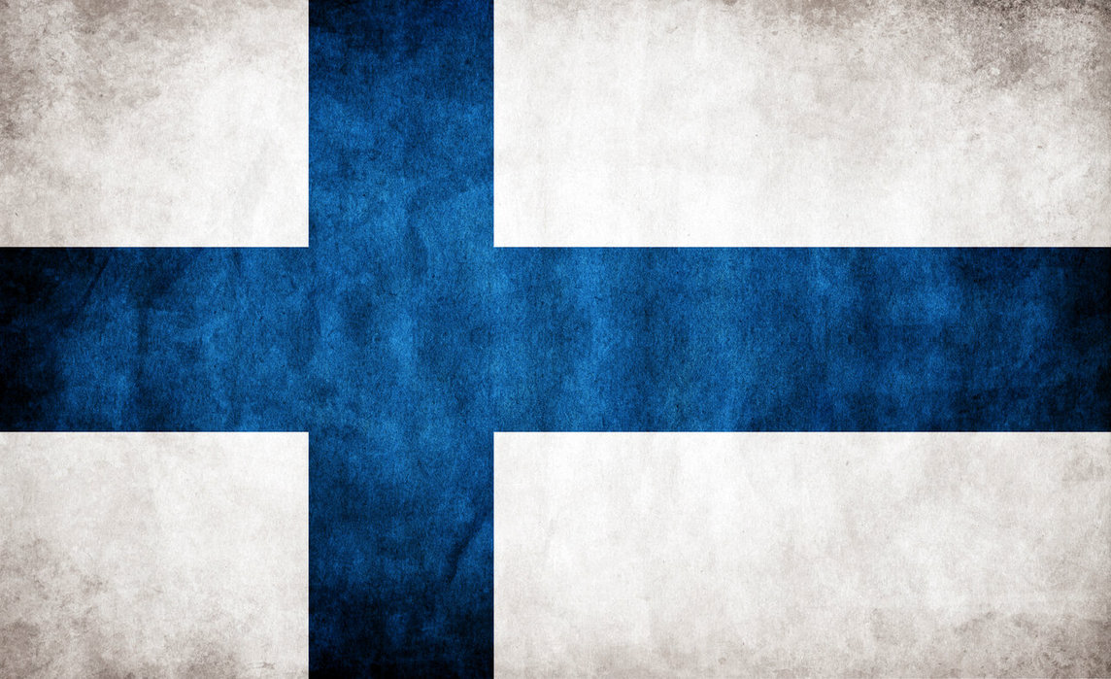
Interesting facts about Finland

Slide 2
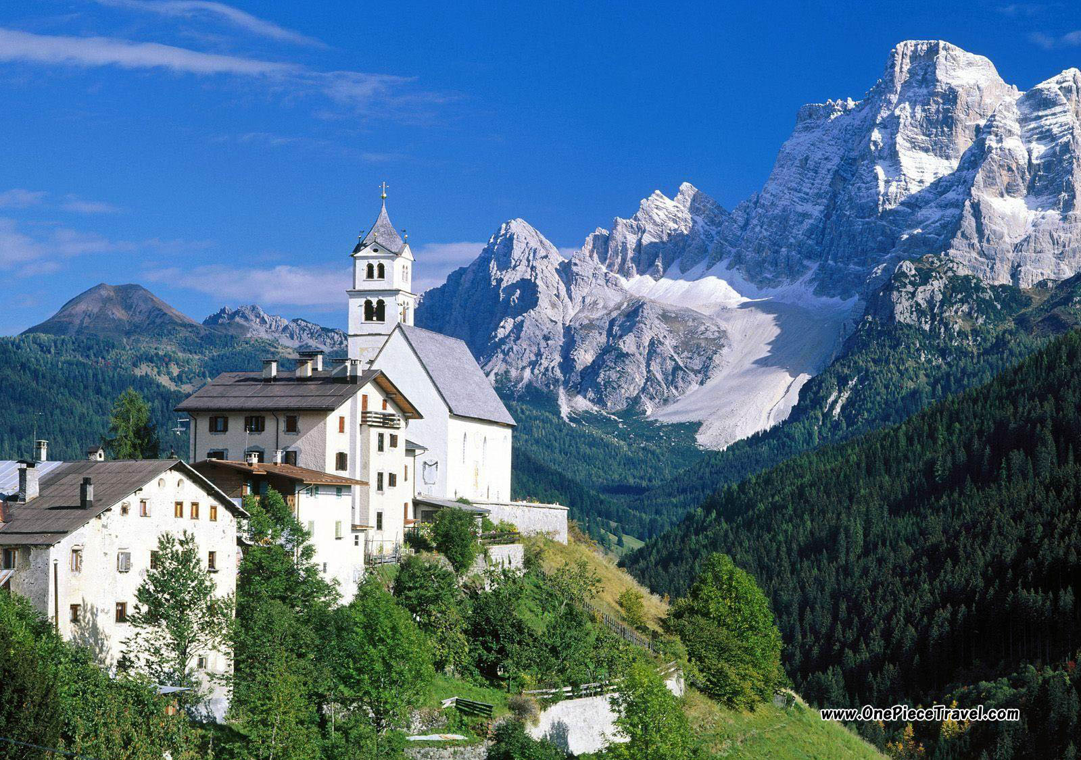
Land & Nature

Slide 3
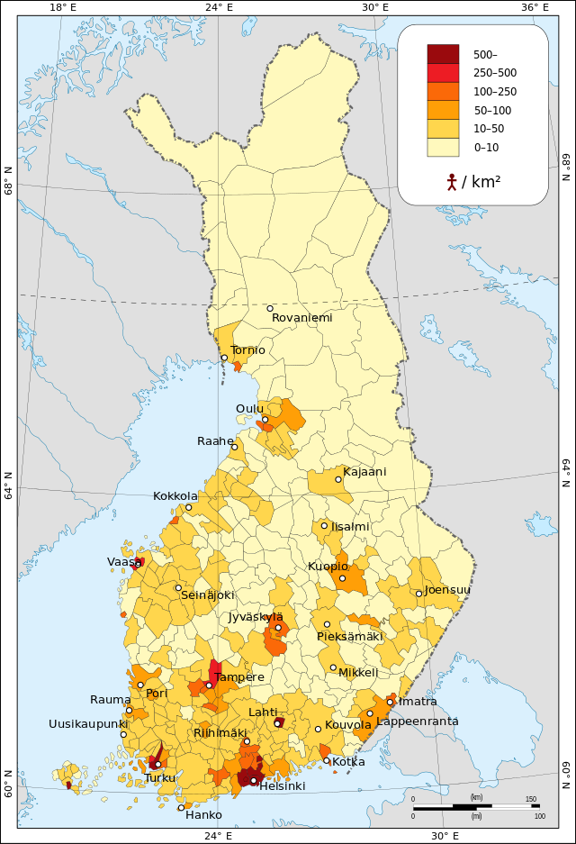
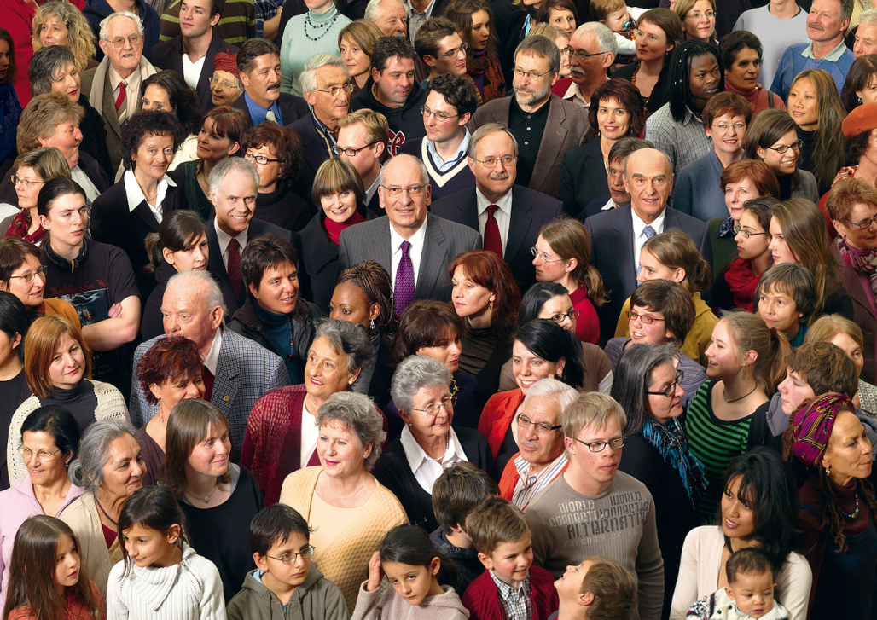
Finland is the most sparsely populated country in the European Union, with only 16 inhabitants per km².

Slide 4
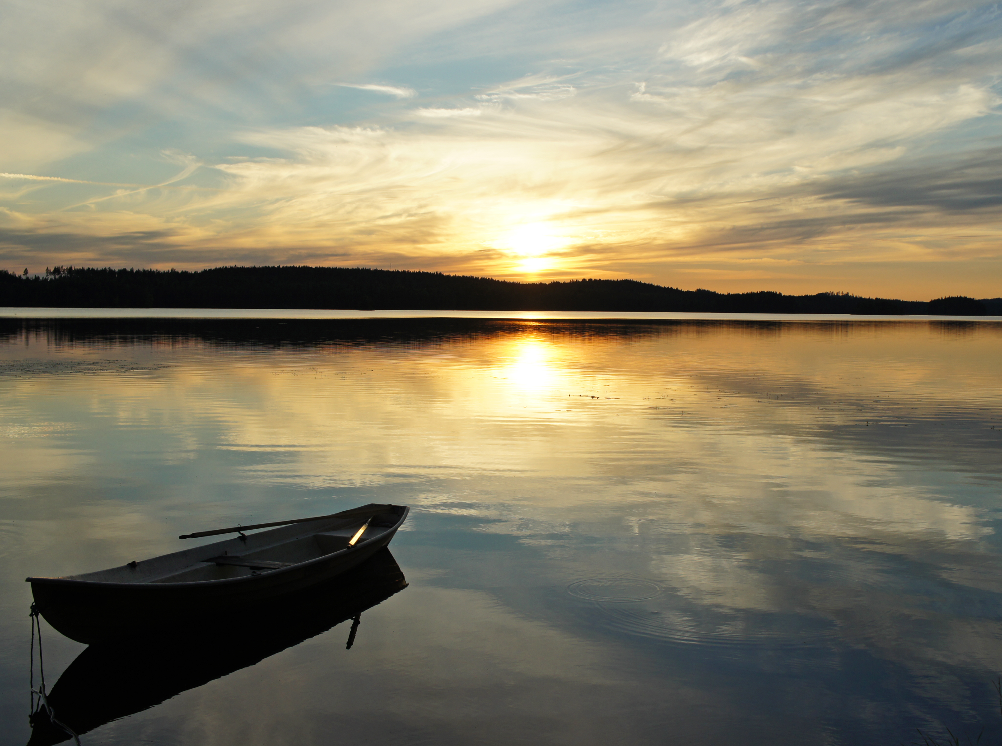
There are exactly 187,888 lakes (larger than 500 m²) and 179,584 islands within the territory of Finland. Both are world records.

Slide 5
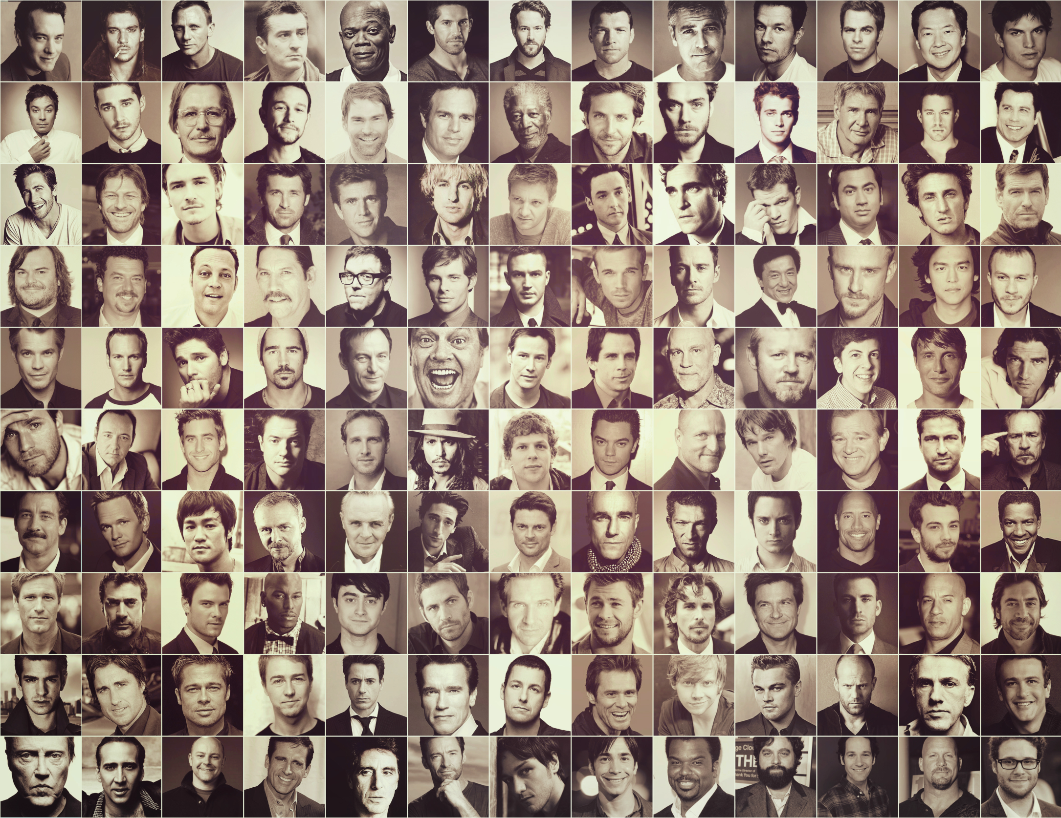
History & People

Slide 6
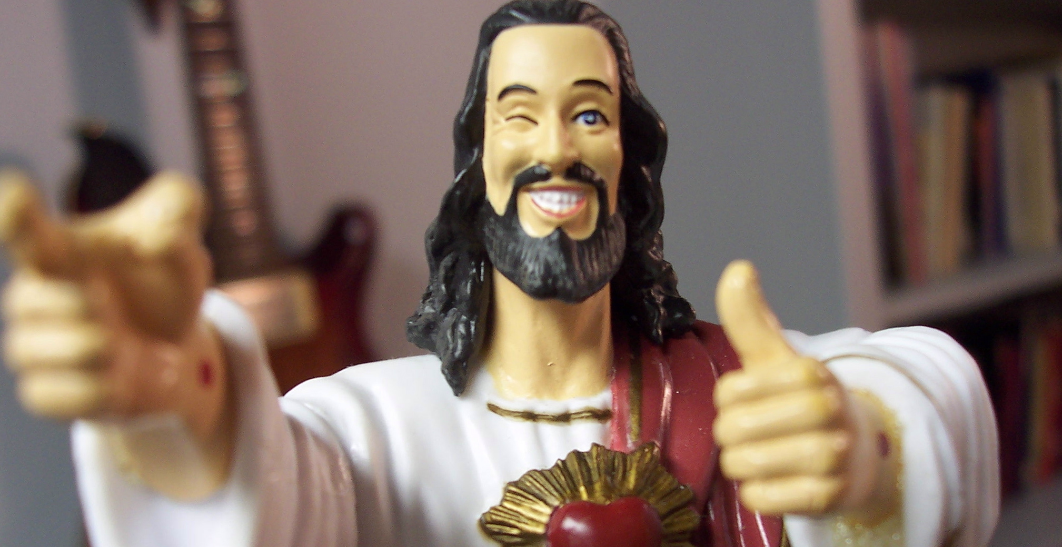

Finland was one of the last region of Europe to be Christianised, in the 12th century.
Finland was one of the last region of Europe to be Christianised, in the 12th century.

Slide 7
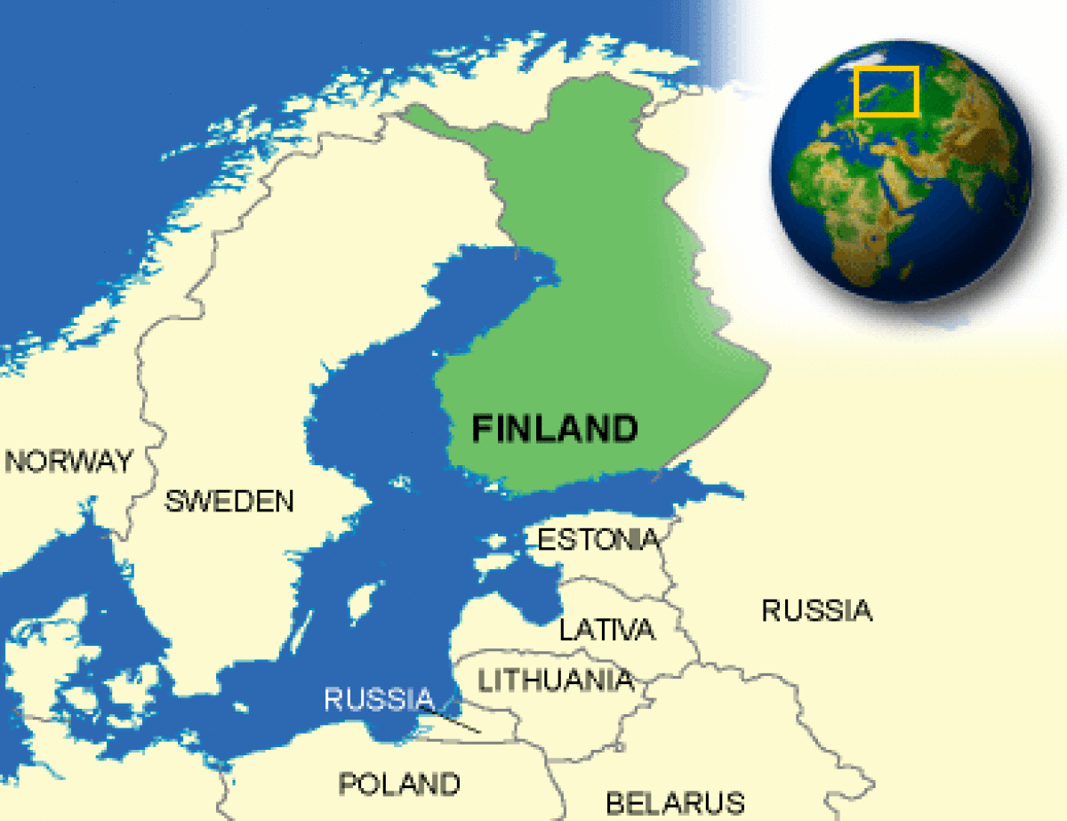
Finland has only been an independent country since 1918. Before that it belonged to Russia or Sweden.

Slide 8
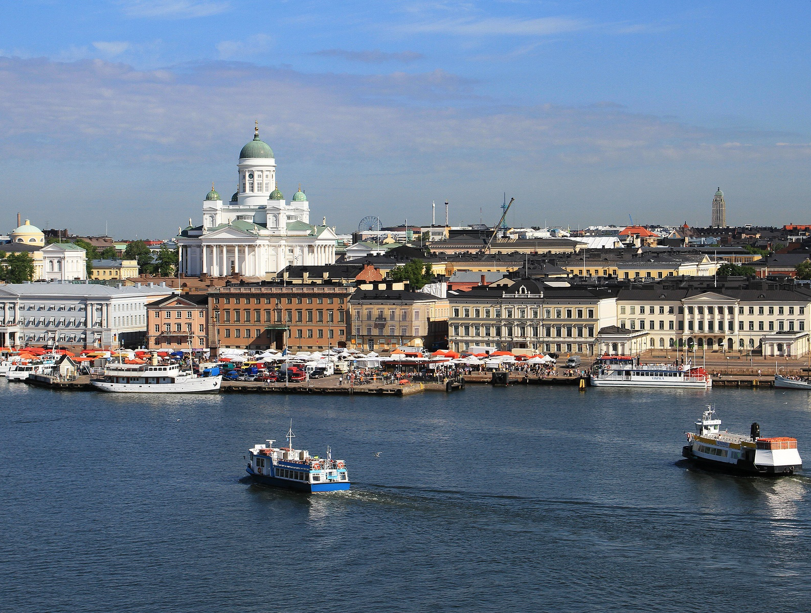
Society & Culture

Slide 9

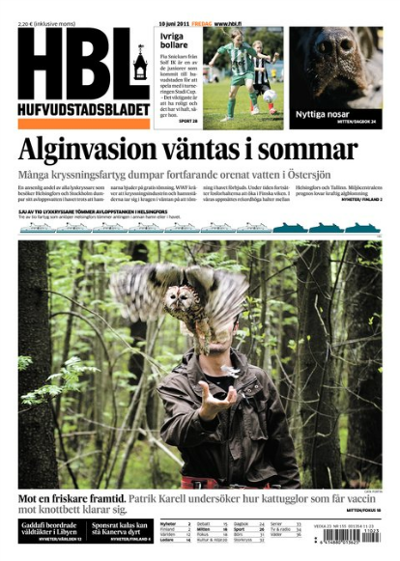


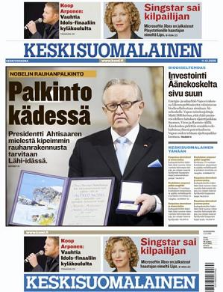


Finland has been at the top of the worldwide Press Freedom Ranking list every year since the publication of the first index by Reporters Without Borders in 2002.

Slide 10
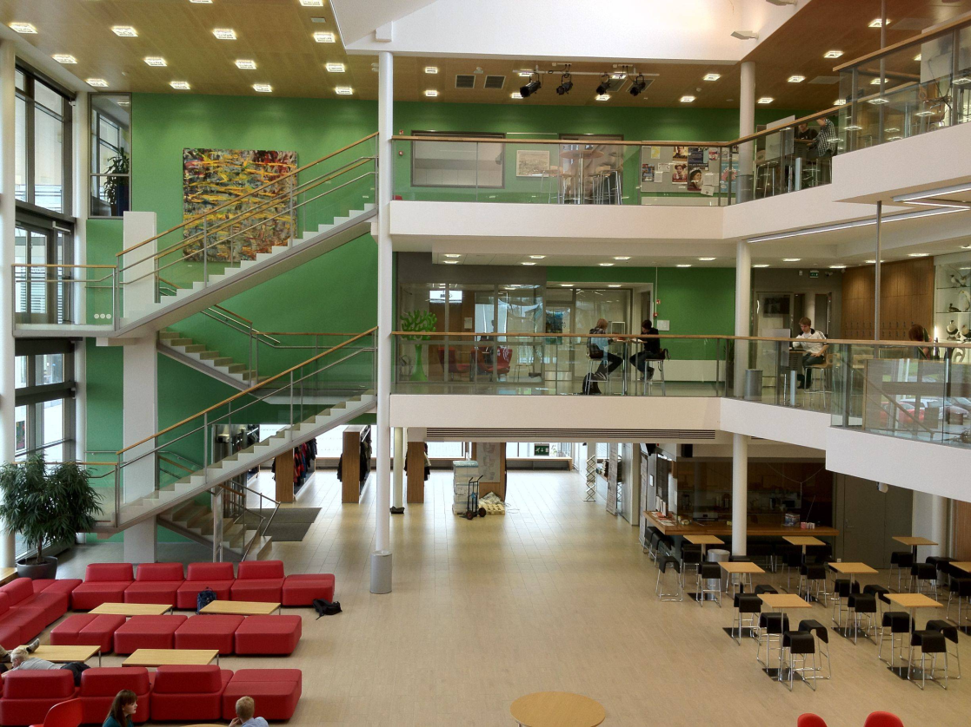
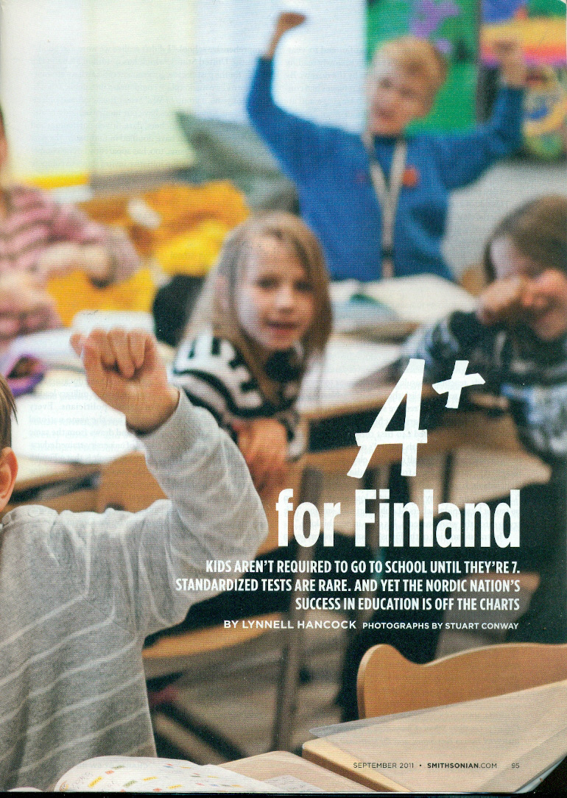
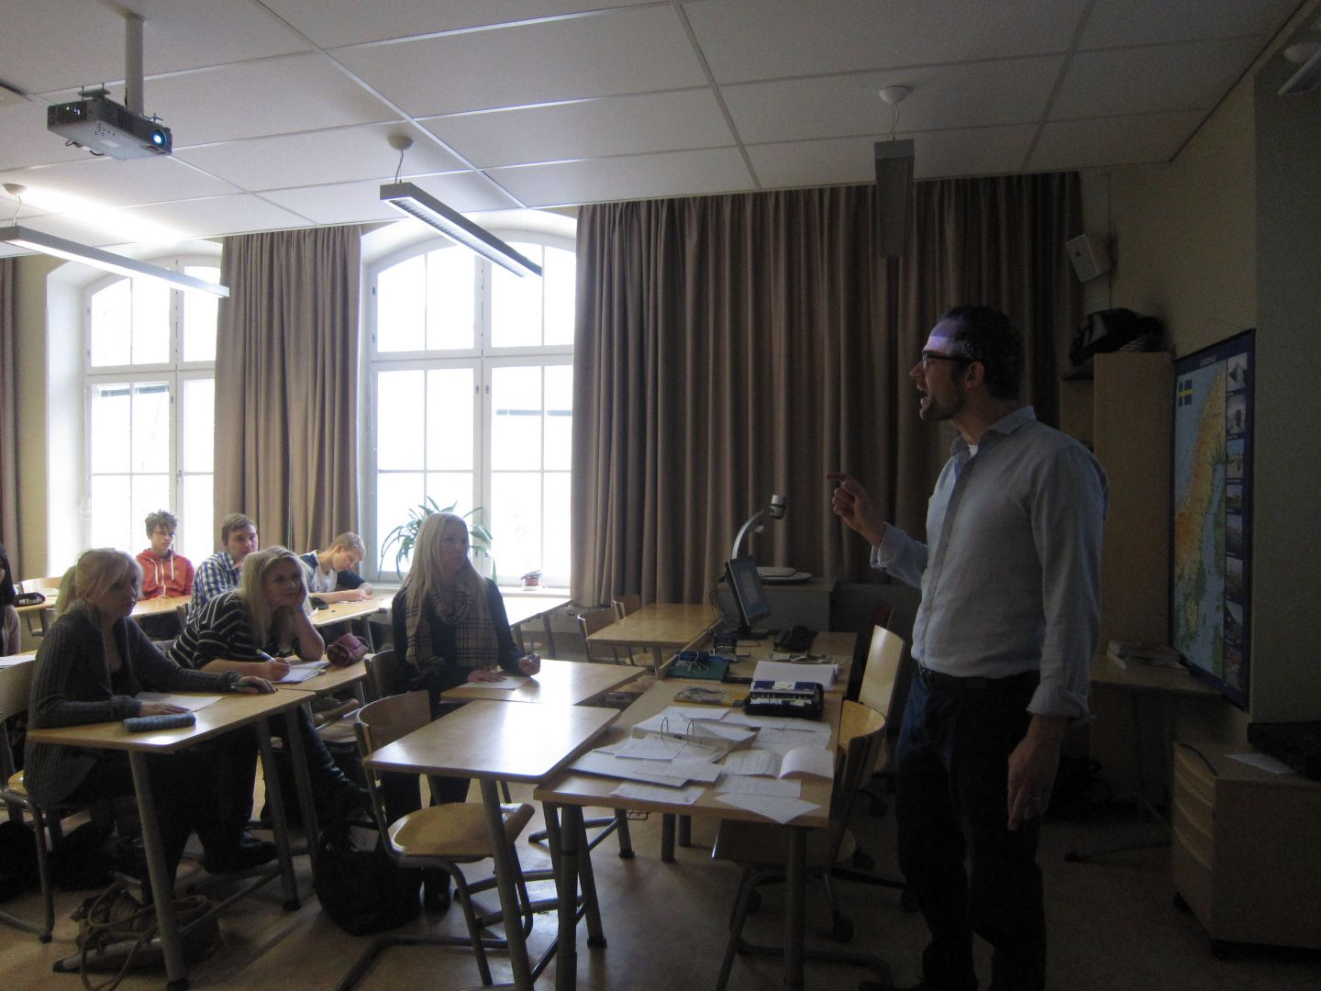
According to the 2007 UNICEF report on child well-being, Finland has the highest level of academic achievements of all surveyed countries for reading, mathematics and sciences. However, it has the lowest percentage of children 'liking school a lot' (only 8%).
According to the 2007 UNICEF report on child well-being in rich countries, Finland has the highest level of academic achievements of all surveyed countries for reading, mathematics and sciences. However, it also has the lowest percentage of children 'liking school a lot' (only 8%).
Learning for life

Slide 11
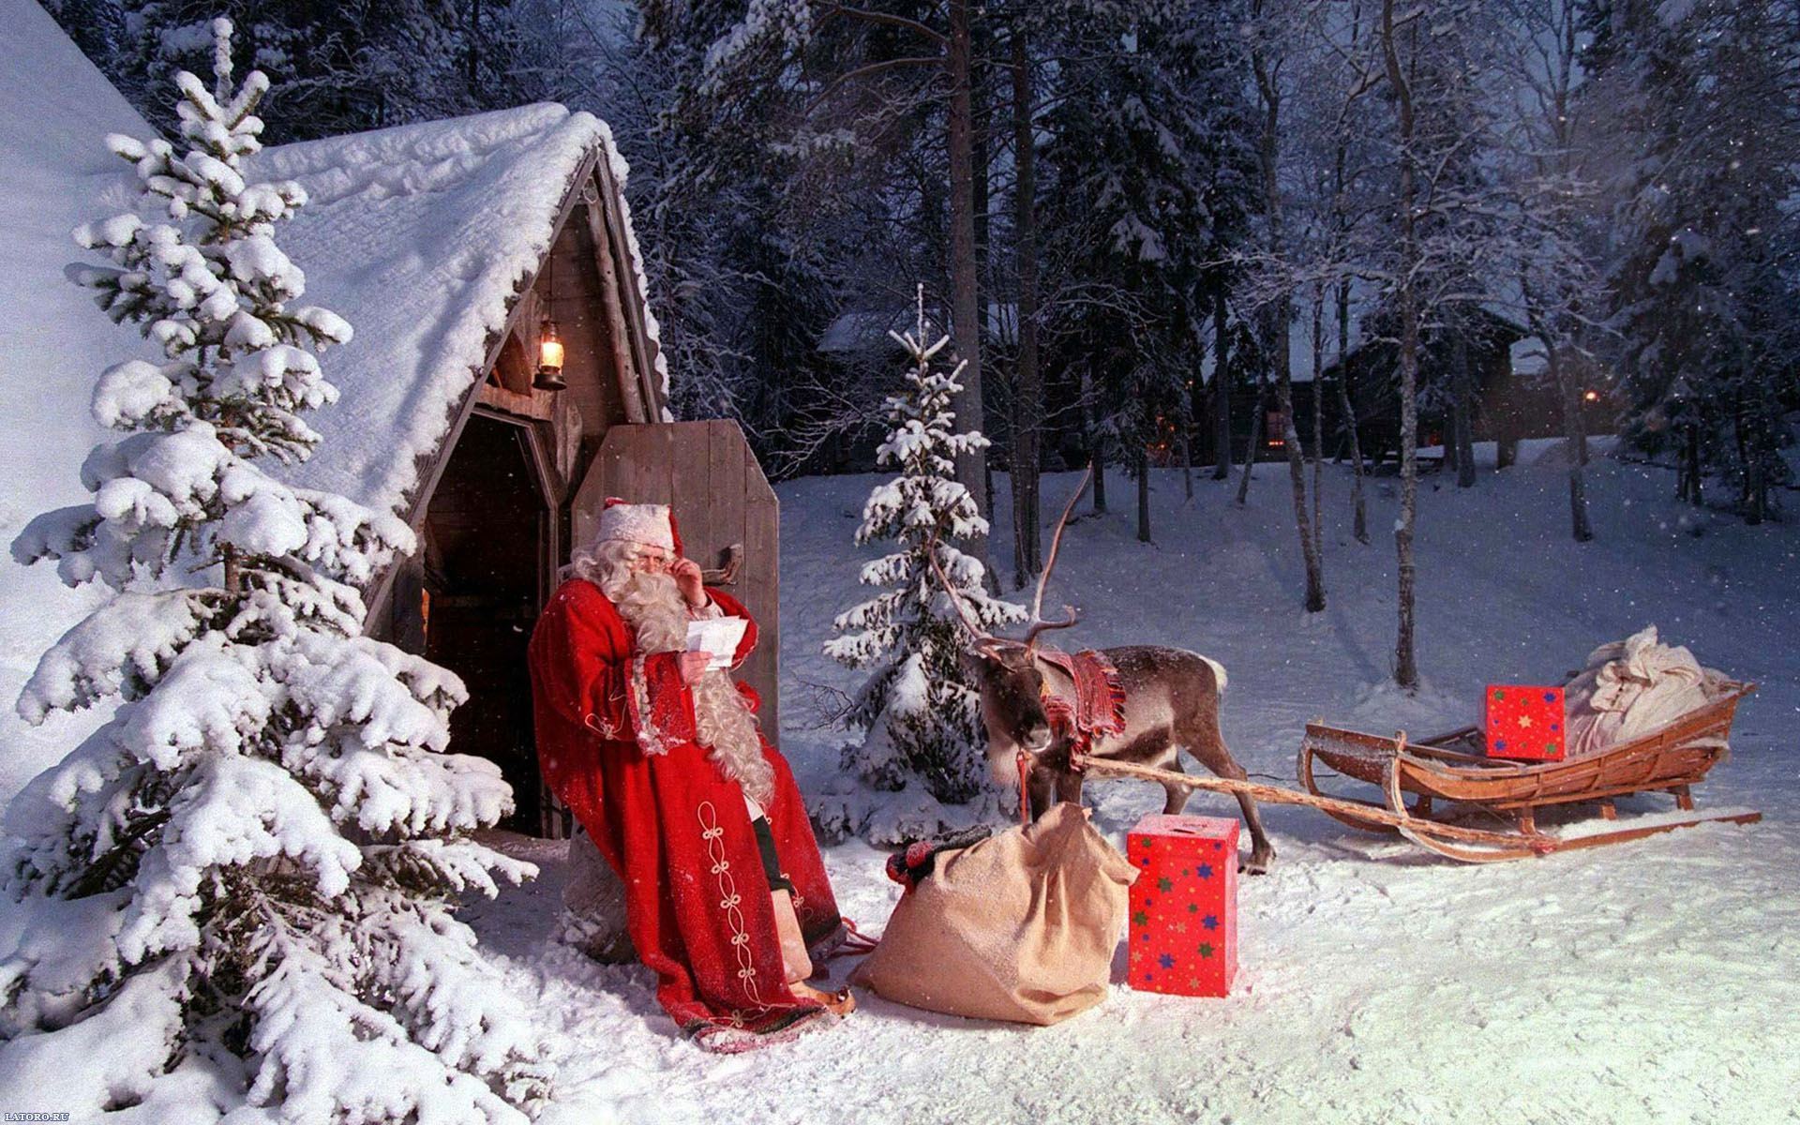
Santa Claus (known in Finland as Joulupukki or "Yule Goat") officially resides in a house built right on top of the Arctic circle, near the town of Rovaniemi, in the northern province of Lappland. The Santa Claus Post Office (address: Santa Claus Village, FIN-96930 Arctic Circle) receives some 700,000 letters every year from children from 198 countries .

Slide 12
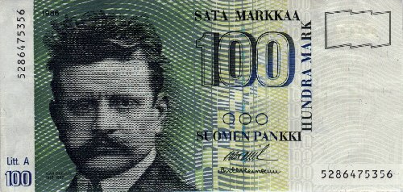

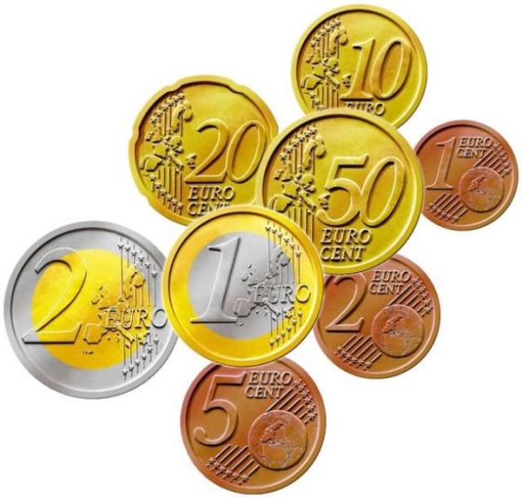
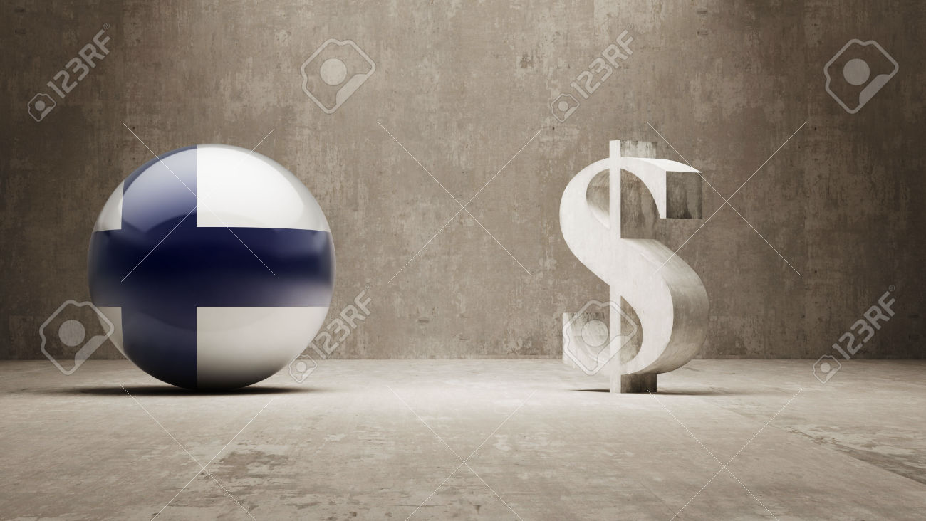
Economy & Politics

Slide 13
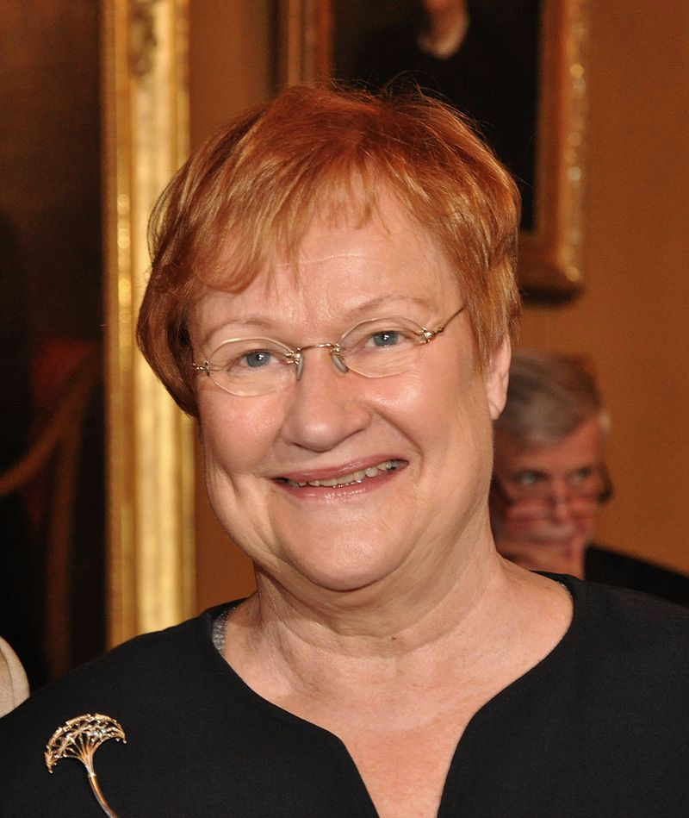
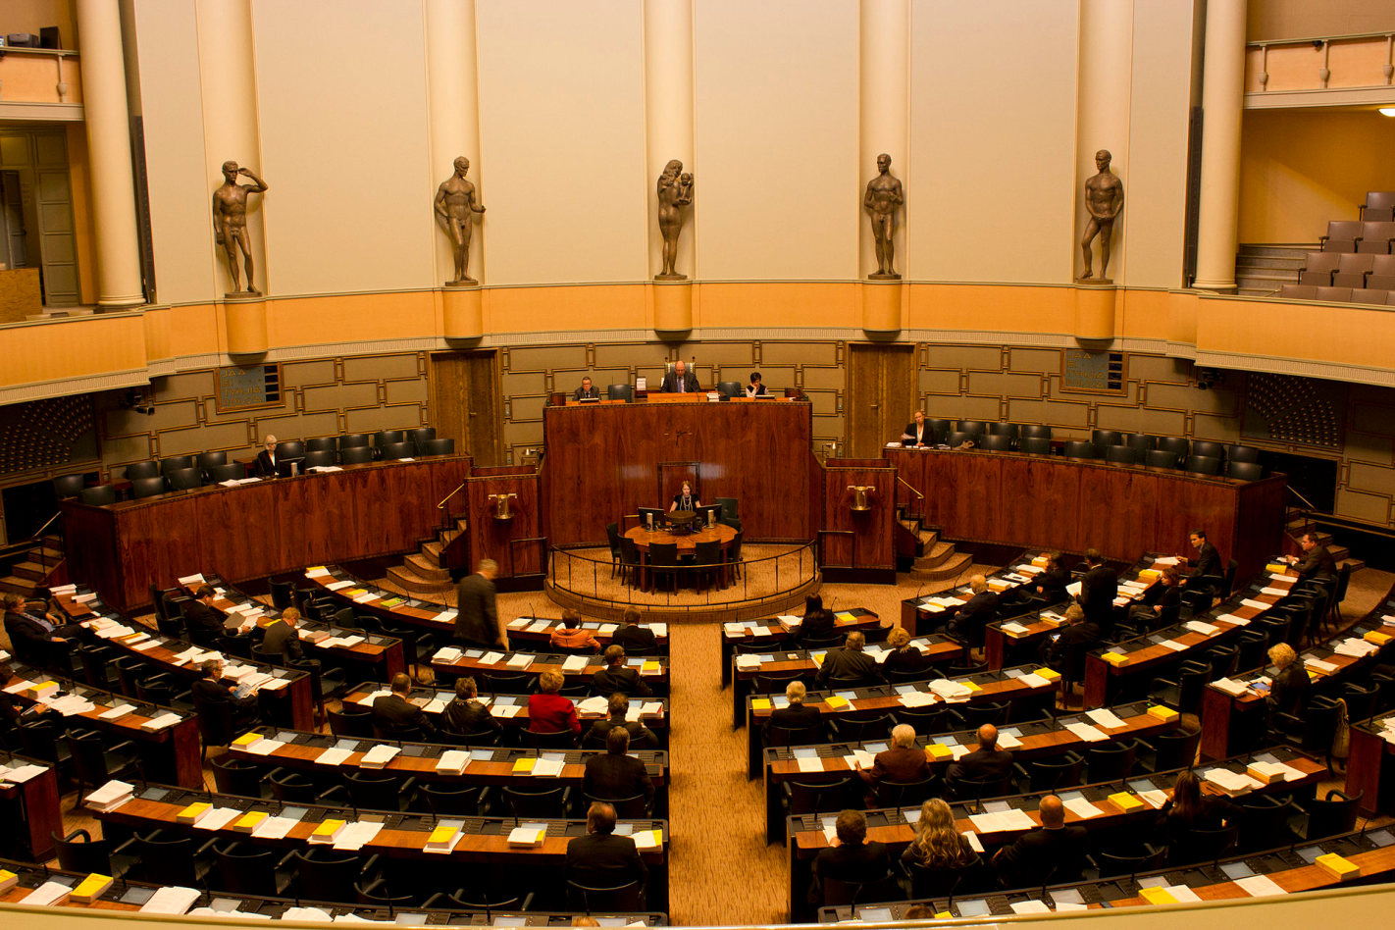
Previous president of Finland, Tarja Halonen, is a woman, as are 12 of the 20 government ministers.

Slide 14
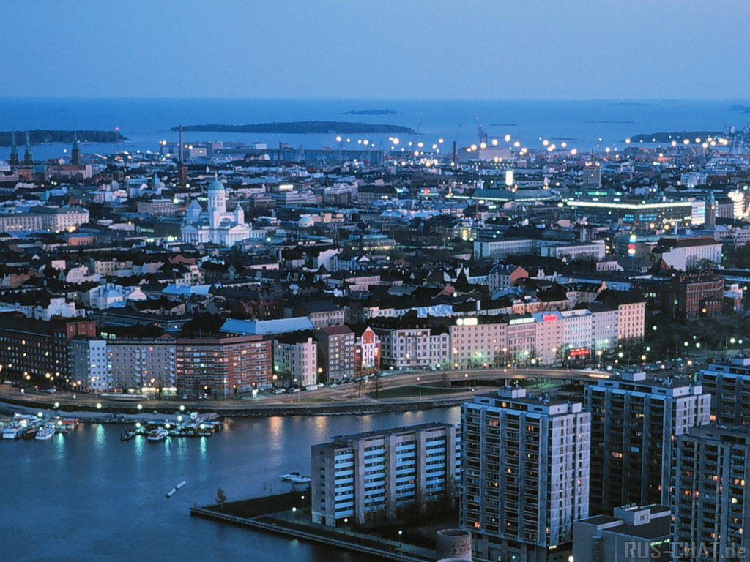
According to the World Audit study, Finland is the least corrupt and most democratic country in the world as of 2012.

Slide 15
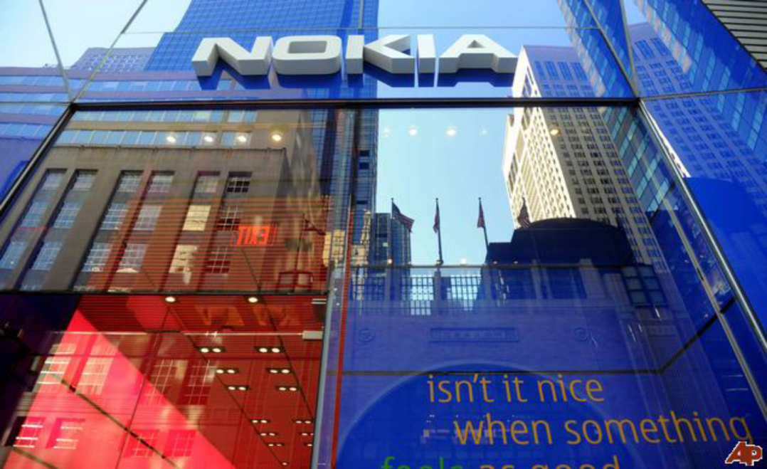
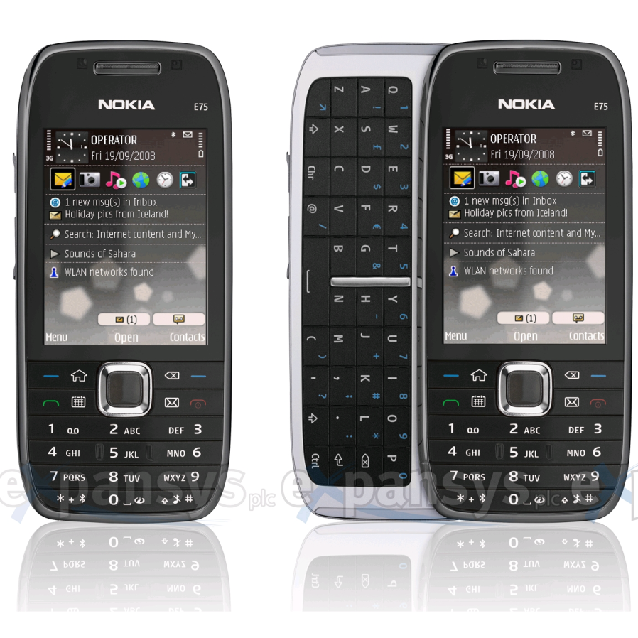
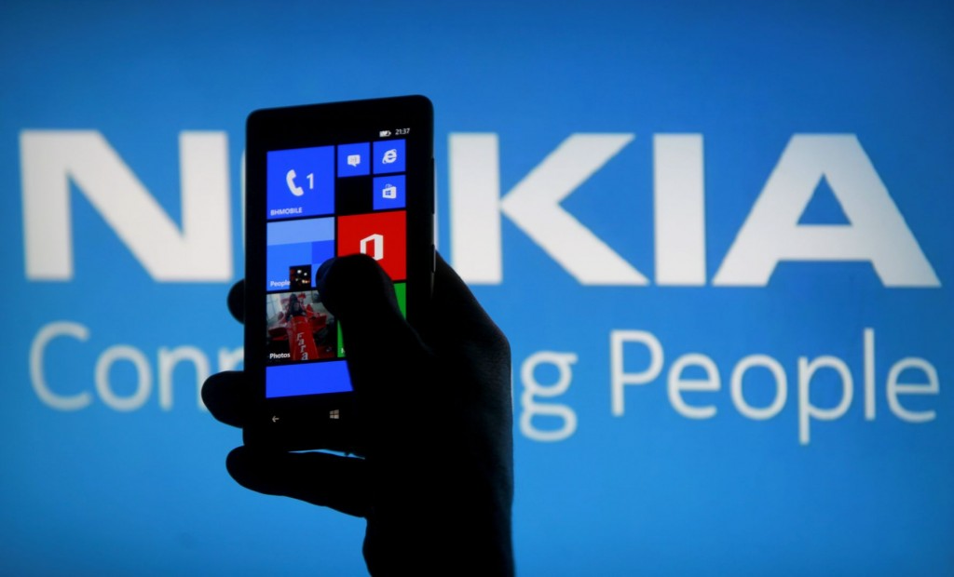
Nokia Corporation (a Finnish company) was the world's largest manufacturer of mobile telephones from 1998 to 2012, with a global market share of over 35% between 2006 and 2009.

Slide 16


