Slide 1
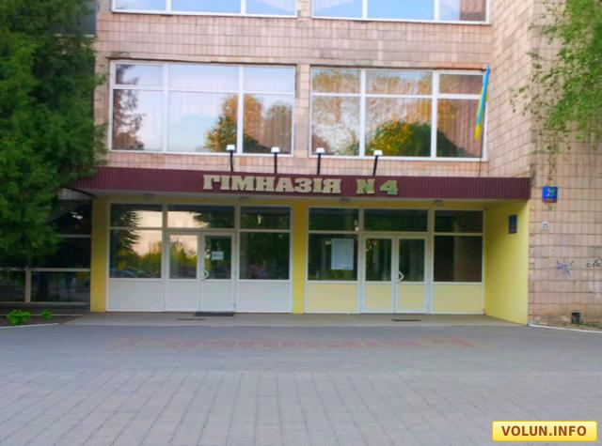
School of my dream
My name is Vlad. Im 14 years old. Im a pupil of a state secondary school. At the moment Im studying in the 5th form Gymnasiums 4 after Modest Levyzkyi.

Slide 2
I'd like to tell you some information about school of my dream. I love my school in general,but there are much,that I don*t like.

Slide 3
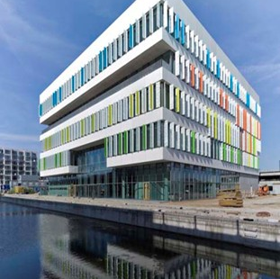
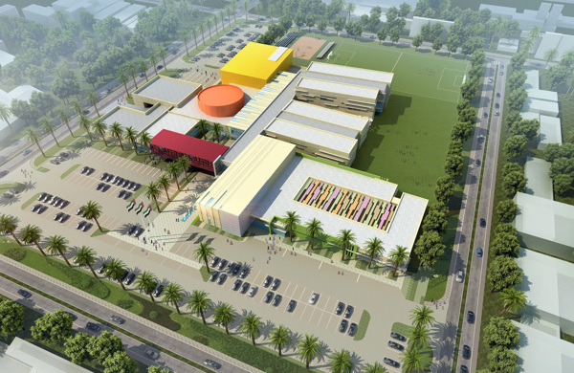
design
I*d demolish my school and build new, better, bigger,more beautiful and more modern school.

Slide 4
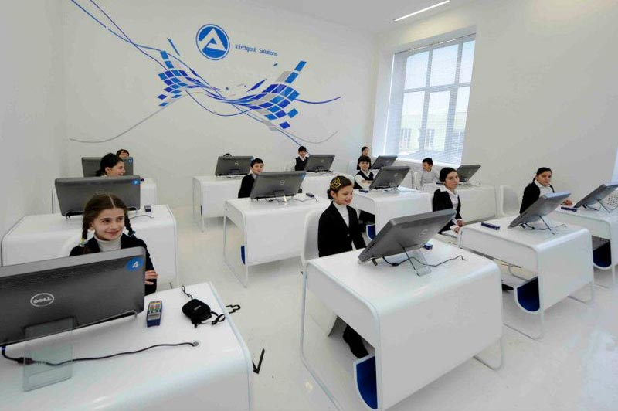
I*d made repair in every classrooms and buy new modern equipment.

Slide 5
I*d made:

Slide 6

Big football pitch

Slide 7
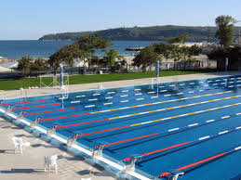
Deep swimming pool

Slide 8
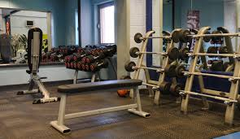
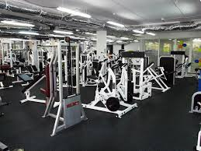
And gym

Slide 9
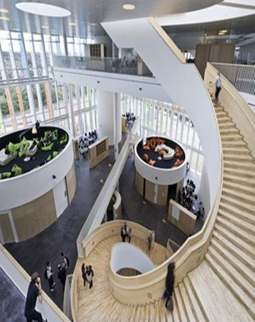
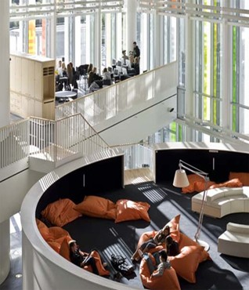
i*d made big light corridors with comfortable soft furniture.

Slide 10
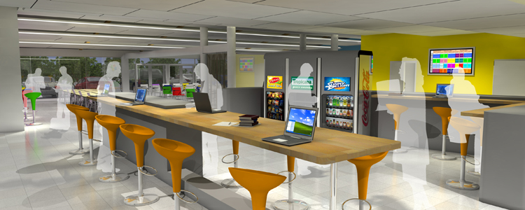
i*d made big dinning room with tasty food.

Slide 11

i*d cancel homework.

Slide 12

i*cancel school uniform.

Slide 13

Thank you for your attention!

