Slide 1
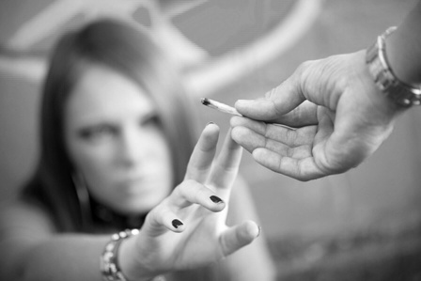

DRUGS
Harmful Effects of Drug Use

Slide 2
PLAN
About drugs
Harmful effects of drugs

Slide 3

About drugs
Drugs have been part of our culture since the middle of the last century. Popularized in the 1960s by music and mass media, they invade all aspects of society.
An estimated 208 million people internationally consume illegal drugs. In the United States, results from the 2007 National Survey on Drug Use and Health showed that 19.9 million Americans (or 8% of the population aged 12 or older) used illegal drugs in the month prior to the survey.

Slide 4
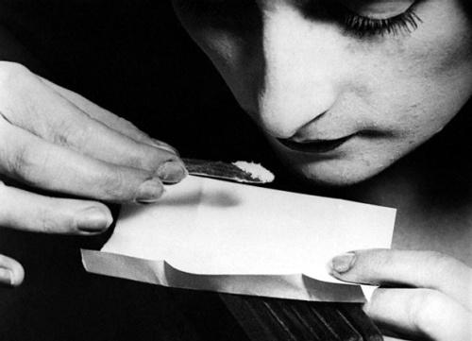
When people talk about a "drug problem," they usually mean abusing legal drugs or using illegal drugs, such as marijuana, ecstasy, cocaine, LSD, crystal meth, and heroin. (Marijuana is generally an illegal drug, but some states allow doctors to recommend it to adults for certain illnesses.)

Slide 5
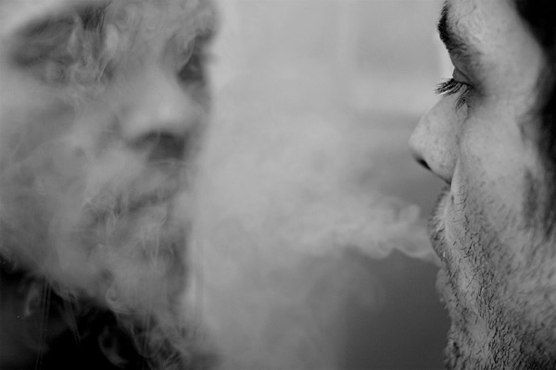
The World Health Organization describes substance abuse as, "The harmful or hazardous use of psychoactive substances, including alcohol and illicit drugs." Often people begin experimenting with drugs; however this can lead to addiction.
Unfortunately, most people don't realize they are addicted until it is too late. Once addicted, the drug user will continue to use drugs even though it can cause great harm.
Drug addiction can be harmful to many elements of one's life. Areas at risk are one's health, social life, financial state and legal/criminal record.

Slide 6
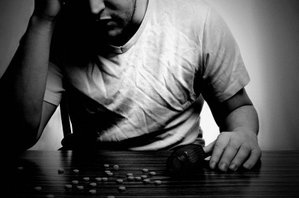
Trouble thinking clearly, paying attention and remembering are consequences of drug use. As a result, students who use drugs may do poorly in school or even drop out. Adults might have trouble with their work performance and maintaining employment. In addition, social relationships regardless of age could suffer.

Slide 7
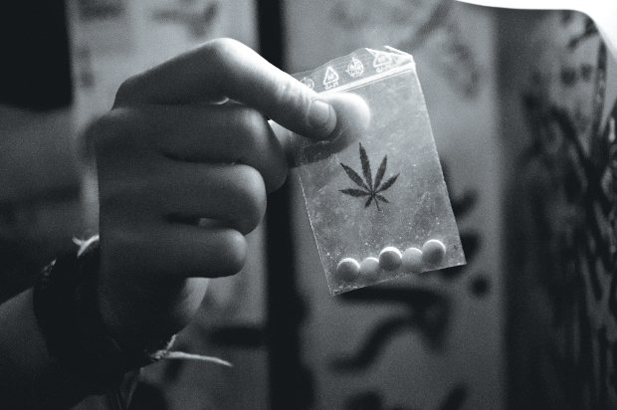
Individuals may act on at risky behaviors while under the influence of drugs which can result in violence and infectious diseases. Drug use can alter the function and structure of the brain. Other medical problems which can result of drugs use are: Mental disorders, cardiovascular disease, stroke, HIV/AIDS, cancer, Hepatitis B, Hepatitis C and lung disease and Death just to name a few.

Slide 8
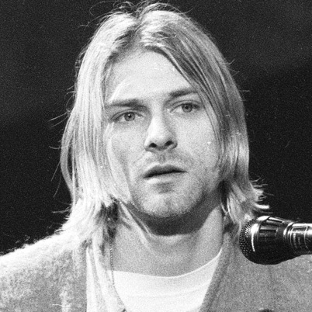
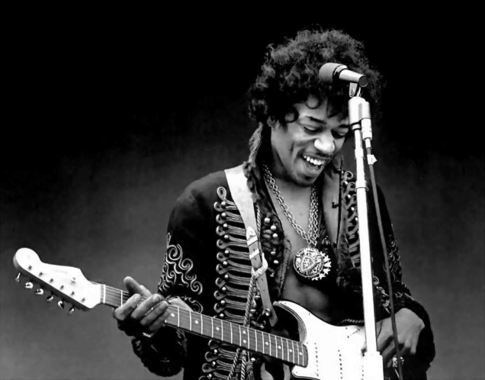
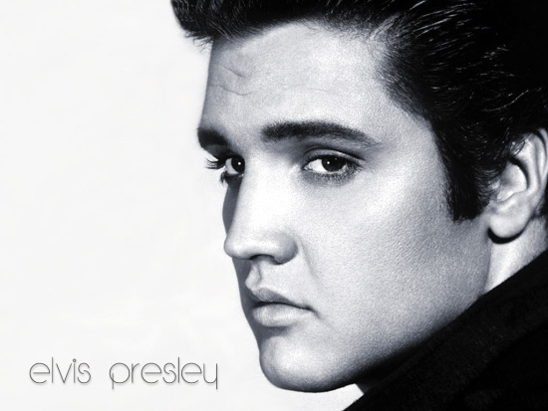
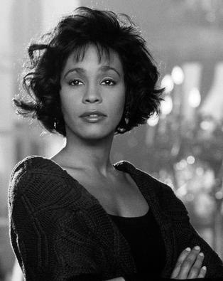
Victims of drugs
Elvis Presley
Jimi Hendrix
Kurt Cobain
Whitney Houston

Slide 9

Making the Right Choice

