Slide 1
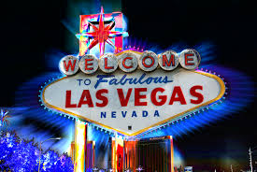
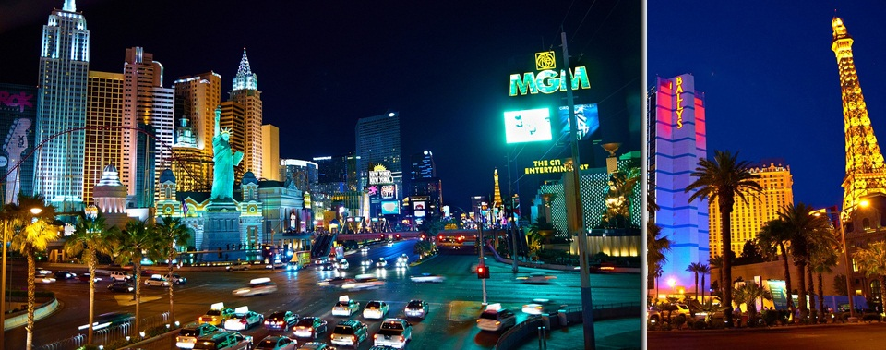
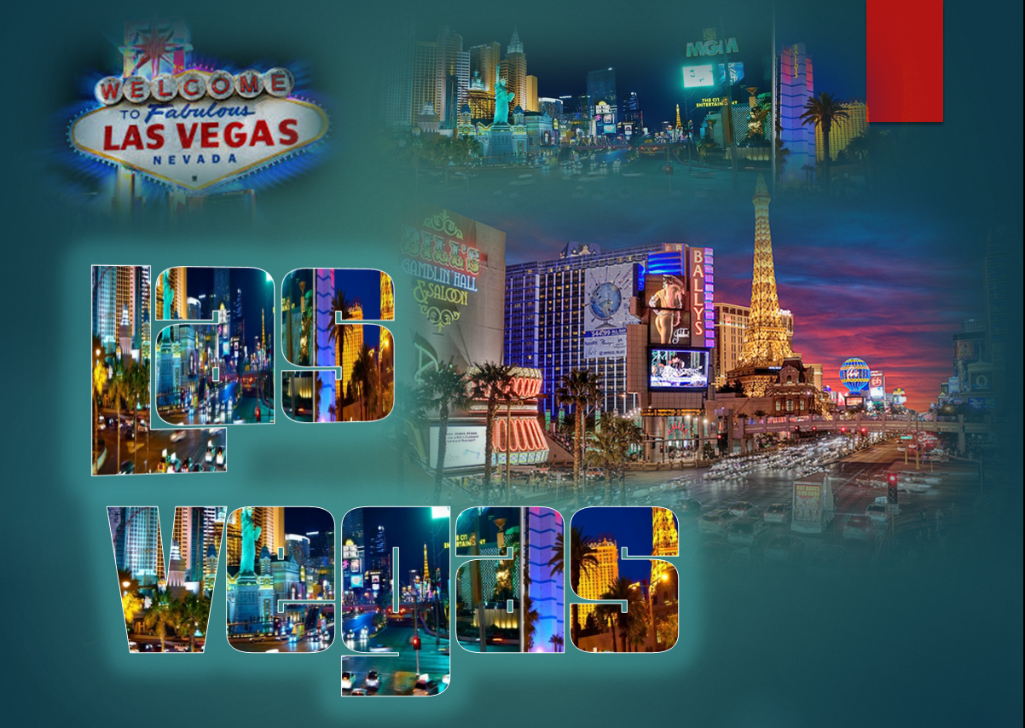
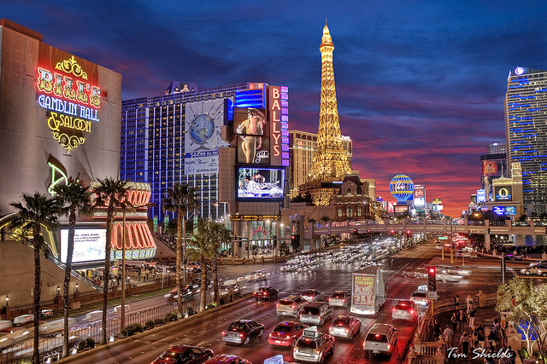
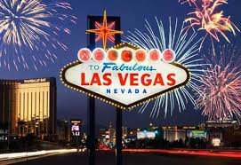
Las
Vegas

Slide 2
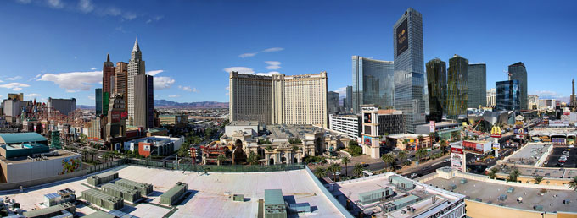
Las Vegas (Nev.) - A city in the south-western part of the United States and the largest city in the state of Nevada (Nevada). Las Vegas is an internationally recognized center for entertainment and recreation, it is an unofficial capital of the world of gambling
The panorama of the city

Slide 3
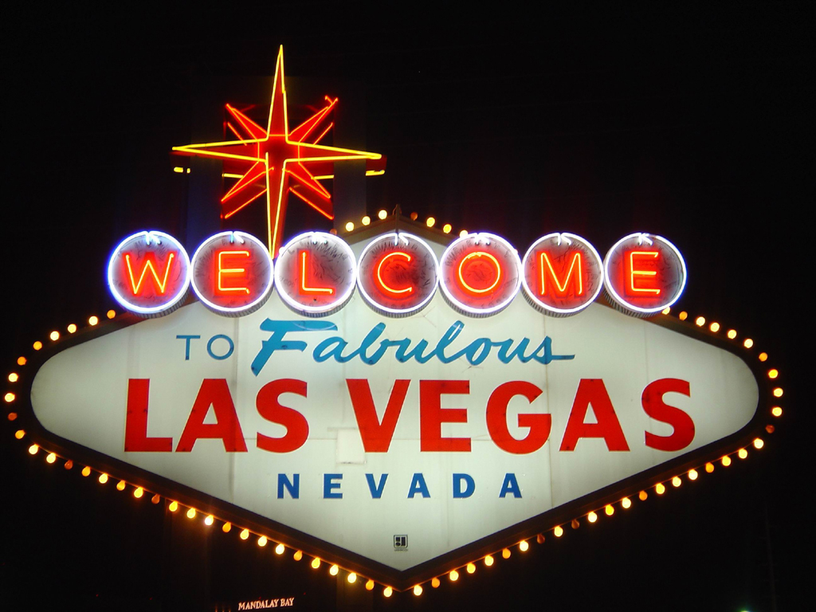
Gambling was offically allowed in May19, 1931

Slide 4
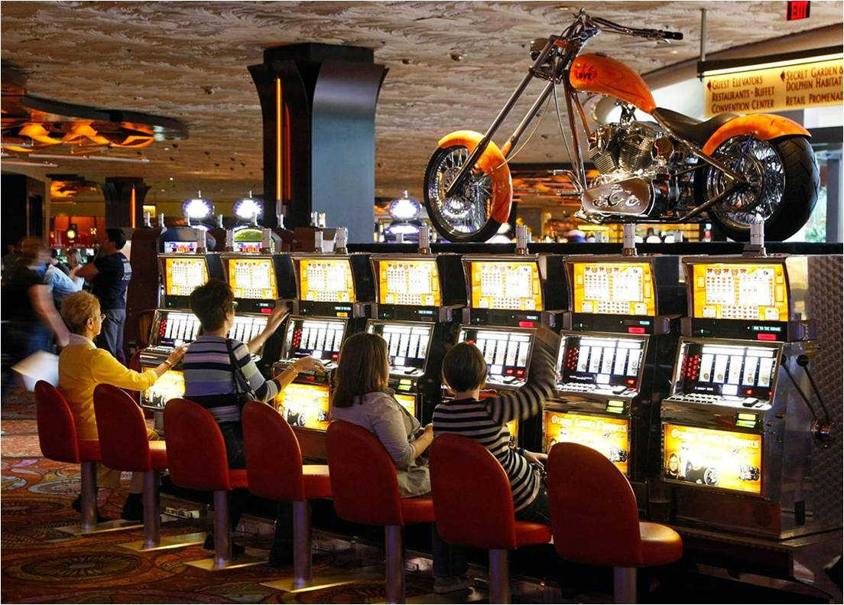
Revenue from hotels (including most of the world's largest), gambling, entertainment, and other tourist-oriented industries forms the backbone of the economy.

Slide 5
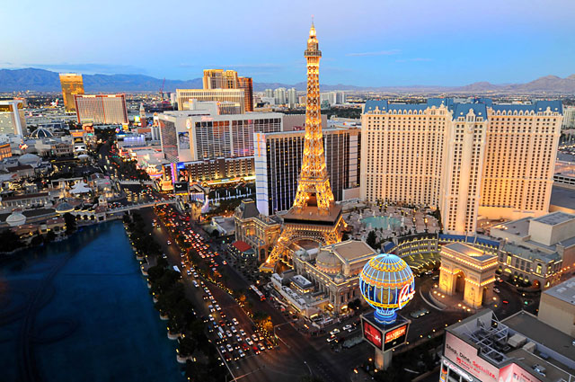
The Strip is a main street in Las Vegas

Slide 6
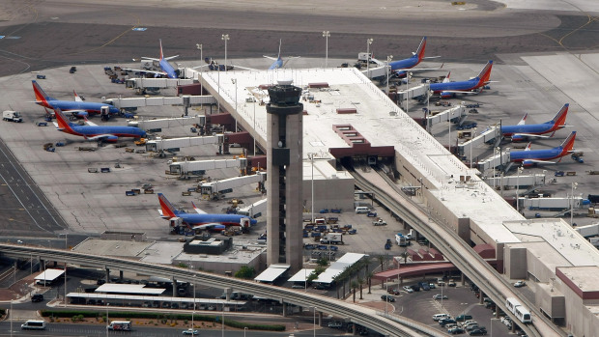
McCarron International Airport

Slide 7
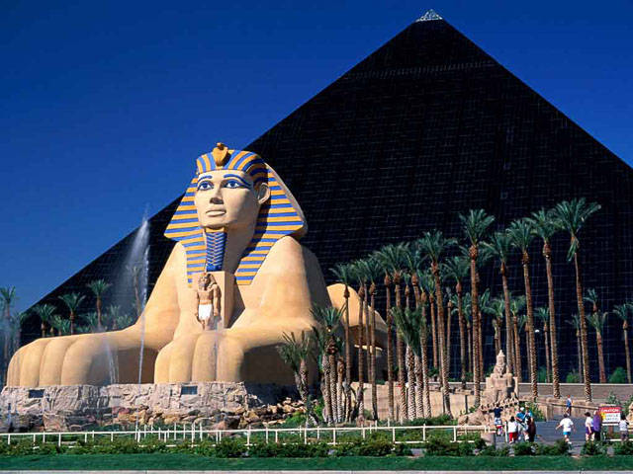
Luxor (Casino and Hotel)

Slide 8
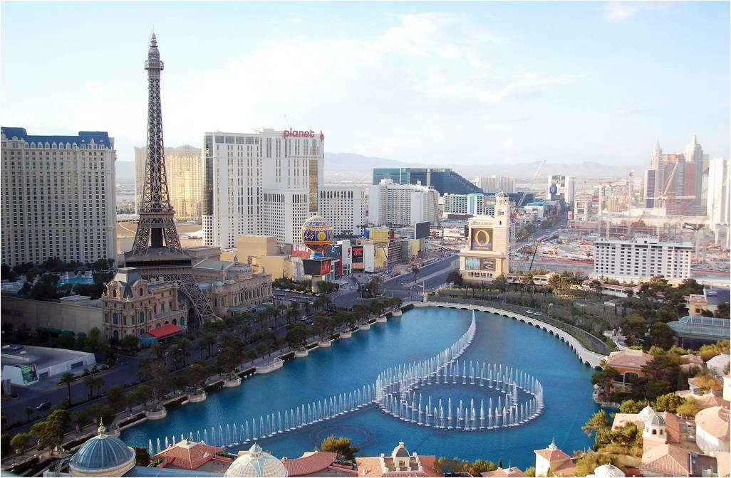
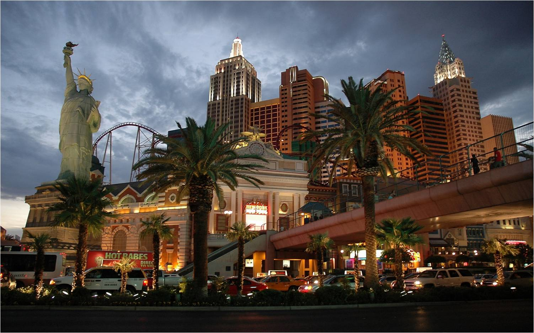
Real silhouettes of the Statue of Liberty, the Eiffel Tower

Slide 9
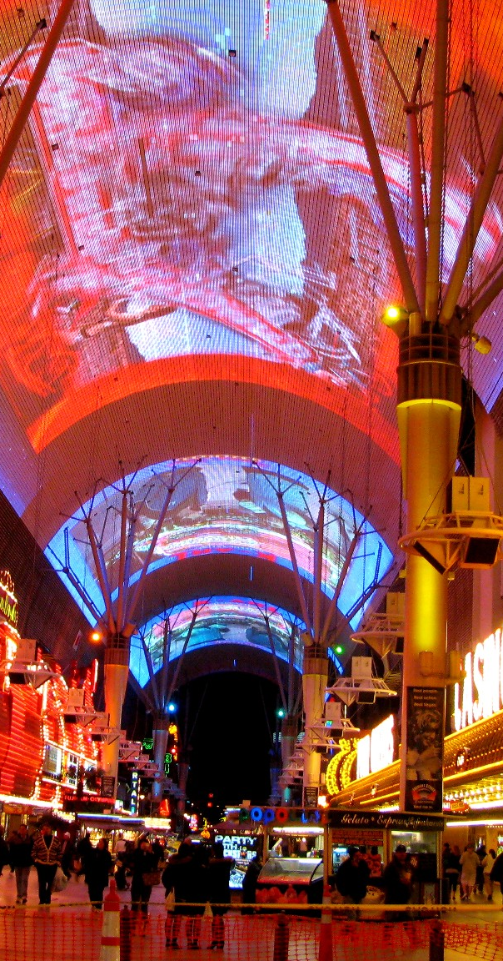
Fremont Street Experience
Most of the major casinos are concentrated in the center of the pedestrian zone - Fremont Street Experience

Slide 10
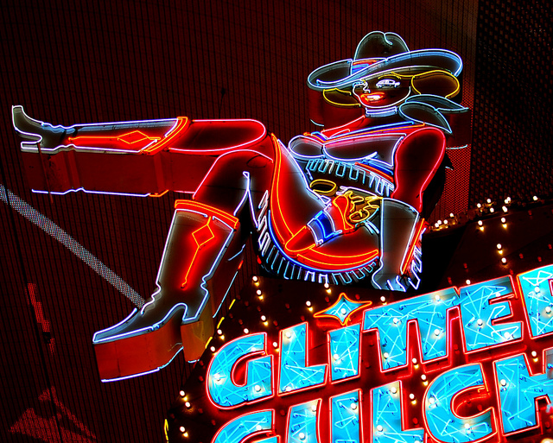
Glitter Gulch
Glitter Gulch is a world famous area of night clubs

Slide 11
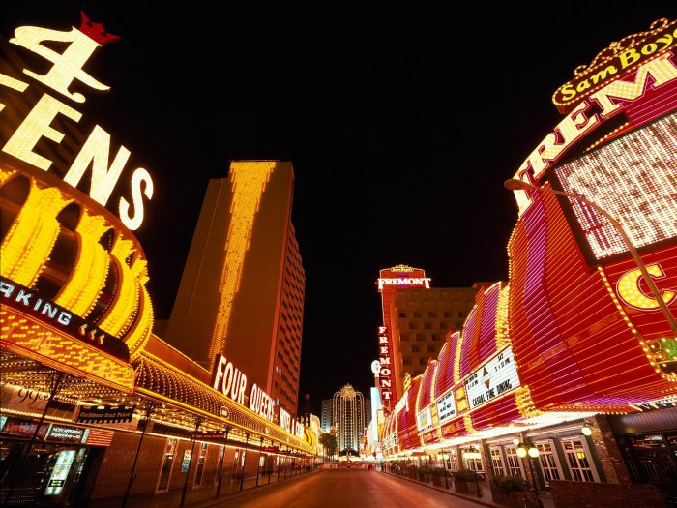
Fremont Street
Fremont Street is a heart of Las Vegas. Everything here has its initial experience

Slide 12
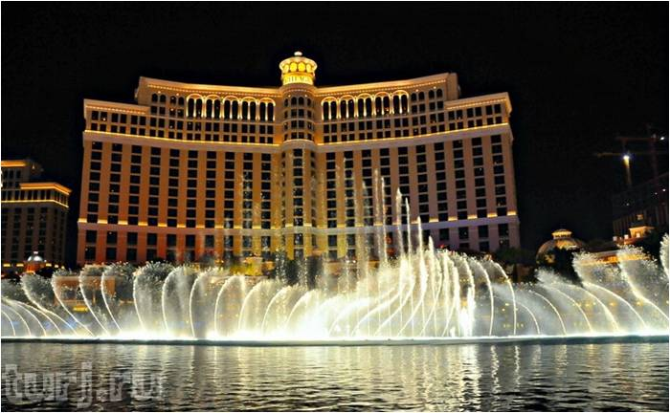
Hotel Bellagio
Dancing Fountains Bellagio are estimated at $ 40 million

Slide 13
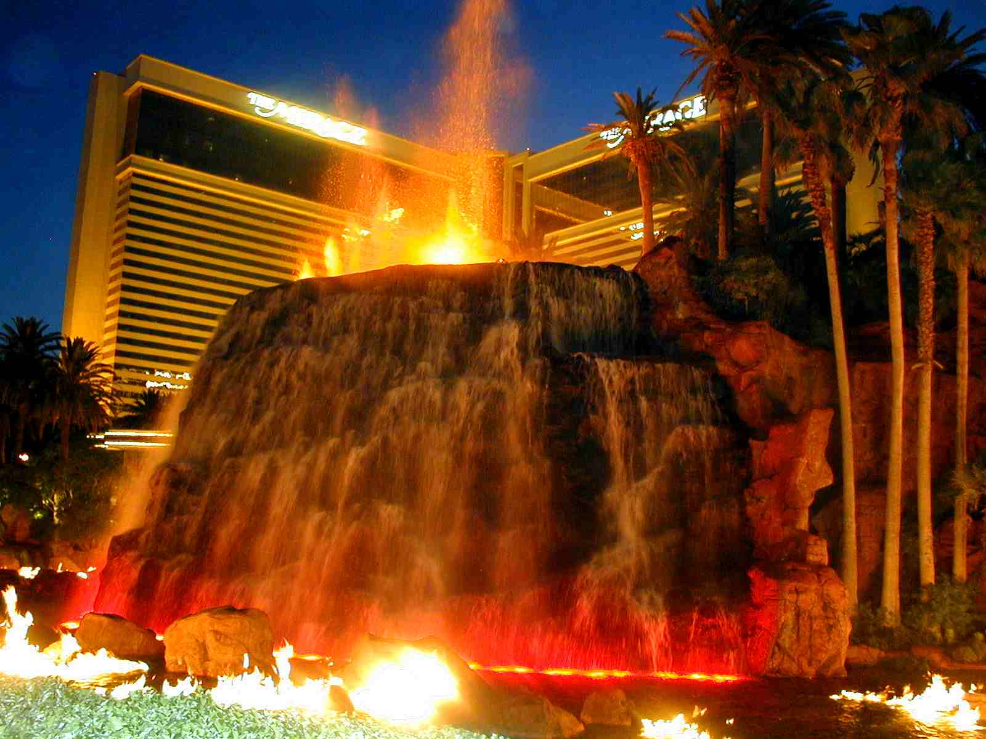
Volcano
Volcano erupts fire and lava flows every 15 minutes

Slide 14
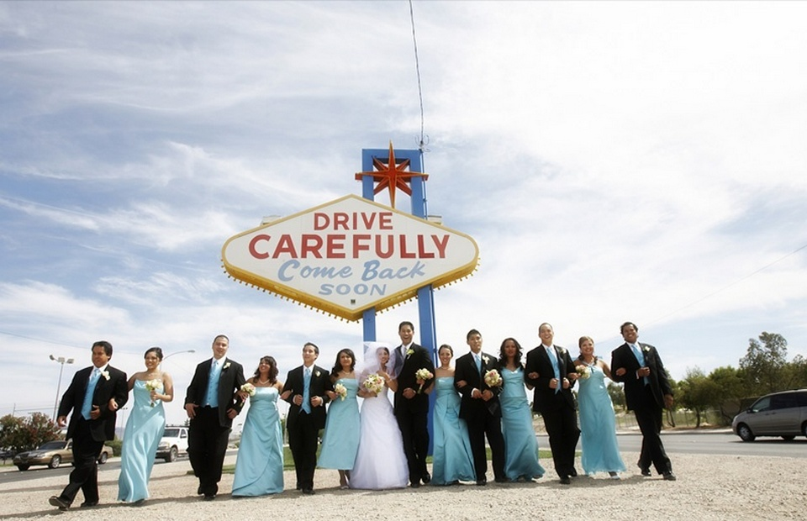
You can also get married in L.V. The wedding ceremonies are fast and cheap

Slide 15
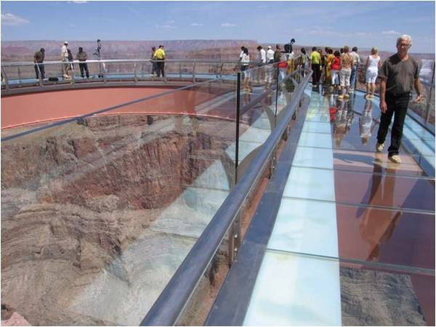
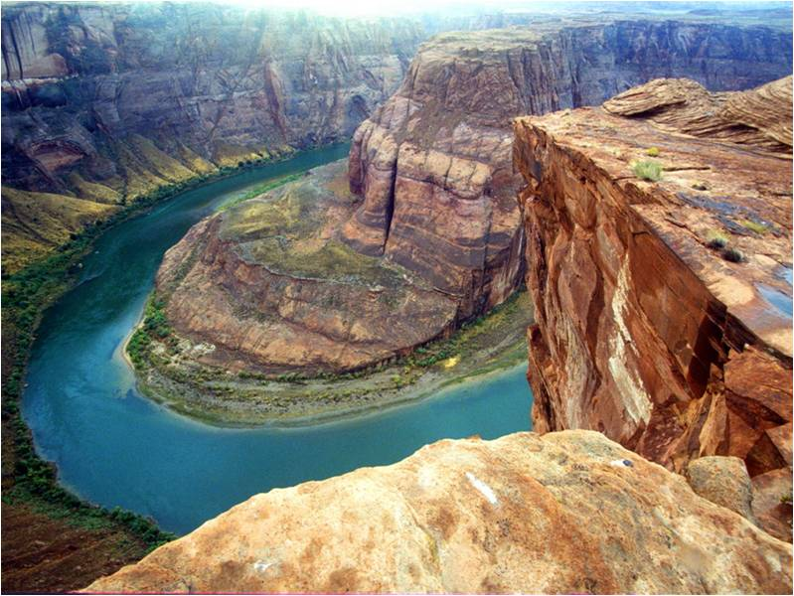
the Grand Canyon

Slide 16
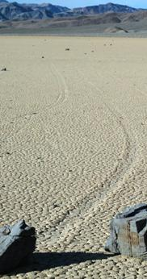
The Death Valley
… is famous for its moving stones

Slide 17
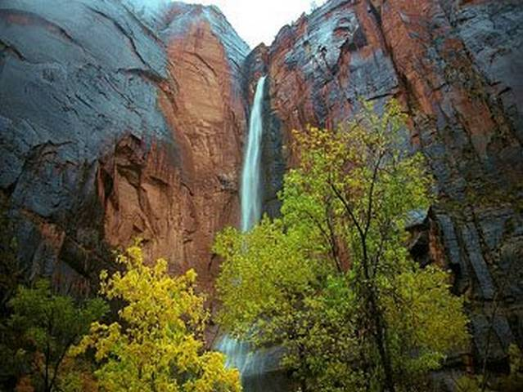
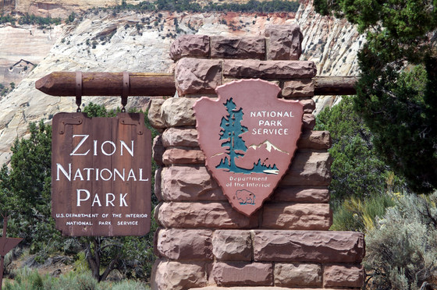
Zion National Park

Slide 18
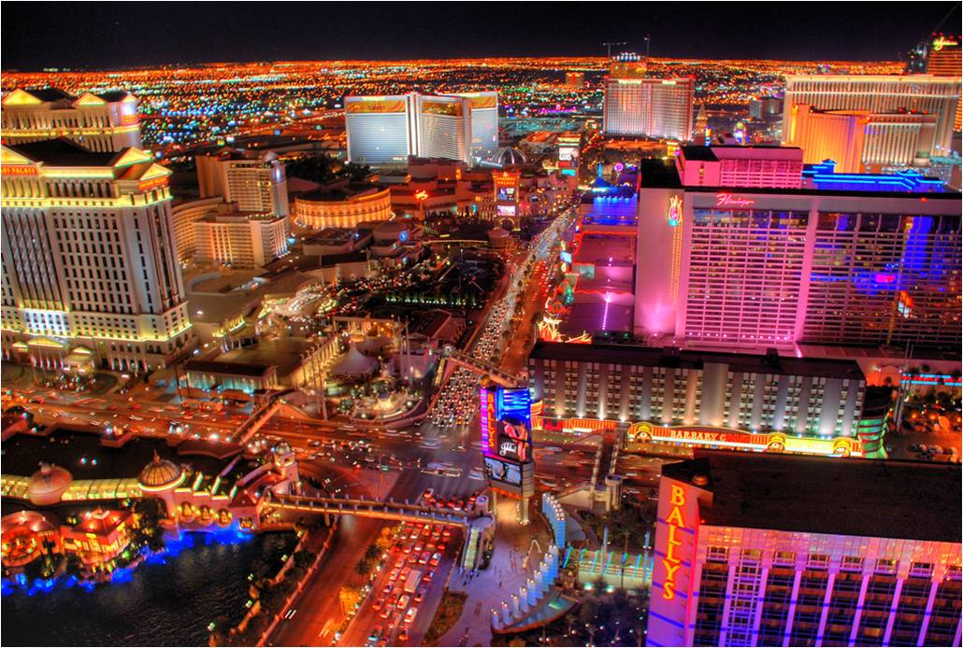
The end

Slide 19
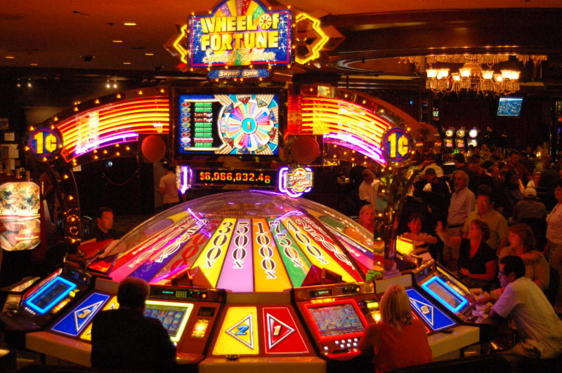

Slide 20
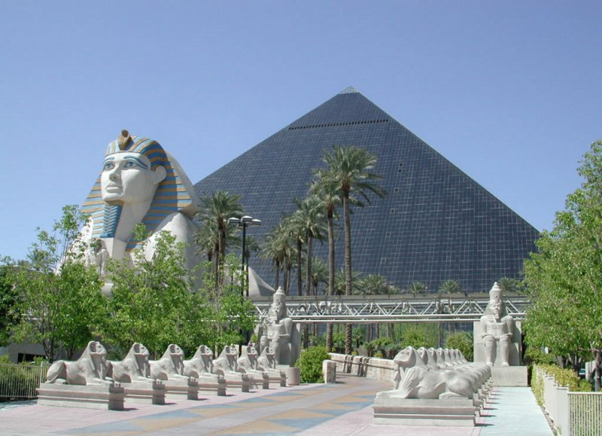

Slide 21
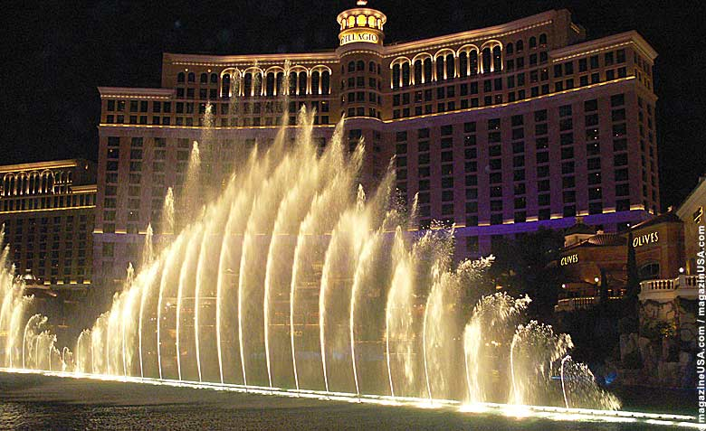

Slide 22
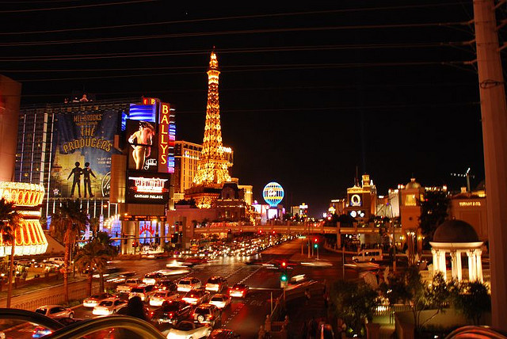

Slide 23
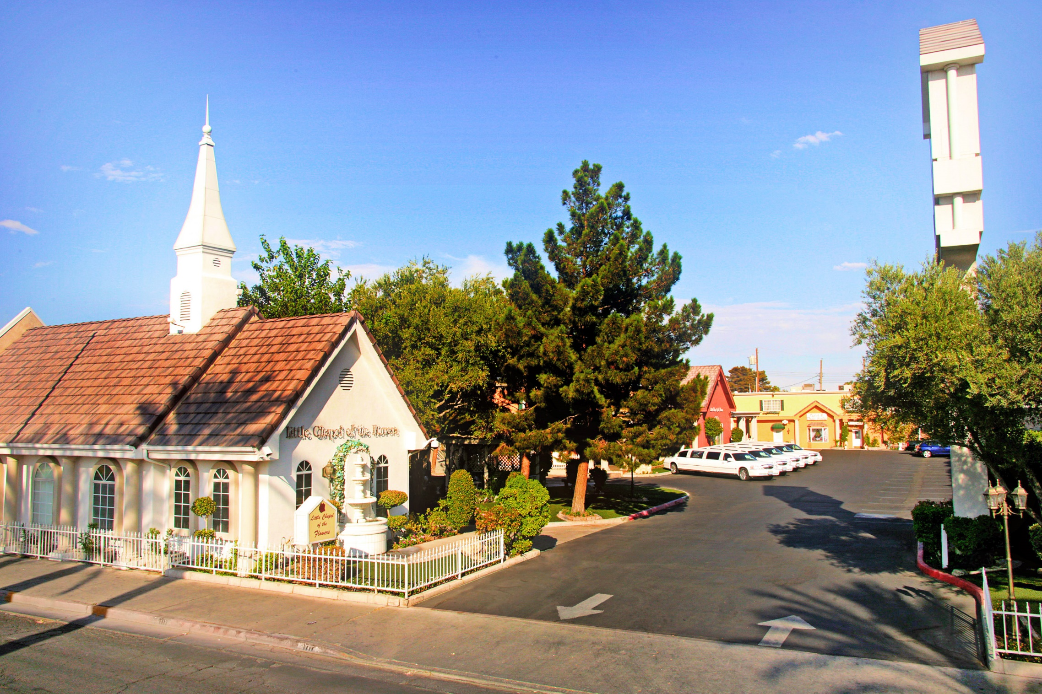

Slide 24
