Slide 1

I and world around me
Made by Maryna Zimenko
Form 11

Slide 2

Nature gave us wonderful world, which does not leave a single person indifferent. It amazes us its beauty and mystery.

Slide 3

The most amazing thing in the world around us is life.

Slide 4


Slide 5
The world around me
Friendship
hobby
education
family

Slide 6
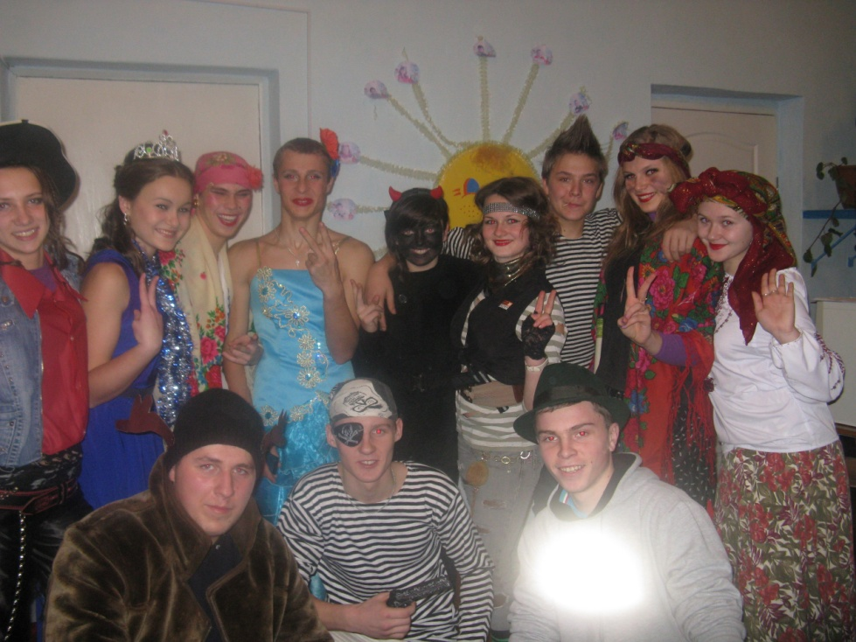
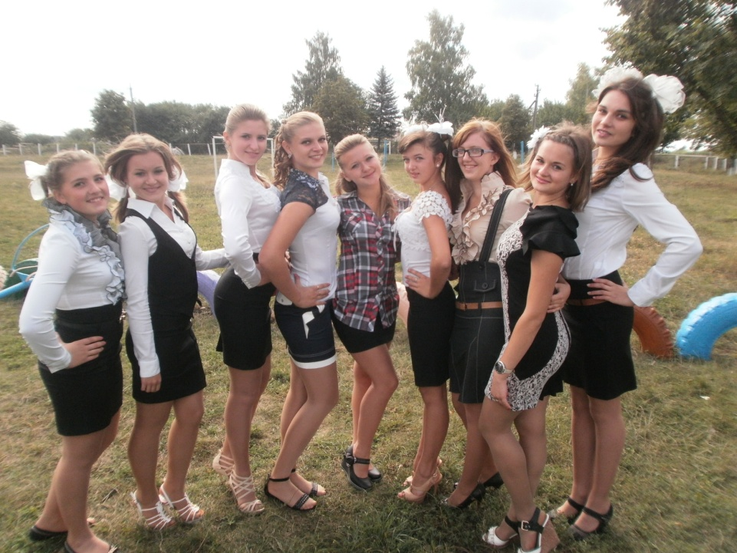
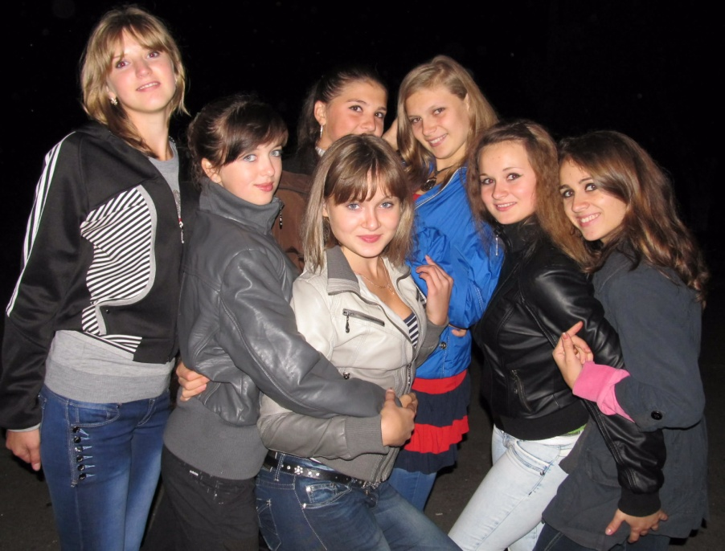
Friends in my life

Slide 7

I spend with my friends a lot of time. We often have a rest together. They became part of my life. I cannot imagine my life without them.

Slide 8
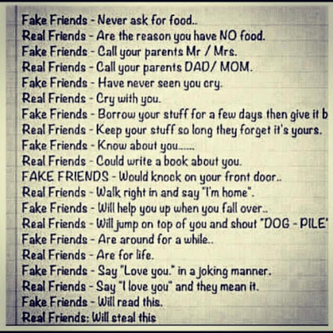

Slide 9
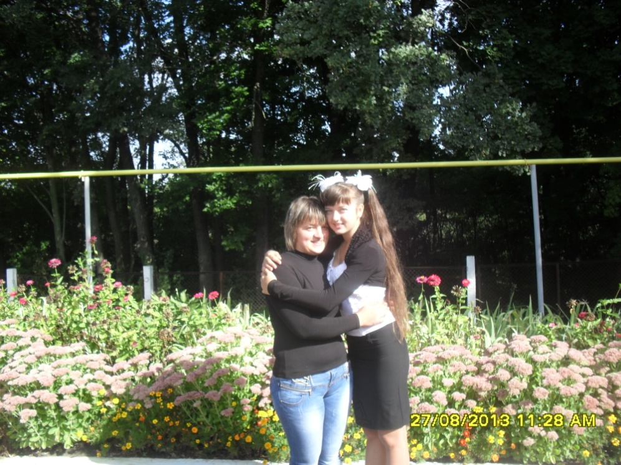
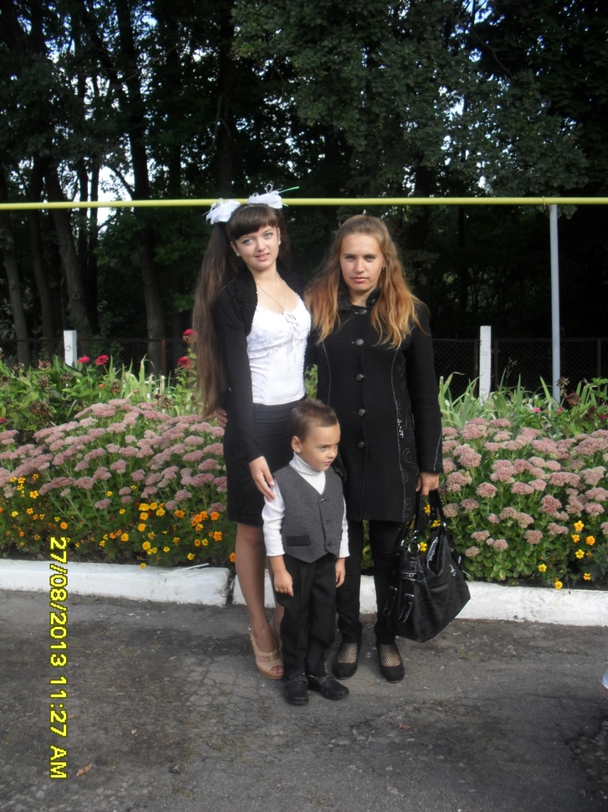
Family in my life

Slide 10
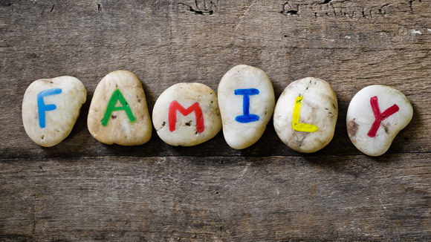
My family is not large. I live with my mom. She raised me. I must love and respect her because it is my the most valuable treasure.
“You don`t choose your family. They are God`s gift to you, as you are to them.”

Slide 11

About family…

Slide 12
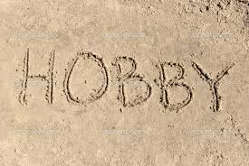
Hobby in my life

Slide 13
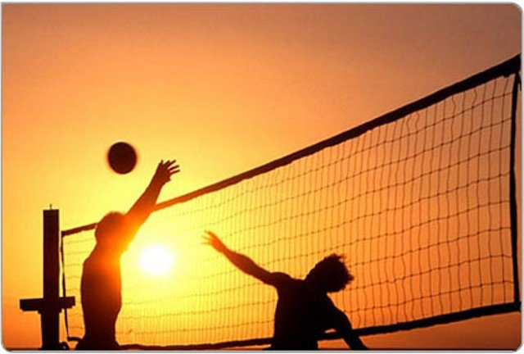


I pay a lot of attention to my Hobby. I go in for sport, play various sport games, and also I like to dance and listen music.

Slide 14


Education in my life

Slide 15
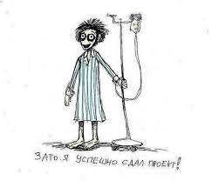
Education take the main part of my day. In school I have 8 lessons each day. Then all evening I am doing homework.
but I made a successful project.

Slide 16
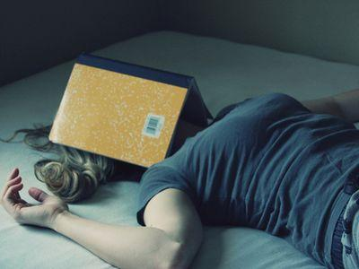
So I look like when I will finish all the lessons.

Slide 17

I value every moment in my life, because life is one for us and we should live it not in vain.

Slide 18


