Slide 1
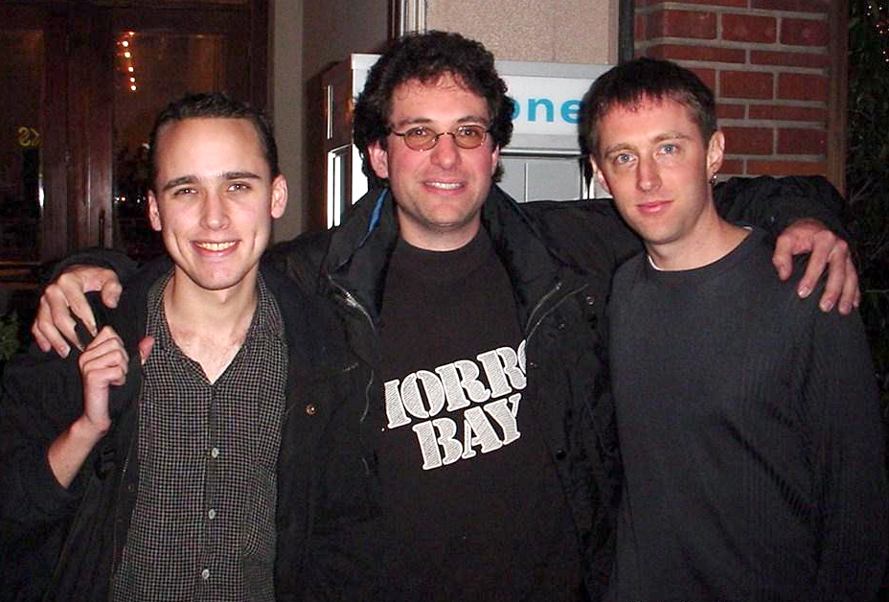
Famous hackers

Slide 2
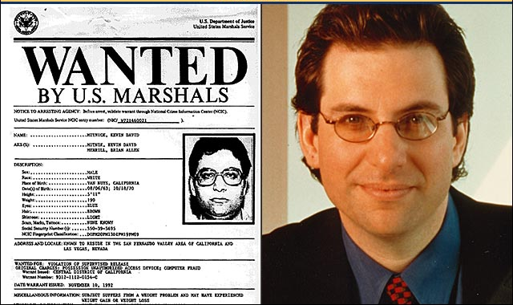
Kevin Mitnick

Slide 3
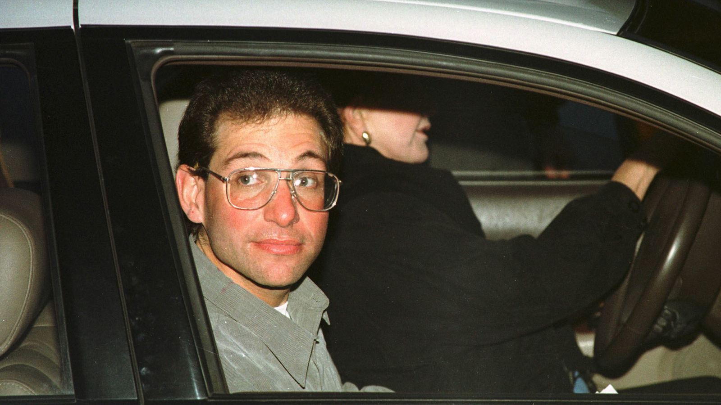
The most famous, and undoubtedly most gifted hacker in history, made a name for himself in 1981 at the tender age of 17 by getting into a phone exchange, which allowed him to redirect subscriber calls in any way he wanted.

Slide 4
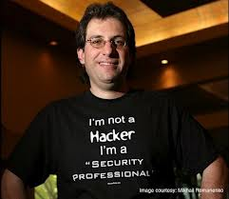
In 1983, he achieved his first major coup - and also his first arrest - when he accessed a Pentagon computer. It was his repeated offenses that made him a target of the FBI. He was sentenced to five years in prison in the 1990s, but today he is a security consultant and owns his own company: Mitnick Security.

Slide 5
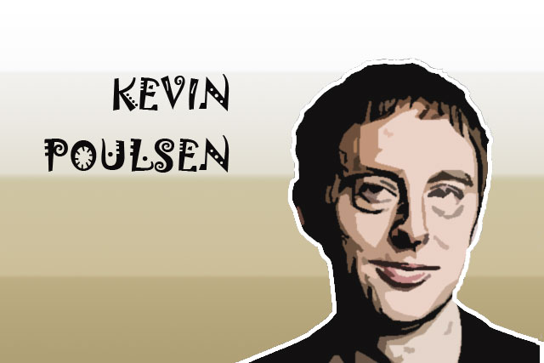

Slide 6
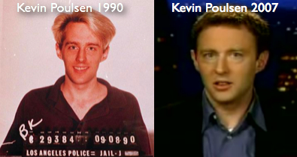
The current editor-in-chief of Wired was formerly known for rather different activities. In 1983, when he too was only 17 years old, he made his first intrusions into different networks, resulting in a few run-ins with the US legal system.

Slide 7
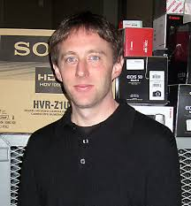
He continued with his illegal activities until his arrest by the FBI in April 1991. In 1994 he was sentenced to four years in prison.

Slide 8
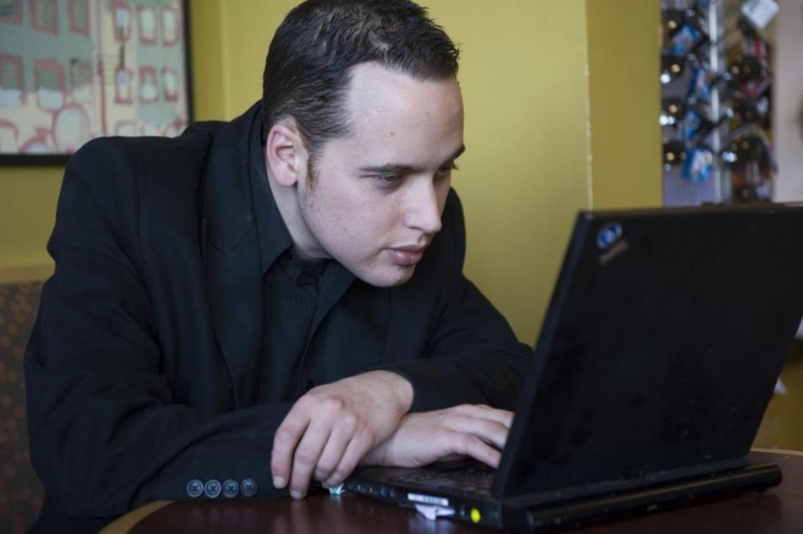
Adrian Lamo

Slide 9
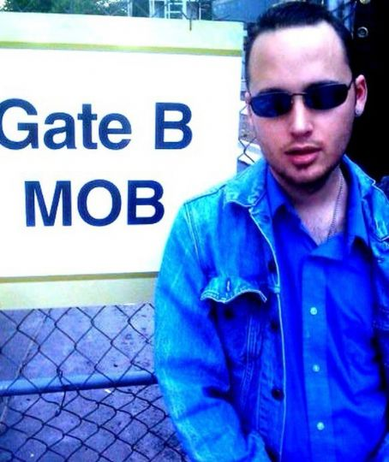
Lamo has certainly driven the highest number of network administrators insane. From Microsoft to Yahoo!, going through Sun Microsystems, MacDonald's, Cingular, AOL or even the New York Times, he is credited with all types of intrusions and corporate security system violations.

Slide 10
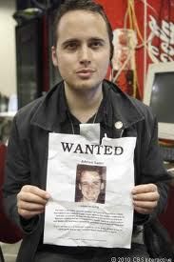
He has bypassed protections with disconcerting simplicity: during a broadcast of the NBC Nightly News, the host asked him to prove his talents in front of the camera, and he responded by gaining access to the company's internal network in less than five minutes.

Slide 11
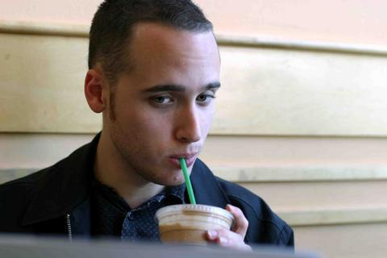
Today he is an expert in security and enjoys full freedom of movement, after being under the surveillance of US authorities for many years.

Slide 12
Thank you for attention!

