Slide 1
Richelle mead
Made by Kaleria Aleinikova

Slide 2
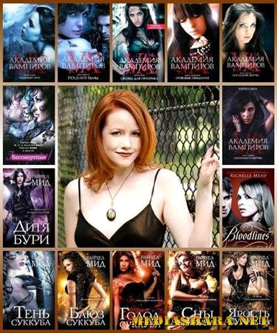
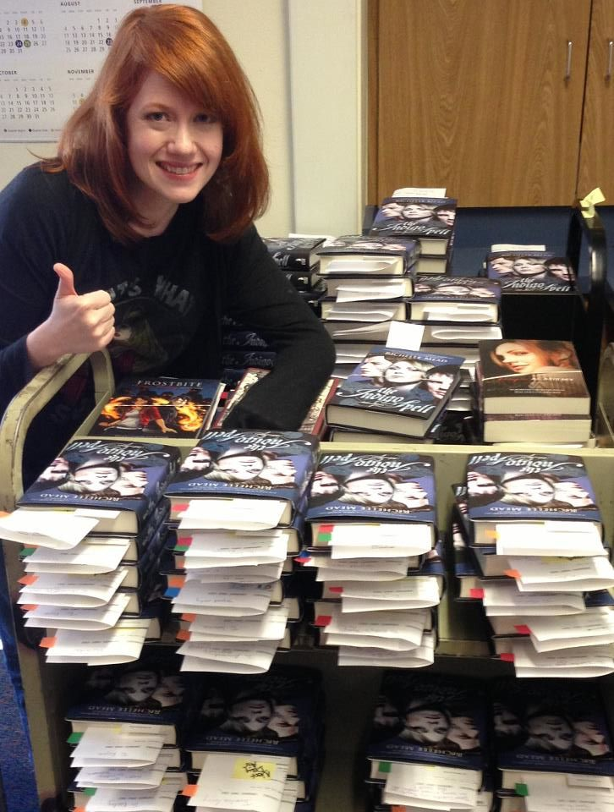

Slide 3
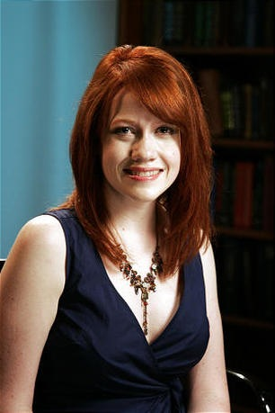
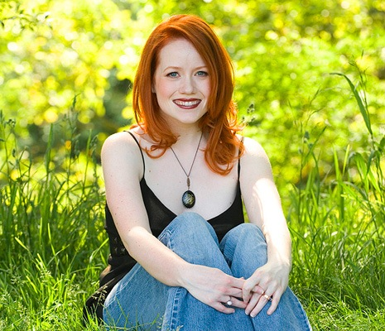
Richelle Mead (born November 12, 1976) is a bestselling American fantasy author. She is known for the Georgina Kincaid series, Vampire Academy, and the Dark Swan series.

Slide 4



Education and career
Richelle Mead was born in Michigan,and currently lives in the Seattle suburb of Kirkland, Washington, United States. She has three degrees: a Bachelor of General Studies from the University of Michigan, a Master of Comparative Religion from Western Michigan University, and a Master of Teaching from the University of Washington.[Her teaching degree led her to become an 8th grade teacher in suburban Seattle, where she taught social studies and English. She continued writing in her free time, until she sold her first novel, Succubus Blues. After quitting her job to write full time, her other books quickly followed.

Slide 5



Slide 6
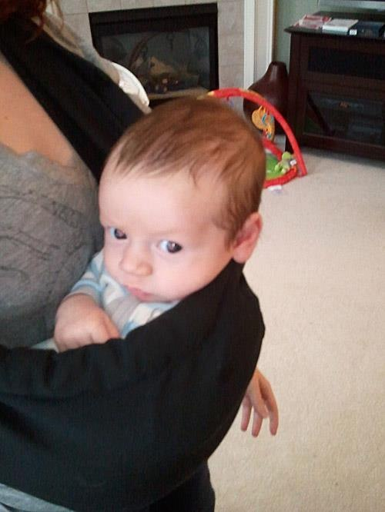
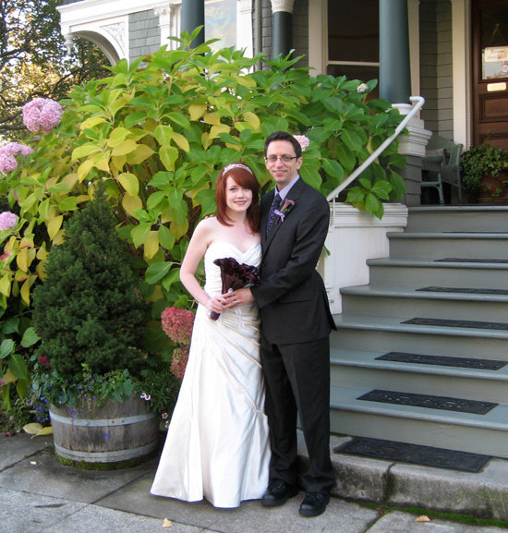
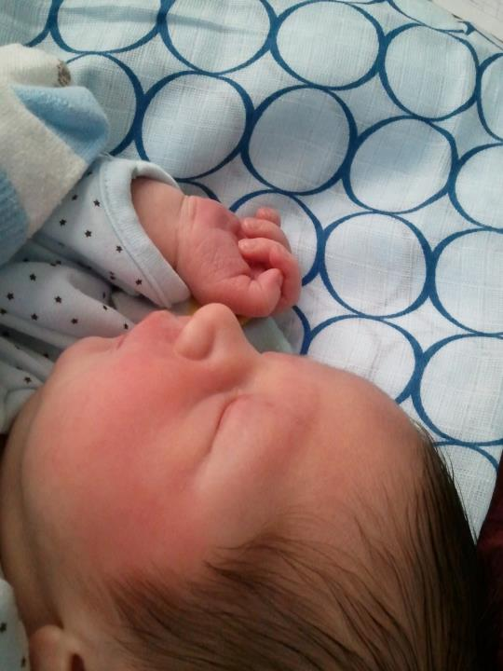
Family

Slide 7
Bibliography
Novels
Georgina Kincaid series
● Succubus Blues (February 27th, 2007): Nominee - 2007 Reviewers' Choice Awards - Best Urban Fantasy Novel
● Succubus on Top (December 18th, 2007) (UK title: Succubus Nights)
● Succubus Dreams (September 30th, 2008)
● Succubus Heat (May 26th, 2009)
● Succubus Shadows (March 30th, 2010)
● Succubus Revealed (August 30th, 2011)

Slide 8
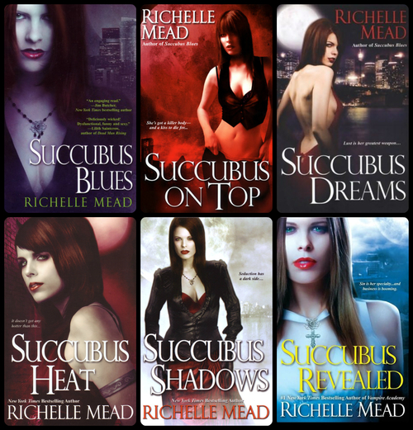

Slide 9
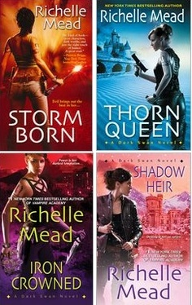
Dark Swan series
Storm Born (August 5th, 2008): Nominee - 2008 Reviewers' Choice Awards - Best Urban Fantasy Novel
Thorn Queen (July 28th, 2009)
Iron Crowned (February 22nd, 2011)
Shadow Heir (December 27th, 2011)

Slide 10
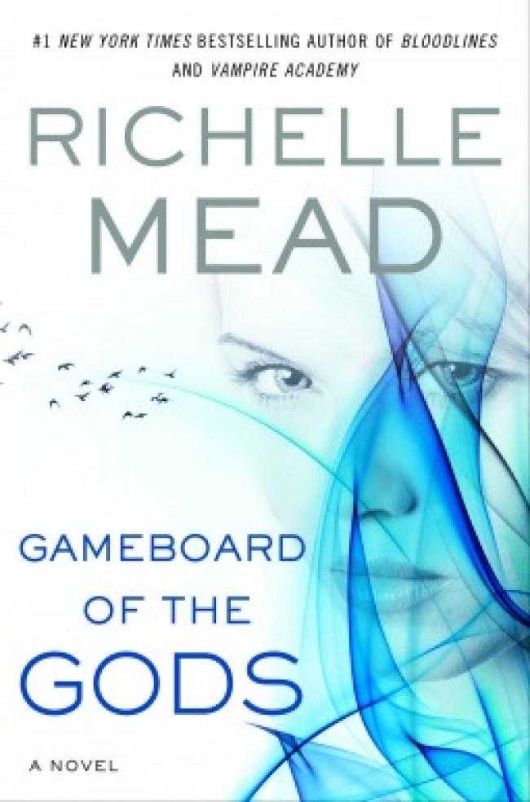
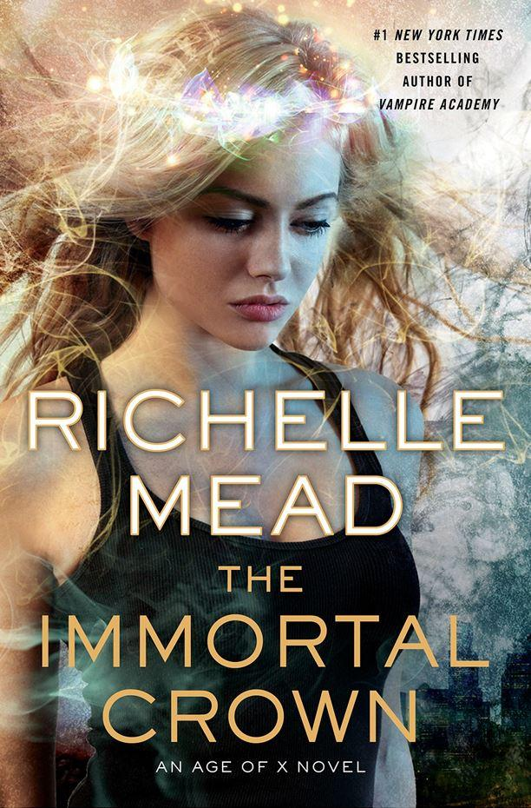
Age of X Series
Gameboard of the Gods (June 4th, 2013)
The Immortal Crown (May 29th, 2014)

Slide 11
Young adult novel
Vampire Academy series
Vampire Academy (August 16th, 2007):Library Association: 2008 Quick Picks for Reluctant Young Adult Readers
Frostbite (April 10th, 2008): Library Association: 2009 Quick Picks for Reluctant Young Adult Readers
Shadow Kiss (November 13th, 2008)
Blood Promise (25 August 2009)
Spirit Bound (May 18th, 2010)*Nominee - 2011 Children's Choice Book Awards - Teen Choice Book of the Year
Last Sacrifice (December 7th, 2010)

Slide 12
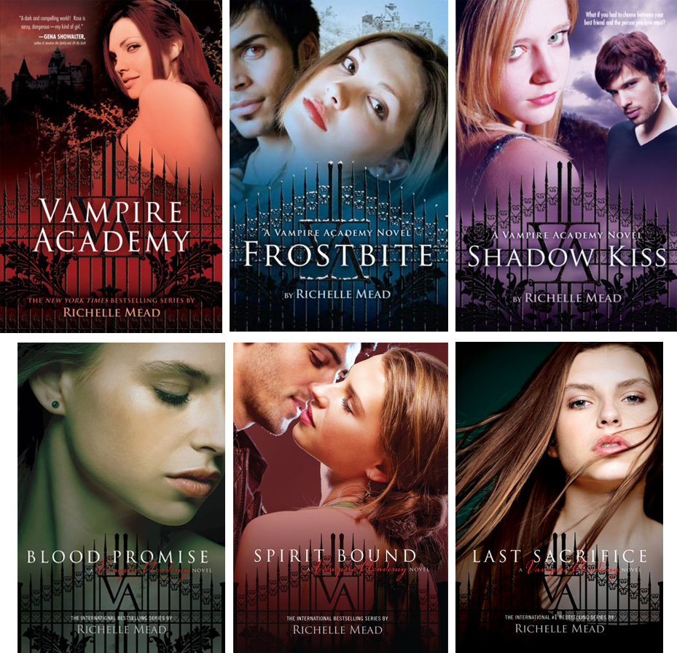

Slide 13


Vampire Academy: Blood Sisters
The first Vampire Academy book is being adapted into movie with the title Vampire Academy: Blood Sisters .

Slide 14
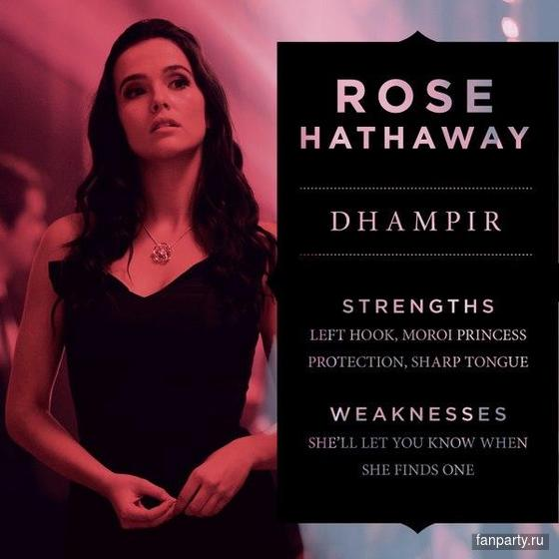
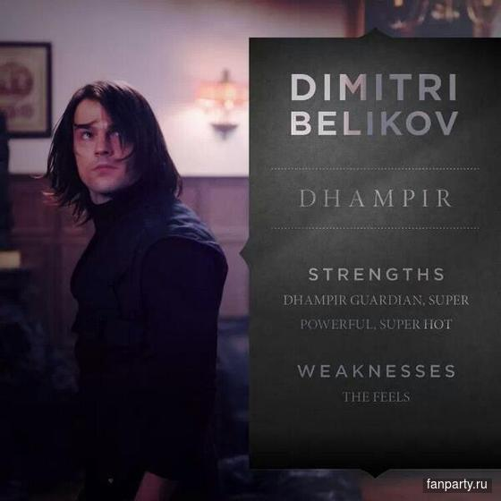

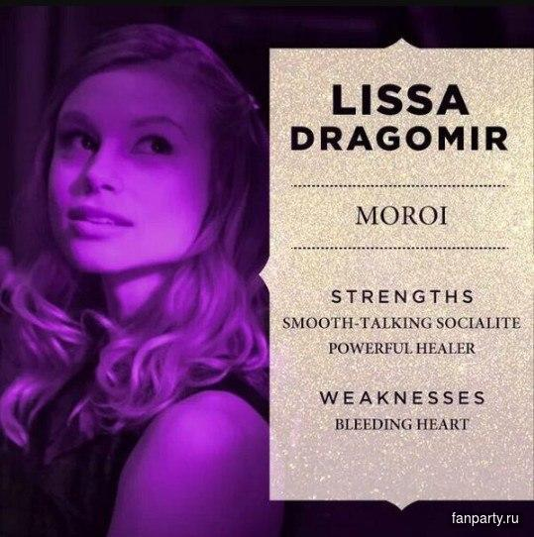
Main Characters and Actors

Slide 15
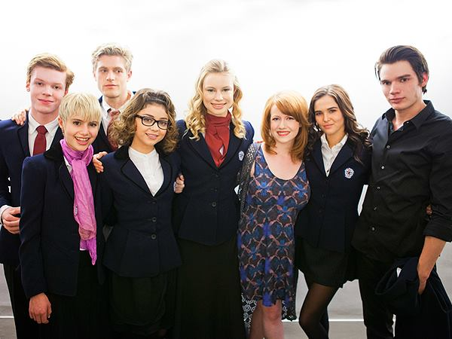
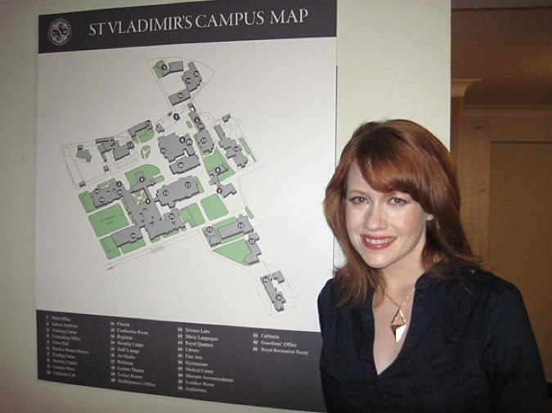
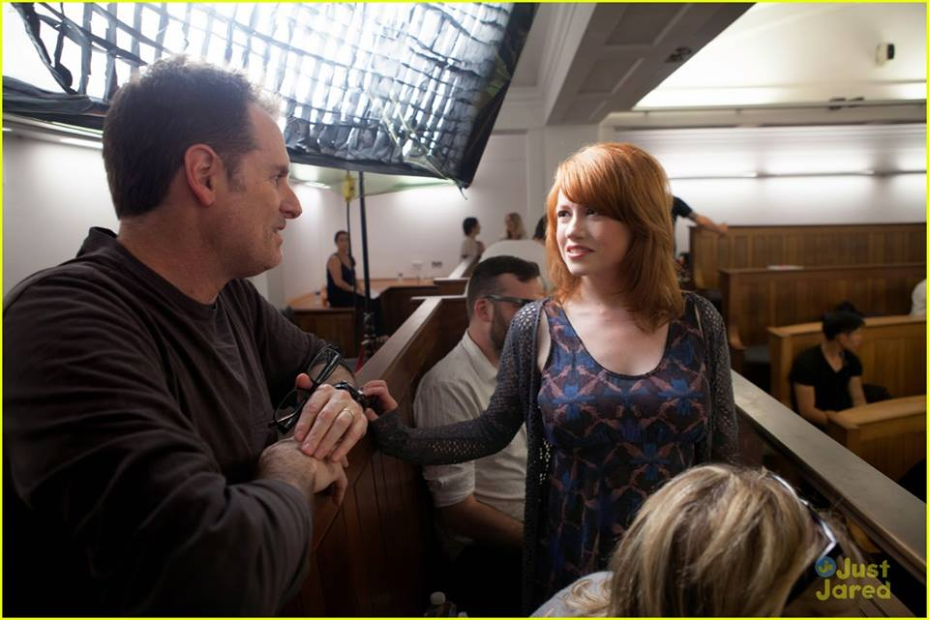
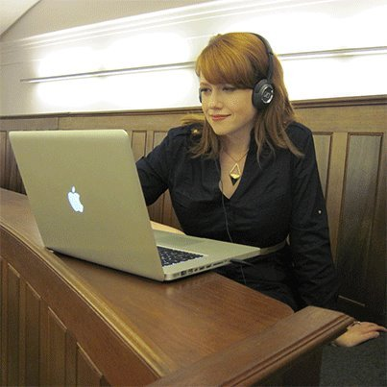


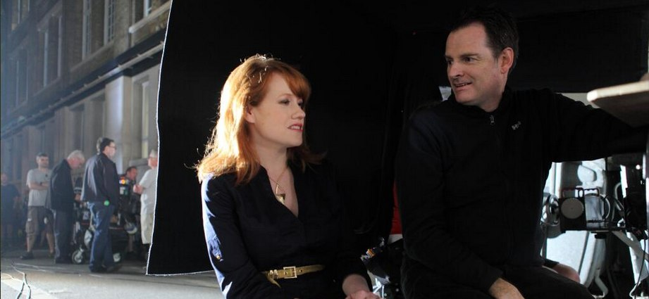

Slide 16
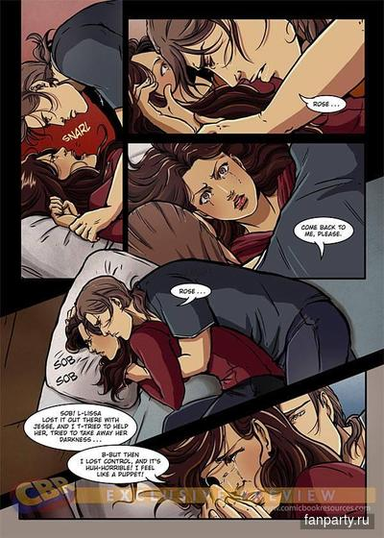
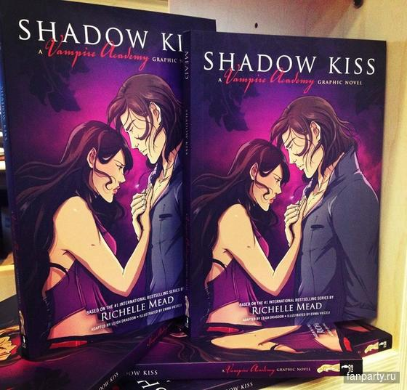
Graphic Novel

Slide 17
Bloodlines series
Bloodlines (August 23rd, 2011, )
The Golden Lily (June 12th, 2012, )
The Indigo Spell (February 12th, 2013)
The Fiery Heart (November 19th, 2013)
Silver Shadows (July 29th, 2014)
Mead is writing a six-book spin-off series featuring characters in the Vampire Academy series: Sydney, Jill, Eddie, and Adrian. "Spin off series takes place in the same universe as Vampire Academy. Same rules, same races. What happens here is that the side characters from Vampire Academy are now the main characters. And so the series will be following Sydney, Jill, Adrian, and Eddie". Mead has confirmed that Bloodlines will be the name of both the series and the first book.

Slide 18
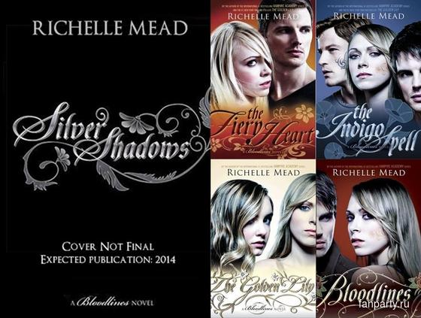


Slide 19


Children's novels
Doctor Who: Something Borrowed, the sixth Puffin E-short featuring the Sixth Doctor and Peri Brown (23 June 2013)

Slide 20
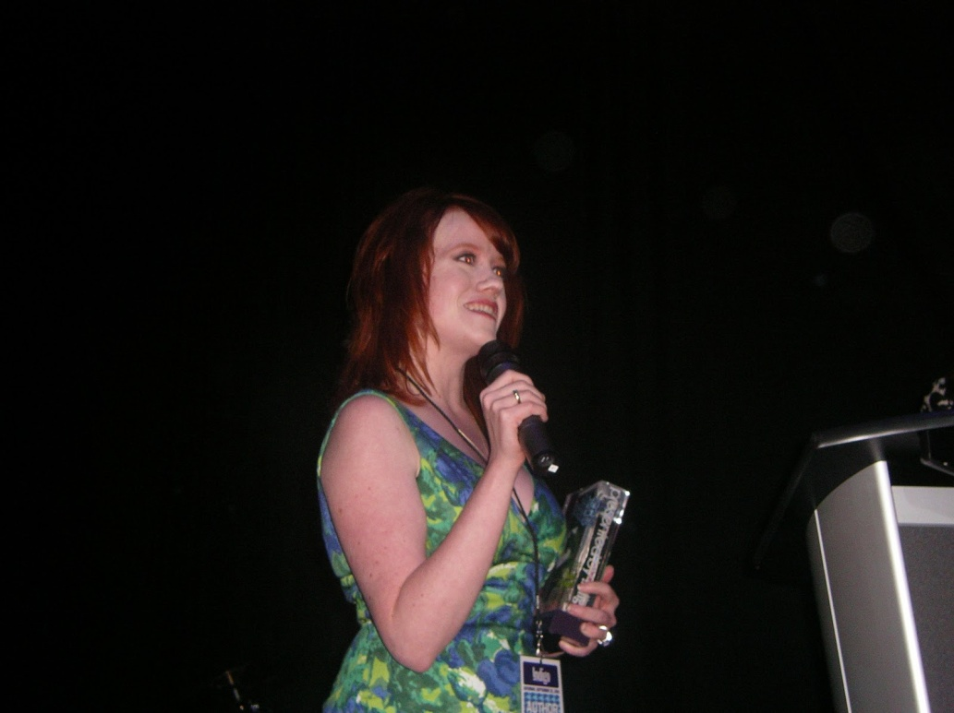
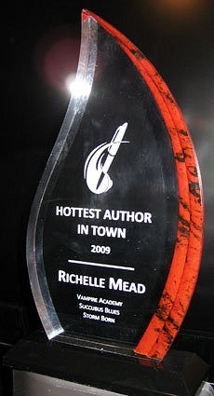
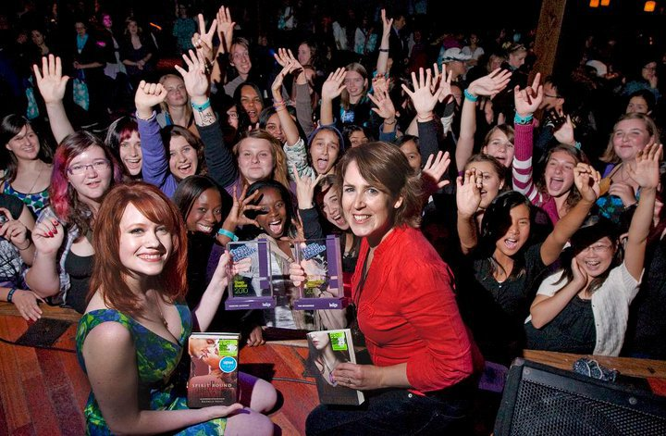
Awards and recognitions
Honorable Mention - 2009 P.E.A.R.L. Awards - Best Romantic Fantasy - Thorn Queen
Winner - 2010 Teen Read Awards - Best Teen Series - Vampire Academy series
Winner - 2010 Goodreads Choice Awards - Goodreads Author - Richelle Mead
Nominee - 2010 Goodreads Choice Awards - Paranormal Fantasy - Succubus Shadows
Nominee - 2011 Kids' Choice Awards - Favorite Book - Vampire Academy series
Winner - 2011 Goodreads Choice Awards - Best Graphic Novels and Comics - Vampire Academy
Nominee - 2011 Goodreads Choice Awards - Favorite Book of 2011 - Bloodlines
Nominee - 2011 Goodreads Choice Awards - Best Paranormal Fantasy - Succubus Revealed
Nominee - 2011 Goodreads Choice Awards - Best Young Adult Fantasy and Science Fiction - Bloodlines
Nominee - 2011 Goodreads Choice Awards - Best Goodreads Author

