Slide 1
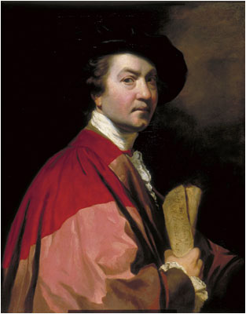
Sir Joshua Reynolds
(16 July 1723 – 23 February 1792)

Slide 2
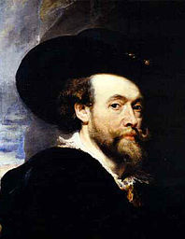
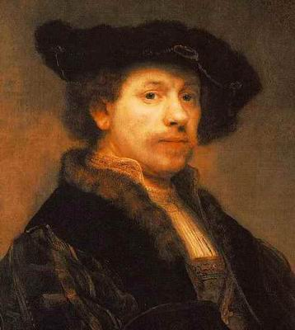
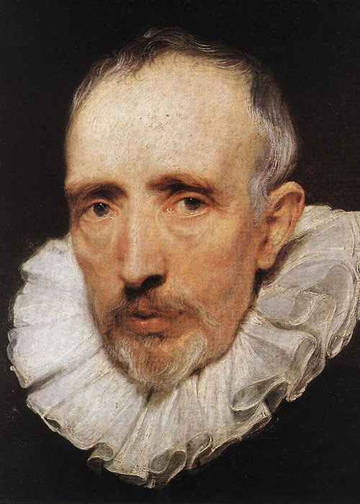
Rubens
Rembrandt
Van Dyck

Slide 3
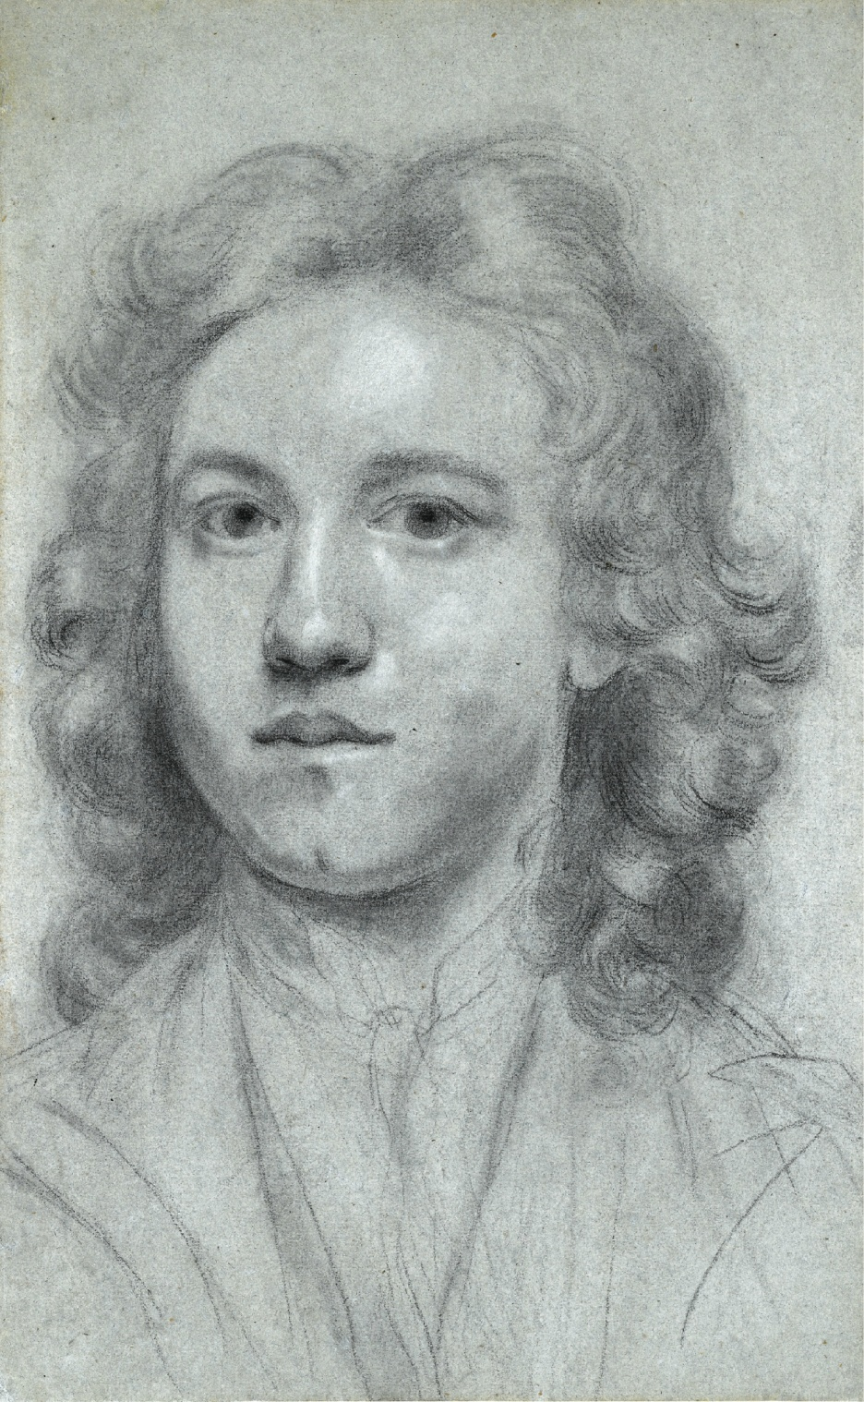
Self-portrait
(17 years old)

Slide 4
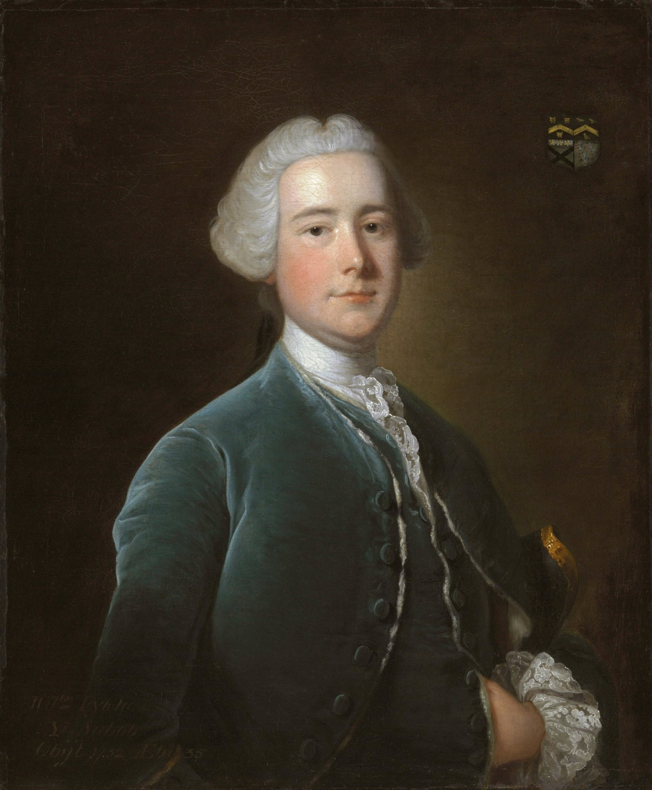
Thomas Hudson

Slide 5
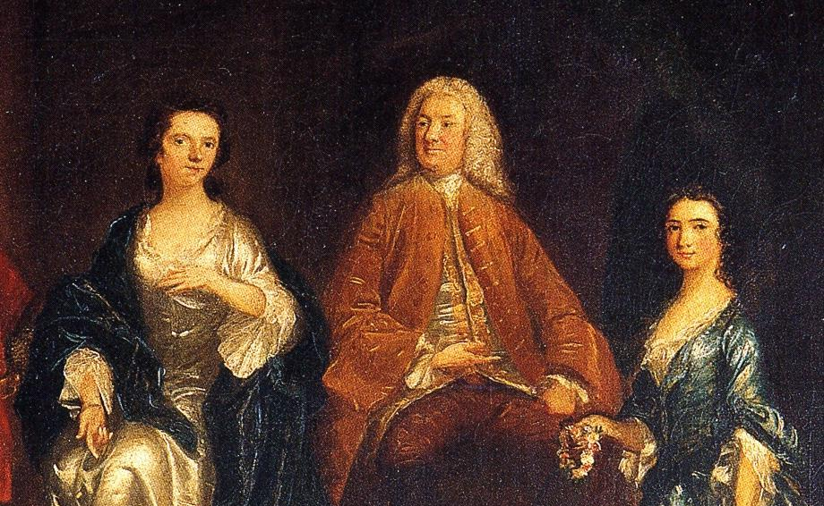
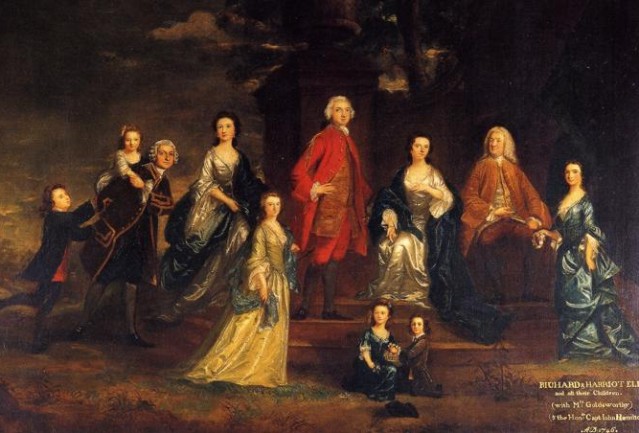
The Eliot Family

Slide 6
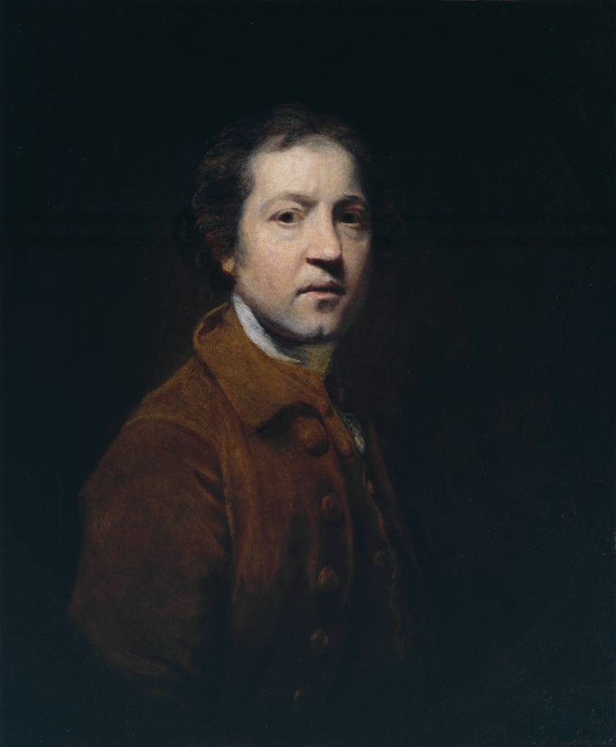
Sir Joshua Reynolds, Self-Portrait when Young (1752)

Slide 7
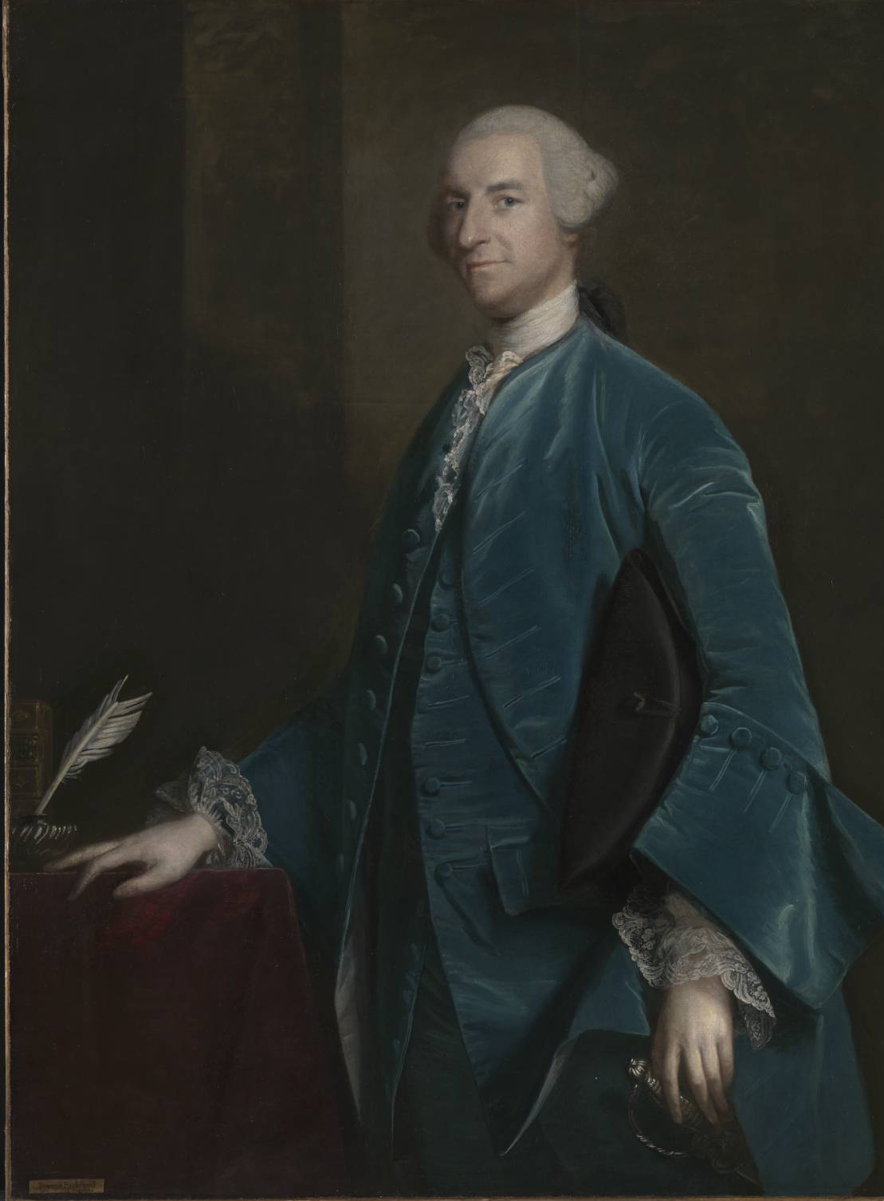
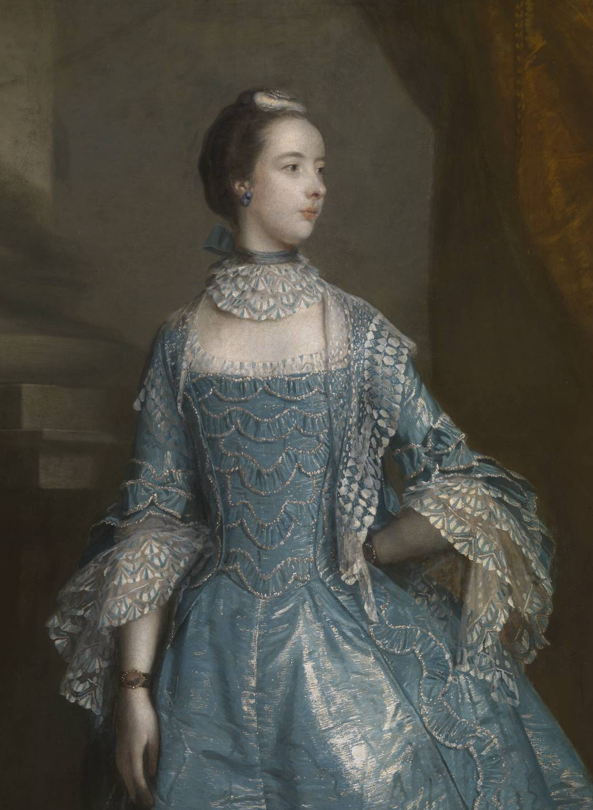
Reynolds's works (1755-1769)
Francis Beckford (1755)
Suzanna Beckford (1756)

Slide 8
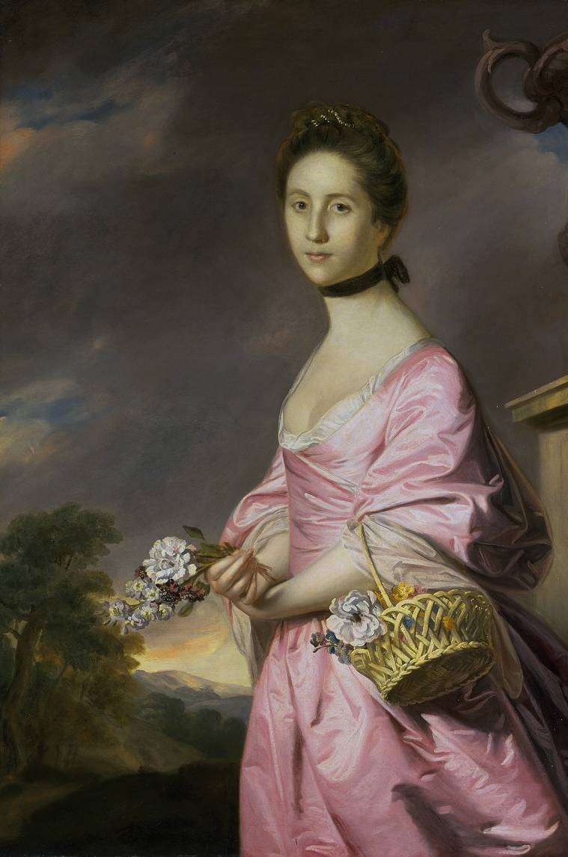
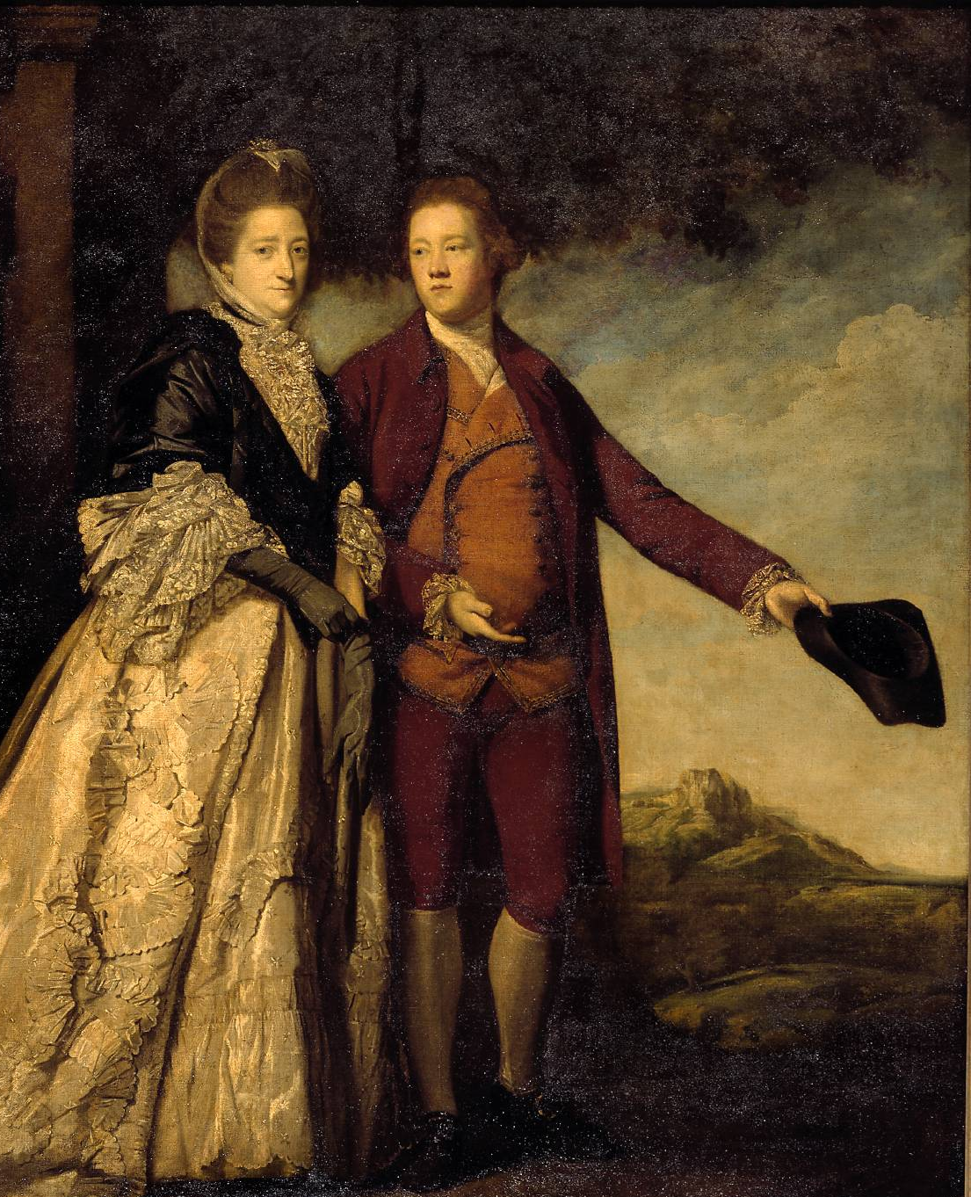
Reynolds's works (1755-1769)
Sir Watkin Williams-Wynn and his Mother (1768)
Lady Anstruther (1761)

Slide 9
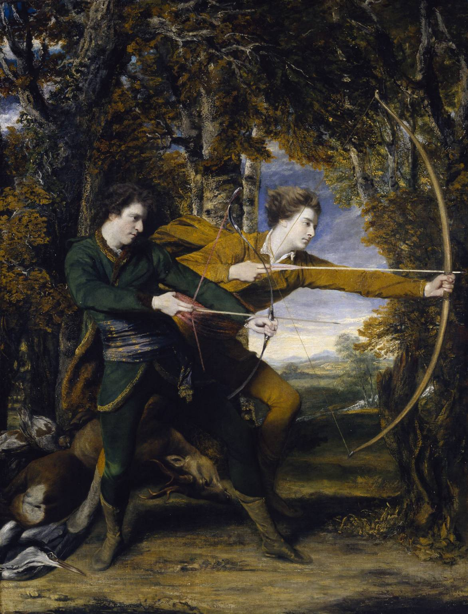
Reynolds's works (1755-1769)
The Archers (1769)

Slide 10
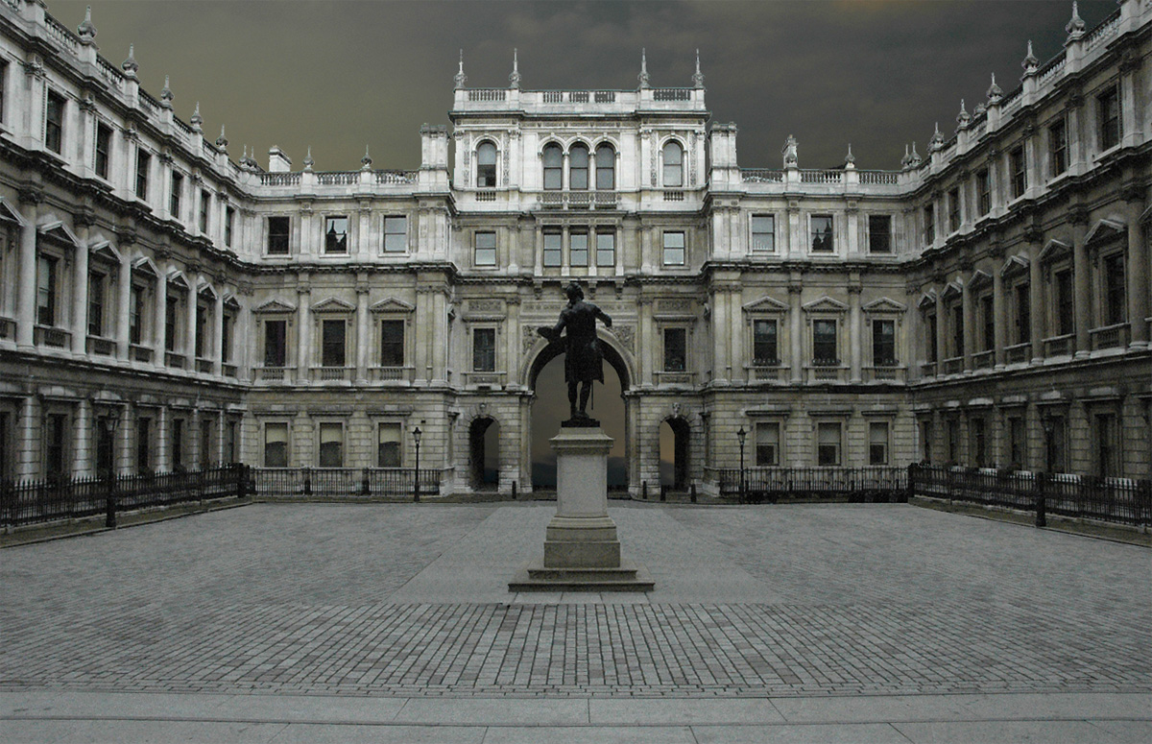
The Royal Academy (founded in 1768)

Slide 11
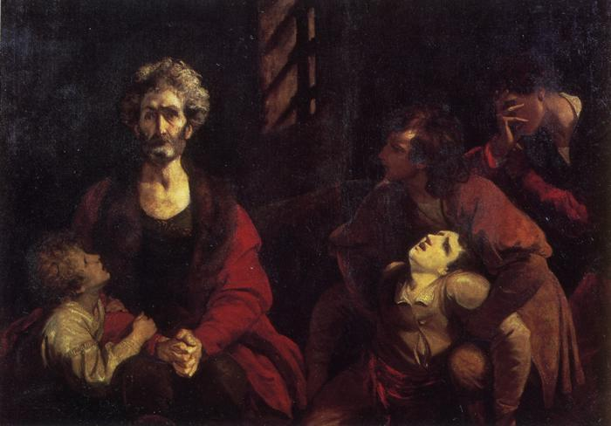
Reynolds's works (1773-1777)
Ugolino and his children (1773)

Slide 12
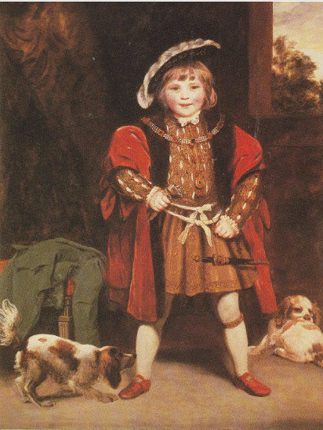
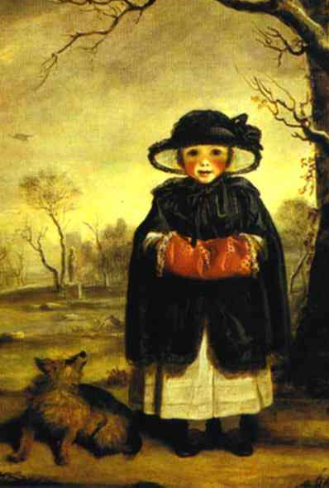
Reynolds's works (1773-1777)
Master Crewe as Henry VIII (1775-76)
Lady Caroline Scott as Winter (1777)

Slide 13
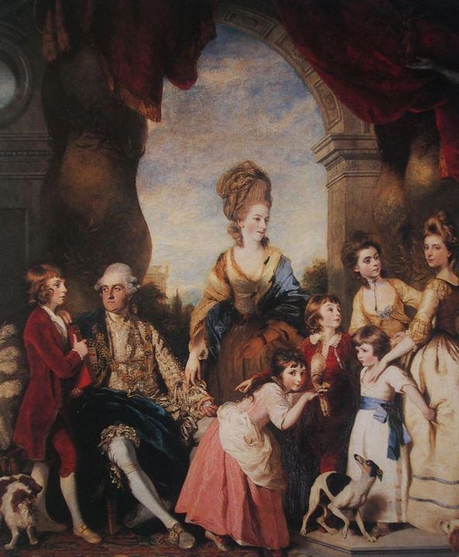
Reynolds's works (1773-1777)
The Family of the Duke of Marlborough (1777)

Slide 14
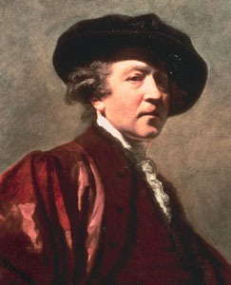
Sir Joshua Reynolds

