Slide 1
Humanistic psychology
A person is more important of all?

Slide 2
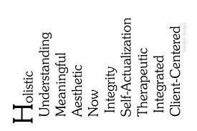
Why humanistic?
Humanistic psychology - this is a direction in modern Western, American psychology, the study of which is the subject of the whole human in his highest, specific for human manifestations:development and self-actualization, its highest values ​​and meanings, love, creativity, mental health.

Slide 3
Main features
In 1963, the first president of the Association for Humanistic Psychology, James Bugental, put forward five basic provisions of this area of psychology:
Man as a whole being greater than the sum of its parts (in other words, a person can not be explained as a result of the scientific study of its partial functions).
The human being deployed in the context of human relationships (in other words, a person can not be explained by its partial functions, which are not taken into account the interpersonal experience).
The man knows himself to (and can not be understood in psychology, which does not consider it a continuous, multi-level self-awareness).
A person has a choice of (a person is not a passive observer of the process of its existence: he creates his own experience).
Man intentsialen (the man turned to the future and in his life has a purpose, value and meaning.)

Slide 4
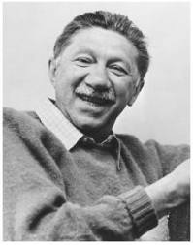
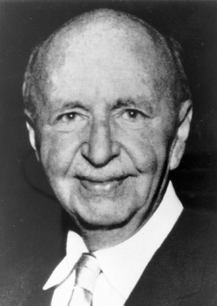
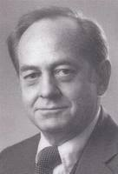
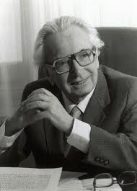
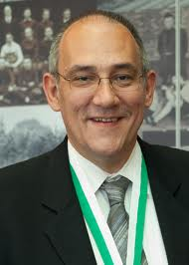
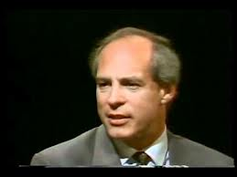
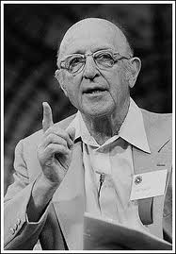
Representatives
A .Maslow
K. Rogers
V. Frankl
S. Buhler
F. Barron
R. May
S. Dzhurard

Slide 5
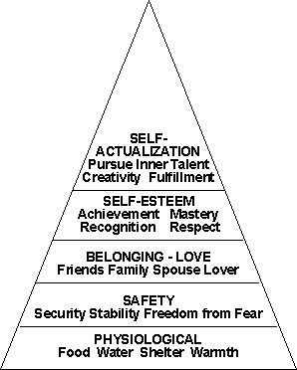
Humanistic psychology, MASLOW AND IMAGE OF MODERN CULTURE
Feauture humanistic psychology, Maslow (1908-1970) is that in modern society, he sees the two cultures: one is formed by people prone to higher feelings and oriented toward the higher values ​​of life (beauty, truth, goodness), the other embodies the technocratic-bureaucratic tendency in society. It is made by people who are not prone to higher experiences. Maslow constructs in their research model is ideal culture (eupsihiya), allowing people to discover their potential. Ideal culture created by the people of a special mold of the main features of which - the desire for self-improvement, self-actualization. Man must become what it can be - the main principle of the creation of a new society.

Slide 6
The pyramid of Maslow
Maslow is known as one of the founders of humanistic psychology. He is best known his hierarchical model of motivation. According to this concept in humans from birth consistently appear and accompany him growing up seven classes of needs:
Physiological (organic) needs such as hunger, thirst, sexual desire, and so on;
Security needs - the need to feel safe, get rid of fear and failure, the aggressiveness;
The needs of respect (reverence) - the need to achieve success, approval, recognition, prestige;
Cognitive needs - the need to know and be able to, to understand, to explore;
Aesthetic needs - the need for harmony, symmetry, order, beauty;
The needs of self-actualization - the need to achieve their goals, abilities, the development of self.

Slide 7
Carl Rogers
One of the leaders of the humanistic psychologist Carl Rogers (1902 - 1987 she.) Believed that a fundamental component of personality own life concept, which is formed in the process of human interaction with the social environment. He suggested that the main provisions of the "self-concept". According to his theory, important are the following: communication normal people should be indirektivnym, not pressure, respecting the position of each individual human core or center of personality based on her self-esteem, which is formed by the interaction with others, leading motive is the motive of the person growth of the "I" that is accelerating, inhibited interpersonal relationships in a social environment.The mismatch between the "self-concept" and the idea of ​​the perfect "I", which swarm is adequate self-esteem, encourages people to personal growth. Rogers has also developed a psychological instrument and psychotherapy treatments which contribute to the successful realization of the "self-concept".

Slide 8
The theory of personality traits G. Allport
In his concept personological G. Allport considers man as a complex "open" system, in a hierarchical organization of which he points out the following integrative levels of interaction of the individual with the world - reflexes, skills, personality traits, the system features that vary in different cases and forming multiple I- personality. A special place in this intricate system is need-motivational sphere. In it there are two levels of operation: the level of need and the level of motivation of higher motives, or the motives of development. The principle of the so-called homeostasis - the desire to eliminate stress - applicable only to the lowest level of the motivational system (based on needs). Forms true personhood (the pursuit of new goals, setting creative tasks, updating sense of initiative and responsibility, etc.) do not fit into the formula of homeostasis. Search for a DC voltage, the resistance of equilibrium - the characteristics of motives. System of higher motives are included in the central core of the personality - I - and transformed into a system of human values. The quest for self-actualization and self-realization are based development and are initially laid down in the human needs. The motives of facing the future generate a system of goals, the implementation of which ensures the formation of new human capabilities. Man, according to Allport, turned in their future.

Slide 9
Personality in terms of humanistic psychology
Humanistic psychology views the individual as a unique holistic system which is open to self-actualization, unique to humans. The founder of humanistic psychology of Carl Rogers (1902-1987 PP) in the creation of his theory of personality based on the fact that each person is endowed with the ability to personal self-improvement. An important component of the personality structure, C. Rogers, is a "self-concept". It is formed in the interaction of the subject with the environment is an integral mechanism of self-regulation of human behavior and can be positive, negative or ambivalence (controversial). As far as man content with life as he experiences the happiness of life depends on the extent to which his experience, his "real self" and the "ideal self" relate to each other. If the real life experience contradicts the "self-concept" that has developed, there is a Incongruent (disparity) between the self-image and actual experience. At the same time the most important characteristic psychologically mature person - its openness to experience, flexibility, improvement of human I.

Slide 10
What is a personality?
In humanistic psychology, personality is understood as a self-sustaining system capable of transcending itself to artistic creation itself. Living, real people can not be reduced to a set of mental and physiological functions, and there is a unique I, as an integral unity of body, soul and spirit. The main problems of humanistic psychology of the person: the problem of self-consciousness of personality, her self-actualization, self-development, the problem of the meaning of life.

