Slide 1
Ivan Dorn
Prepared:Troyanovskaya Tamilа

Slide 2

I like listening to a very wide variety of music, including pop, hip- pop, rap music, sometimes rock and also I like electronic music. I like listening loud music but it scarcely ever works out.

Slide 3
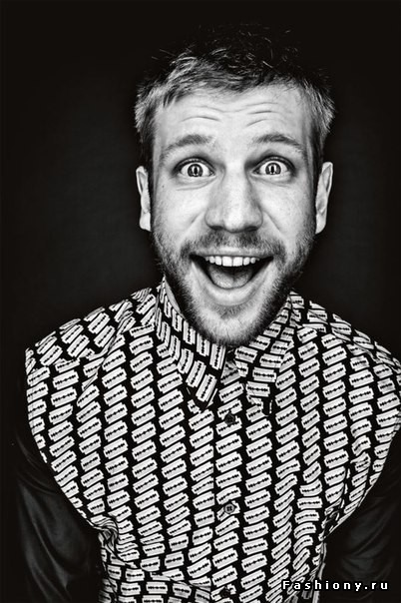
At the moment my favorite singer is Ivan Dorn. This is a Ukrainian singer who has released two albums and he is the most popular singer in Russia and Ukraine now. Viva Magazine recognized him as the most handsome man in 2012. And I just like listening to his music and dance with it.

Slide 4
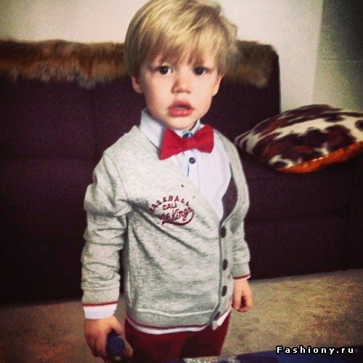
Ivan grew up in normal family, and at the age of 6 years he started to go on stage for singing songs. When he was at school he took part in all events held at the school.

Slide 5
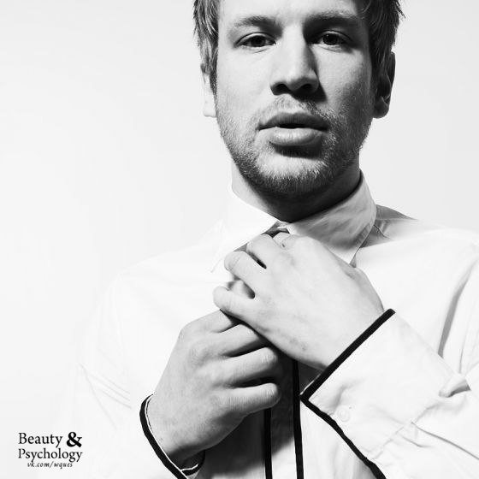
In 2007 he became the second member of the band "Paranormalnye", which was very popular and it was a pity that the band broke up. And since 2010 Dorn began his solo career releasing songs that he writes himself.

Slide 6
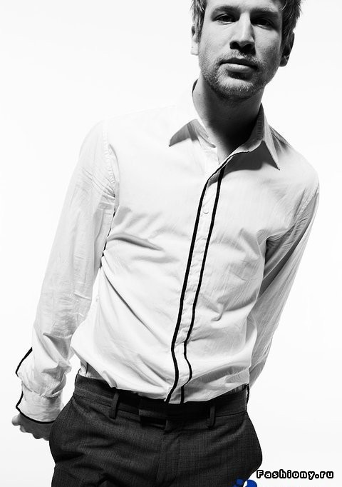
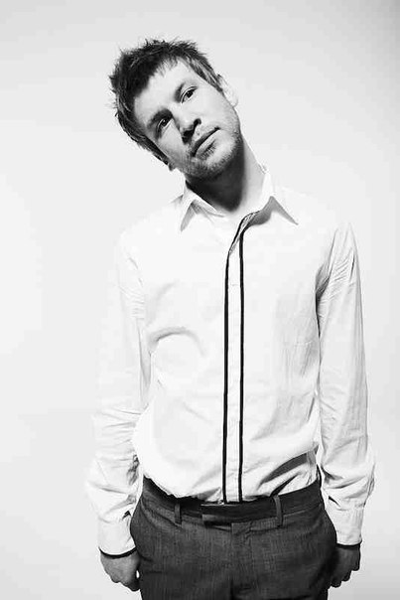
Generally I also like Dorn how person which in his 25 years has made a lot thanks to his efforts and talent. At his concerts he sings only live and in this way he shows their respect to his fans. He does not use services of producers, hides his personal life from the media, he does not advertise himself with various scandals. He's just doing his job which he loves and for that reasons he is loved by his fans. On the Internet the number of his hits broke all records in views and downloads because he makes quality and fashionable music.

Slide 7
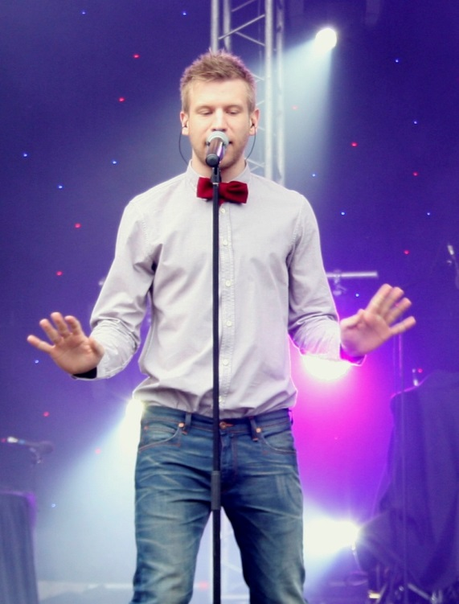
Songs

Slide 8
Иван Дорн–
Бигуди (Slider & Magnit Remix)
Иван Дорн–
Стыцамен (Dj Ivan Frost)
Иван Дорн–
Мишка виновен
Иван Дорн–
Северное сияние
Иван Дорн–
Lola Lola
Иван Дорн–
Не надо стесняться
Иван Дорн–
История Любви
Иван Дорн–
Кричу
Иван Дорн–
Бигуди (минус)
Иван Дорн–
Невоспитанный
Иван Дорн–
Мишка Виновен (Leo N Remix)
Иван Дорн–
Спортивная
Иван Дорн–
Целовать другого
Иван Дорн–
Стыцамен (минус)
Иван Дорн–
любовь
Иван Дорн–
Бигуди( ремикс )
Иван Дорн–
Танец Пингвина
Иван Дорн–
Лова Лова Dj Domingos Club House Mix (осень 2012)
Иван Дорн–
Ненавижу (DJ Zapad Remix)
Иван Дорн–
Leave (Eunique Remix)
Иван Дорн–
Случайная
Иван Дорн–
Бигуди (DJ Kirillich Mix)
Иван Дорн–
Leave (Eunique Remix)
Иван Дорн–
Кричу
Иван Дорн–
Северное Сияние (OST Физрук)
Иван Дорн–
Телепорт
Иван Дорн–
3000
Иван Дорн–
Лететь
Иван Дорн–
Lola Lola
Иван Дорн–
Актриса
Иван Дорн–
Дружба, Кому Это Нужно
Иван Дорн–
Безмато
Иван Дорн–
Где вино
Иван Дорн–
Кричу (new remix)
Иван Дорн–
Leave (Eunique Remix)
Иван Дорн–
Стая
Иван Дорн–
Невоспитанный
Иван Дорн–
Весна (feat. Pianoboy)
Иван Дорн–
Бигуди (Slider & Magnit Remix)
Иван Дорн–
Lola Lola
Иван Дорн–
Ты всегда в плюсе
Иван Дорн–
Ненавижу (DJ ALEX GOOD mash-up 2k13)(Dj Ok mix)
Иван Дорн–
Гребля
Иван Дорн–
Северное Сияние (Anton Ishutin edit)
Иван Дорн–
Река Меняет Русло
Иван Дорн–
Мишка Виновен (Matthew Maas Edit)
Иван Дорн–
Дружба кому это нужно?
Иван Дорн–
Прониклась Мной (ft. Кравц) (Ingo & Micaele remix)
Иван Дорн–
Невоспитанный
Иван Дорн–
River (Sako Isoyan Edit)

Slide 9
THE AND

