Slide 1

Natural disasters
Natural disasters
Підготувала
учениця 10-А класу
Сарненського НВК «Школа-колегіум»
Аврамишина Дарина
Підготувала
учениця 10-А класу
Сарненського НВК «Школа-колегіум»
Аврамишина Дарина

Slide 2
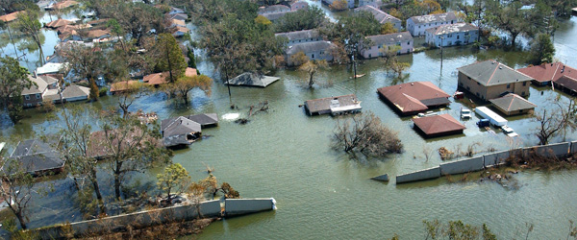
Flood
A flood is an overflow of water that submerges land which is usually dry. Flooding may occur as an overflow of water from water bodies, such as a river or lake, in which the water overtops or breaks levees, resulting in some of that water escaping its usual boundaries, While the size of a lake or other body of water will vary with seasonal changes in precipitation and snow melt, these changes in size are unlikely to be considered significant unless they flood property or drown domestic animals.

Slide 3
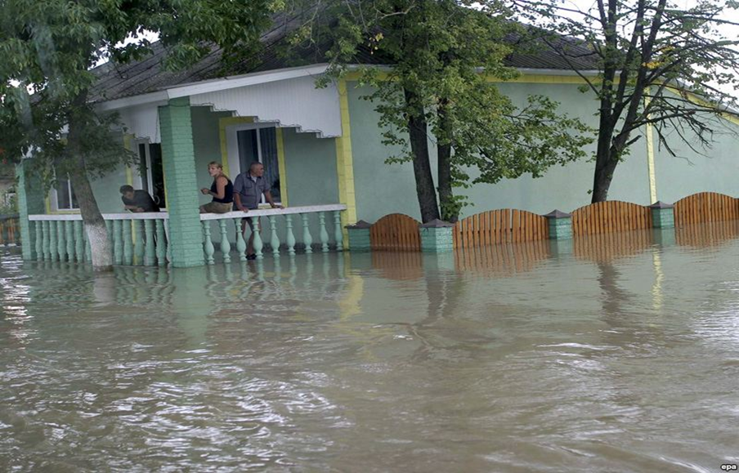
Сause flooding
Сause flooding
During the last 50 years a great deal of forests in the Carpathians have been cut down. Deforestation has led to changes in local climate. That's why we have so much trouble with floods in this region. Irresponsible attitude to it might lead to terrible results.
During the last 50 years a great deal of forests in the Carpathians have been cut down. Deforestation has led to changes in local climate. That's why we have so much trouble with floods in this region. Irresponsible attitude to it might lead to terrible results.

Slide 4
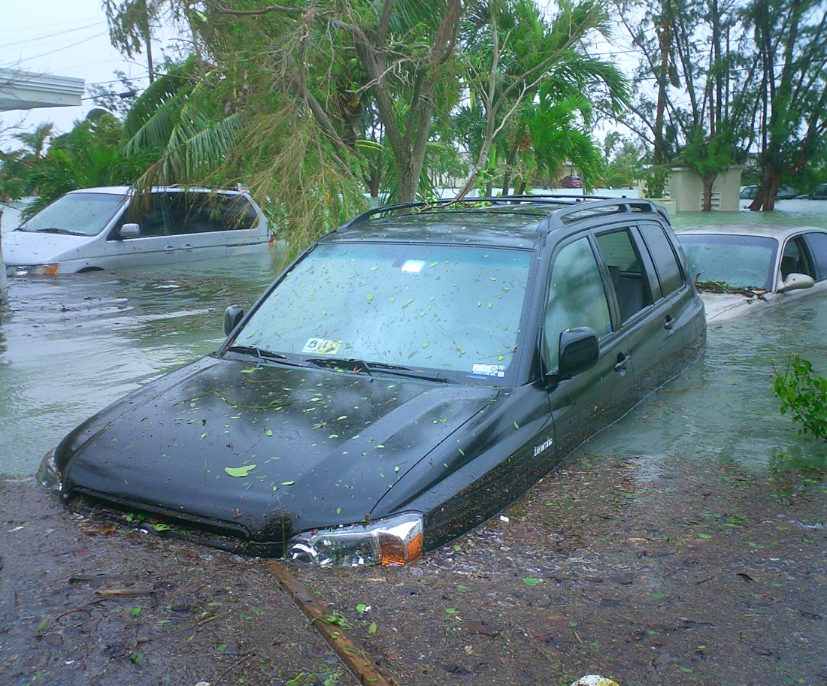
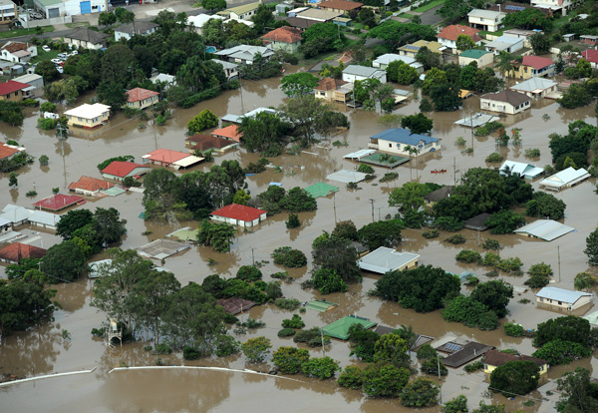
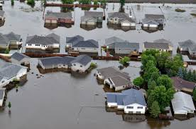
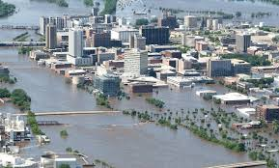

Slide 5

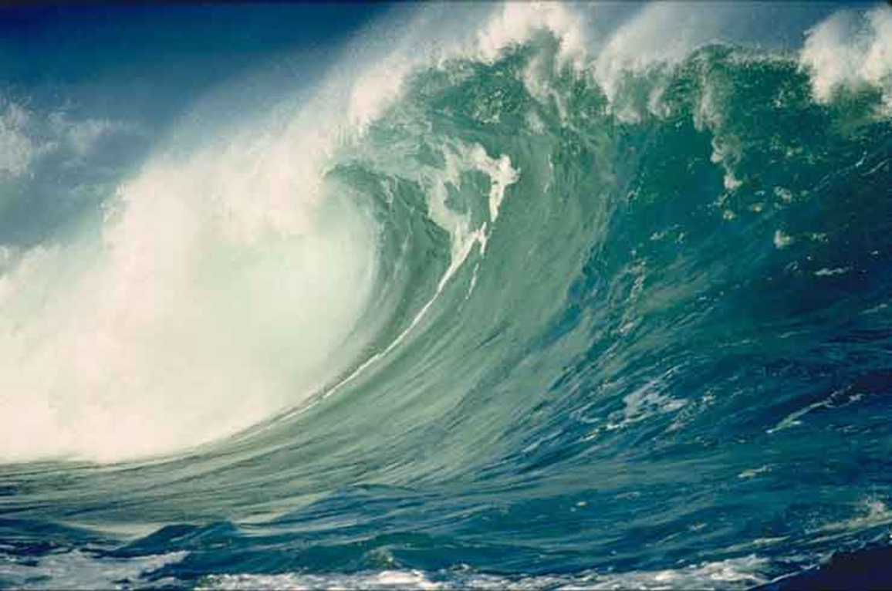
A tsunami is a series of water waves caused by the displacement of a large volume of a body of water, generally an ocean or a large lake. Earthquakes, volcanic eruptions and other underwater explosions , landslides, glacier calvings, meteorite impacts and other disturbances above or below water all have the potential to generate a tsunami.

Slide 6
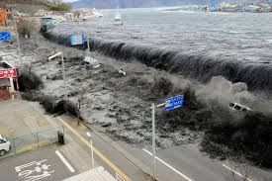
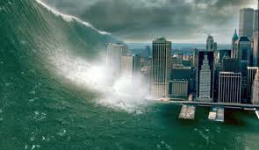
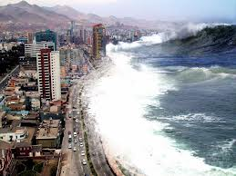
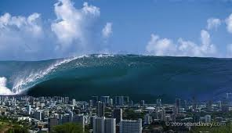

Slide 7
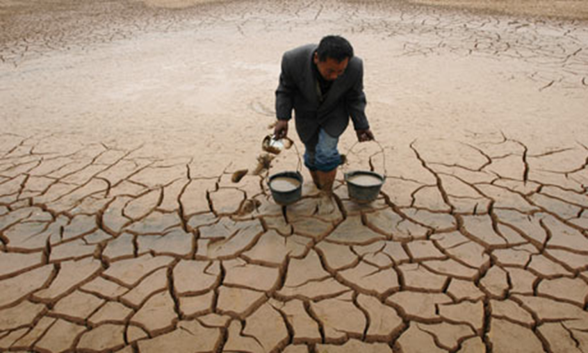
Drought
Drought is an extended period when a region notes a deficiency in its water supply whether surface or underground water. A drought can last for months or years, or may be declared after as few as 15 days. Generally, this occurs when a region receives consistently below average precipitation. It can have a substantial impact on the ecosystem and agriculture of the affected region. Although droughts can persist for several years, even a short, intense drought can cause significant damage

Slide 8
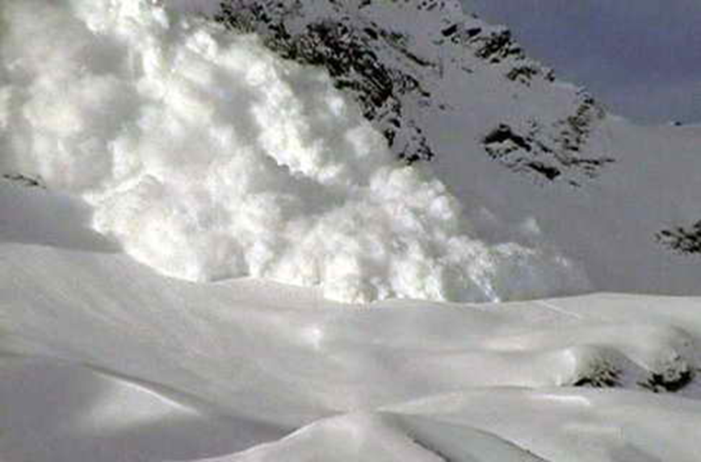
Avalanche
The load on the snowpack may be only due to gravity, in which case failure may result either from weakening in the snowpack or increased load due to precipitation. Avalanches can also be triggered by other loads such as skiers, snowmobilers, animals or explosives.

Slide 9
