Slide 1
Charitable organizations

Slide 2


Slide 3
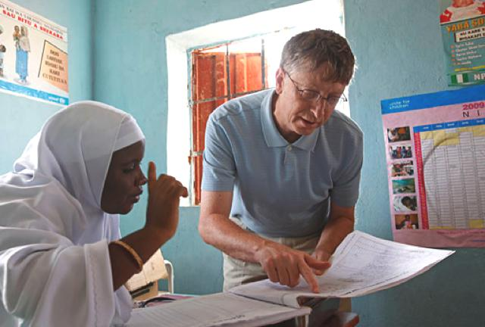
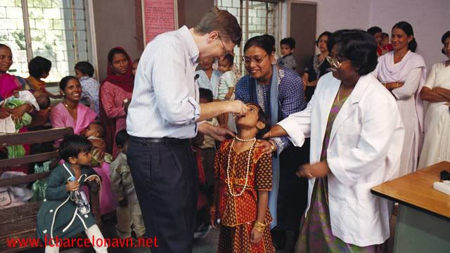
Bill & Melinda Gates Foundation is the biggest charitable foundation in the world.

Slide 4
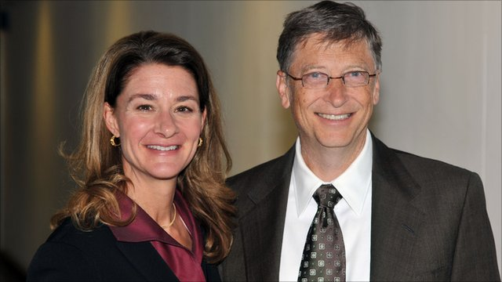
It was founded by Bill Gates and his wife Melinda in 1994.

Slide 5

This foundation is situated in Seattle state Washington.

Slide 6
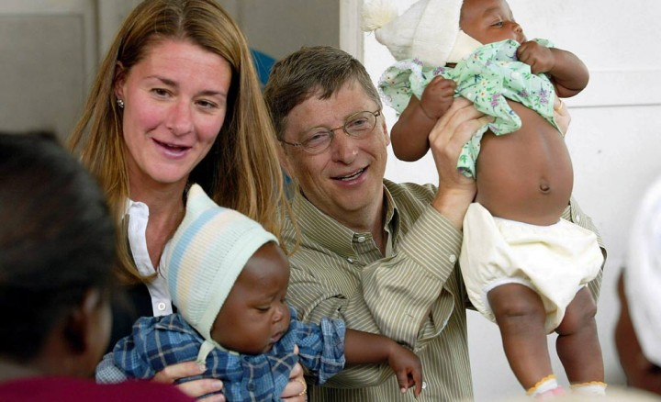
The fund is about 26 billiard dollars.

Slide 7


In 2006 the mumber of this foundation Warren Buffet donated 37 million dollars.

Slide 8
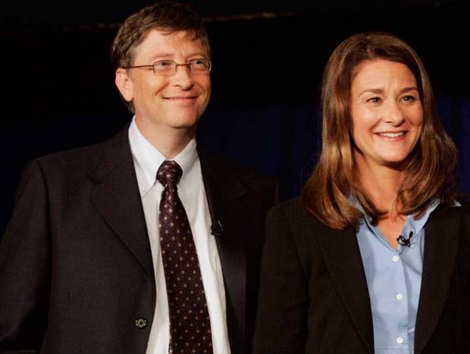
It was the biggest donation in the history of the USA.

Slide 9

The main aim of this foundation is to support the system of health careness and to overcome the famine in poor countries.

Slide 10




Slide 11
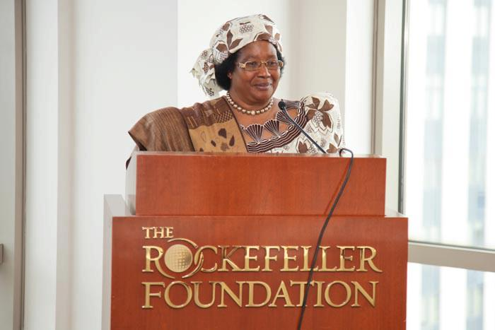
Rokfeller « s Foundation is a charitable organization and a private foundation.

Slide 12

It was founded by a famous business man John Rokfeller and his son John.
The main historic mission is to help the mankind in different fields.

Slide 13


Slide 14



Slide 15
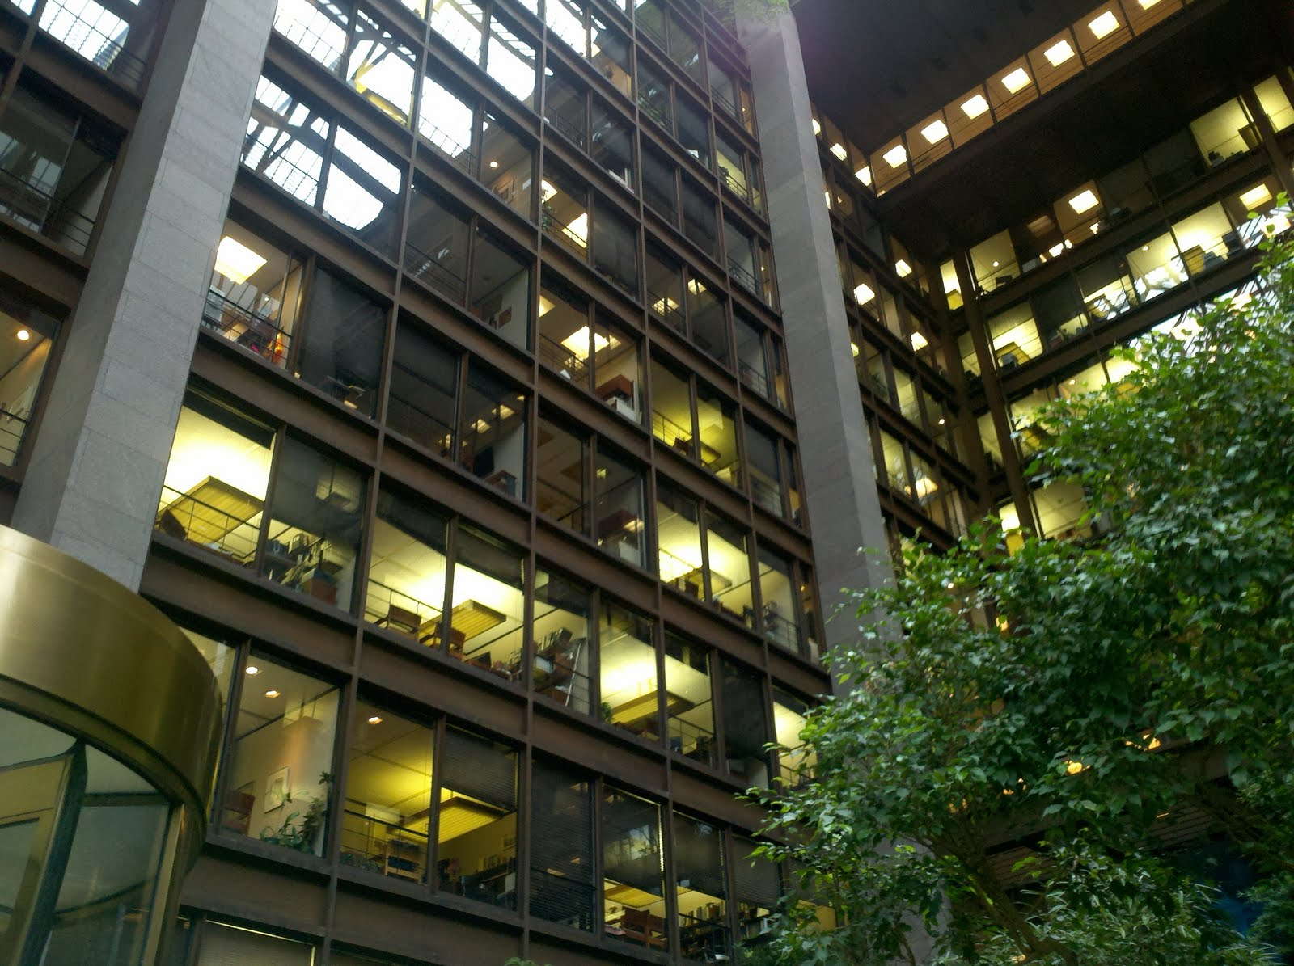
Ford” s Foundation is an American charity foundation.
It was founded to finance different projects and programmes to support democracy, to diminish poverty and to develop international cooperation.

Slide 16
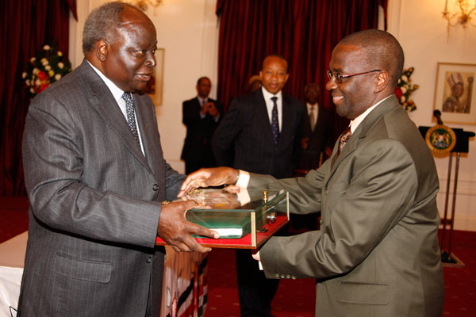
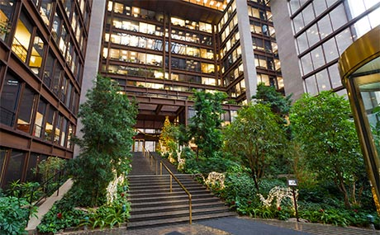
The staft of the foundation is in New York.
It was founded in 1936 by Enselan Ford his son Henry and two directors.

Slide 17


Slide 18


After Endsel” s death in 1943 and Henry Ford» s death in 1947 Henry Ford 2 became the director.
In 1952 the Foundation opened his first international office in New Deli, India.

Slide 20


At the end of 1980s this Foundation began to help in the fighting with AIDS.

Slide 21
Thank you for your attention!

