Slide 1
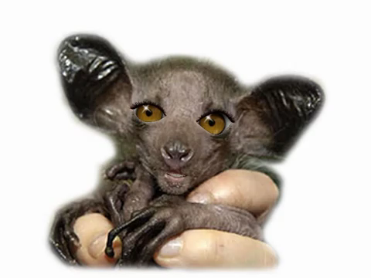

Slide 2
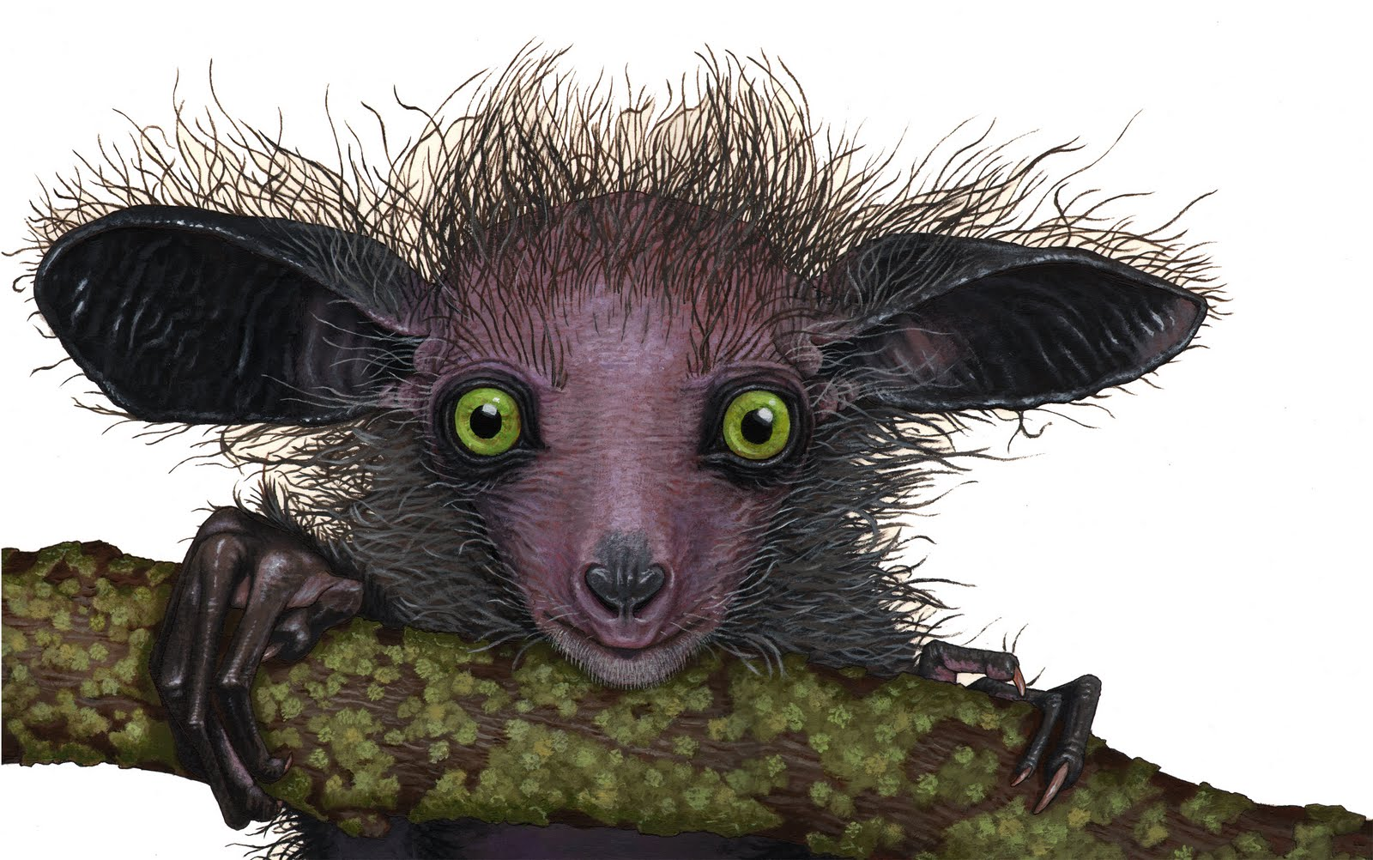
Aye-Aye

Slide 3
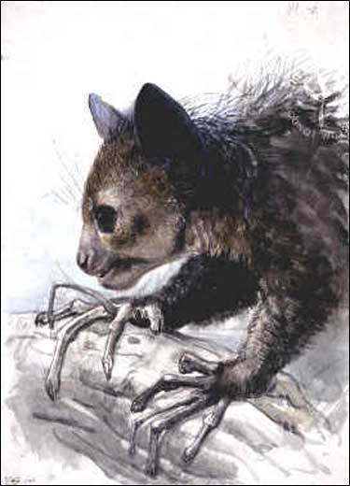
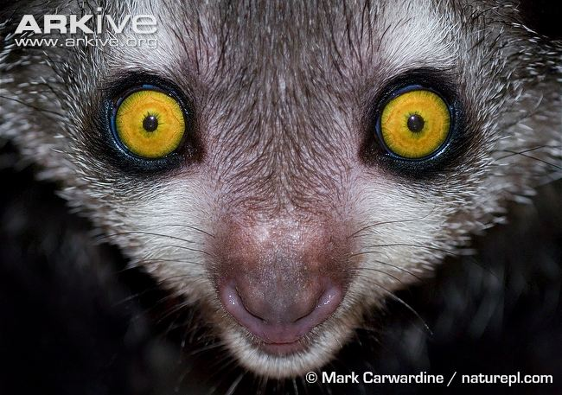
Aye-Aye
The aye-aye with its strange looks and extremely thin fingers is considered to be one of the most unusual primates in the world. It is rare and listed as a near-threatened species.

Slide 4
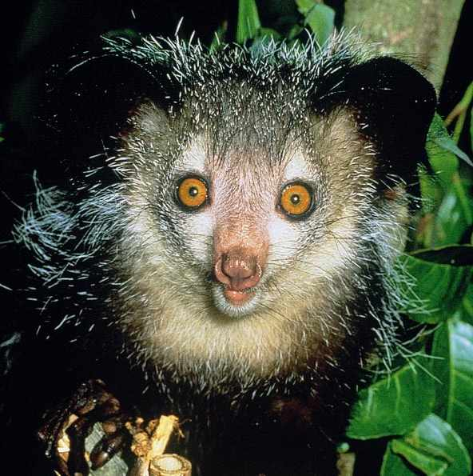
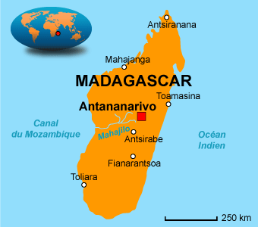
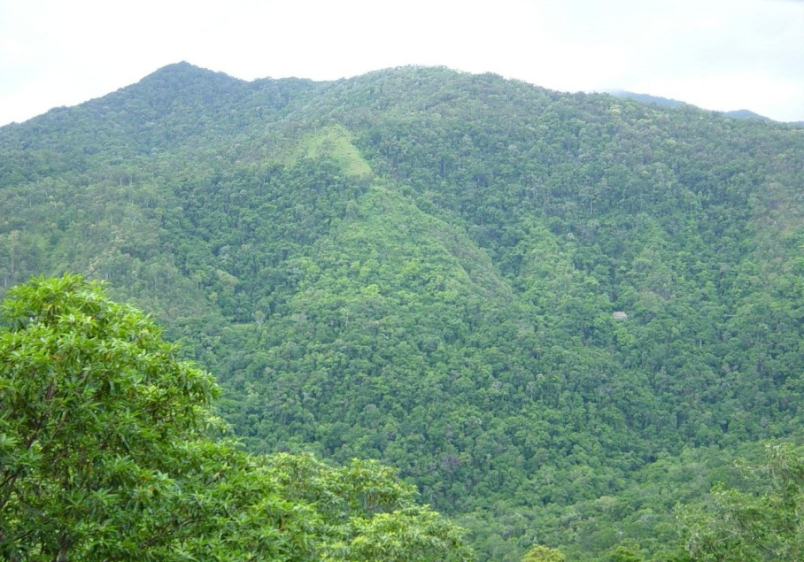
These rare animals may not look like primates at first glance, but they are related to chimpanzees, apes, and humans. Aye-ayes can be found only on the island of Madagascar. They lives in the tallest of the trees which are found in the rainforests of the island.

Slide 5
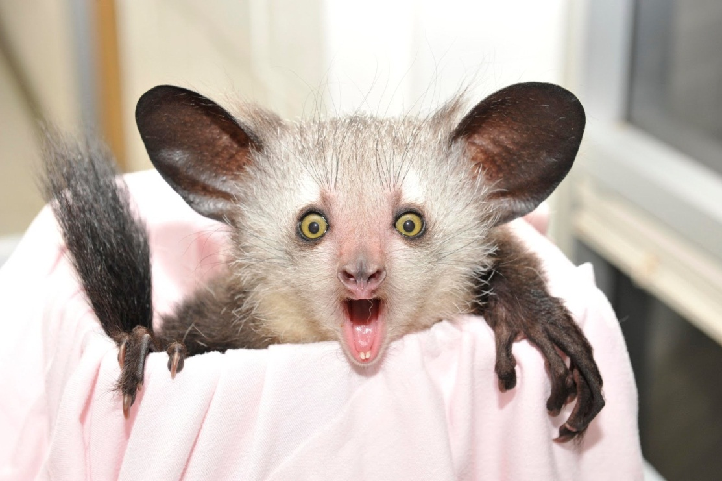
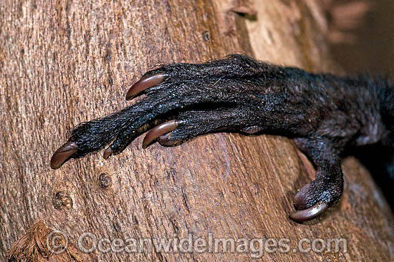
The Look
Aye-ayes have a black or dark brown coarse shaggy coat with a few white hair that blend into the foliage in the dark. Their most distinguishing features include the long bushy tail that is longer than the body, large sensitive ears, slender and long fingers, and big beady eyes. All the toes and fingers are equipped with pointed claws, apart from the opposable big toes, which help them to hang from branches.

Slide 6
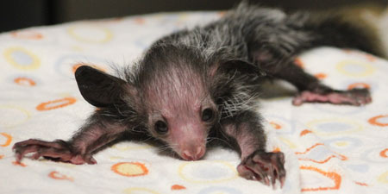
Quick Facts
They are found only on the northeastern coast of Madagascar.
This rodent-like creature has incisor teeth that grows continuously till the day they die.
They tend to build new nests with twigs and leaves, and shift every few days. They sometimes construct up to 20 nests in their territory.
The strange aye-aye feeds on animal matter, nuts, insect larvae, nectar, seeds, fungi, and fruits such as coconuts, mangoes, lychees and even sugar cane!
They are mostly found at an altitude of above 700 meters in the deciduous forests.
The ancient legends of Malagasy considered it the symbol of death due to its scary looks and eerie call.
Their lifespan in natural habitat is unknown, but if bred in captivity, they are known to live up to 20 - 23 years.
The aye-aye is the largest nocturnal primate in the world. They are highly active during the night, moving over large distances, hardly ever stopping to rest.
They weigh around 6 to 7 pounds, and can grow up to 2 feet tall. Their extra-long bushy tail can sometimes seem like it is twice the length of their bodies.
Their predators are mostly humans, the cat-like fossa (another inhabitant of Madagascar), and some birds of prey.
They are gentle and curious primates, and are quite harmless, though they are aggressive towards each other.
The aye-aye has been categorized as 'Near Threatened' by IUCN red list, as it is estimated that there are only about 1,000 to 2,000 left in the forest of Madagascar. Today, it is a protected animal, and efforts are on to try to revive their numbers.

Slide 7
