Slide 1
Alaska

Slide 2
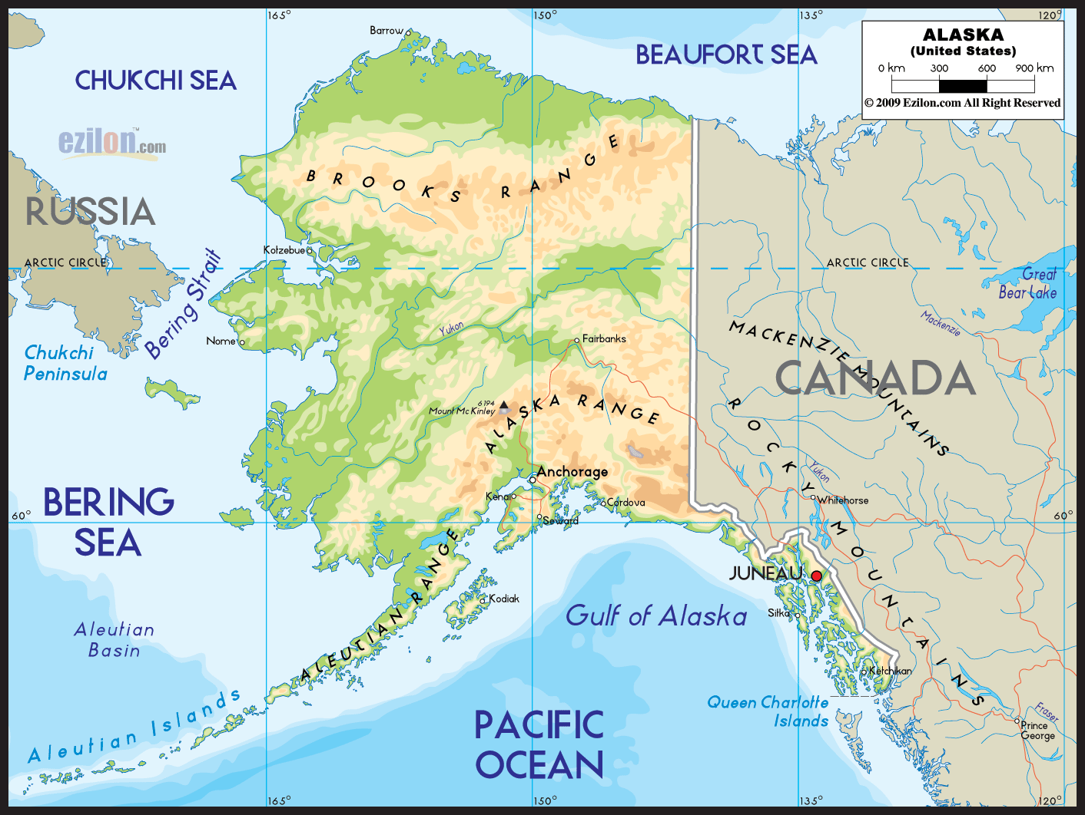
Alaska
Alaska is the largest state in the United States in land area at 663,268 square miles. Counting territorial waters, Alaska is larger than the combined area of the next three largest states: Texas, California, and Montana. It is also larger than the combined area of the 22 smallest U.S. states.

Slide 3
Alaska natives, languages
Numerous indigenous peoples occupied Alaska for thousands of years before the arrival of European peoples to the area.
According to the 2011 American Community Survey, 82.4% of people over the age of five speak only English at home. About 3.5% speak Spanish at home. About 2.2% speak another Indo-European language at home and about 4.3% speak an Asian language at home

Slide 4
Religion
According to statistics collected by the Association of Religion Data Archives from 2010, about 34% of Alaska residents were members of religious congregations. 100,960 people identified as Evangelical Protestants, 50,866 as Roman Catholic, and 32,550 as mainline Protestants. Roughly 4% are Mormon, 0.5% are Jewish, 1% are Muslim, 0.5% are Buddhist, and 0.5% are Hindu.

Slide 5
Iditarod Trail Sled Dog Race
Some of Alaska's popular annual events are the Iditarod Trail Sled Dog Race that starts in Anchorage and ends in Nome.

Slide 6
The wildlife of Alaska is diverse and abundant.
Alaska contains about 98% of the U.S. brown bear population and 70% of the total North American population.
The black bear is much smaller than the brown bear. They are found in larger numbers on the mainland of Alaska

Slide 7
polar bear
Alaska's polar bear populations are concentrated along its Arctic coastlines.

Slide 8
Caribou
Alaska is home to the Rangifer tarandus granti subspecies of caribou. Caribou in Alaska generally are found in tundra and mountain regions, where there are few trees. However, many herds spend the winter months in the boreal forest areas. Caribou are large-scale migratory animals and have been known to travel up to 50 miles (80 km) a day. The migratory activities of caribou are usually driven by weather conditions and food availability.

Slide 9
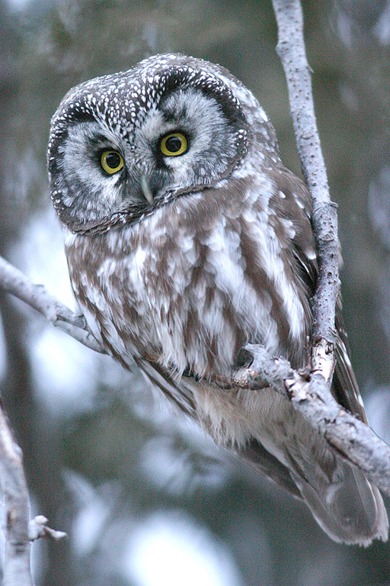
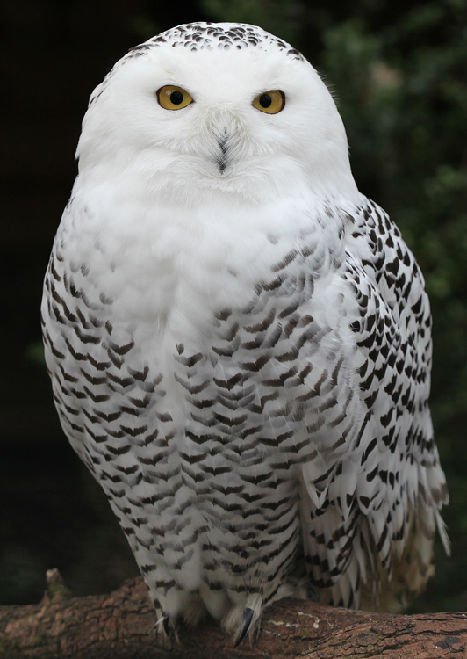
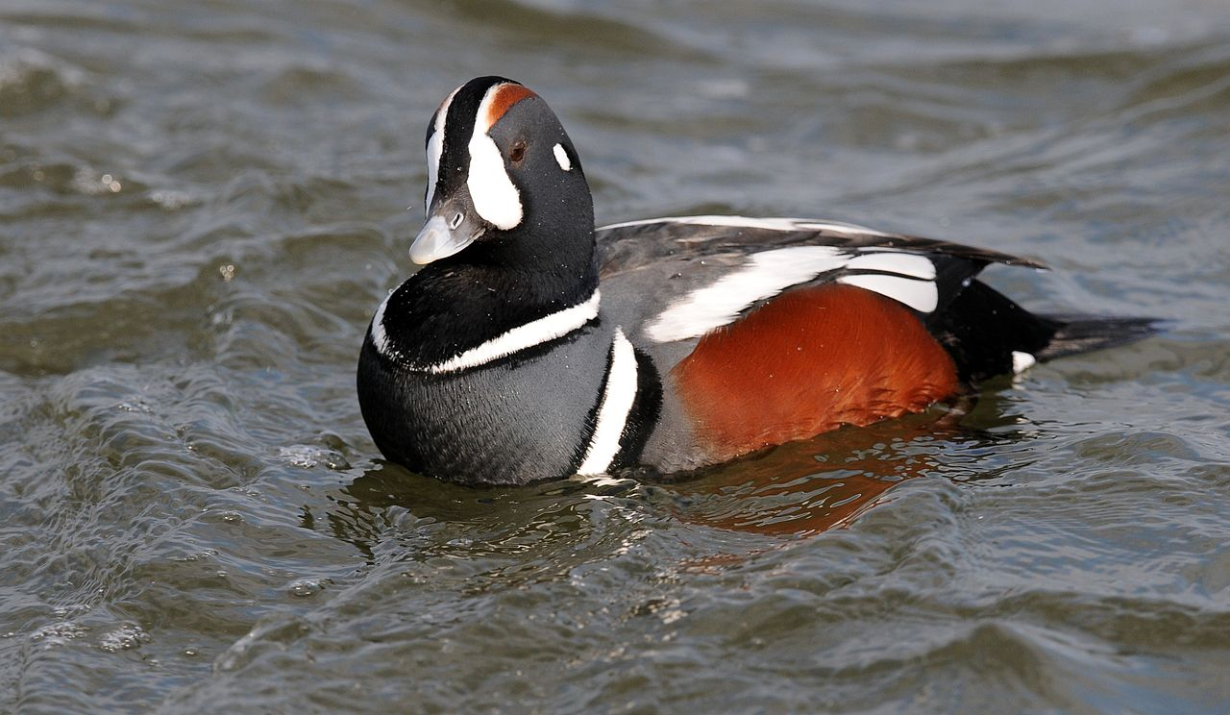
Birds
Hundreds of species of birds inhabit Alaska

Slide 10
Mendenhall ice caves in Alaska
In few places can you experience every stage of the water cycle at once. But there's magic in the Mendenhall Ice Caves, where water runs over rocks under blue ceilings inside a partially hollow glacier.
The Mendenhall Glacier is a 12-mile-long glacier in the Mendenhall Valley, located only 12 miles from downtown Juneau in Southeast Alaska.

Slide 11
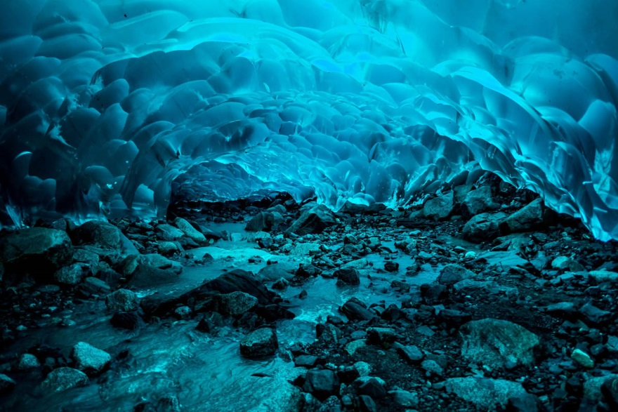
Mendenhall ice caves in Alaska
Over the past year, researchers have noticed strange ancient trees standing upright in the ice caves. Turns out that as it recedes, the glacier is unearthing forests which have been frozen for the last 1,000 years or so.

Slide 12
northern lights
Alaska is one of the best places on earth to see the northern lights – colorful bands of light that dance in the dark night sky. Travelers from all over the world come to Alaska each winter to see this stunning display.

Slide 13
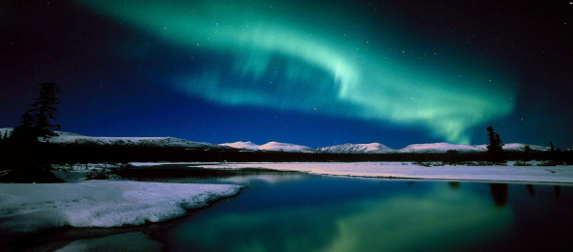
northern lights

Slide 14
Alaska is one of the most beautiful places in the world. It is very expensive and isolated place. It is very famous among tourists. There are many places in this world with the spectacular and awe-inspiring beauty. Alaska is considered most wonderful place.

