Slide 1
City of My Dreams
Presentation prepared by Tania Shchur

Slide 2
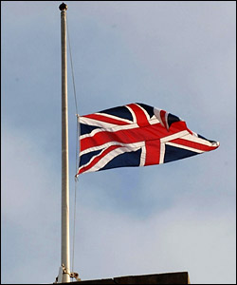
❤London❤
I've never been to London, but to visit the capital of Great Britain is dream of my life.

Slide 3
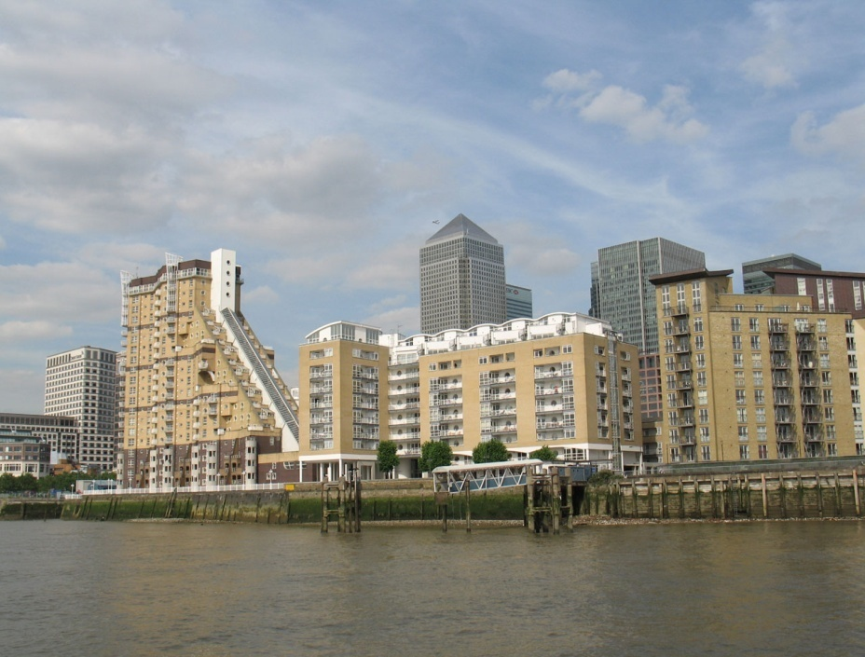
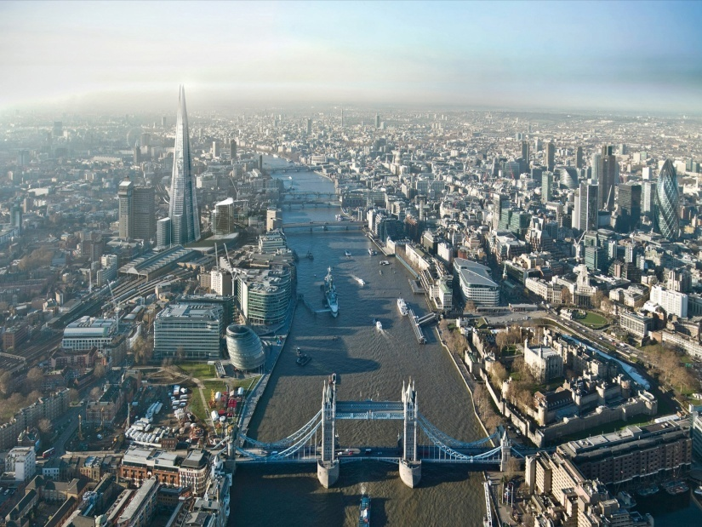
There are many interesting places to visit in London, such as WWT London Wetlands Centre, London Eye Ferris Wheel, London Dungeon, London Planetarium and many others.

Slide 4
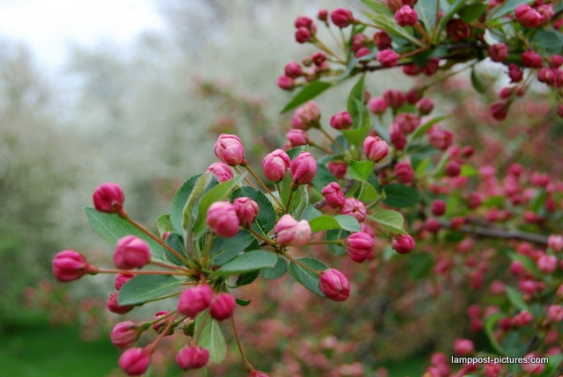
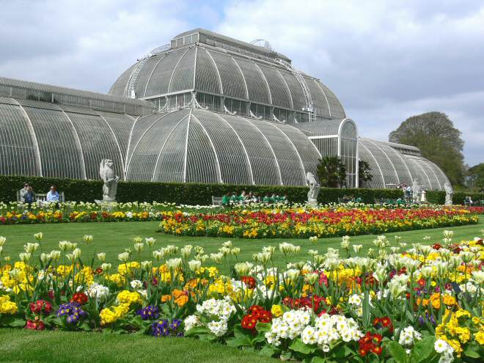
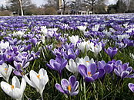
Kew Gardens
The Royal Botanic Gardens, Kew, usually referred to as Kew Gardens, is 121 hectares of gardens and botanical glasshouses between Richmond and Kew in southwest London.

Slide 5
Kew Gardens

Slide 6
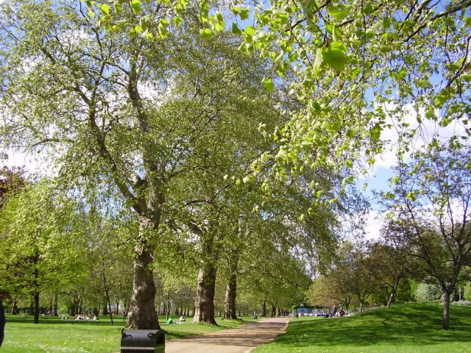
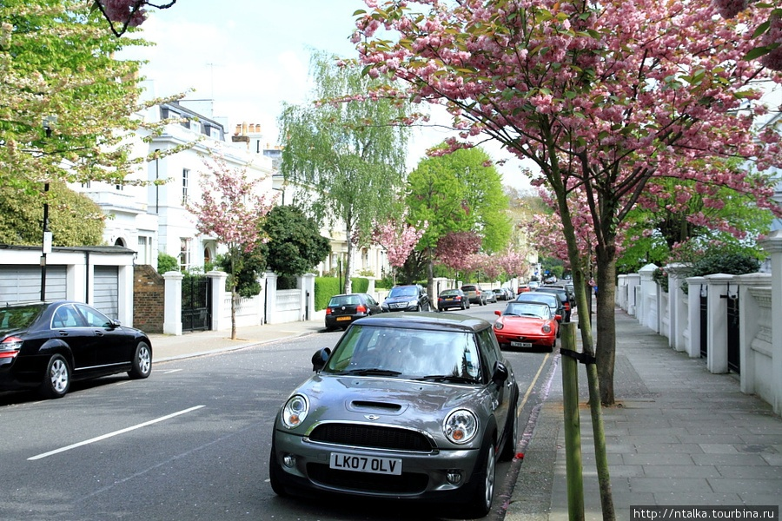
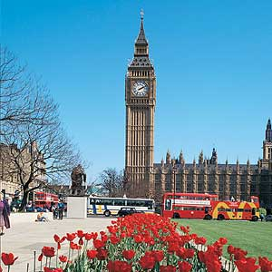
Come to London in the spring. In the spring, the city is getting warmer by gentle spring sun. Spring - the perfect time to visit the many attractions of London.

Slide 7
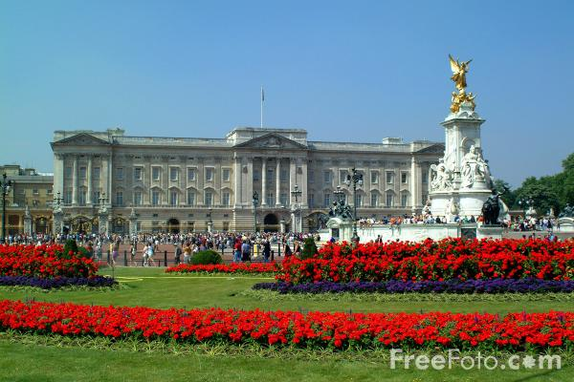
You can admire the flowers at Kew Gardens (Kew Gardens), to observe the newly hatched ducklings in a London Centre of wildlife and aquatic lands (WWT London Wetlands Centre) or a stroll in one of the beautiful Royal Parks of London.

Slide 8
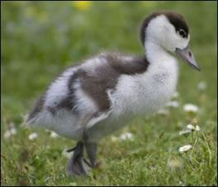
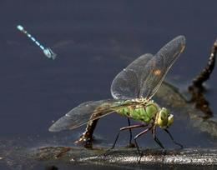
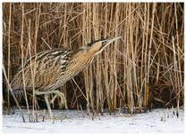
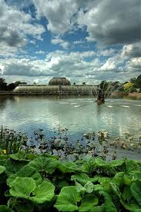
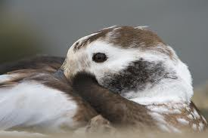
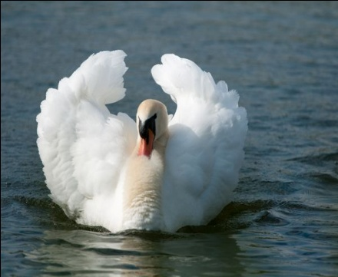
WWT London Wetlands Centre

Slide 9
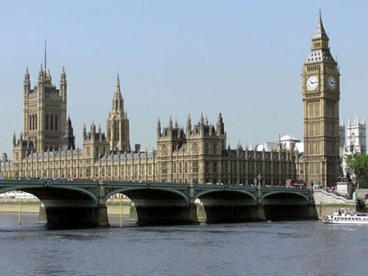
The capital of Great Britain is a very popular city for tourists not only in his country and Europe as a whole, and in London there are many attractions, many of which are included in the UNESCO World Heritage List. Everyone is familiar with names such as Big Ben, Tower of London, Westminster, Buckingham Palace, Trafalgar Square etc.

Slide 10
Tower Bridge - a bridge with a combined mobile farm in London, England over the River Thames. That's close proximity to the Tower of London, gave the name of this bridge. Tower became a symbol of London as Big Ben or the Houses of Parliament of Great Britain.

Slide 11
London Eye Ferris Wheel

Slide 12
Tower Bridge

Slide 13
Big Ben

Slide 14
Park Hotel

Slide 15
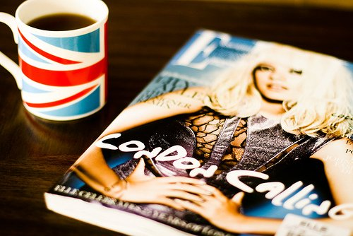
❤ P.S.❤
I hope that my dream will come true once, and I see all the recreation of London.

