Slide 1
Henry Ford
Performed:
student of 11th class
Marta Mankina

Slide 2
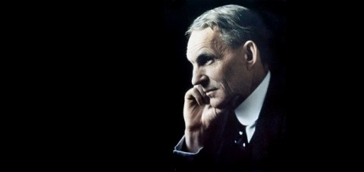
Henry Ford was born in the town of Springfield, Michigan July 30, 1863. He was the eldest of six children of William and Mary Ford, who owned a prosperous farm. Childhood Henry went to his father's farm, where he helped the family and attended regular village school. The huge interest in technology that Henry showed even at a very young age, and allowed him to become one of the most famous manufacturers in the world.

Slide 3
Experience
At age 12 , Henry equipped small shop, where enthusiastically spent all his spare time. It was there a few years later he designed his first steam engine. In 1879, Henry Ford moved to Detroit, where he was employed assistant engineer . Three years later, Ford moved to Dearborn in the course of five years in the construction and repair of steam engines , laboring from time to time at a factory in Detroit. In 1888 he married Clara Braent and soon took over as manager at the mill .
In 1891, Ford became an engineer company Edison Illuminating, and two years later was appointed chief engineer of the company. A decent salary and enough free time allowed Ford devote more time to the development of internal combustion engines.

Slide 4
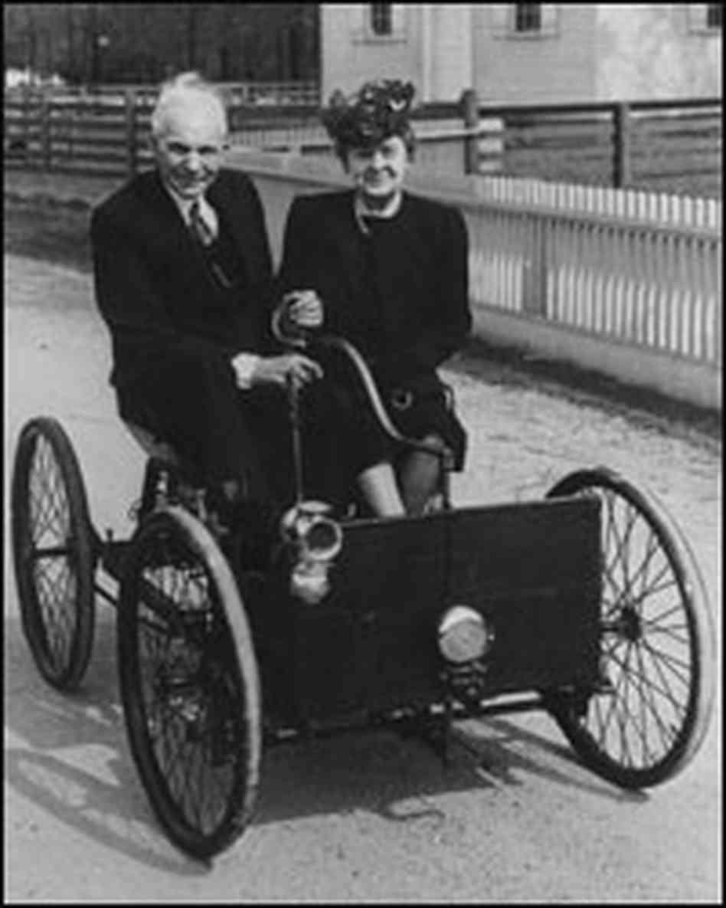
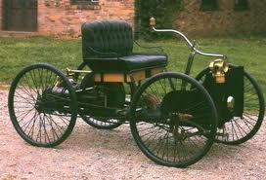
Quad bike
The first internal combustion engine Ford gathered in the kitchen of their home. Soon he decided to put the engine on the frame with four bicycle wheels. So in 1896, appeared ATV - a vehicle which has become the first car Ford.

Slide 5
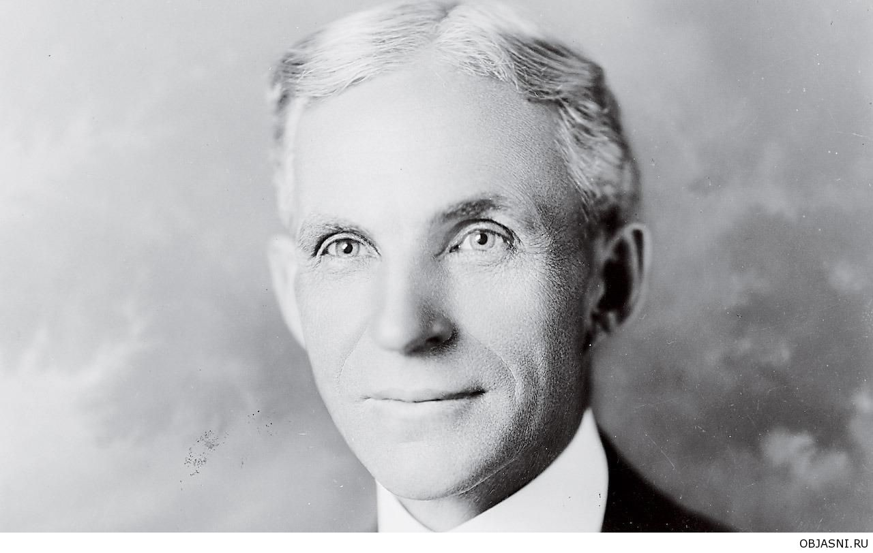
Own business
Released in 1899, the company Edison Illuminating, Henry Ford founded his own firm Detroit Automobile. Despite the fact that the company went bankrupt a year later, Ford has managed to gather a few race cars. Ford himself took part in the race and in October 1901 was able to win the championship of America Alexander Winton.

Slide 6
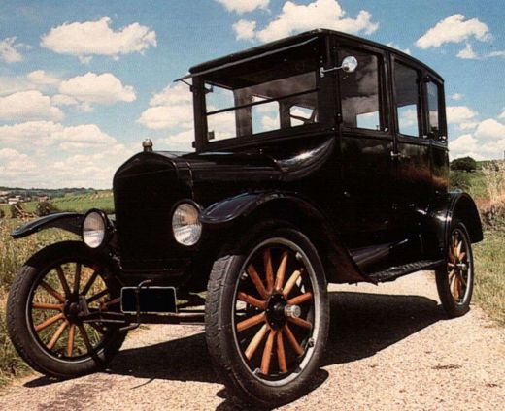
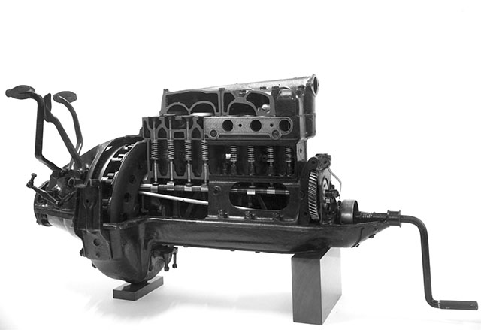
The company "Ford Motor"
The company "Ford Motor" appeared in 1903. Its founders were twelve businessmen from the state of Michigan , led by Henry Ford, which held 25.5 % of the shares and held the positions of vice - president and chief engineer. The first company car was sold July 23, 1903 . In 1906, Henry Ford became president and principal owner of the company.
In 1908, Henry Ford embodied in his dream by releasing model «T» - reliable and affordable car that was one of the most popular and the most popular cars of its time. It is the emergence Ford Model "T" marked a new era in the development of personal transport.

Slide 7
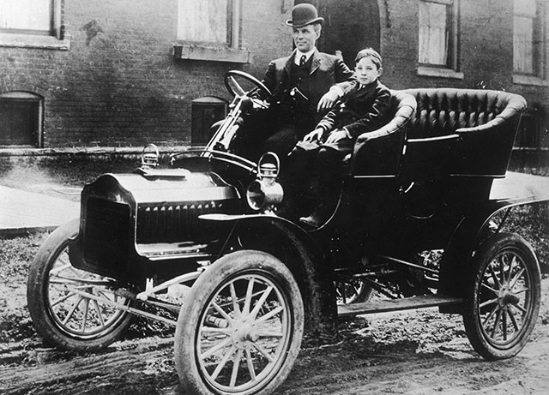
A new generation
In 1919, Henry Ford and his son Edsel bought shares in the company by other shareholders of U.S. $ 105,568,858 and became the sole owner of the company. In the same year, Edsel inherited from his father as president, which he held until his death in 1943. After the sudden death of the son of Henry Ford once again had to stand at the helm of the company.

Slide 8
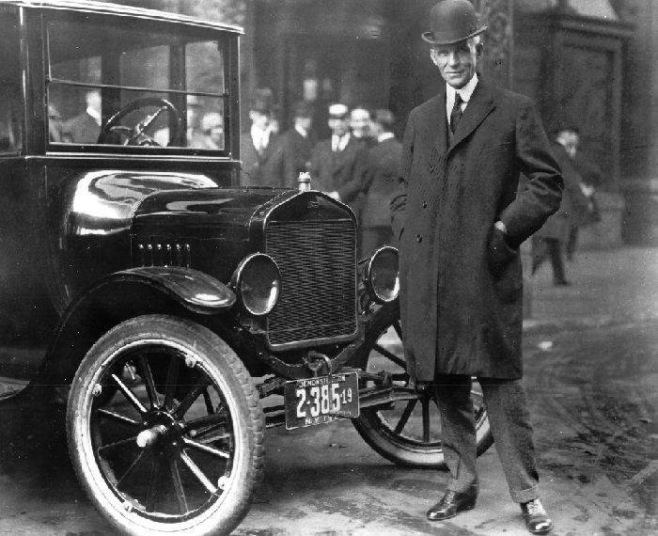
Retirement
In September 1945, Henry Ford gave authority to his eldest grandson - Henry Ford II. In May 1946, Henry Ford Senior was awarded an honorary award for services to the auto industry, and at the end of that year, the American Petroleum Institute awarded him a gold medal for services to the community.

Slide 9
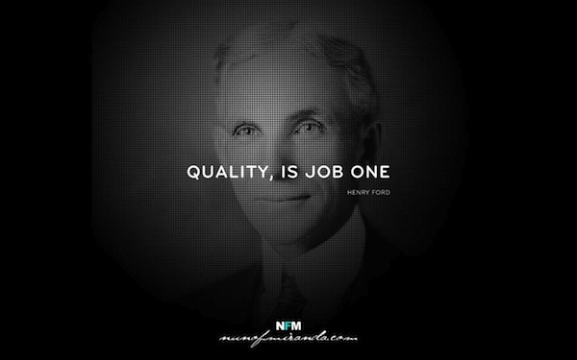
End of era
Henry Ford died at the age of 83 years at his home in Dearborn April 7, 1947. Thus ended an era in the history of Ford Motor, which despite the death of its founder continued to develop.

Slide 10
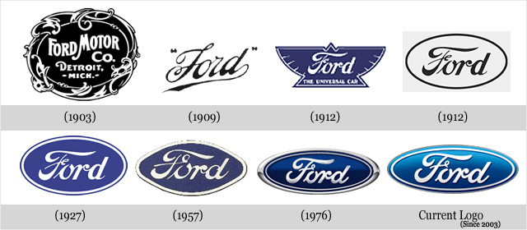

Slide 11
Thank you! ☺

