Slide 1
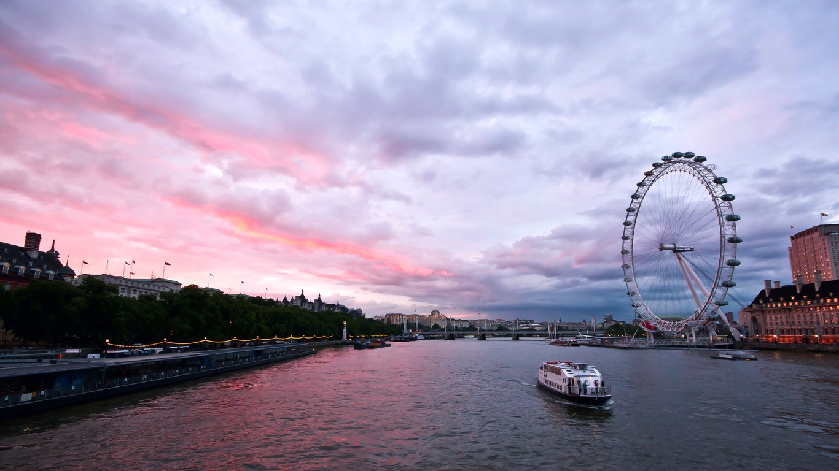
LONDON
Piccadilly Circus

Slide 2
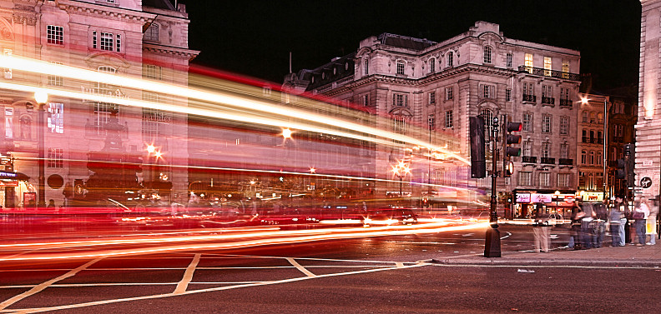
Many Londoners agree that the center of London is located at Piccadilly Circus.
Piccadilly Circus has appeared in London in 1819 and soon gained fame as the most bustling and never sleeping area.

Slide 3
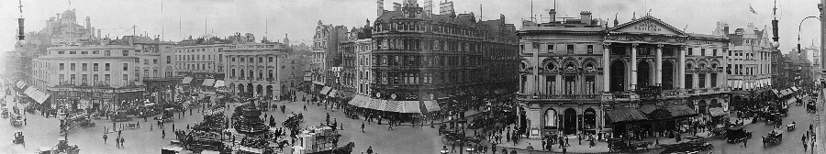
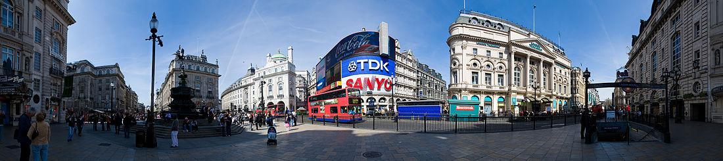
The area is the historic center of London and is located at the intersection of four major shopping streets - Regent, Shaftesbury Avenue, Piccadilly and Covent.

Slide 4
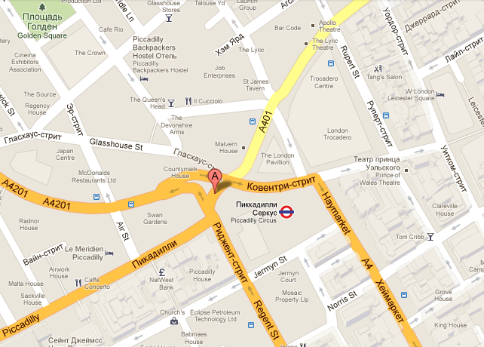
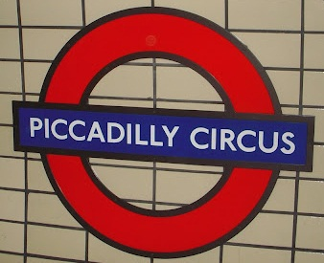
Sometimes the word circus mistranslated as an entertainment show. In fact, it is word that means "circle" - a typical organization of road junctions and intersections for England.

Slide 5


The name itself was born probably in the XVII century, when lace collars - "pikkadills" were smartly traded there.

Slide 6

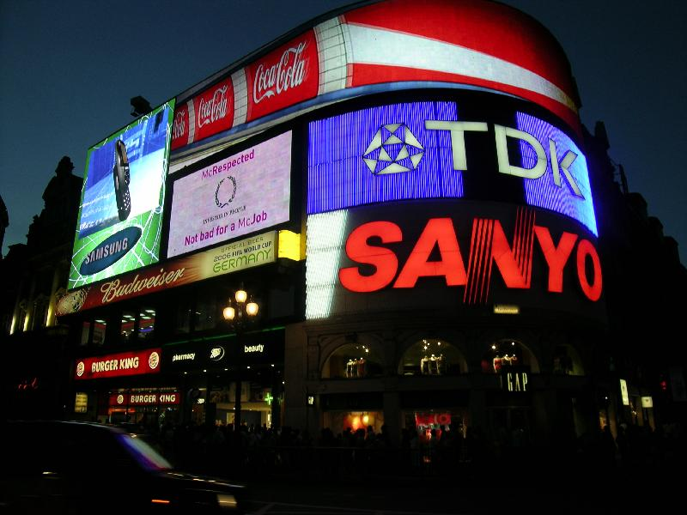
Six grand panels illuminate Piccadilly Circus since 1980, and they are a symbol of modern London.

Slide 7

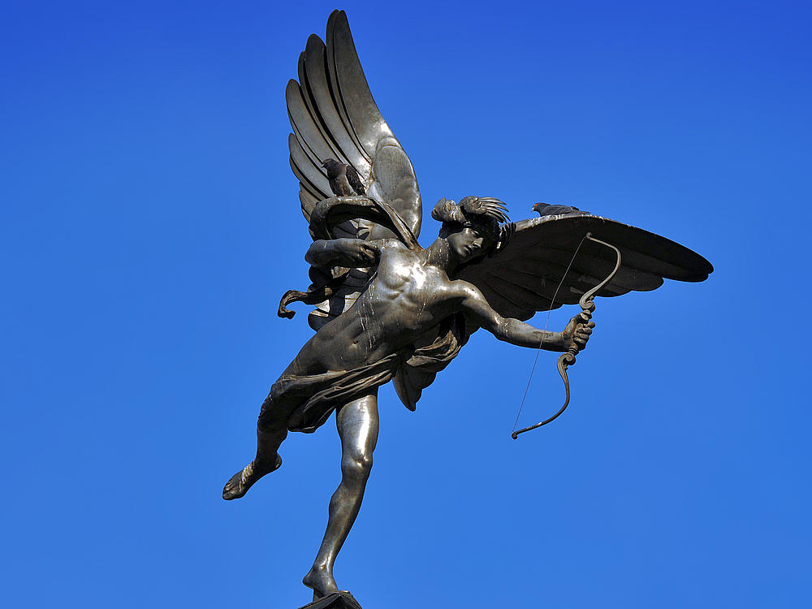
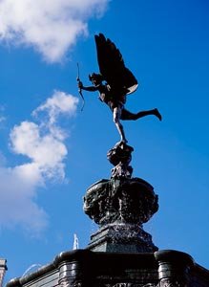
The Angel of Christian Mercy

Slide 8
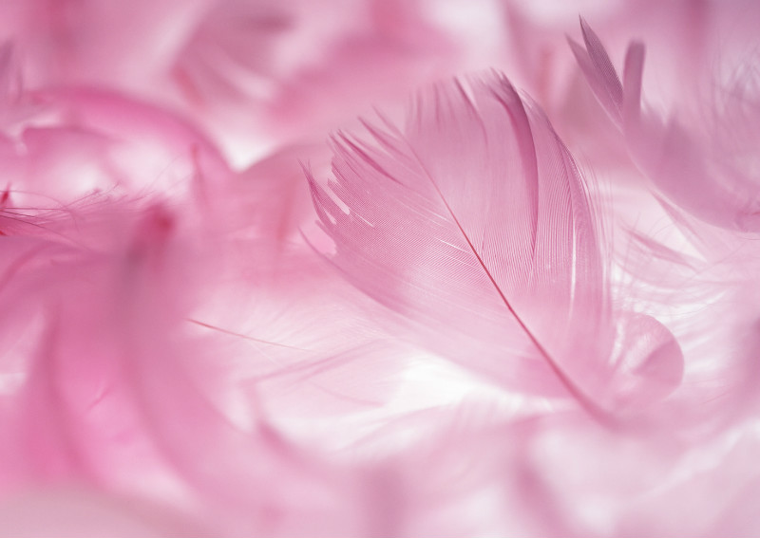
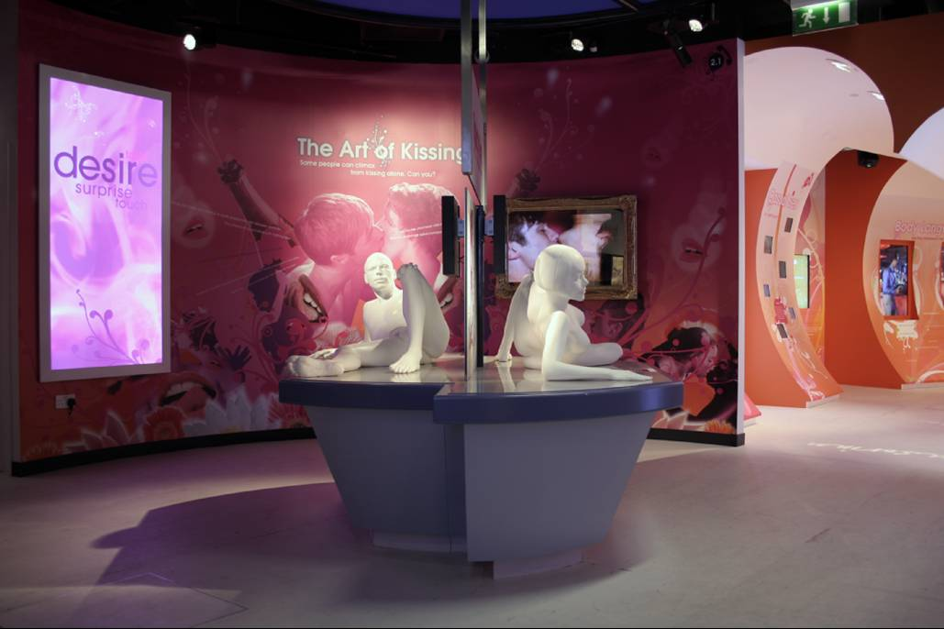
Rooms are made in pink and reddish tones, and skillfully installed lighting creates the right atmosphere.

Slide 9

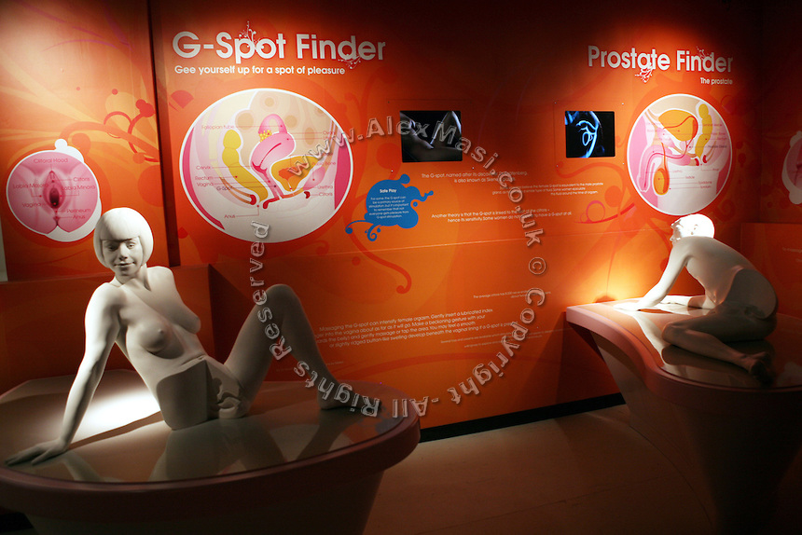
Amora - is a complete encyclopedia of love that illuminates the hidden side of the relationships between a man and a woman.

Slide 10
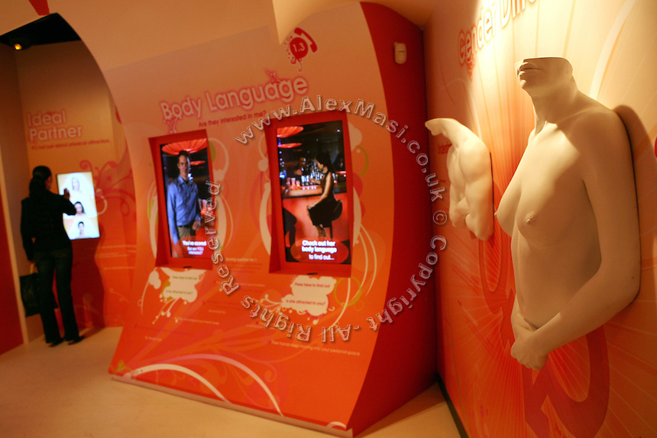

Slide 11

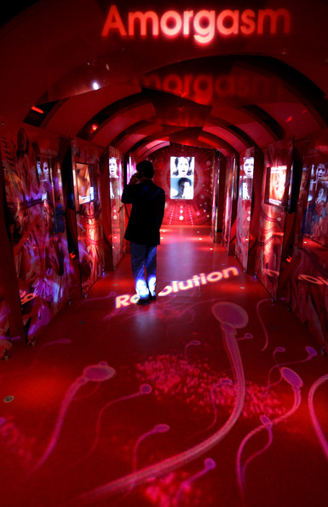
"You can know nothing
about sex, but after
visiting this place, you will get all the necessary information and will be able to build a relationships that will satisfy you."

