Slide 1
National British gallery

Slide 2
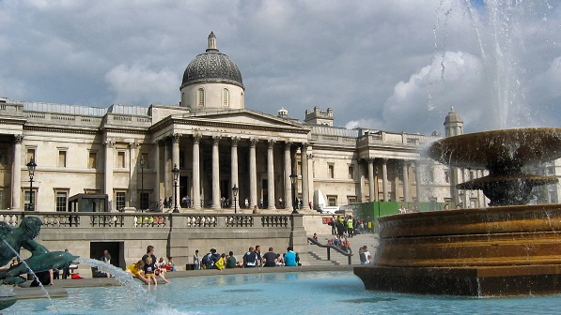
History
The National Gallery is an art museum on Trafalgar Square in London. It was founded
on April of 1824 by art dealer, painter, and official functionary in the art world William
Seguier, but officially it was opened to the public on May 1824. Gallery was housed in
Angerstein's townhouse on Pall Mall - is a street in the City of Westminster, London.
Angerstein's 35 paintings were joined in 1826 and after the exhibition, all of these
paintings have brought great success to the museum.
In 1832 construction began on a new building by William Wilkins. The location was a
significant one, between the wealthy West End and poorer areas to the east. «The
collection could be accessed by people of all social classes» - was the main argument for
that.

Slide 3
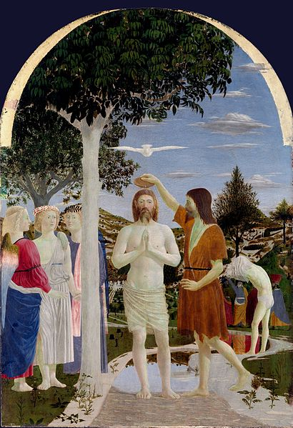
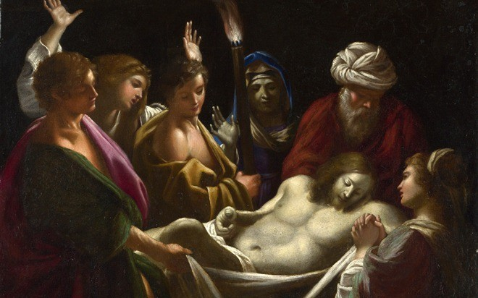
History
15th- and 16th-century Italian paintings were at the core of the National Gallery and for the first 30 years were the mainest works.
The\Jesus Christ in his grave.
Jesus Christ in his grave
by Sisto Badalocchio
Baptism of Jesus Christ by Piero della Francesca.

Slide 4
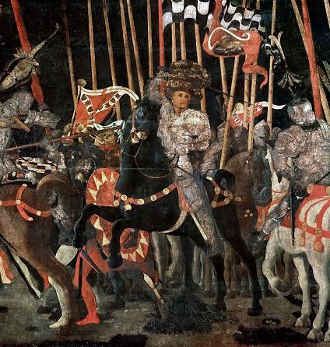
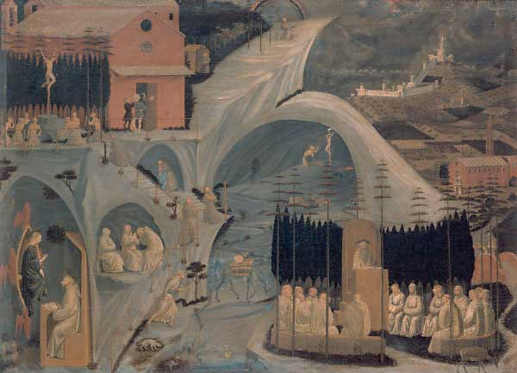
History
Sir Charles Lock Eastlake, who was President of the Royal Academy, played an essential
role in the foundation of the National Gallery. When Eastlake became a new keeper of
museum, he made ​​annual tours to the continent and to Italy to buy there painting. The most
famous works of that times in the National Gallery were paintings of Paolo Uccello's Battle
of San Romano and Episodes hermit life.

Slide 5
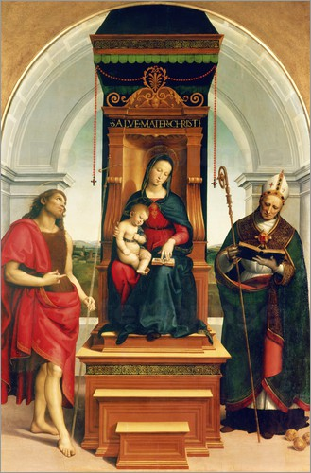
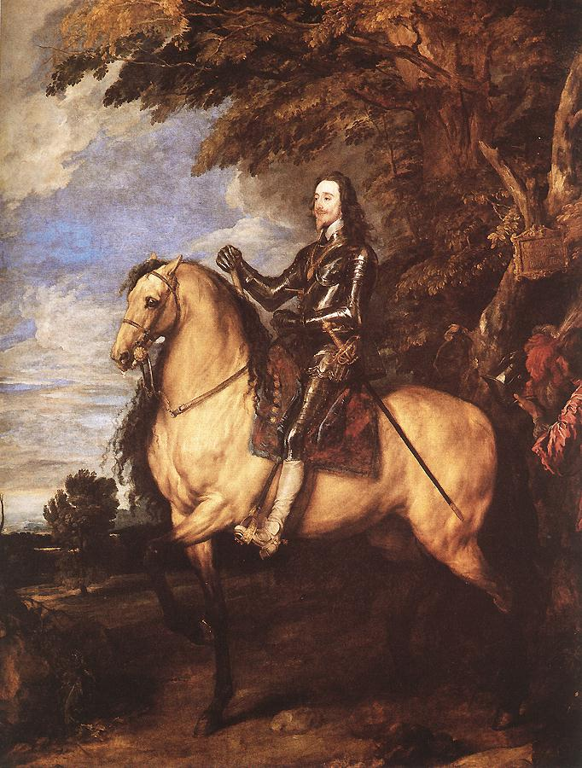
History
The third director, Sir Frederick William Burton, laid the foundations of the collection of
18th-century art and made several outstanding purchase from English private collections.
The purchase in 1885 of two paintings from Blenheim Palace, Raphael's Ansidei Madonna
and Van Dyck's Equestrian Portrait of Charles I.

Slide 6
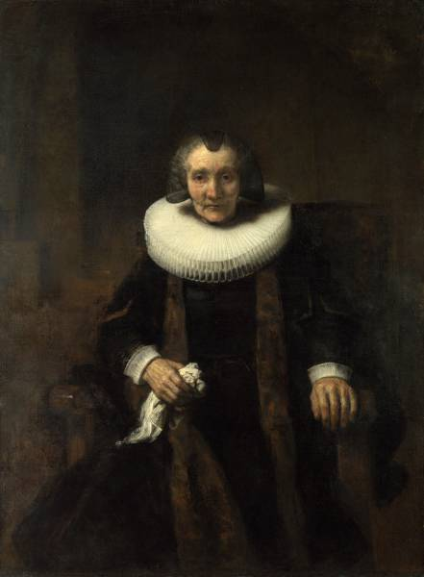
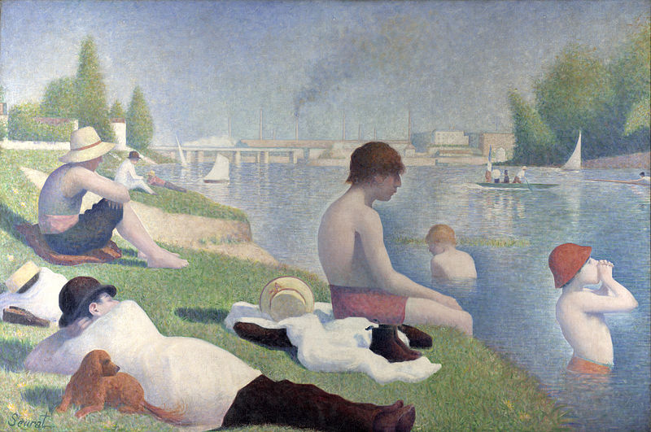
History
In the 20 century in National Gallery were many new paintings and purchase, but most
impressive were Seurat's Bathers at Asnières and Rembrandt's Portrait of Margaretha de
Geer.

Slide 7
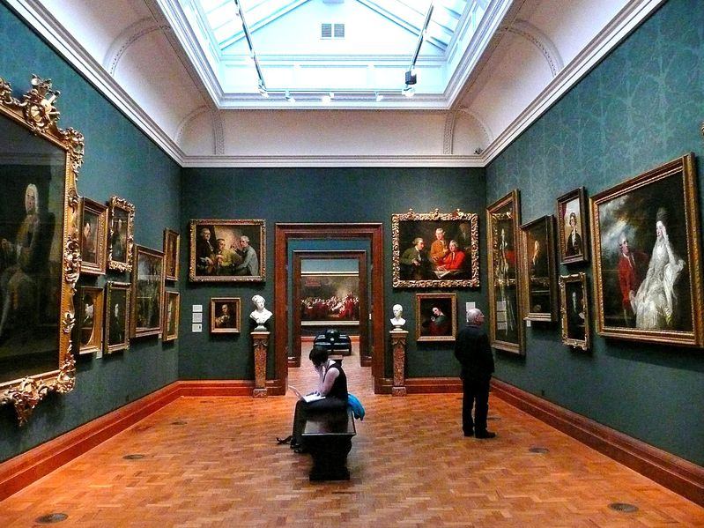
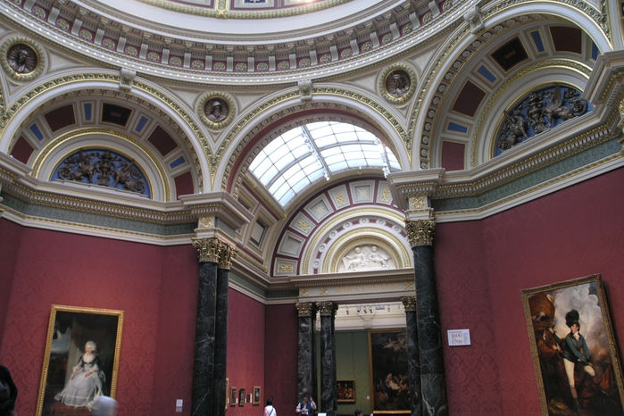
History
Nowadays Gallery is one of the main attractions of the UK. It is visited by over a million
people a year. Tourists love this museum and pictures that are out there. Today Nicholas
Kenny is director of the gallery.

Slide 8
The most amazing exhibits
Mystic of Christmas

Slide 9
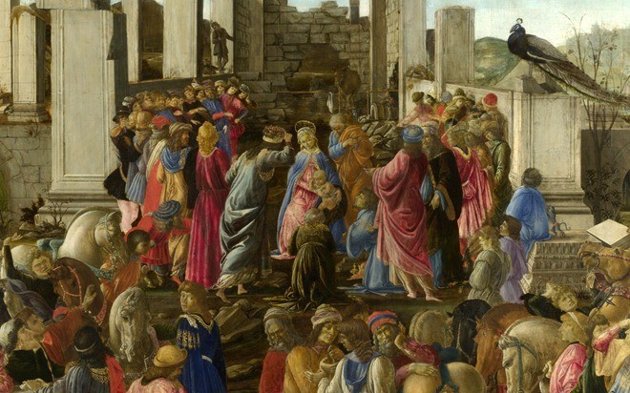
The most amazing exhibits
Adoration of the Magi

Slide 10
The most amazing exhibits
Four Scenes from the Life of St. Zenobius early

Slide 11
The most amazing exhibits
Madonna and Child with Saints

Slide 12
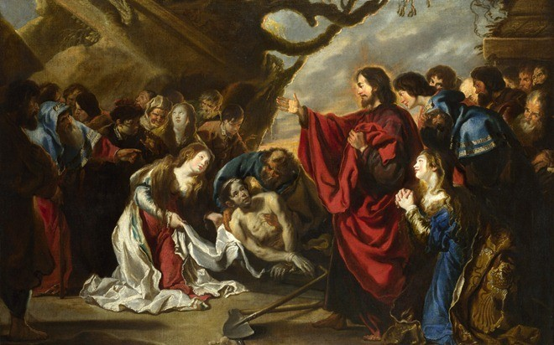
The most amazing exhibits
Raising of Lazarus

Slide 13
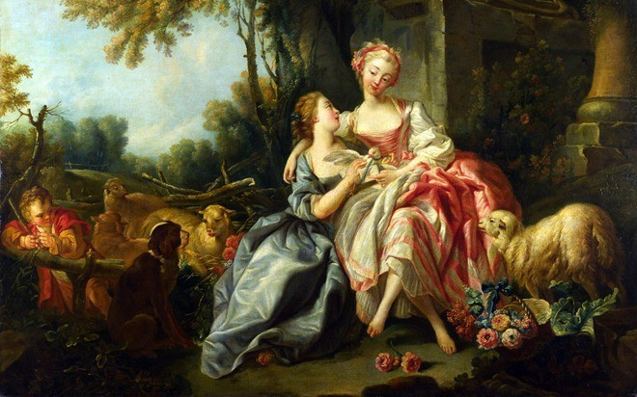
The most amazing exhibits
Love letter

Slide 14
The most amazing exhibits
Kornard forest near Sudbury, Suffolk

Slide 15
Thank you for your attention!

