Slide 1
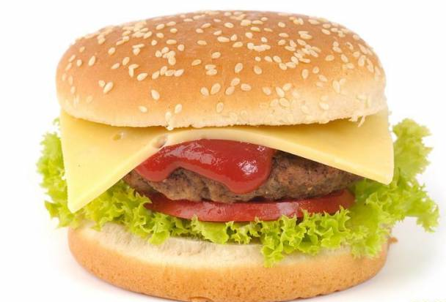
American food
Prepared by Holub Marharyta

Slide 2
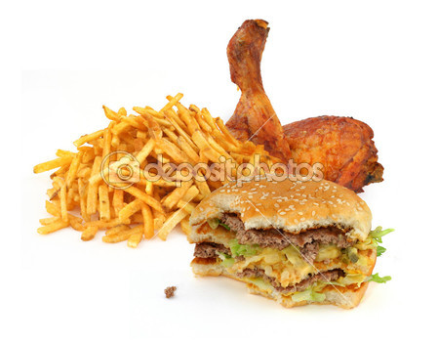
What is American food?

Slide 3

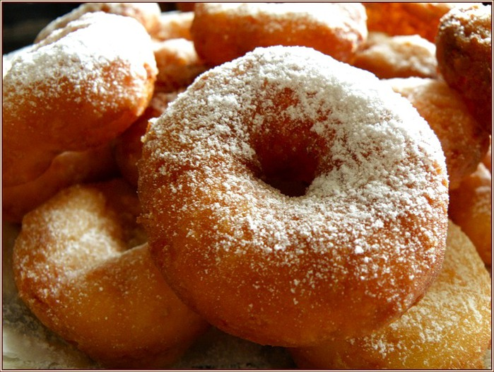
The story about the doughnuts

Slide 4
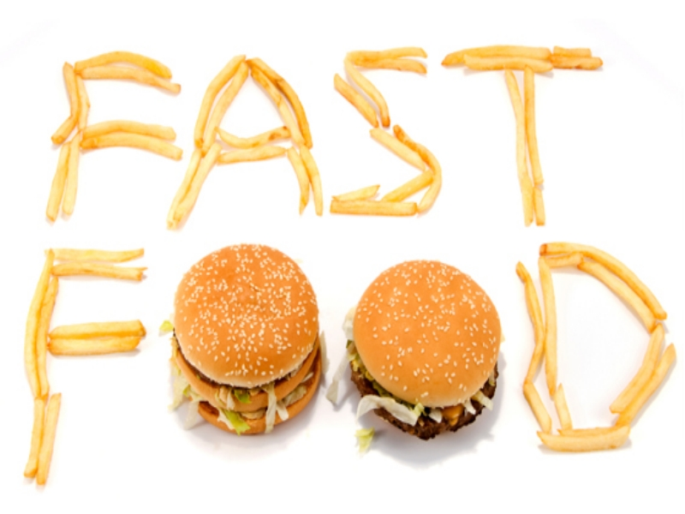
Fast food and it’s restaurants

Slide 5
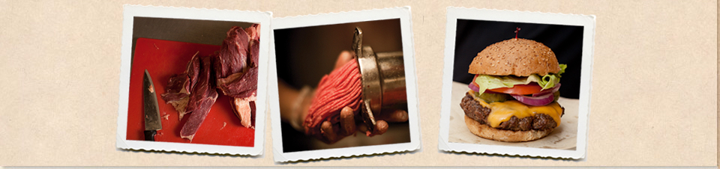
B.GOOD
In 2002, b. good was established. Two best friends started a business together around a simple idea - to make fast-food "real", made by people, not factories.

Slide 6
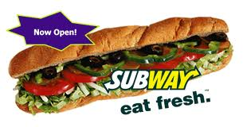
SUBWAY
The first store was opened in Bridgeport in August 1965

Slide 7
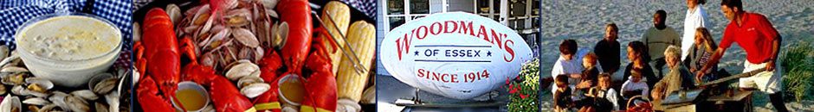
Woodman's
Woodman's was founded in 1914, during the war. But they became famous in 1916 , when they invented fried clams , and their new delicacy - clams with cornmeal fried. According to Forbes FYI Magazine - This is the best seafood restaurant in America. Woodman's maintains the tradition of the Yankees more than 95 years .

Slide 8
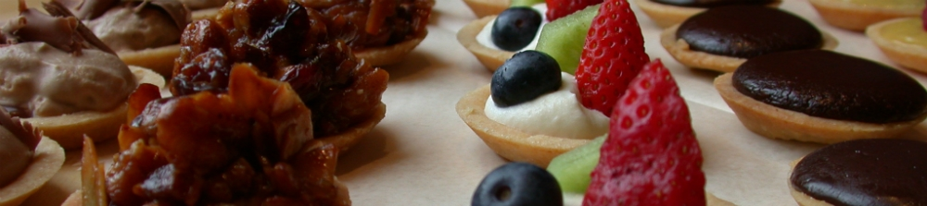
FLOUR BAKERY
Flour offers baked goods for breakfast, great homemade cookies, luscious cakes, birthday cakes, sandwiches, soups and salads. Flour bakery - it's great food, good service, warm atmosphere, heady aroma.

Slide 9

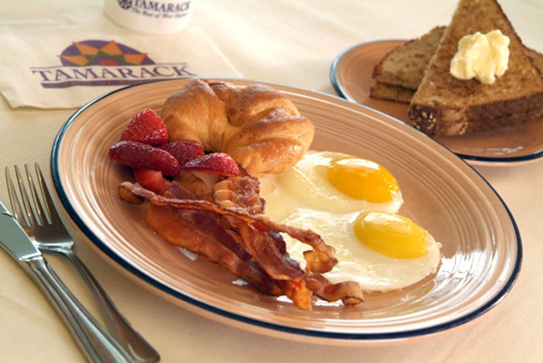
American breakfast
American breakfast - it's fried or scrambled eggs with bacon, ham , sausages and chips. Besides eggs will only corn flakes, sometimes oatmeal .

Slide 10
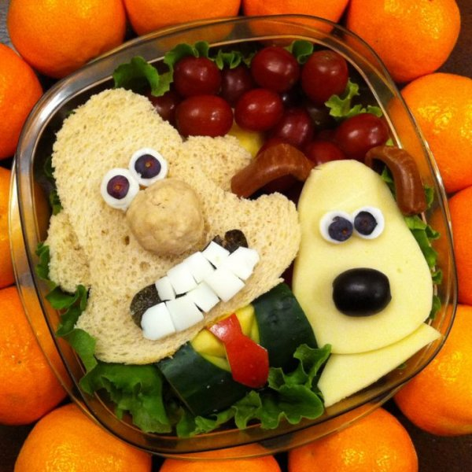
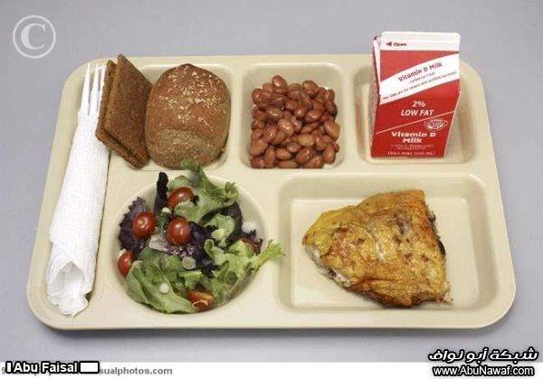
Lunch
Lunch (from 12 to 14 hours) The standard version of lunch is a soup + burger ( cheeseburger mamaburger , papaburger etc.). Very common lunch order by phone . Usually it is used in offices. This can be Japanese, Chinese , and any other cuisine .

Slide 11
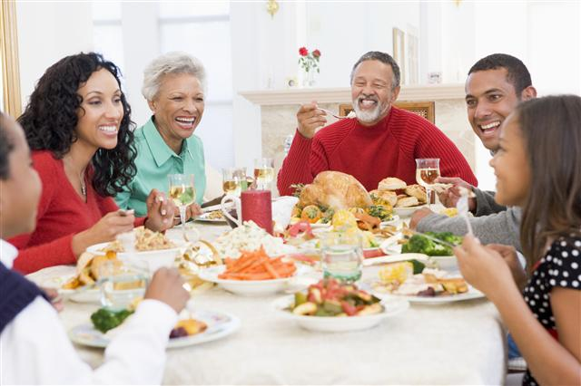
American-style dinner
American-style dinner is similar to our lunch - soups , second meal , salads , etc.

Slide 12
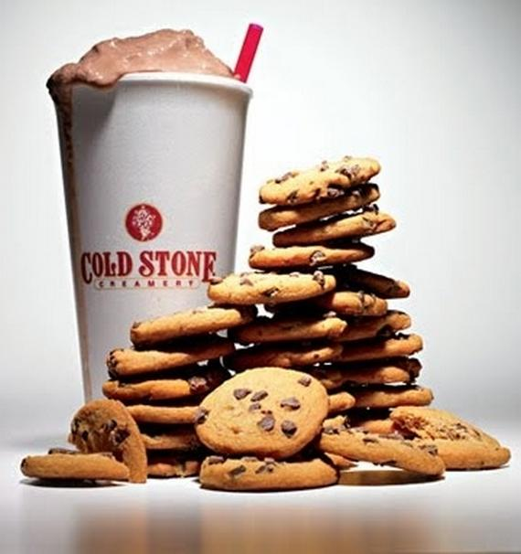
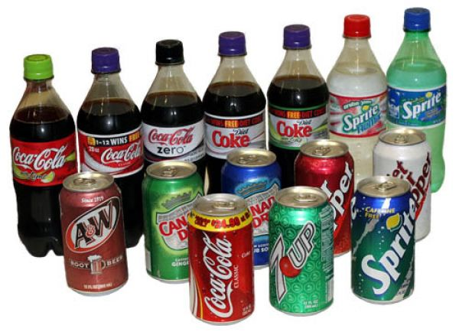
Drinks
Americans joke that they drink only one drink . When it is hot it is called coffee , and when it is cold – Coca-Cola .

Slide 13
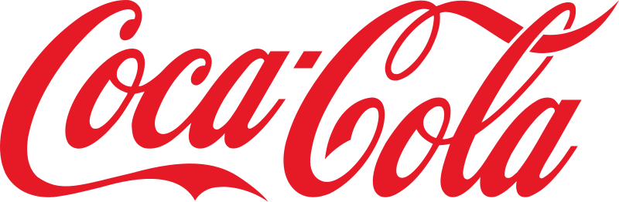
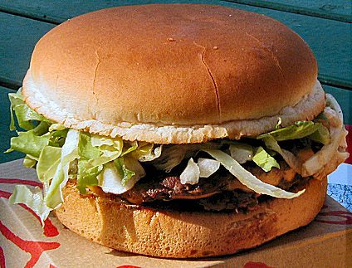
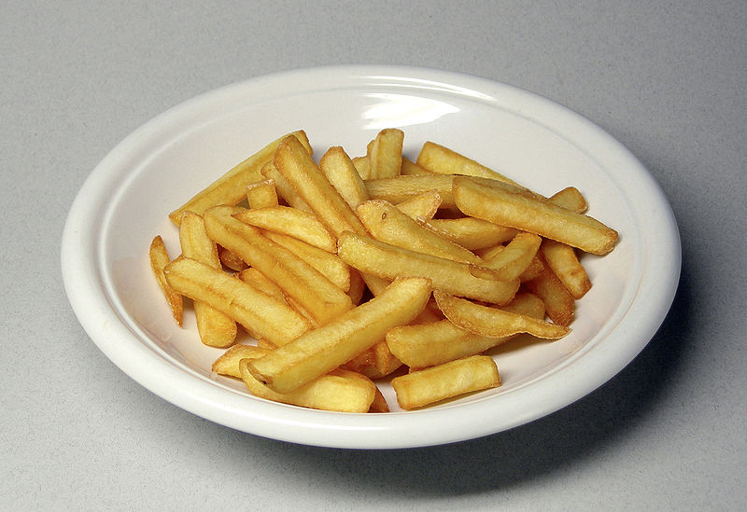
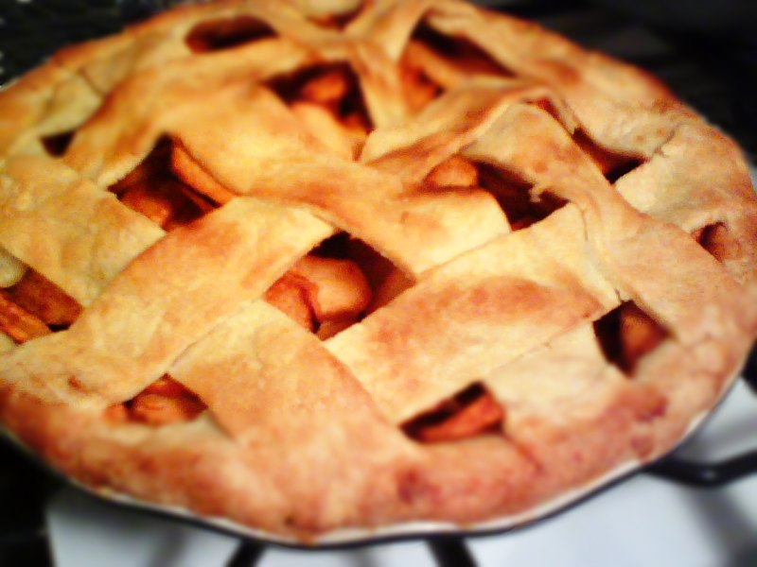
Typical dishes and drinks
Ice-cream, steak , hot dog , French fries (chips), hamburger, grilled chicken, apple pie.

Slide 14


Slide 15
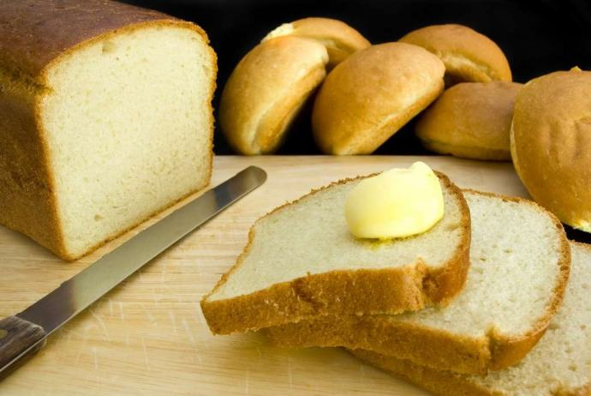
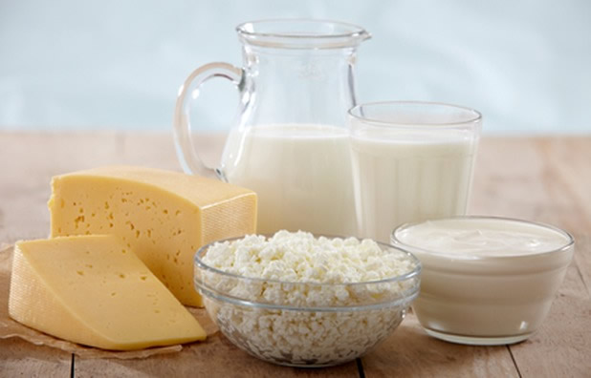
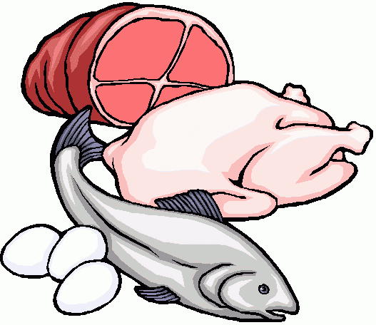
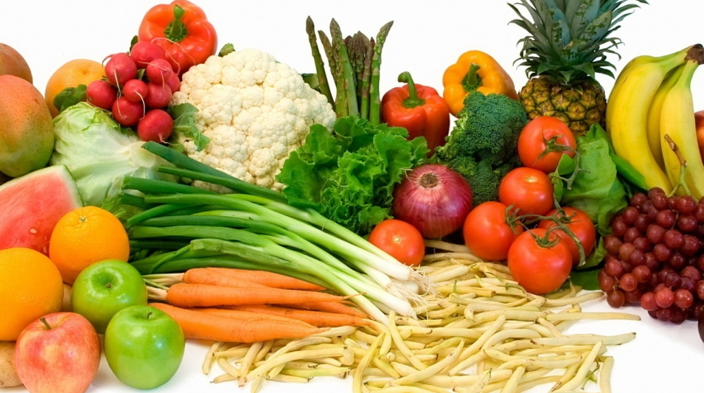
healthful eating habits
Every day eat
Bread and butter,
Milk and cheese,
Meat and eggs,
Vegetables,
Fruits, and a vitamin C food.

Slide 16

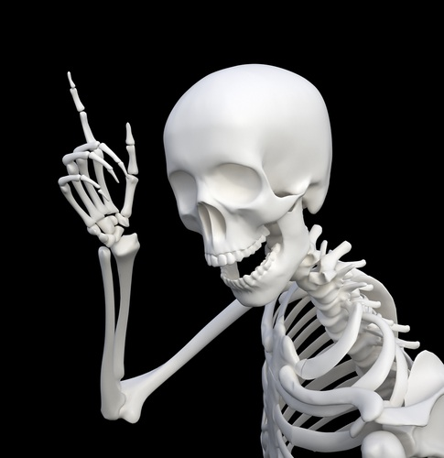
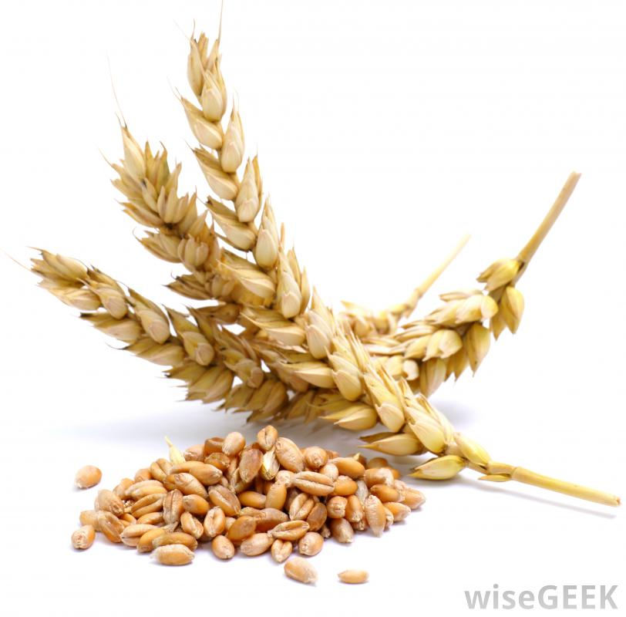
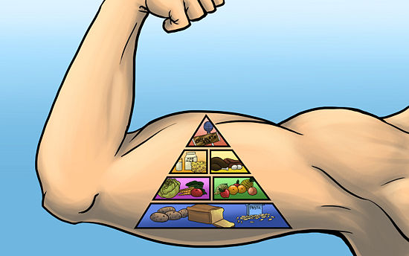
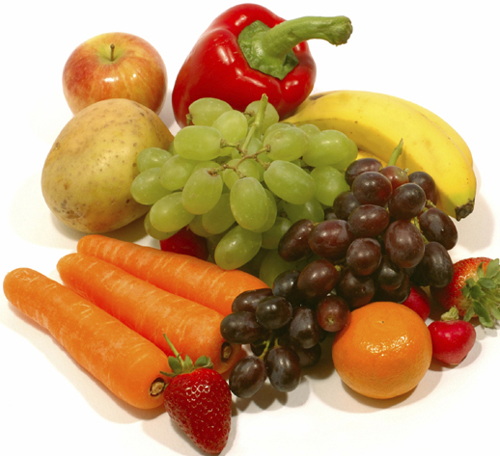
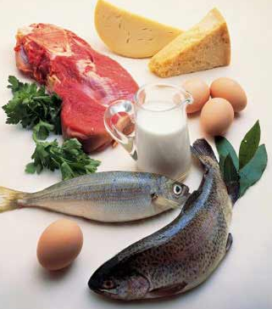
Every living creature must eat to live, and Ox as we all know can do very nicely on nothing but grass. There are other creatures on this Earth that require the diet of meat and only meat, while still others prefer vegetables and fruit, always the same food. Well, that’s all right for them because they only need one type of food. But man needs a variety of foods to be healthy. Animal foods are muscle builders. Vegetables and fruits build sound bones and teeth. And grains and roots give energy. And the combination of all three builds resistance against disease.

Slide 17
