Slide 1

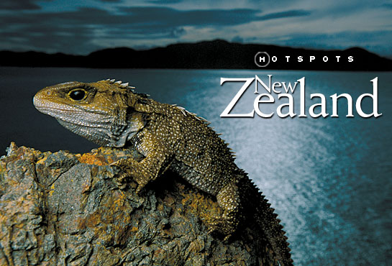
New Zealand

Slide 2
Fact File
Official name New Zealand (English); Aoteraoa (Maori)
Capital city Wellington
Largest cities Auckland, Christchurch, Dunedin
Total area 268, 680 sq km
Population 4,116, 000 people
Main religions Christian, Catholic
Major ethnic groups Europeans, Maori, Pacific Islanders, Asian
Consist of North Island, South Island, Stewart Island,
Chatman Islands and minor islands
Currency New Zealand Dollar (NZ$)
Official language English, Maori
Nationality a New Zealander (the New Zealanders)
Form of government parliamentary democratic monarchy
Natural resources land (for farming, dairy farming, cattle breeding), forests
Flag the New Zealand Flag
Internet TLD (top-level domain) .nz
International dialing code + 64

Slide 3
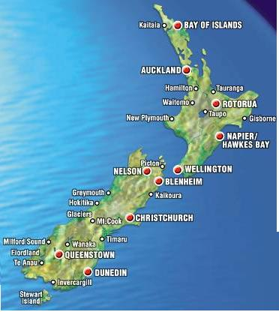
The map of New Zealand
New Zealand lies between the Equator and the South Pole in the southern Pacific Ocean, near the eastern coast of Australia.
New Zealand is an island country with a total area of 268, 680 sq km.
It has no land boundaries. Australia is New Zealander’s nearest western neighbour. These two countries are separated from each other by the Tasman Sea.

Slide 4
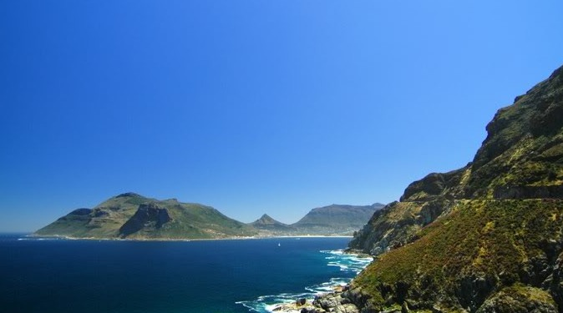
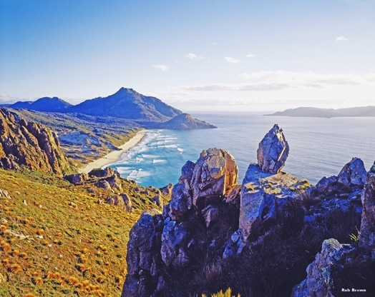
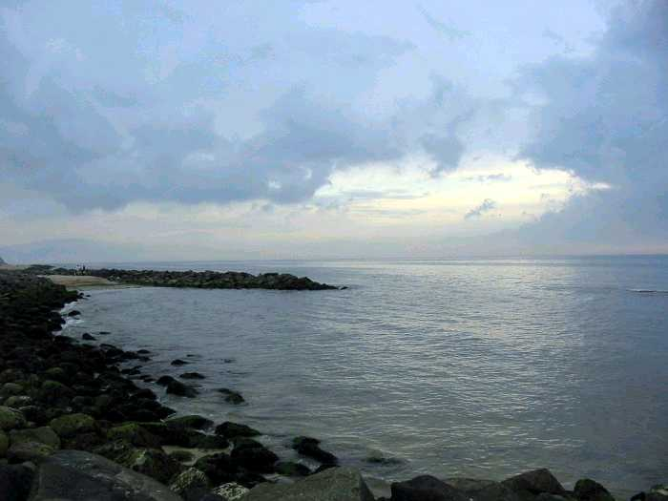
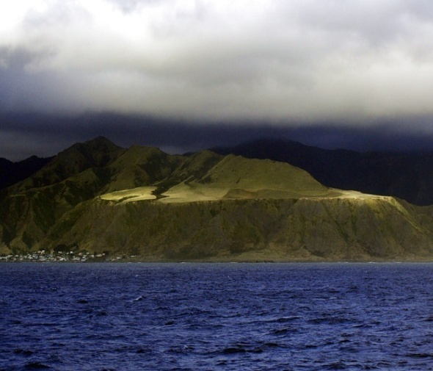
The geographical peculiarities
New Zealand is made up of three main islands – the North Sea, the South Sea and the Stewart Island. The South Island is separated from the North island by Cook Strait.
The South Sea
The Stewart Island
The North Sea
Cook Strait

Slide 5
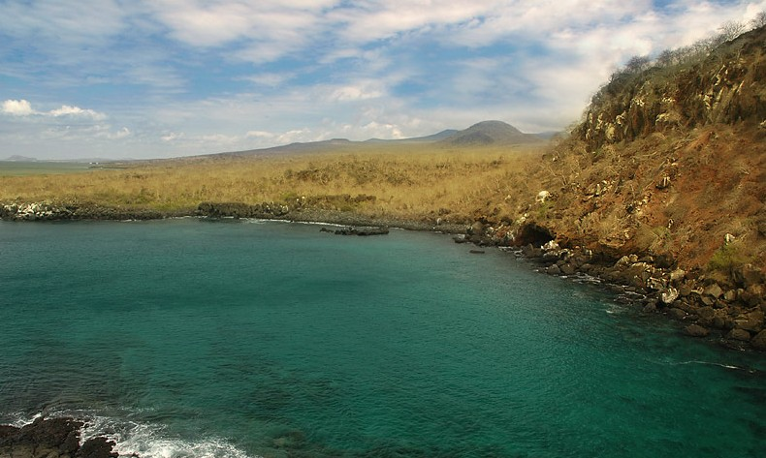
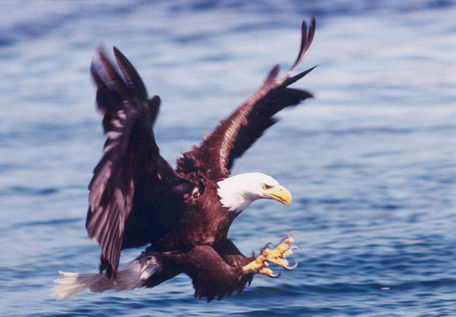
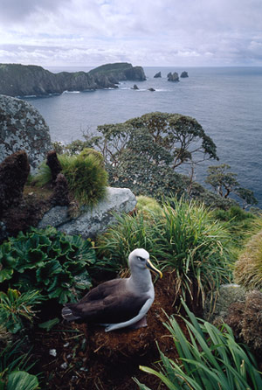
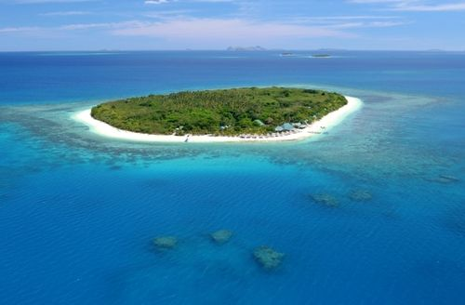
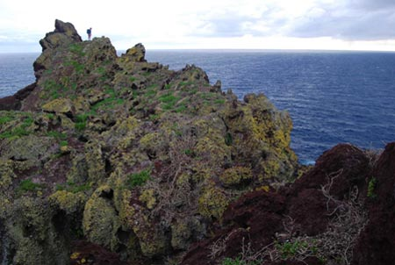
The geographical peculiarities
There are also such smaller offshore islands as the Chatham Islands, Campbell Islands, the Antipode Islands, the Bounty Islands and the Auckland Islands.
Chatham Island
Campbell Island
The Antipodes Islands
The Bounty Island
The Kermadec Islands

Slide 6
It’s interesting to know…
…New Zealand is 12 hours ahead of Greenwich Mean Time (GMT). So, it is one of the first places in the world to see the new day.
…The Maori people call New Zealand Aotearoa, which is usually translated into English as “The Land of the Long White Cloud”.
…New Zealand is also called “Godzone”, “Pig Isles”, “Shaky Isles”, “Quaky Isles”, “Maoriland” and “Kiwiland”
An interesting historical fact…
The name “New Zealand” came from Dutch cartographers, who called the islands “Nova Zeelandia”, after the Dutch province of Zeeland. British explorer James Cook adapted the name to the English language and the name became New Zealand.

Slide 7
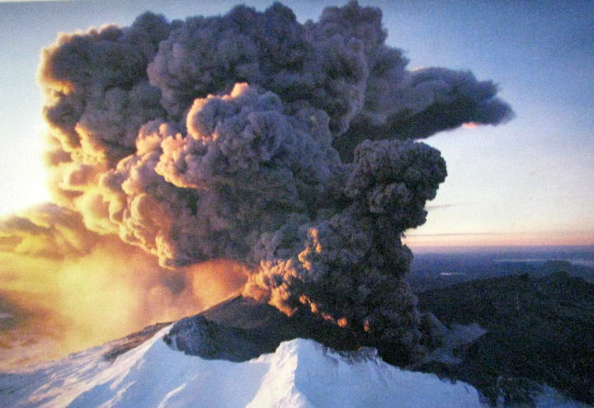
The geographical peculiarities
Though the country is so small there are so many beautiful things that attract attention - volcanoes, subtropical rainforests, geysers, fiords, beaches, glaciers and high mountain peaks.
New Zealand lies on the plates that make geological movements. Volcanic action still continues on the islands. Earthquakes are frequent here though they are not so damaging.
The North Island has a number of large active volcanoes, among them is Ruapehu. The last eruptions were here in 1995 and 1996.
Ruapehu

Slide 8
Flora and fauna of New Zealand
Flora in New Zealand is very rich. There are about 2,000 species where 1,500 are endemic (which are only found in this country). It also has some of the oldest trees.
Fauna in this country is also special. Long time ago, without enemies, some birds lost their ability to fly, and some insects became gigantic.
It’s interesting to know…
Before Europeans came to New Zealand there were no predatory animals at all. This was so good for many flightless birds. All wild mammals living in New Zealand at present were imported.

Slide 9
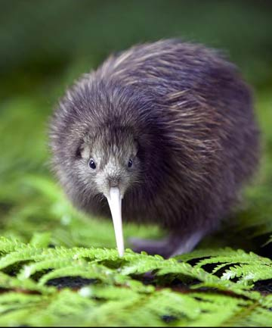
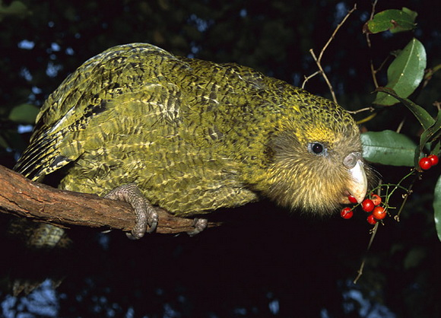
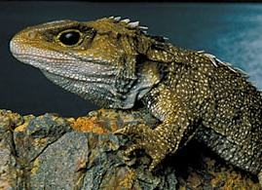
Flora and fauna of New Zealand
Many of New Zealand’s native animals are found nowhere else in the world:
the kiwi – its egg is about one fifth of its own weight
the kakapo – the world’s largest flightless parrot
the tuatara – the oldest living reptile Tuataras live for 300 years. They can be
traced back 190 million years to the Mesozoic era
kiwi
kakapo
tuatara

Slide 10
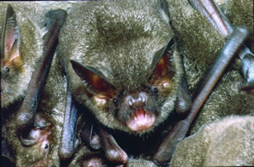
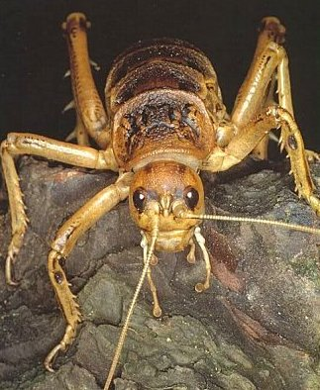
Flora and fauna of New Zealand
the biggest earthworms in the world
the smallest bats in the world – the only native land mammals in New
Zealand
the weta – the heaviest insect in the world (70 gm and 20 cm long)
New Zealand bat
the weta

Slide 11
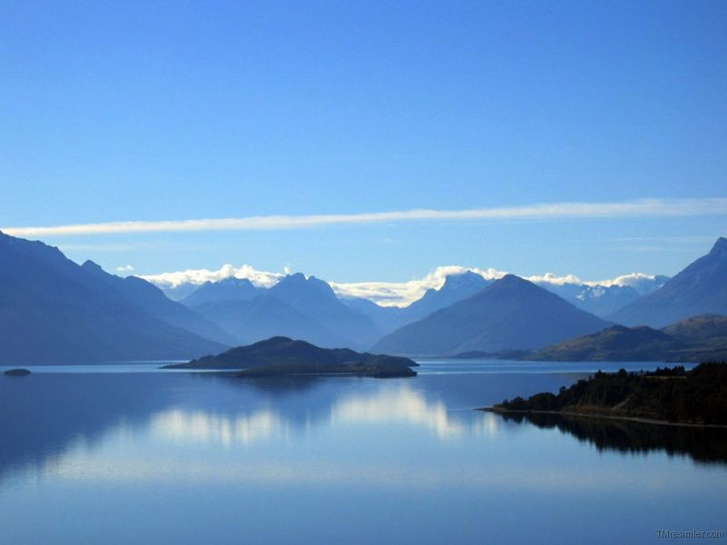
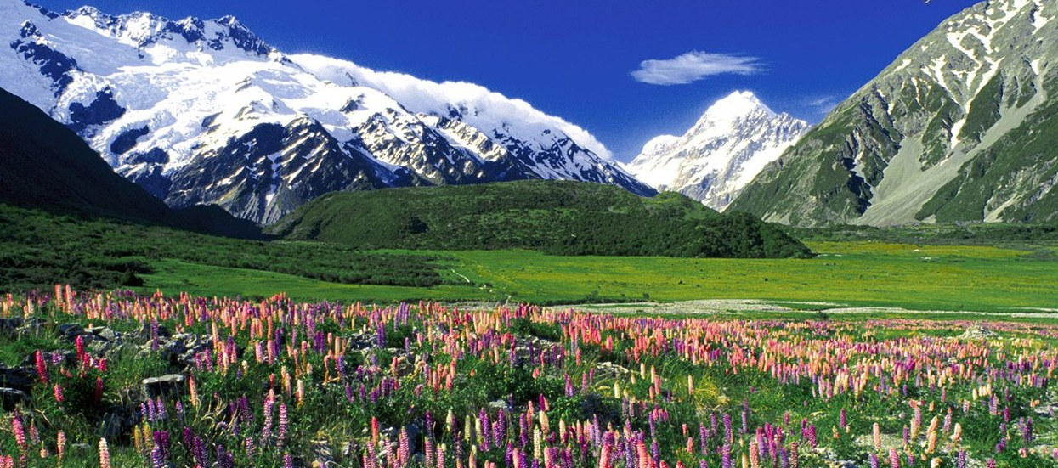
Rivers and mountains
New Zealand is a very mountainous country. About one third of the islands is covered with mountains. The Southern Alps run along the western coast of the South Island and are the highest in New Zealand. Mount Cook is the highest mountain there (3, 050 metres above the sea level).
the Southern Alps
Mount Cook

Slide 12
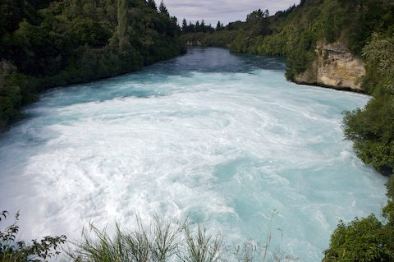
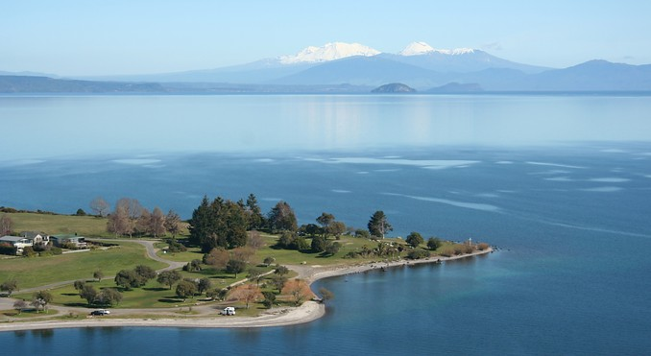
Rivers and mountains
It’s interesting to know…
Sometimes New Zealanders say that the North Island means “beaches” and the South Island means “mountains”
New Zealand’s rivers are mainly short and swift. The longest river is the Waikato. There are many lakes on both islands as well. The North Island’s volcanic interior contains New Zealand’s largest lake. Its name is lake Taupo.
Waikato
Taupo

Slide 13
Climate
New Zealand is known for its maritime climate which is quite good during the whole year. It is moist, temperate and is affected by latitude and the proximity of the ocean.
Climate of this country has no extremes and no wide range of temperatures. The difference of winter and summer temperatures is about 10 degrees. That is why New Zealand is very attractive for tourists. Seasons here are reverse of the Northern Hemisphere like in Australia.
Because of New Zealand’s wet and mild climate many inhabitants of the country are busy with farming and dairy goods production.
There are heavy rainfalls in New Zealand all year round which is very good for cattle –farming, sheep- farming, growing fruit, vegetables and flowers.

Slide 14
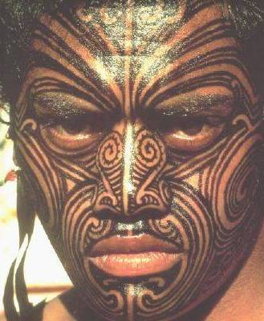
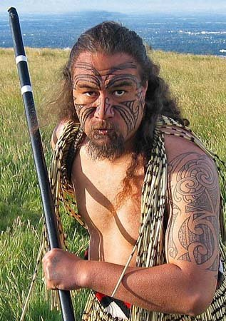
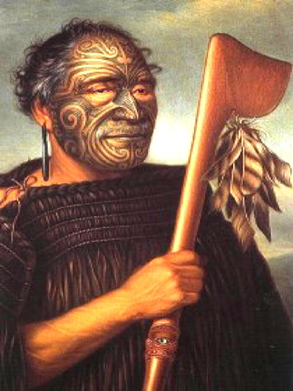
The population of the country
An interesting historical fact…
Before Europeans came to the island, the tribes of Maori did not have the name for themselves. They adopted the name “Maori” meaning “normal” to distinguish themselves from Europeans.
The tribes of Maori are well-known all over the world. The Maori are famous for their folk-songs and wood-work. They are often called “Vikings of Sunrise”.

Slide 15
The population of the country
In the 19th century there was a struggle between the Maori people and the British colonies. It was a series of the Maori Wars. Many of the Maori were killed and English settlers took their lands.
Both English and Maori are official languages. English is more widely spoken, though the Maori language is now coming back thanks to the revival of their native language Maoritanga and Maori culture.

Slide 16
The symbols of New Zealand
The symbol of New Zealand is the kiwi – a flightless bird, native to this country.
Kiwi has no tail, almost no wings and is about the size of a large hen. No other bird lays eggs so large in proportion to its size: the egg is about one fifth of its own weigh. It means that in many ways the kiwi does not look like an ordinary bird. It is rare and very much protected.
It’s interesting to know:
The Kiwi as an emblem first appeared in the late 19th century. During World War I the name “kiwi” was used for New Zealand soldiers.

Slide 17
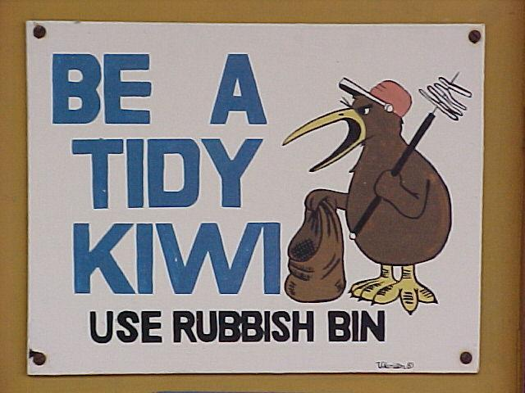
The symbols of New Zealand
Today, New Zealanders overseas (and at home) are called “Kiwis”. The Kiwi is closely associated with the Armed Forces. The green fruit with the brown skin that we call “kiwi” is known as “kiwifruit”.
They often call small children “Kiwis”. In elementary school there are such posters with the words: “Be a tidy kiwi!”
The bird is now used in the coat of arms, crests and badges of many New Zealand cities, clubs and organisations.

Slide 18
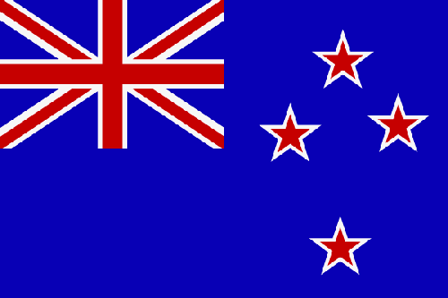
The symbols of New Zealand
As for the New Zealand Flag, the stars of the Southern Cross show country’s location in the South Pacific Ocean. The Union Flag shows that New Zealand was once a British colony.

Slide 19
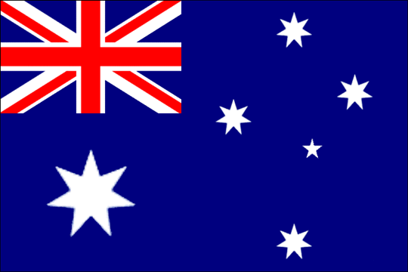
The symbols of New Zealand
The New Zealand and Australian flags have very much in common. The only difference is that the Australian Flag shows the stars of the Southern Cross in white colour on a blue field while the New Zealand Flag shows the stars in red on a blue field.

Slide 20
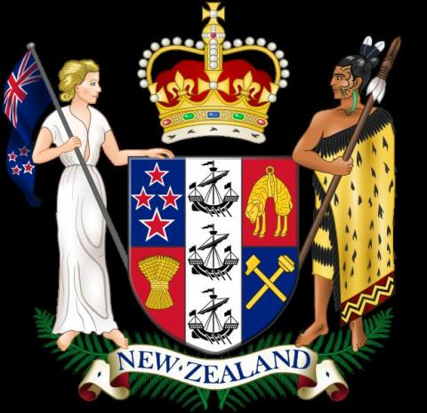
The symbols of New Zealand
There are two national anthems of New Zealand and both have equal status. These are “God defend New Zealand” and “God Save the Queen”. The first one is always used on sports occasions.
New Zealand’s coat of arms

Slide 21
Some details of culture of New Zealand
The culture of New Zealand is a mixture of different cultures: British, Aboriginal and other European countries.
Today New Zealanders are highly educated and sophisticated urban dwellers.
There is a cultural phenomenon in New Zealand known as “kiwiana”. You know that New Zealanders are called “kiwis” around the world after the native bird “kiwi”. Now their “kiwi” sense of humor, “kiwi” view of life make up “Kiwiana”, which is all the special things and details that show their national identity, their “kiwi nationhood”.
Kiwifruit, for example, was once known as Chinese gooseberry, but the fact that it was imported from New Zealand made world call this fruit – kiwifruit.

Slide 22
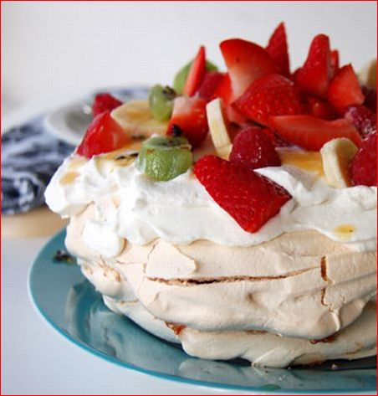
Some details of culture of New Zealand
There is a famous New Zealand dessert called “pavlova” (meringue, cream and kiwi topping). It was invented as a tribute to the Russian ballerina Anna Pavlova who toured to Australia and New Zealand in 1926.

Slide 23
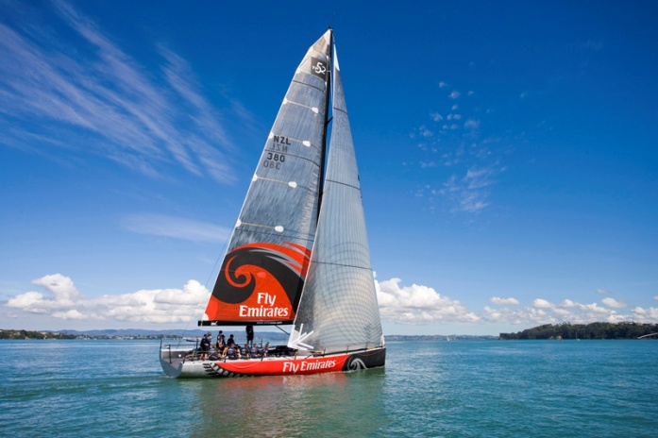
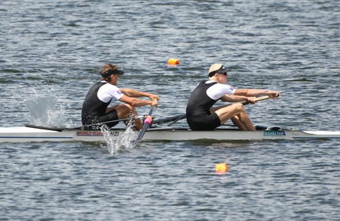
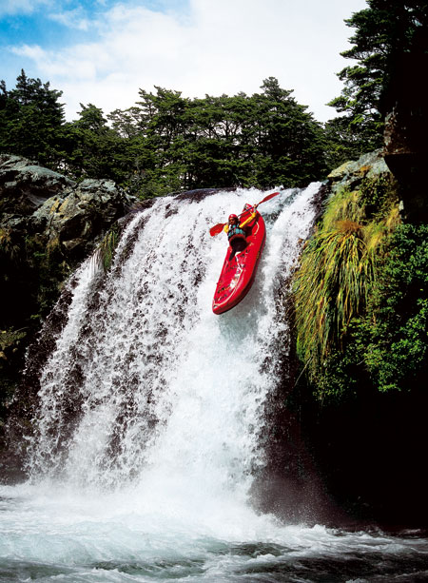
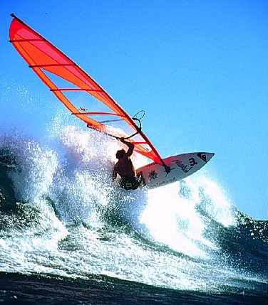
Some details of culture of New Zealand
New Zealanders love water. They have a strong passion for ocean- going craft. New Zealanders have won many medals for yachting, windsurfing, kayaking and rowing.

Slide 24
Some details of culture of New Zealand
Among the qualities valued by New Zealanders are individualism, self-reliance and a genius for invention. Long time ago first people in New Zealand dealt with isolation and the elements, so that it developed their ingenuity and made them multi-skilled. That contributed a lot to their character.
They also have a strong sense of fair play and teamwork. New Zealand was one of the first countries who gave women the right to vote.
The language in this country is close to Australian English with some elements of the Maori language.

Slide 25
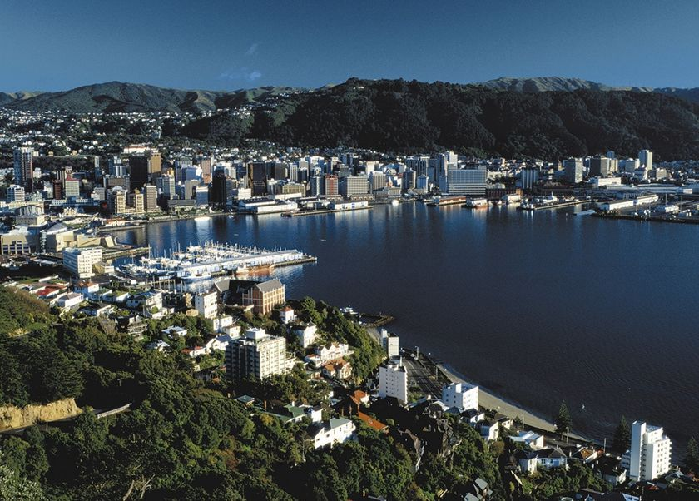
Wellington

Slide 26
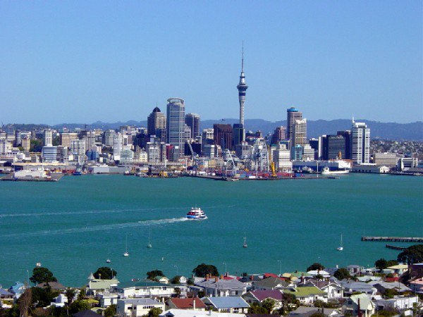
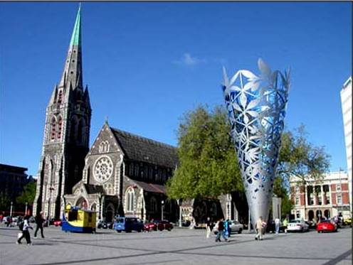
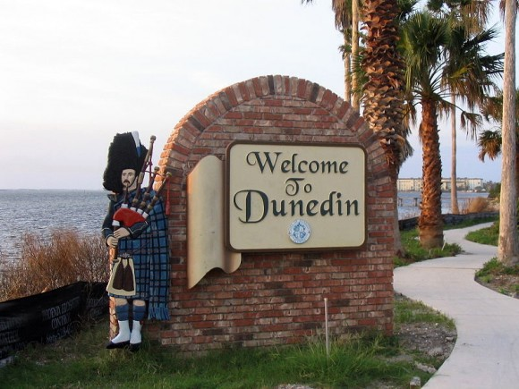
Auckland
Christchurch
Dunedin

Slide 27
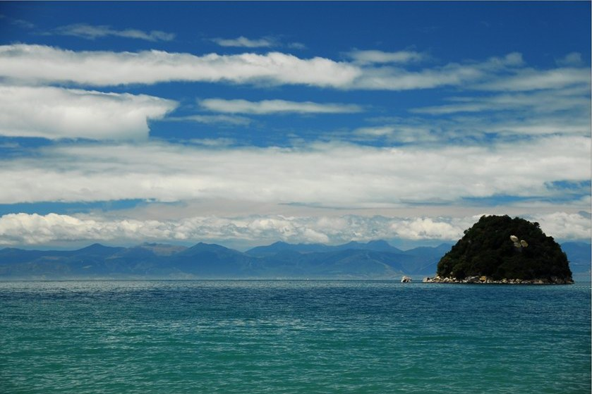
The Tasman Sea

Slide 28
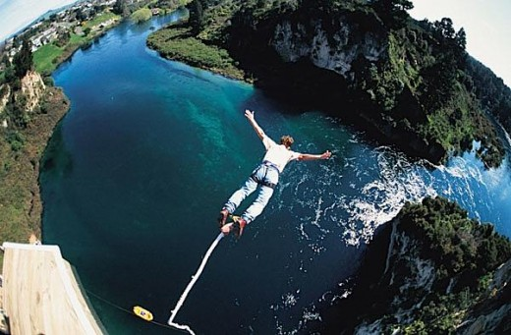
Bungee jumping in New Zealand

