Slide 1
The most beautiful places in our planet

Slide 2
Our planet has a really amazing and marvelous places. Some places was made by people and some was made by nature.

Slide 3
Even though the trappings of civilization are all around us, there are still some parts of the globe where our influence is small:From the ice sheet of Antarctica to the jungles of Papua New Guinea

Slide 4
Grand canyon
Grand Canyon is a National Park, included a World Heritage Site. Lies on the Colorado Plateau in northwestern Arizona.

Slide 5
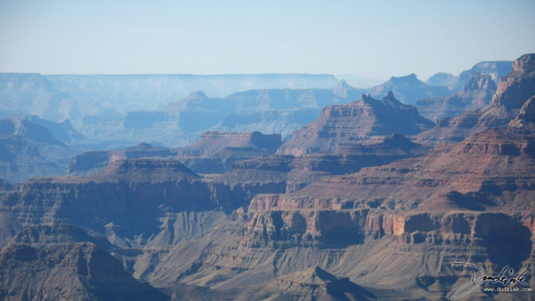

Slide 6
Canadian Rockies, Canada
This beautiful mountain landscapes, lakes, canyons, waterfalls, glaciers, peaks, limestone caves. Included in the list of UNESCO World Heritage sites.

Slide 9
Great Barrier Reef. Australia.
One of the natural wonders of the world.
It is the world's largest coral reef.

Slide 10
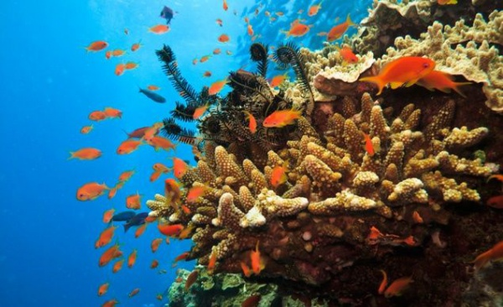
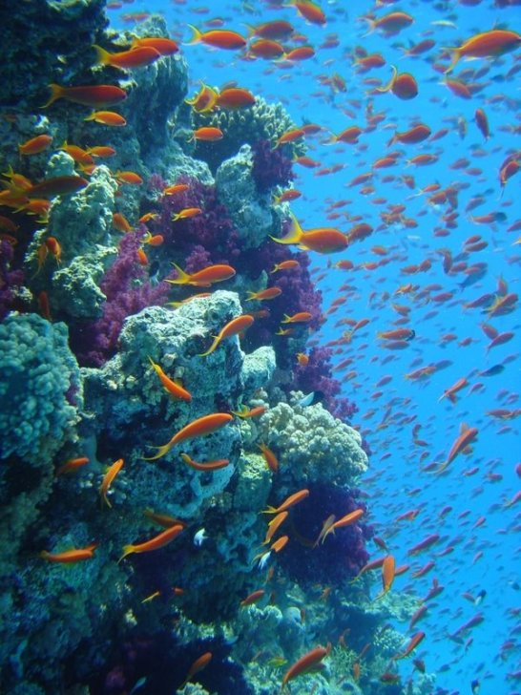
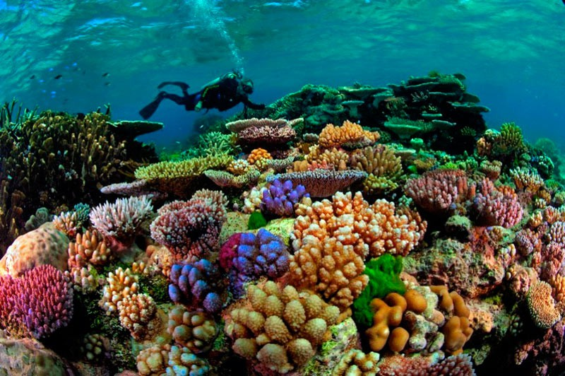

Slide 11
Niagara Waterfall
This is set of waterfalls on the Niagara River. This waterfall is the most powerful and wonderfull in North America.

Slide 12
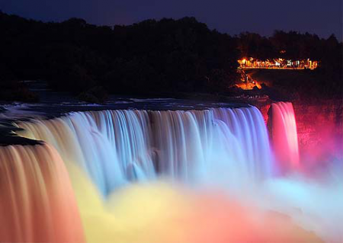

Slide 13
Ice Canyon, Greenland
Greenland - the land of ice and snow that covered the island all year and give it incredible beauty.

Slide 14
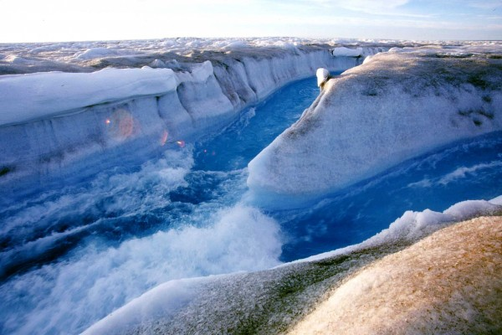

Slide 15
We should save this beauty together.
Thank you!!!

