Slide 1

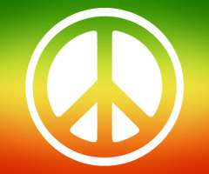
Hippie…

Slide 2
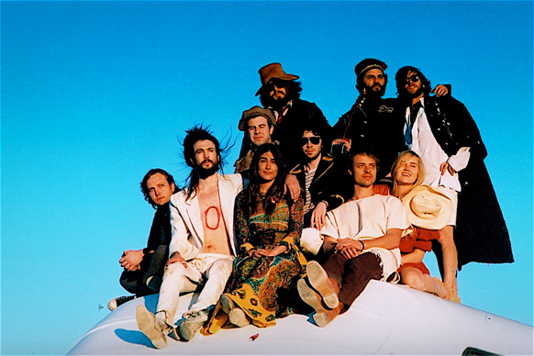
The hippie subculture was originally a youth movement that arose in the United States during the mid-1960s, swiftly spreading to other countries around the world.

Slide 3
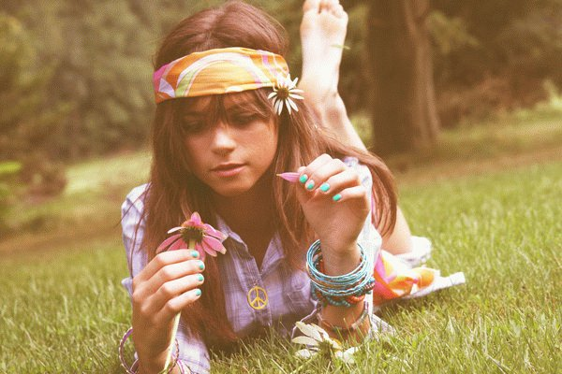
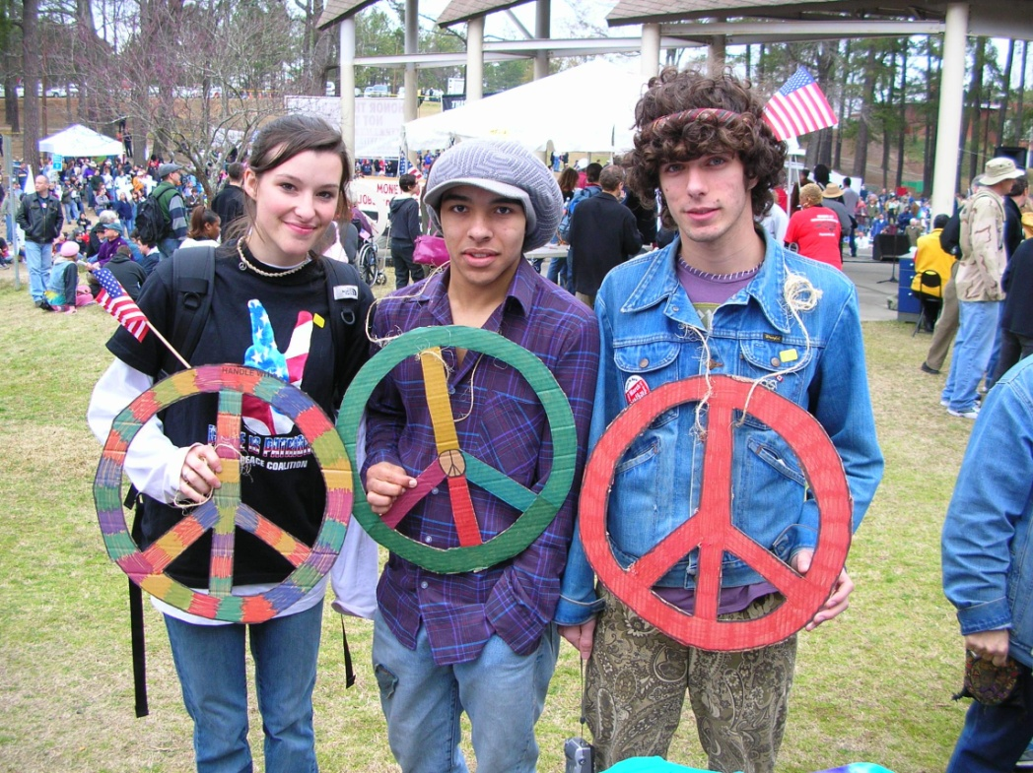
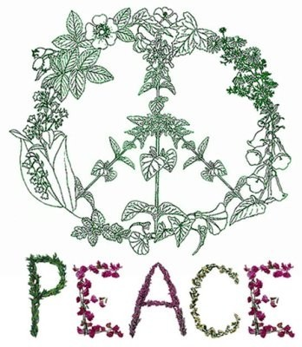
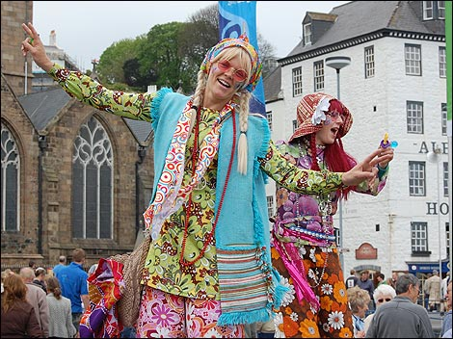
Hippie fashions and values had a major effect on culture, influencing popular music, television, film, literature, and the arts. Since the widespread movement in the 1960s, many aspects of hippie culture have been assimilated by mainstream society.

Slide 4
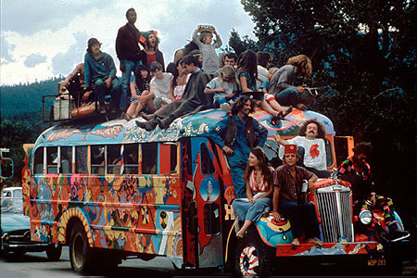
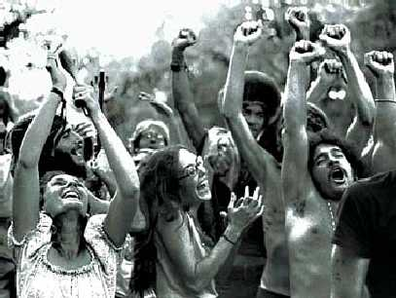
The religious and cultural diversity espoused by the hippies has gained widespread acceptance, and Eastern philosophy and spiritual concepts have reached a wide audience.
From around 1967, its fundamental ethos — including harmony with nature, communal living, artistic experimentation particularly in music, and the widespread use of recreational drugs — spread around the world.

Slide 5
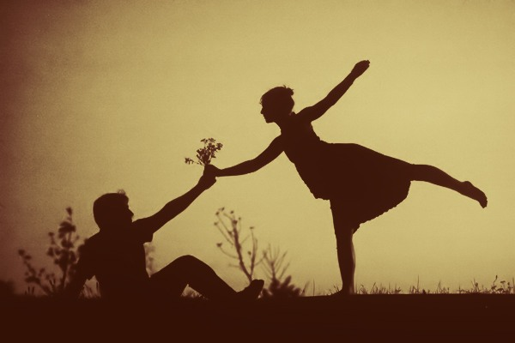
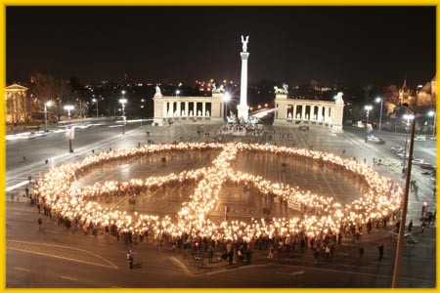
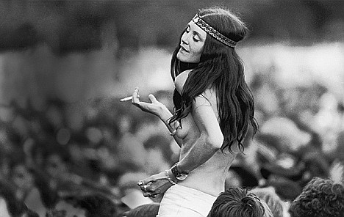
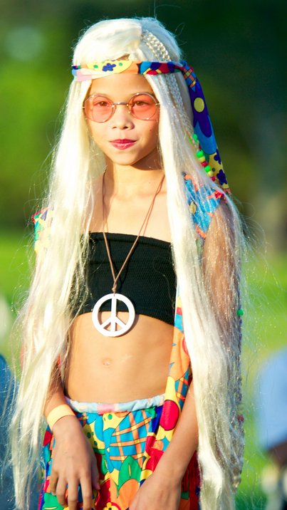
On January 14, 1967, the outdoor Human Be-In organized by Michael Bowen helped to popularize hippie culture across the United States, with 20,000 hippies gathering in San Francisco's Golden Gate Park
Sedgwick and 10,000 hippies came together in Manhattan for the Central Park Be-In on Easter Sunday.
The Monterey Pop Festival from June 16 to June 18 introduced the rock music of the counterculture to a wide audience and marked the start of the "Summer of Love."

Slide 6
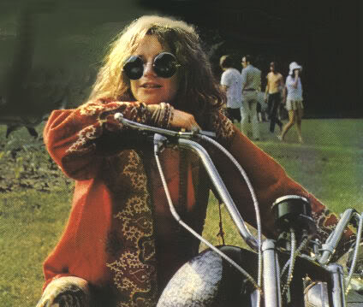
Many took to living on the street, panhandling and drug-dealing. There were problems with malnourishment, disease, and drug addiction. Crime and violence skyrocketed. By the end of 1967, many of the hippies and musicians who initiated the Summer of Love had moved on. Misgivings about the hippie culture, particularly with regard to drug abuse and lenient morality, fueled the moral panics of the late 1960s.

Slide 7
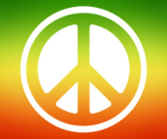
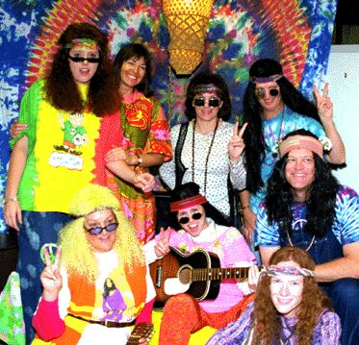
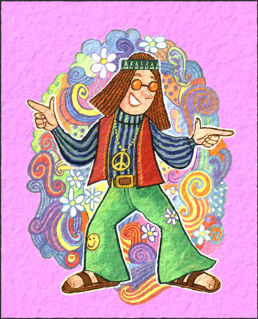
As with other adolescent, white middle-class movements, deviant behavior of the hippies involved challenging the prevailing gender differences of their time: both men and women in the hippie movement wore jeans and maintained long hair, and both genders wore sandals or went barefoot. Men often wore beards, while women wore little or no makeup.
Hippies often chose brightly colored clothing and wore unusual styles, such as bell-bottom pants, vests, tie-dyed garments, peasant blouses, and long, full skirts; non-Western inspired clothing with Native American, Asian, Indian, African and Latin American motifs were also popular. Much of hippie clothing was self-made in defiance of corporate culture, and hippies often purchased their clothes from flea markets and second-hand shops.

Slide 8
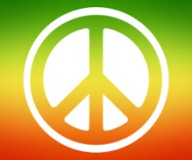
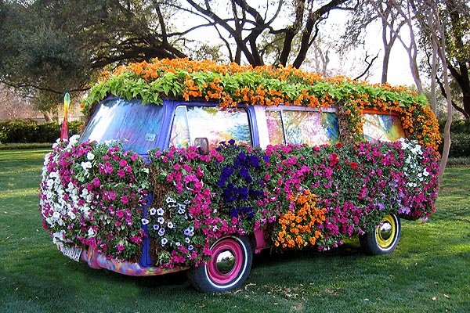
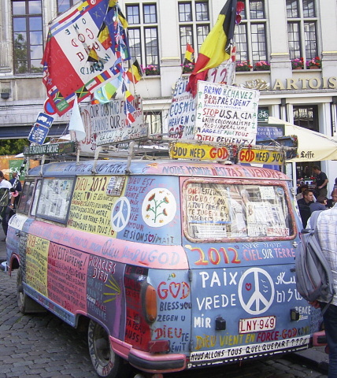
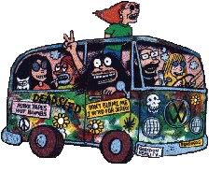
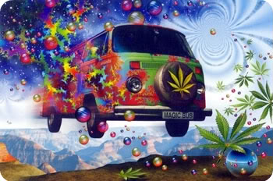
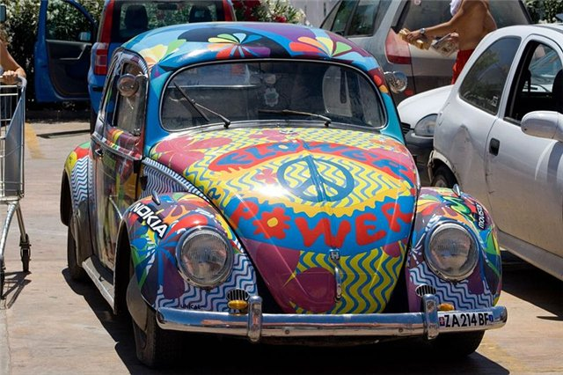
One of the symbols of the hippie movement is considered old minibus "Volkswagen", which is traditionally painted hippie-style «Flower Power». At these vans hippie group liked to ride on a small conservative American town and shock of their inhabitants by various antics.
The picture presented minibus Barkas B 1000.

Slide 9
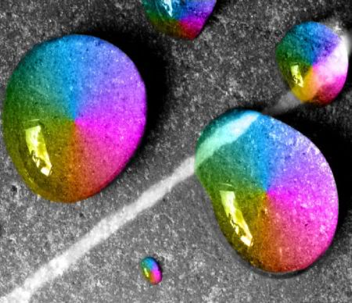
Slogans Hippie 60's.
«Make Love, Not War»(«Занимайтесь любовью, а не войной»)
«Off The Pig!»(«Долой свиней!») (игра слов, свиньей назывался пулемет M60, немаловажный во время Вьетнамской войны)
«Give Peace A Chance»(«Дайте миру шанс»)
«Hell No, We Won’t Go!» («Ни черта мы не уйдём!»)
«All You Need Is Love!» ("Всё, что нужно, это любовь!)

Slide 10
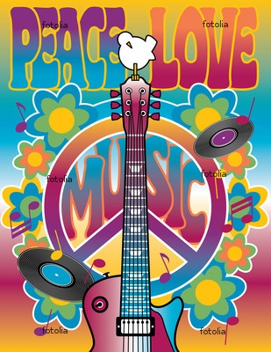
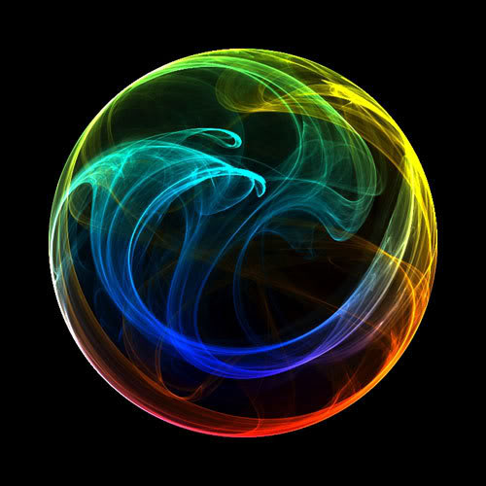
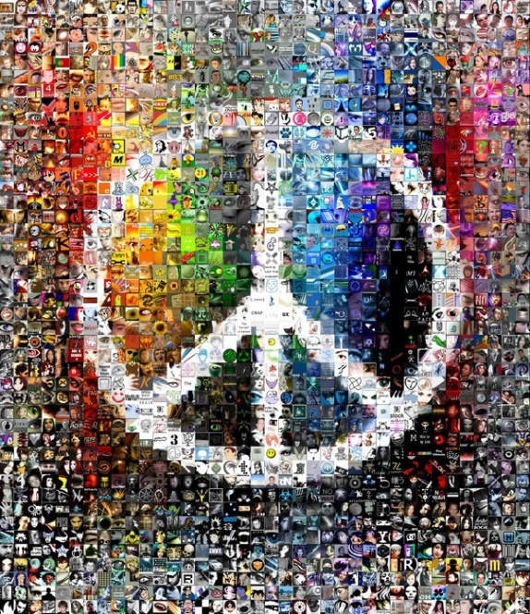
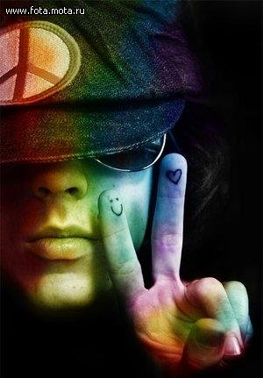
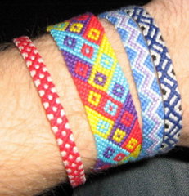
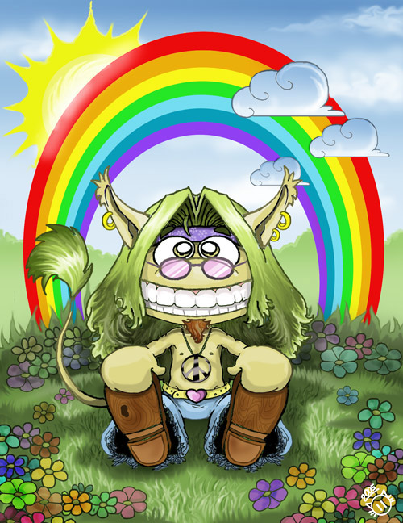
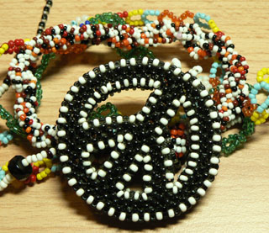
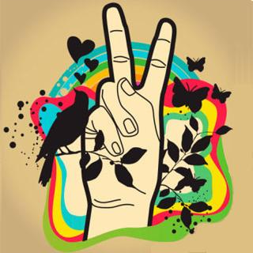
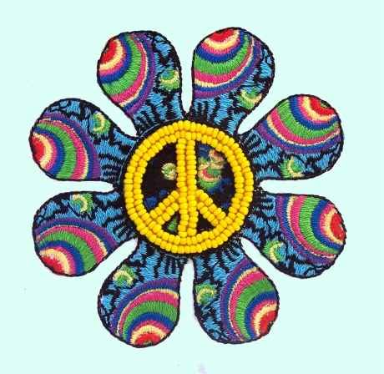
symbols hippie.

Slide 11
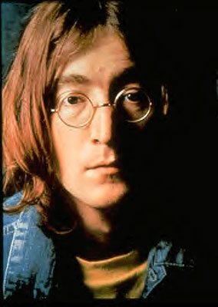
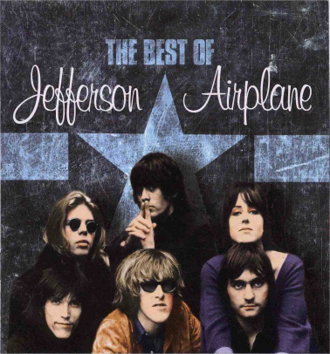
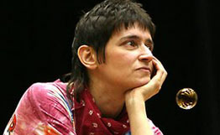
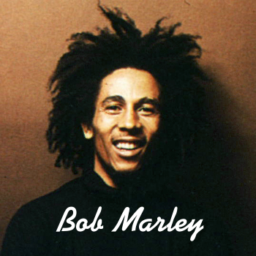
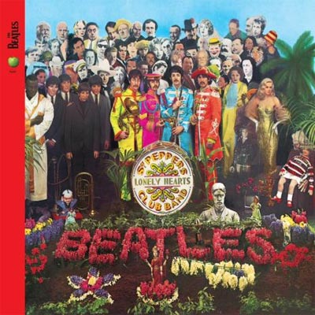
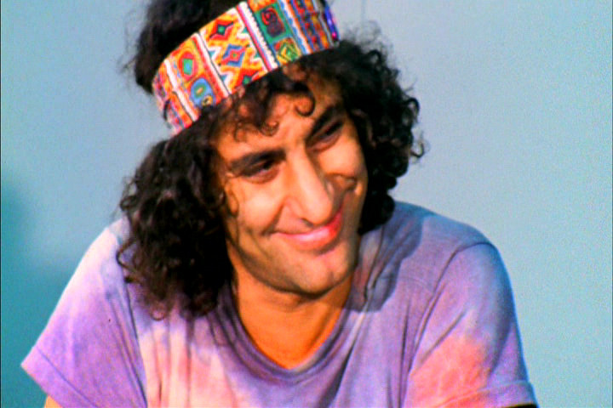
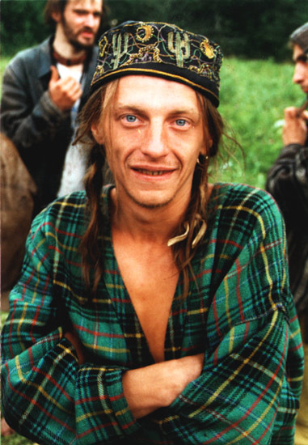
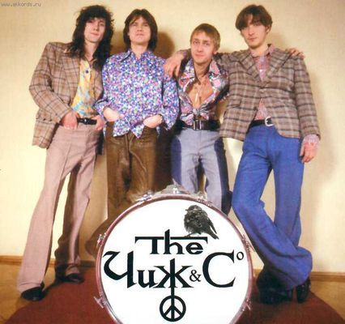
Famous hippie:
Foreign hippies :
John Lennon
Also mentioned in connection with the hippie movement:
Domestic hippie:
Anna Gerasimova (Umka), musician
Abbie Hoffman
Eugene Chicherin, musician
The Doors;Grateful Dead;Black Sabbath;Led Zeppelin;Helms, Chet;
Ginsberg, Allen;Kesey, Ken;Aquarium
Joplin, Janice ; Baez, Joan ; Kessadi Neil;Ouselaw;Morrison, Jim ;Hendrix, Jimmy;Jerry Rubin
Yuri Morozov, musician, philosopher.
Olga Arefieva, musician.
Sergei Solmi, artist.

Slide 12
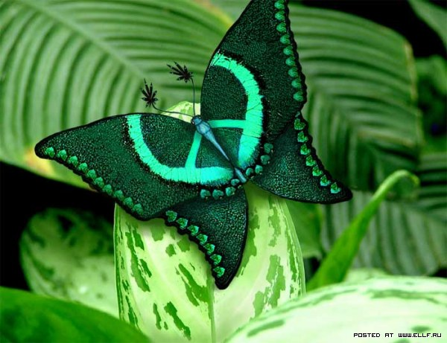
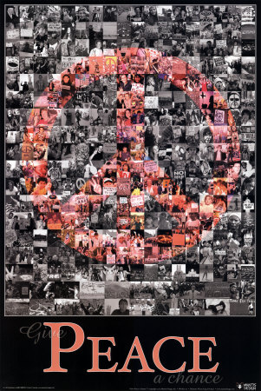
The end.

