Slide 1
JEANS
I open
my
company

Slide 2
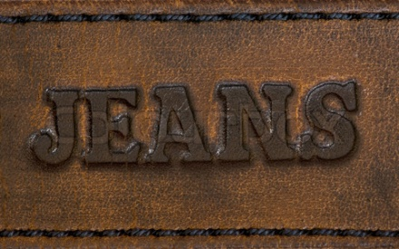
If I open my own company, it would have been firm on making jeans.

Slide 3
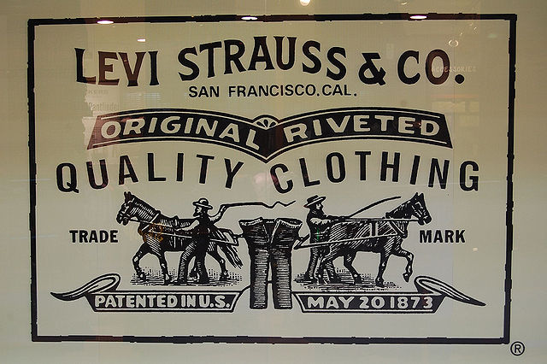
History
Jeans are trousers made from denim or dungaree cloth. Often the term "jeans" refers to a particular style of pants, called "blue jeans" and invented by Jacob Davis and Levi Strauss in 1873.

Slide 4
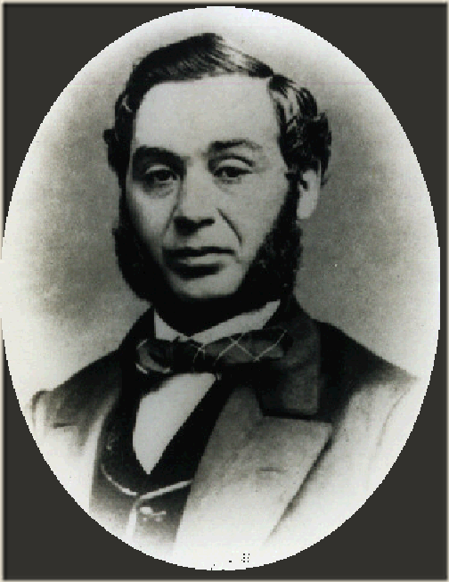
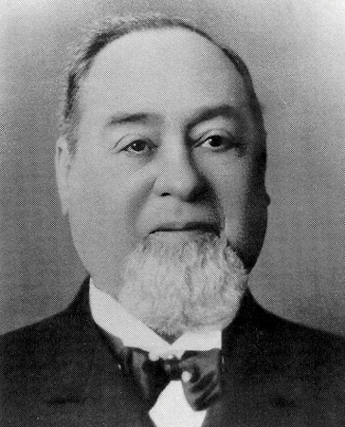
Jacob Davis
Levi Strauss

Slide 5
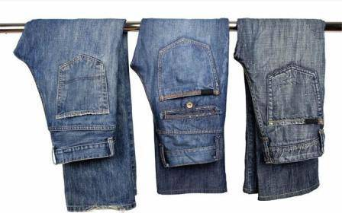
The story of jeans begins in the city of Genoa, in Italy, famous for its cotton corduroy. Jean fabric from Genoa (at that time) was in fact very similar to corduroy; Genoese sailors started to use it to cover and protect their goods on the docks from the weather.

Slide 6
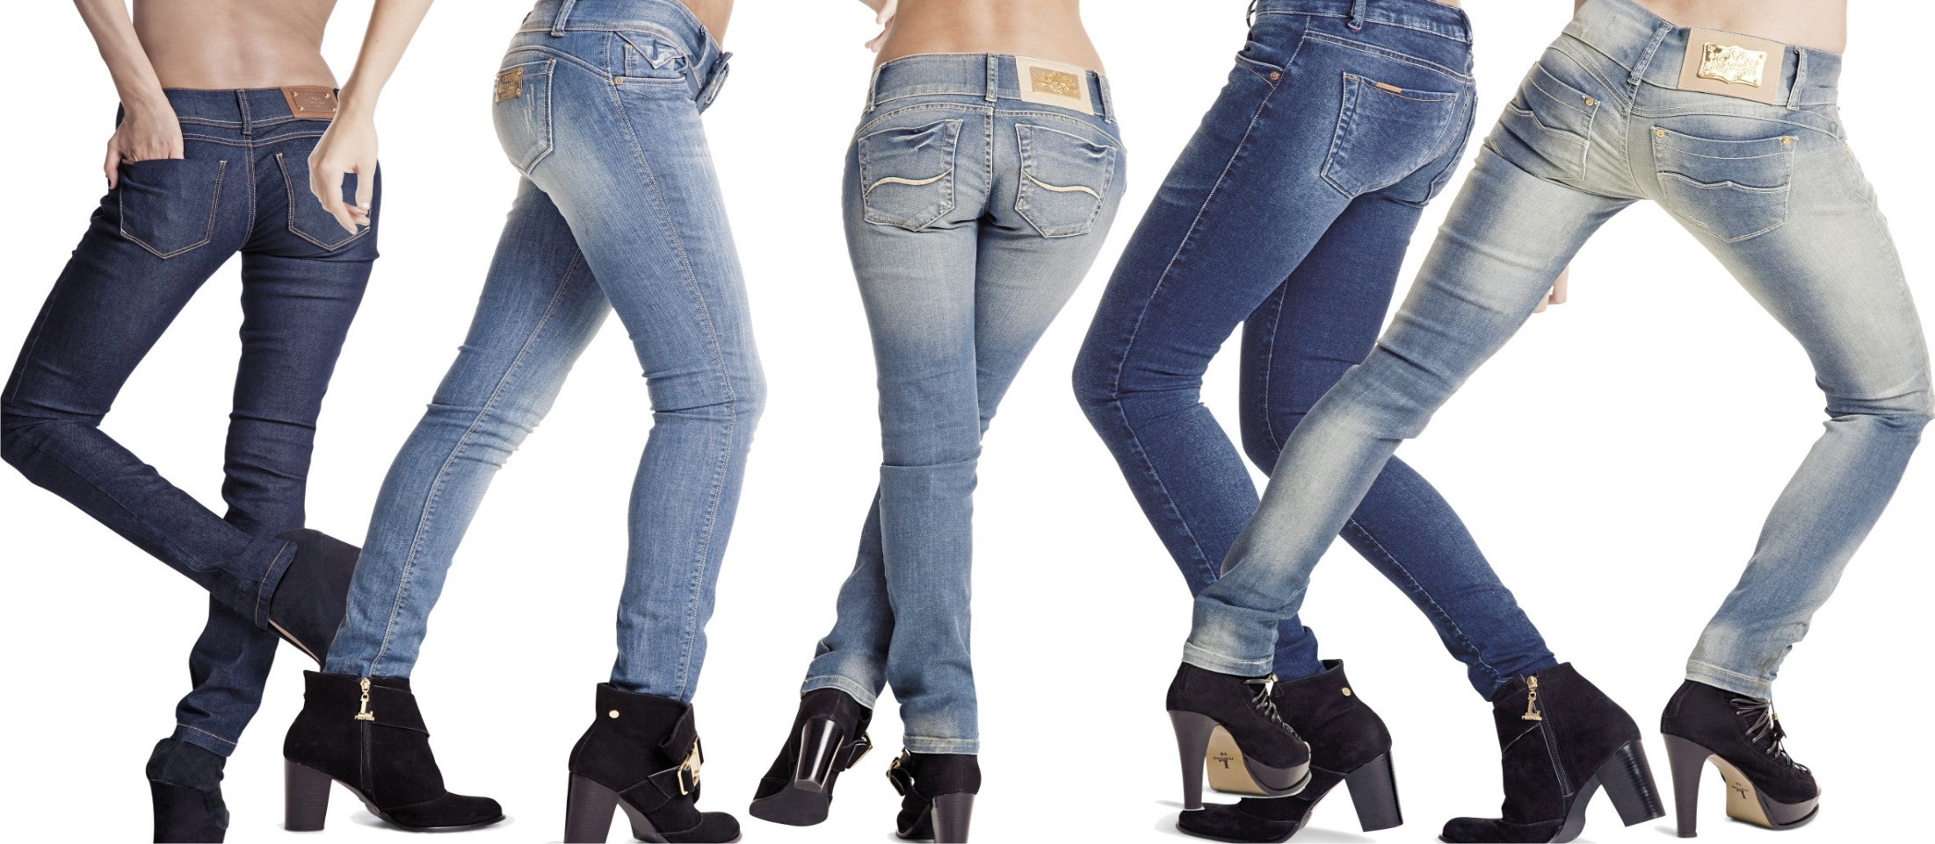
Starting in the 1950s, jeans, originally designed for cowboys and miners, became popular among teenagers, especially members of the greaser subculture. Historic brands include Levi's, Lee, and Wrangler. Jeans come in various fits, including skinny, tapered, slim, straight, boot cut, narrow bottom, low waist, anti-fit, and flare.
Jeans are now a very popular article of casual dress around the world. They come in many styles and colors; however, blue jeans are particularly identified with American culture, especially the American Old West.

Slide 7
What should be the owner
active
creative
sociable
persistent
communicative
judicious
he should be able to listen
he should be able to solve problems
he should be able to find an approach to people

Slide 8
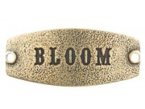

My company
If I created a company for the production of jeans, it would be called a «Bloom».

Slide 9
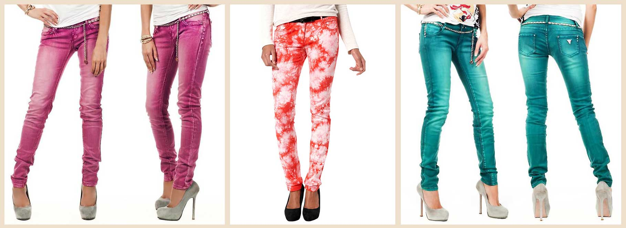
In my company would be produced colored jeans, do not look like classic black or blue jeans.
I think that now it is quite popular among the youth.

