Slide 1
Natural disaster in the U.S. North American winter storm
prepared: Alena Rudenko

Slide 2
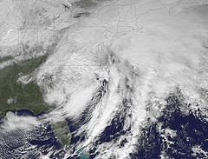
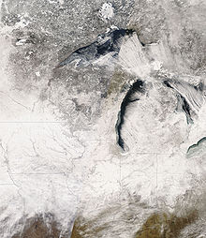
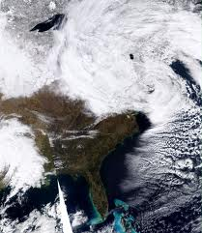
North American winter storm, also known as the Blizzard was the February 11-14, 2014. The strongest snow and ice storm again "attacked" the southern states and the East Coast of the United States. They left without electricity for more than half a million buildings. Disaster was in the Texas and North and South Carolina. Interfax reported that 9 people were killed on Wednesday.

Slide 3
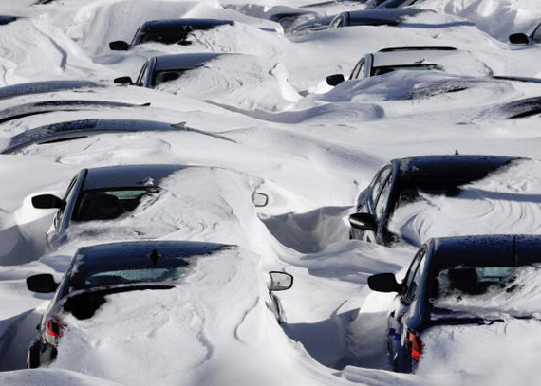
President Barack Obama declared a state of emergency in South Carolina. Airlines canceled thousands of flights, roads partially blocked by snow, partially blocked by abandoned cars. Most schools closed in the south and in several northeastern states.
As a result 22 people had died of February 13, including three in North Carolina.

