Slide 1
My favorite dishes

Slide 2
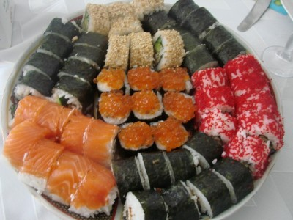
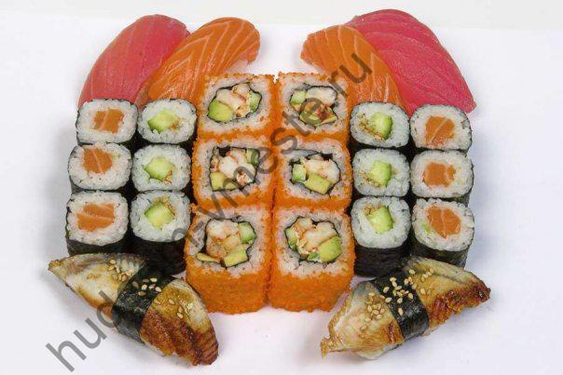
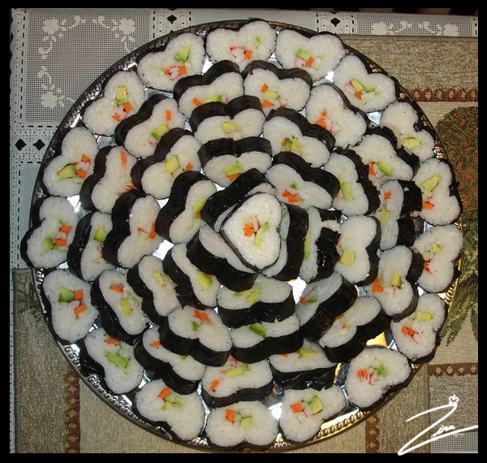
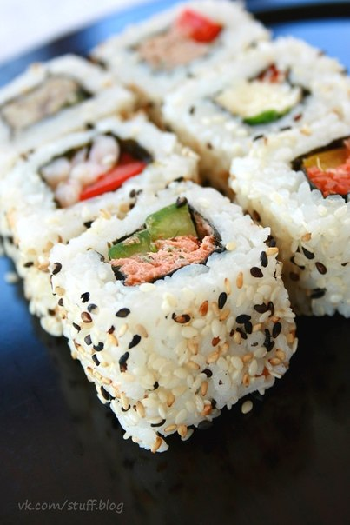
Sushi

Slide 3
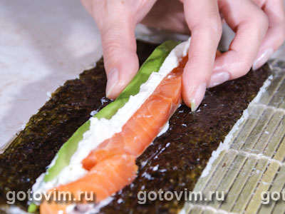
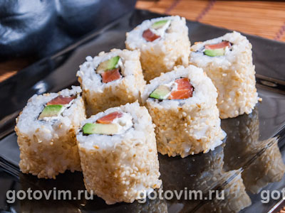
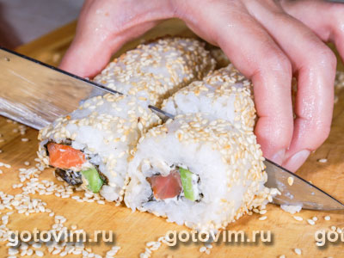
Recipe
trout (salted) - 100g; avocado - 1 piece. cheese 'Philadelphia' - 1/3 of the package; nori - 1-2 leaf; sushi rice - 200g; water - 450ml; sauce: rice vinegar - 120 ml sugar - 5.5 tbsp, salt - 1.5 tbsp; Conboy - 5 cm; sesame - 30g

Slide 4
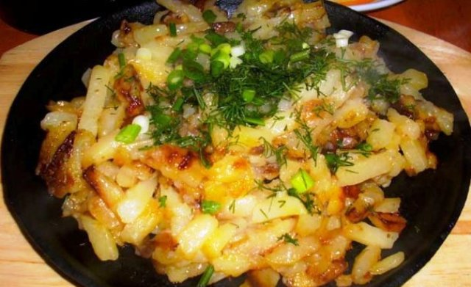
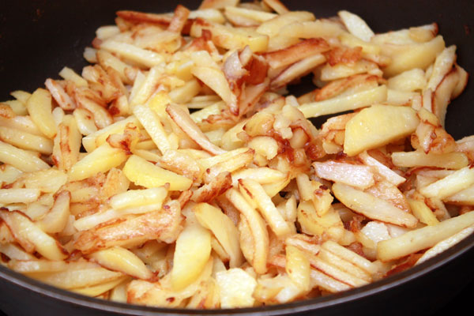
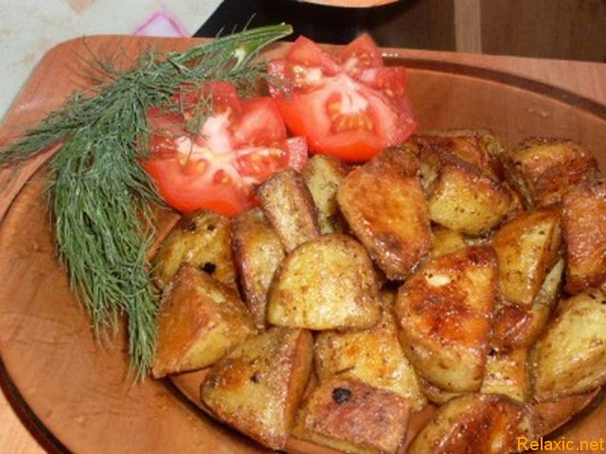
Fried potatoes

Slide 5
Recipe
Clean potatoes, cut into strips and blot excess moisture from the starch and paper towel. Season with salt and shake off excess salt. After 10 minutes, the potatoes and mix gently, lifting toasted wedges from the bottom of the pan and moving them to the upper layers. Sprinkle on top of potatoes chopped onion half-rings. Close the lid and cook another 10 minutes, then stir and close the lid.

Slide 6
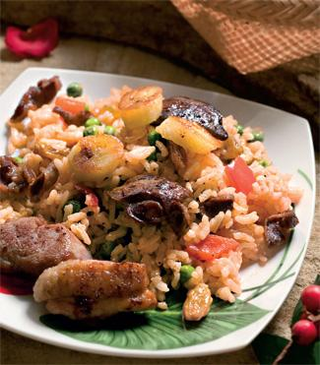
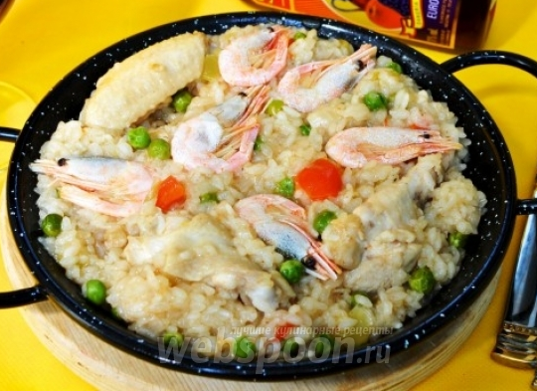
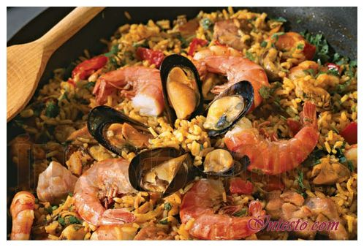
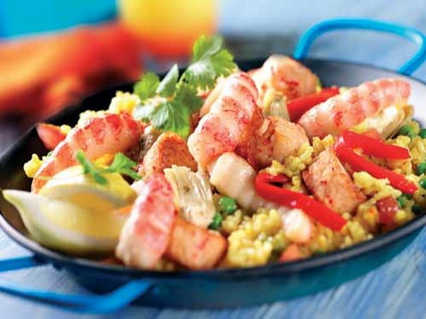
Paella

Slide 7
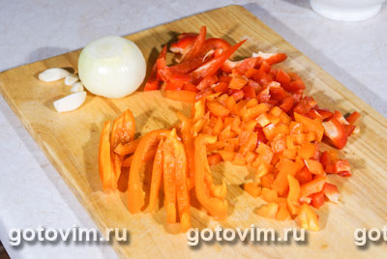
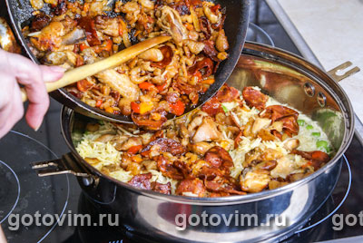
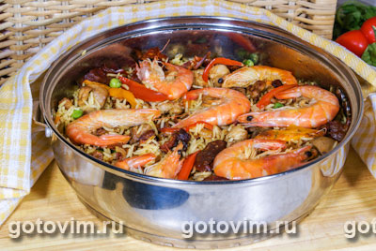
Recipe
Increase rice - 250-300g; chicken - 1 piece. Chorizo ​​- 100g, shelled shrimp - 250g, large shrimp (in shell) - 6 pcs.; Peppers - 2 pcs. Green peas (freezing) - 150g; onions - 1 piece. garlic - 4-5 cloves, saffron - 2 whispers, sweet paprika - 1/2 tsp, olive oil, broth for: onions - 1 piece. carrots - 2 pcs., bay leaf - 1-2 pcs., salt

Slide 8
The end

