Slide 1
Russian painting in the second half XIX - beginning of XX century

Slide 2
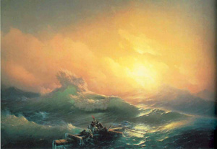
Ivan Aivazovsky
"The ninth wave" is a true masterwork. Aivazovsky reaches in this painting an absolute technical perfection, representing a group of unlucky castaways trying to survive under the merciless charges in form of oceanic waves. Nevertheless, the centre of the composition is the powerful, almost mystical and diffuse representation of the sun, which illuminates the scene with a strange, oneiric range of green and pink shades. This painting is often called "the most beautiful painting in Russia"
The Ninth Wave.
1850. Oil on canvas. The State Russian Museum, St. Petersburg, Russia.

Slide 3
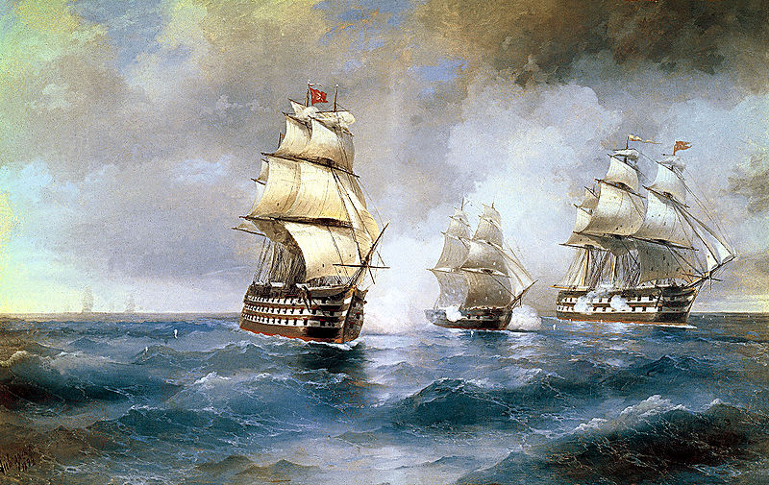
Ivan Aivazovsky
Brig "Mercury" Attacked by Two Turkish Ships
1892. Oil on canvas. The Tretyakov Gallery, Moscow, Russia

Slide 4
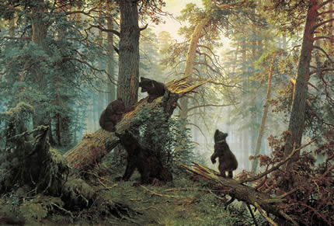
Ivan Shishkin
"Morning in a pine forest" is a marvelous pictorial fantasy that goes beyong the pure realism developed by many other Russian painters of the era. Shishkin has chosen one of his favorite motifs, the dense Russian pine forest, adding the unusual and rather bucolic presence of a family of bears.
"Morning in a pine forest“
1886. Oil on canvas. Tetryakov Gallery, Russia

Slide 5
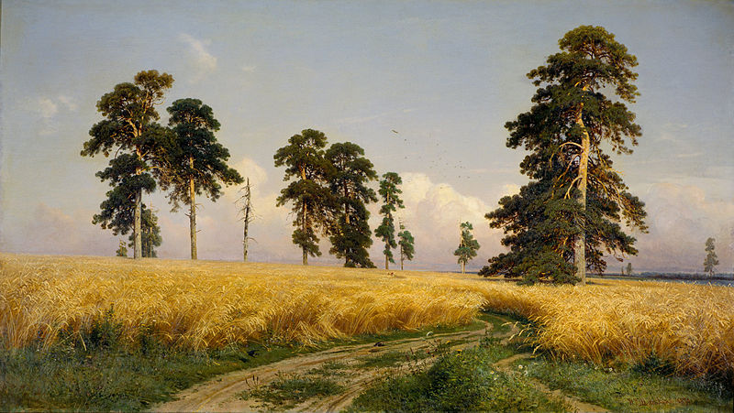
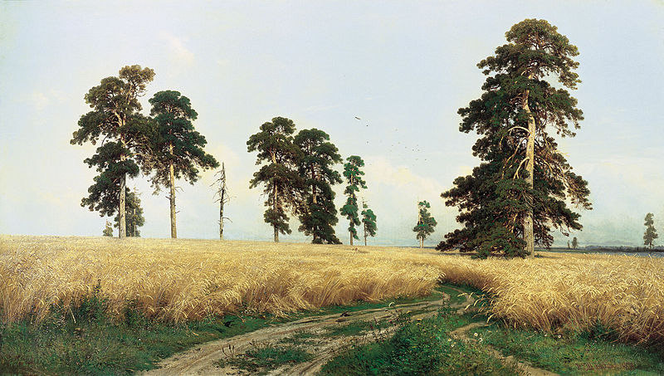
Ivan Shishkin
“Rye Fields”
1878. Oil on canvas. Tretyakov Gallery, Moscow

Slide 6
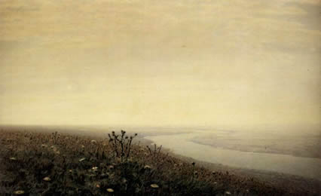
Arkhip Kuindzhi
"Dnepr in the morning" (as "Dnepr in the night", executed a year before) is considered as one of the first works finished with Kuindshi's "mature" style, with stunning light and atmospheric effects. This panoramic view is especially remarkable for its simple but very strong composition.
"Dnepr in the morning“
1881. Oil on canvas. The Tretyakov Gallery, Moscow, Russia

Slide 7
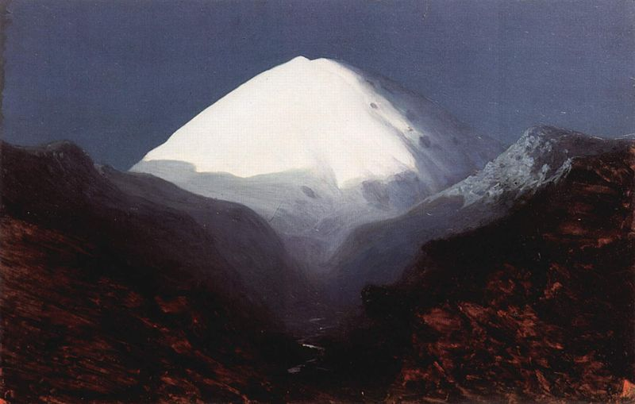
Arkhip Kuindzhi
"Mount Elbrus, moonlit night “
1890-1895. Oil on paper mounted on canvas. Tretyakov Gallery, Moscow

Slide 8
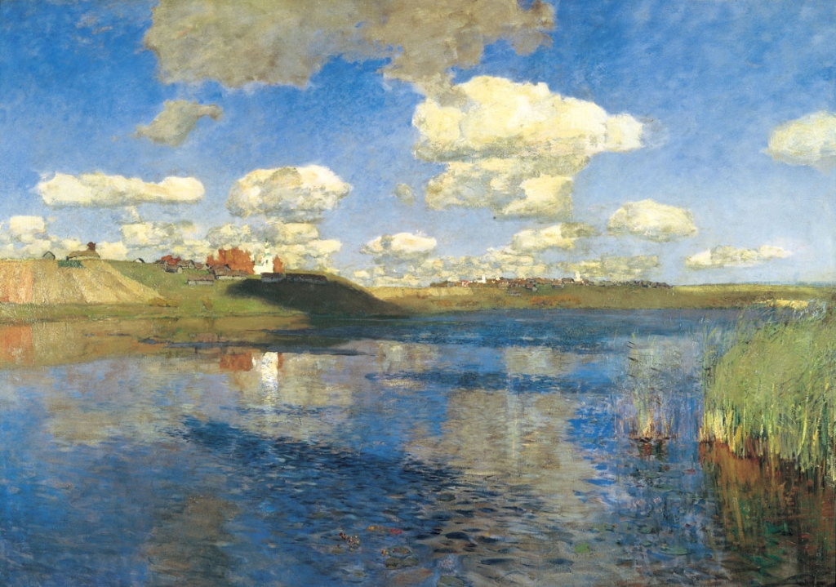
Isaac Levitan
"Lake" is Levitan's last painting, an unfinished masterpiece by the Russian painter (born in Kaunas, Lithuania) who mastered the landscape of mood, a very emotional interpretation of the Russian landscape.
While Levitan, as many other Russian landscape painters, was clearly influenced by the Barbizon School, this late work is (un)finished in a somewhat impressionist way.
"Lake“
1900. Oil on canvas

Slide 9
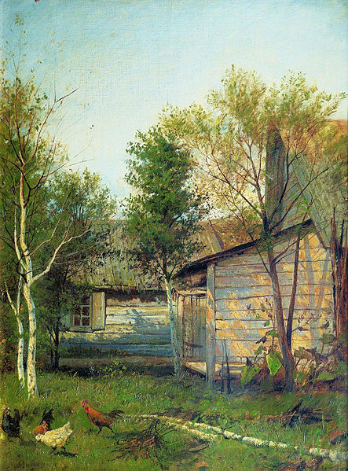
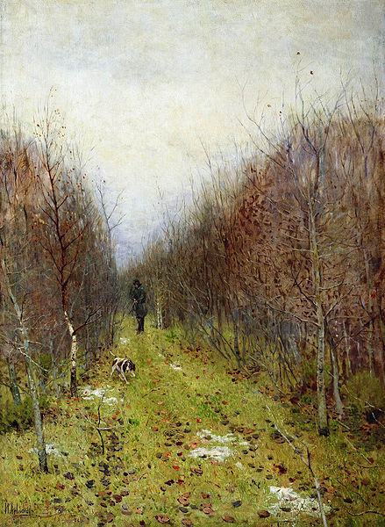
Isaac Levitan
"Lake“
1900. Oil on canvas
“Sunny Day” 1876
“Autumn Landscape” 1880

Slide 10
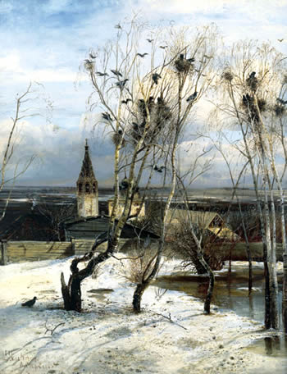
Alexei K. Savrasov
Savrasov was one of the most important -arguably the most important- of all the 19th century Russian landscape painters, considered the creator of the "lyrical landscape style". A trully emblematic work, "the rooks have returned" (or "the rooks have come back") is Savrasov's most famous painting, a lovely elegy to the spring announced by the rooks return. The canvas shows Savrasov's love for the rural Russian landscape, very influenced by John Constable.
“The rooks have returned”
1871. Oil on canvas. Tetryakov Gallery, Russia

Slide 11
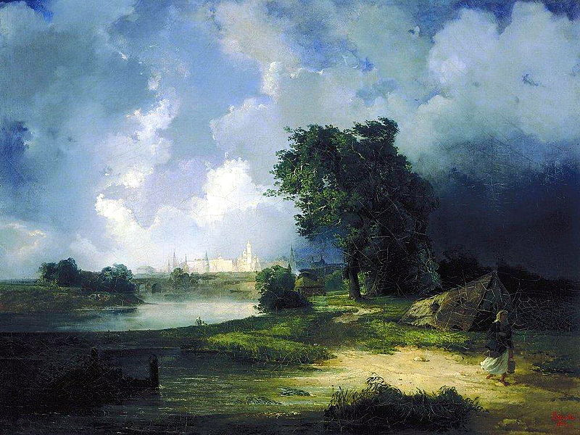
Alexei K. Savrasov
“View of the Kremlin from the Krymsky Bridge in Inclement Weather” 1851

Slide 12
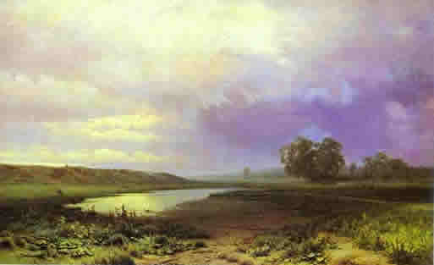
Fyodor Vasilyev
Feodor Vasilyev was a brillian "boy genius" who established himself as one of the most important and respected Russian painters of his era, introducing the lyrical landscape style in Russian painting. "Wet meadow" is a beautiful, lyric masterwork done completely from memory and a few sketches of the Russian plains.
"Wet Meadow“
1872. Oil on canvas. The Tretyakov Gallery, Moscow, Russia

Slide 13
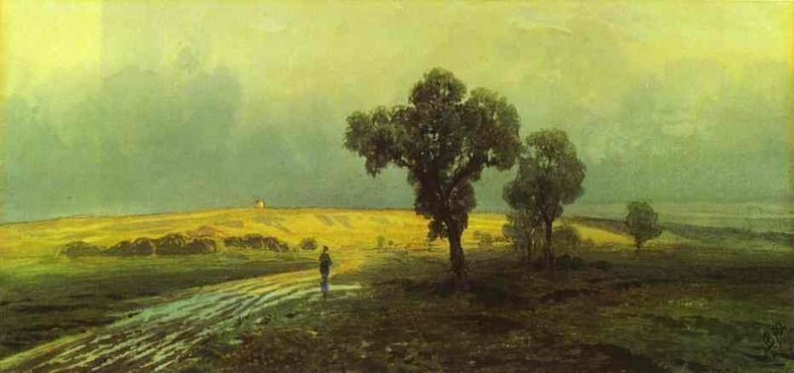
Fyodor Vasilyev
“After a Heavy Rain” 1870

Slide 14
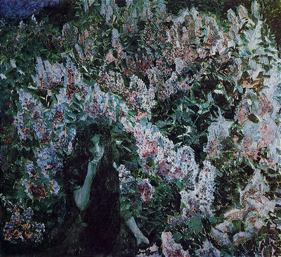
Mikhail Vrubel
In 1900, Vrubel became member of the World of Art group. The same year, he produced some of his best canvases, including The Swan Princess and Lilac.
The artist's fervent love of nature helped him to convey its beauty. The luxuriant clusters of lilac in the painting "Lilac" are alive and fragrant in the starlit night. One of Vrubel's contemporaries wrote that nature blinded him (the artist did indeed go blind near the end of his life) because he looked too closely at its secrets.
Lilac (Siren).
1900. Oil on canvas. The Tretyakov Gallery, Moscow, Russia.

Slide 15
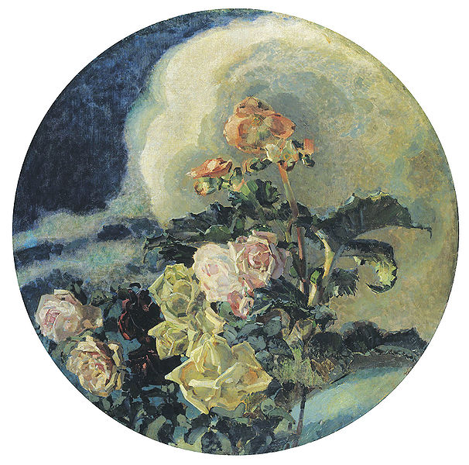
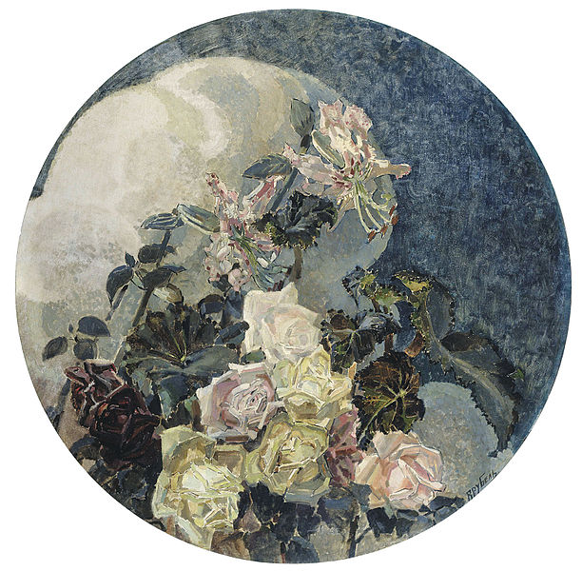
Mikhail Vrubel
“Yellow Roses”
1894. Oil on canvas
“Roses and Orchids”
1894. Oil on canvas

