Slide 1
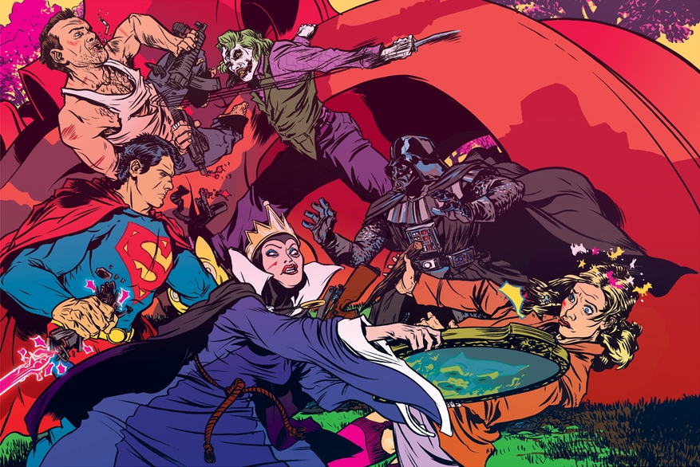
Violence in animated cartoons

Slide 2
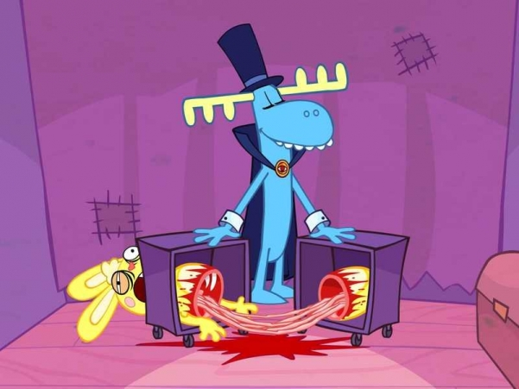
According to results of the research spent by scientists of University college in London and University of Ottawa in Canada, two third of children's animation films show death of one of key characters. As to feature films, only in half from them heroes perish.

Slide 3
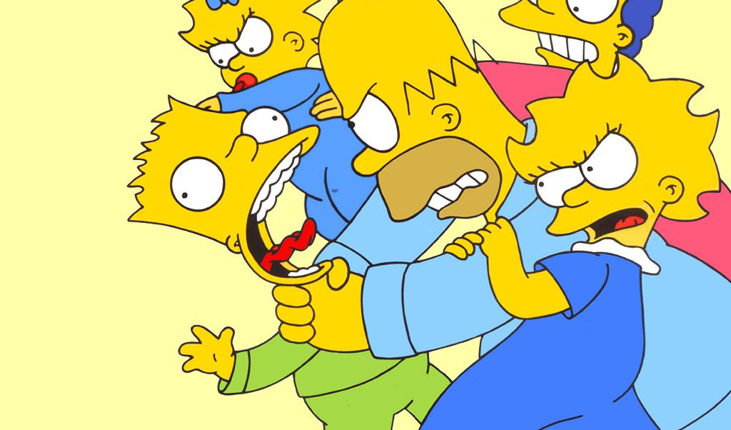
«Children's animation films abound with scenes of murders and death», — is told in results of research «Animated cartoons kill» (Cartoons kill), published in magazine British Medical Journal. In children's cartoon films often show cruel scenes of violent death that injures children's mentality.

Slide 4
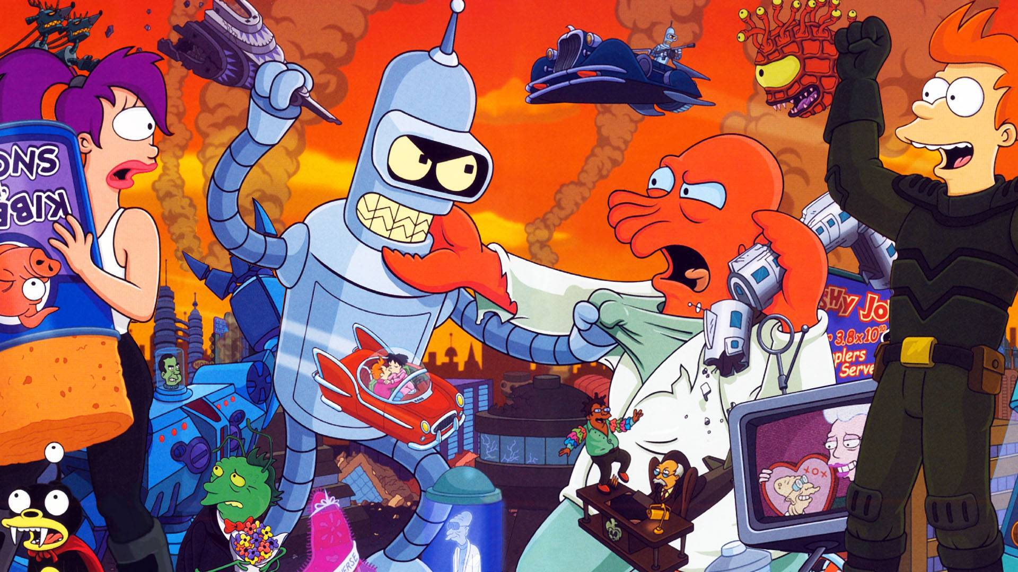
That is great quantity of cartoon films with violence scenes of aggression which are in the easy approach
Is enough dangerous tendency.

Slide 5
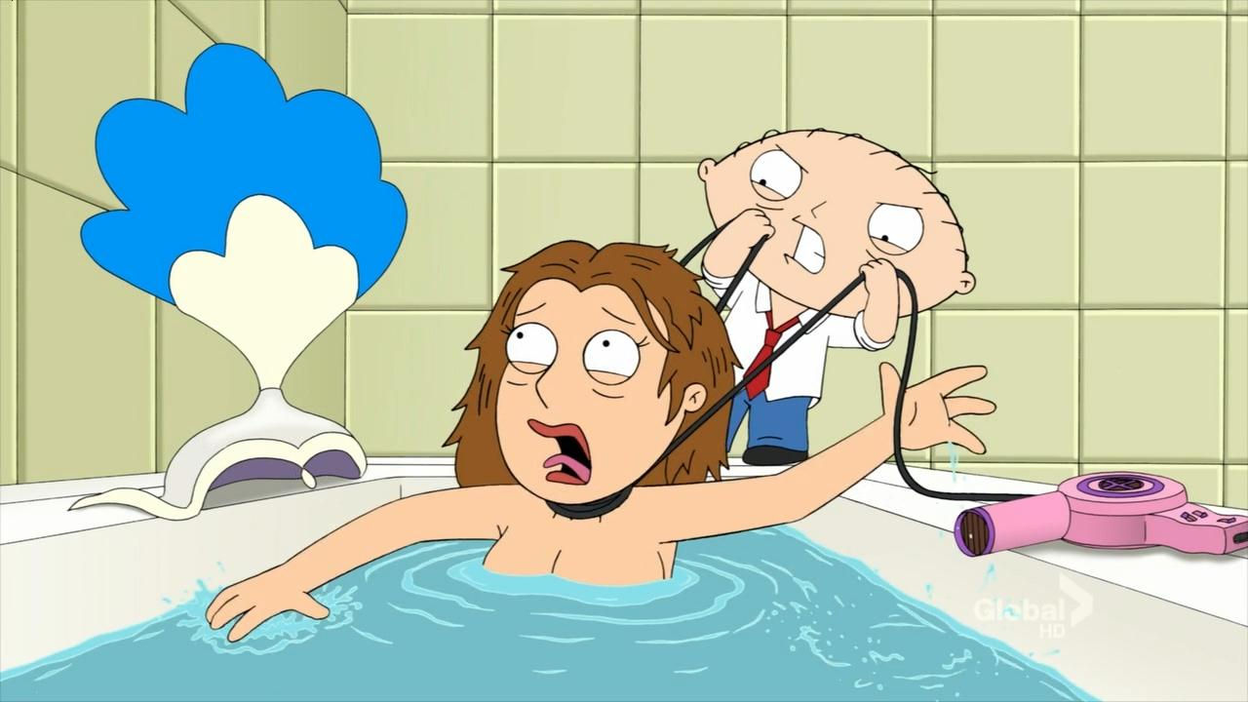
The increase in quantity of violence and cruelty in cartoon films can have irreparable consequences for mental health of the child and its further to formation as persons

Slide 6
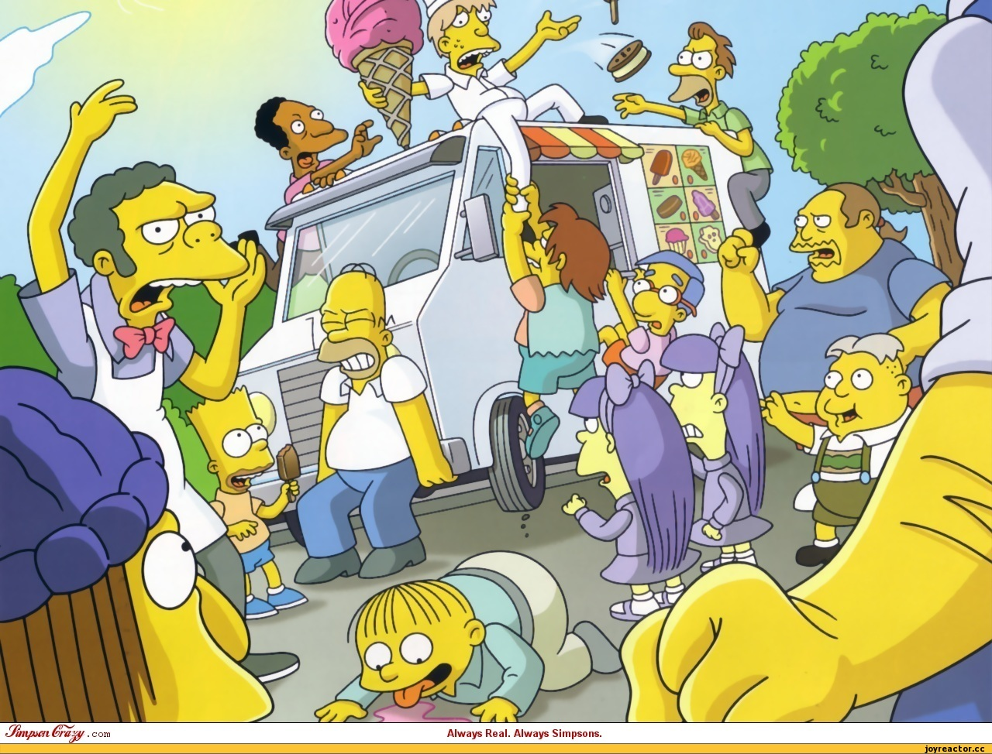
Also the violence which is used by the young spectator from TV screens is fixed in the head of the child as usual action which can be used at possibility

Slide 7
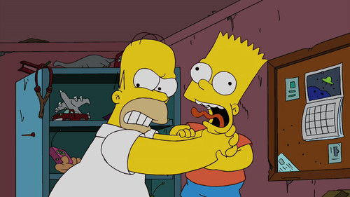
It is not necessary to forget that cruelty on the screen leads emotional that to psychological excitation. The sum of all these factors specifies in negative influence of cruelty and violence in cartoon films on not generated children's consciousness therefore demands intervention of adults

Slide 8
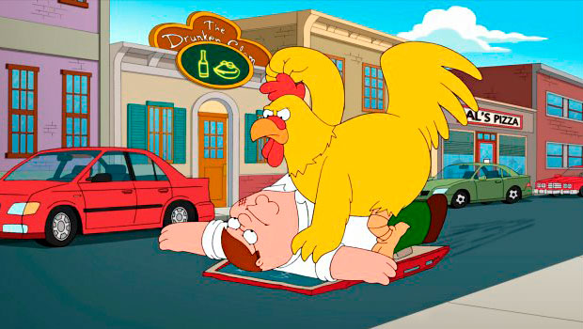
Always it is necessary to remember that the majority of animated cartoons with violence elements are created for adult spectators, and the problem consists that such animated cartoons often are in the easy approach, therefore the main task of parents to protect children from such cartoon films

