Slide 1
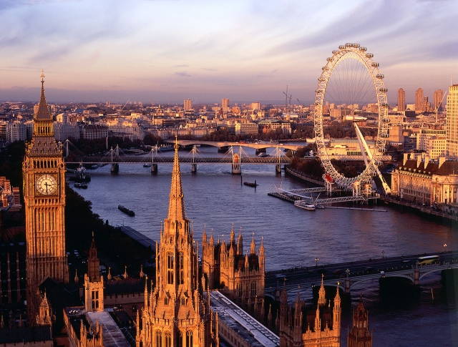
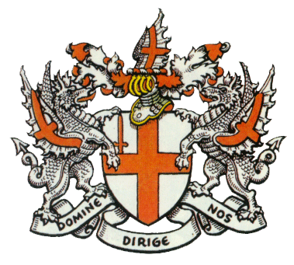
План бизнес-проекта
London
Имя выступающего | название компании

Slide 2
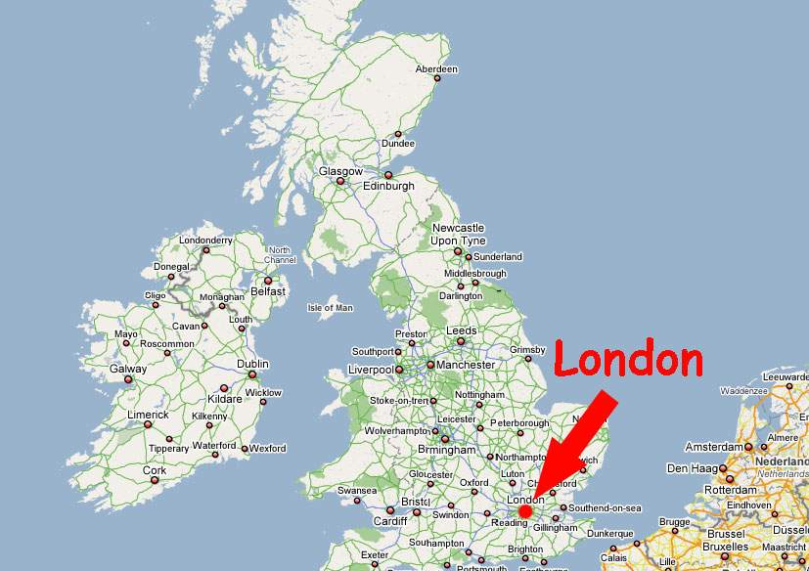
London is the British capital and
one of the biggest cities in the world.

Slide 3
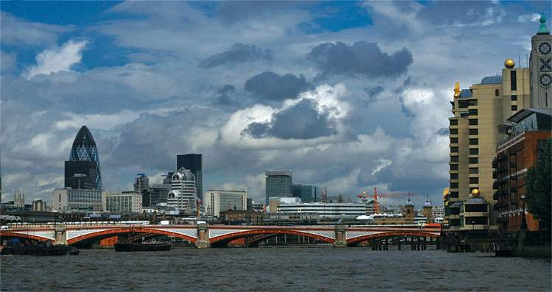
London is situated upon both banks of the
River Thames, it is the largest city in Britain
and one of the largest in the world.
Its population is about
7 million people.

Slide 4
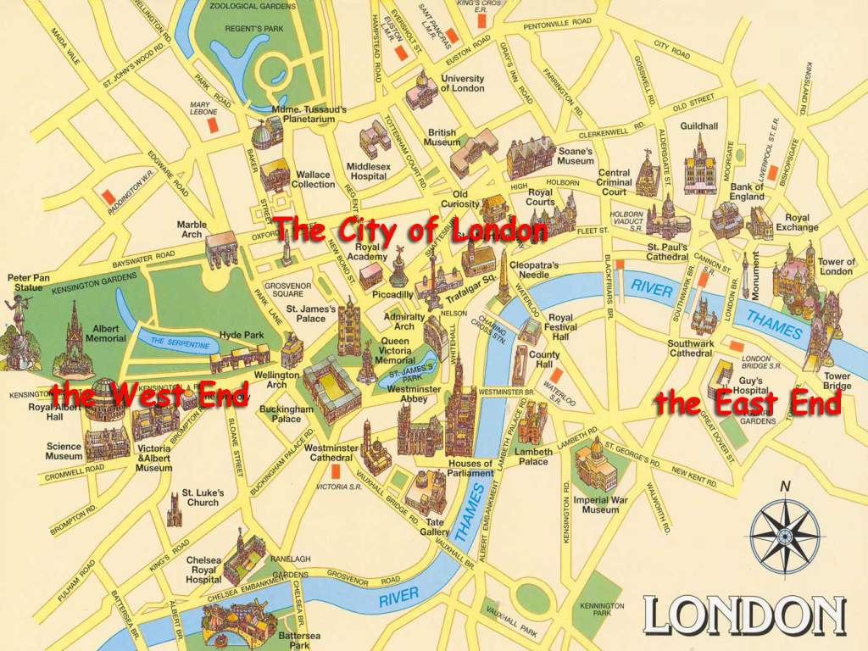
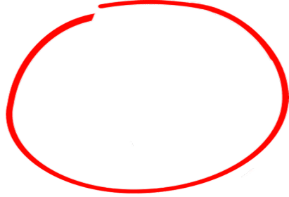
It consists of three parts: the City of London, the West End and the East End.

Slide 5
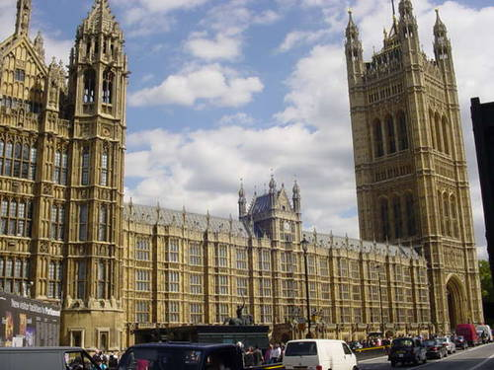
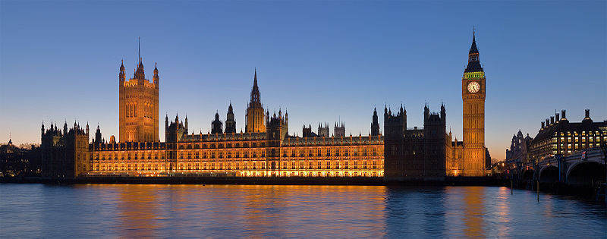
The Palace of Westminster
Весмінстерський палац
The Palace of Westminster, also known as the Houses of Parliament or Westminster Palace, is the meeting place of the two houses of the Parliament of the United Kingdom—the House of Lords and the House of Commons. It lies on the north bank of the River Thames, close to the historic Westminster Abbey. The Palace is one of the centers of political life in the United Kingdom.

Slide 6
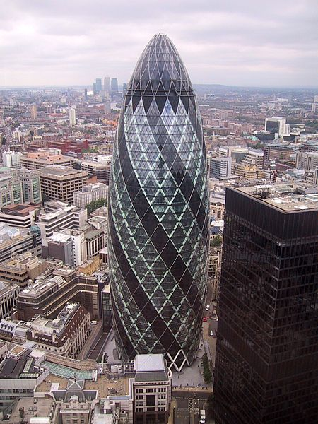
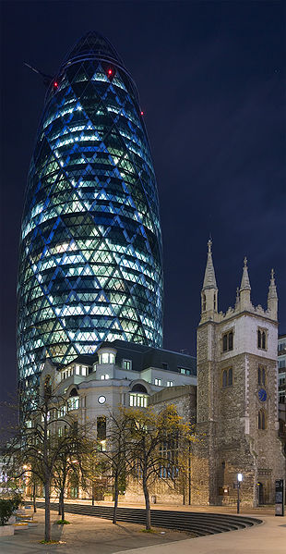
St Mary Axe was a medieval parish in London whose name survives on the street it formerly occupied.
Хмарочос Мері-Екс

Slide 7
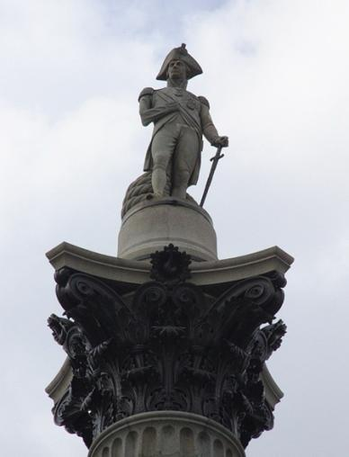
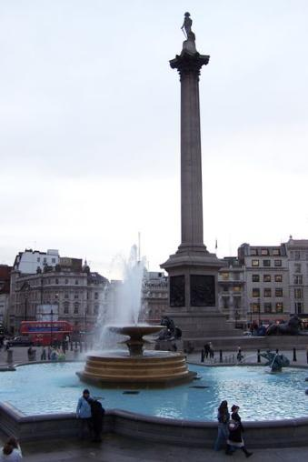
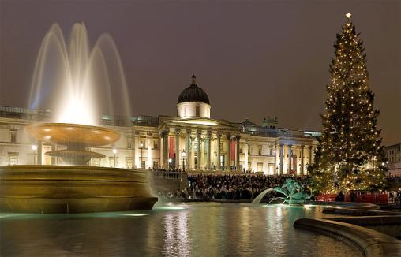
Trafalgar Square
Трафаргарська площа
Trafalgar Square is a public space and tourist attraction in central London, England. At its centre is Nelson's Column. There are a number of statues and sculptures in the square. The square is also used for political demonstrations and community gatherings, such as the celebration of New Year's Eve .

Slide 8
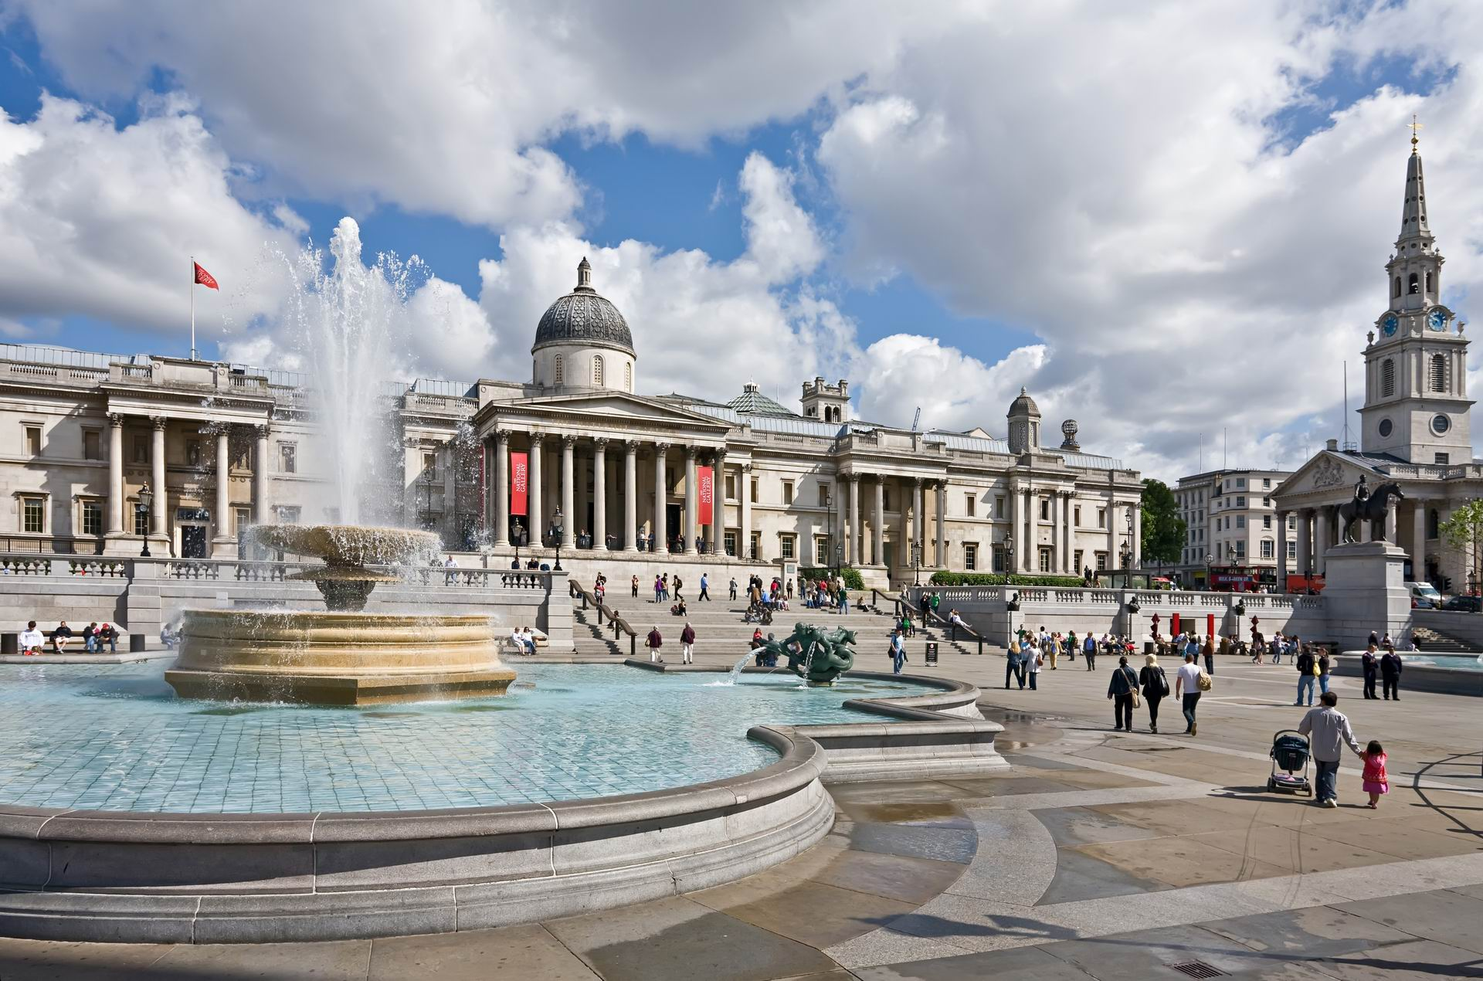
Trafalgar Square

Slide 9
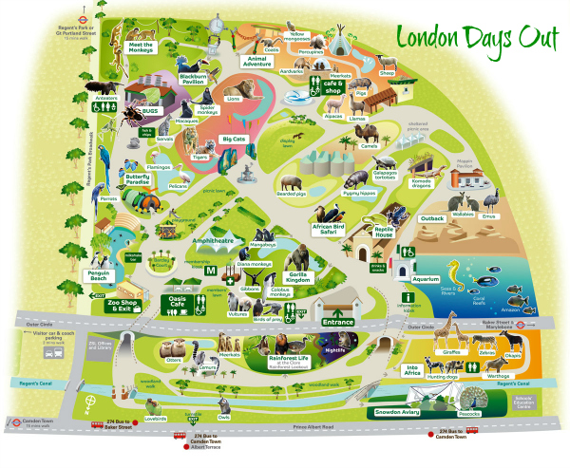
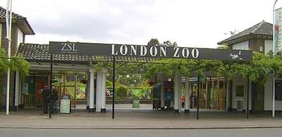
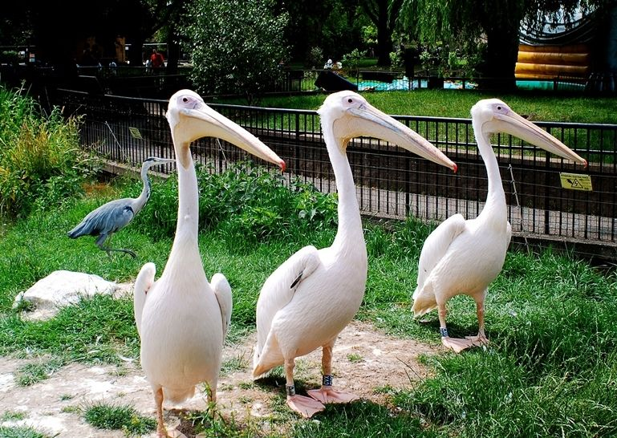
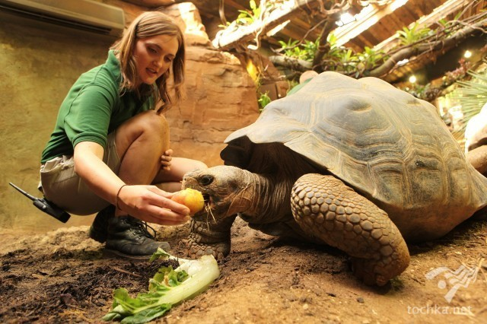
The London Zoo Лондонский зоопарк
London Zoo is the world's oldest scientific zoo. Today it houses a collection of 755 species of animals, with 16,802 individuals, making it one of the largest collections in the United Kingdom.

Slide 10
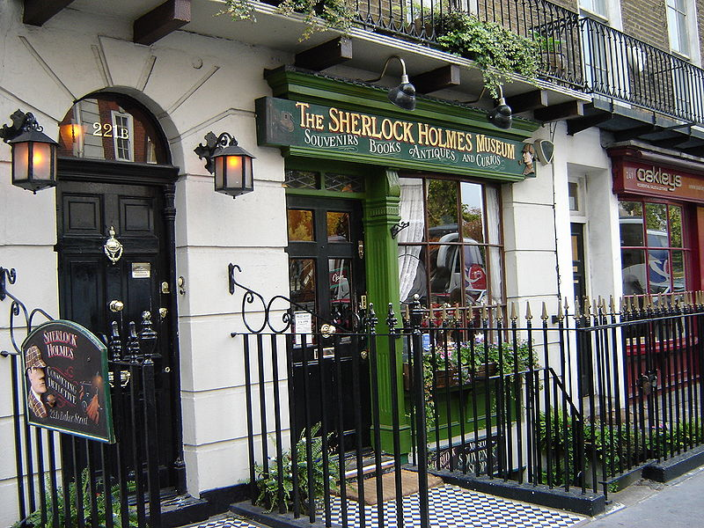
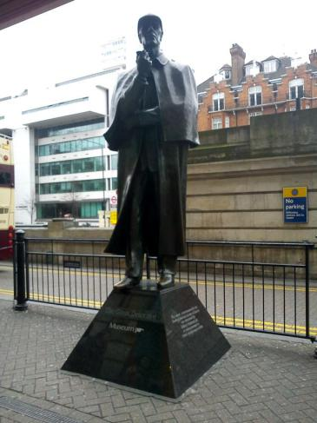
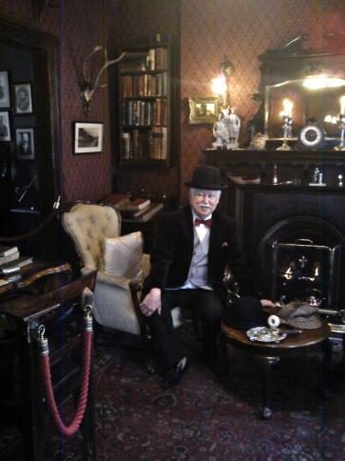
The Sherlock Holmes Museum Музей Шерлока Холмса
The Sherlock Holmes Museum is a popular privately-run museum in London, England, dedicated to the famous detective Sherlock Holmes. It opened in 1990 and is situated in Baker Street.

Slide 11
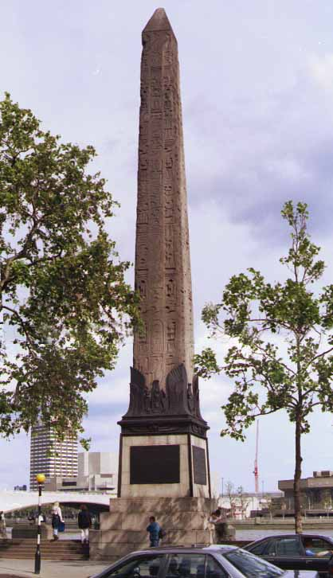
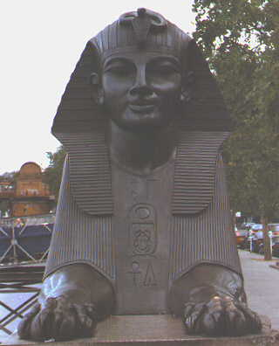
Cleopatra’s Needle Голка Клеопатри
Anyone visiting London for the first time and walking along the Thames may be surprised to come across an original Egyptian obelisk.
This obelisk is known as Cleopatra's Needle …though it has very little to do with Cleopatra at all.
It is known as Cleopatra's Needle as it was brought to London from Alexandria, the royal city of Cleopatra.
Cleopatra's Needle stands on the Thames. Two large bronze Sphinxes lie on either side of the Needle. These are Victorian versions of the traditional Egyptian original.

Slide 12
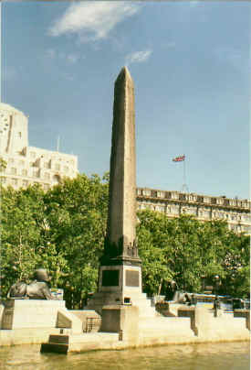
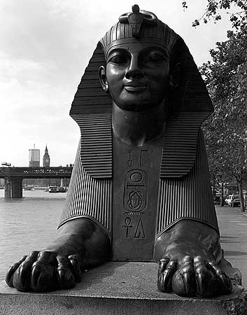
Cleopatra's Needle

Slide 13
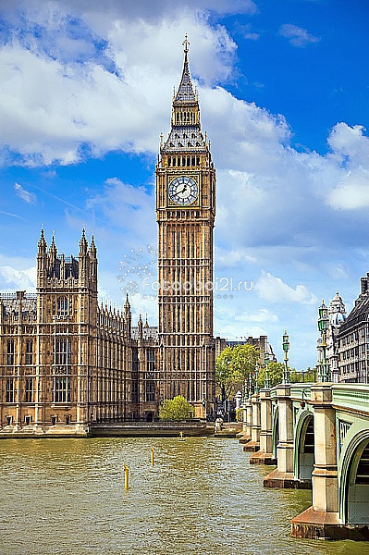
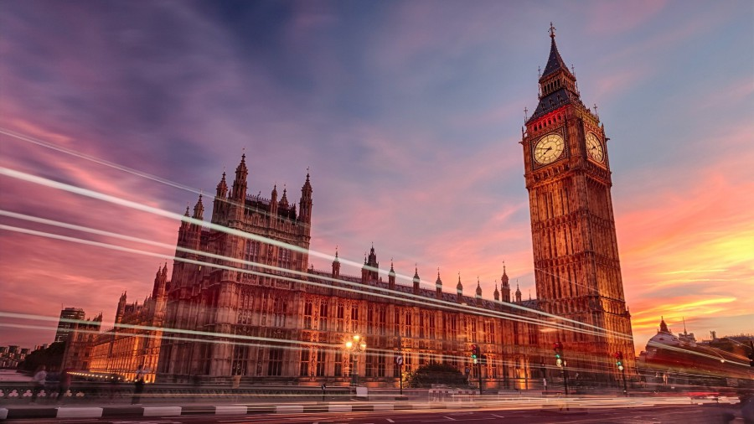
Big Ben

Slide 14
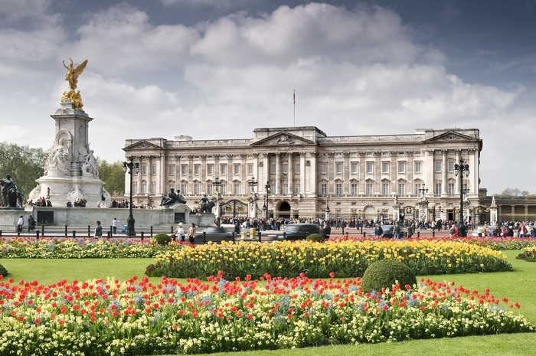
Buckingham Palace

Slide 15
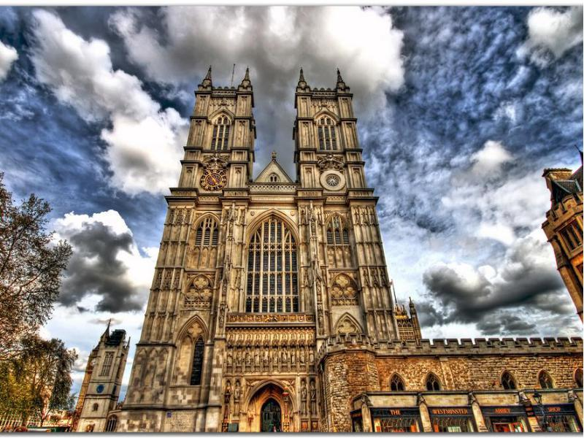
Westminster Abbey

Slide 16
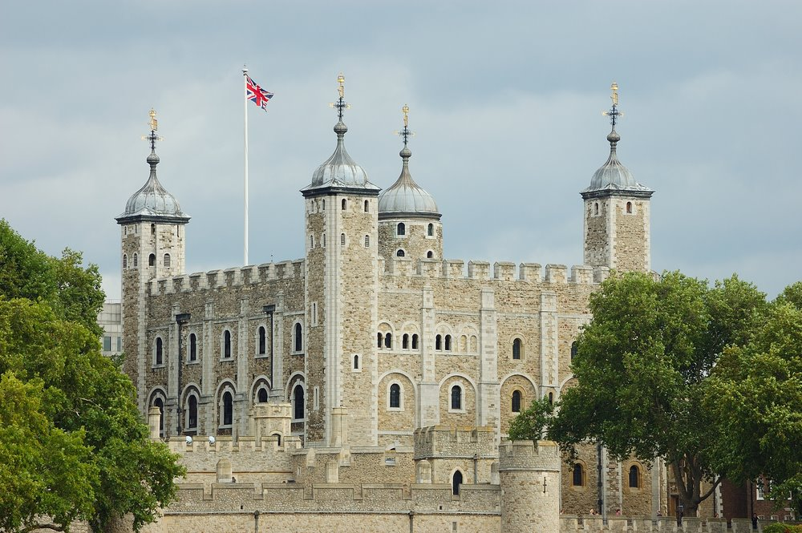
The Tower of London

Slide 17
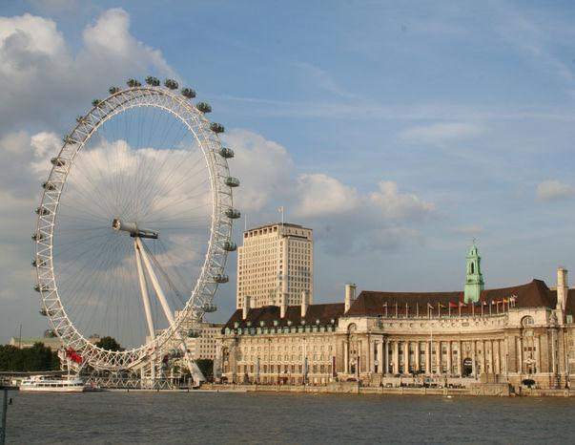
London Eye

Slide 18
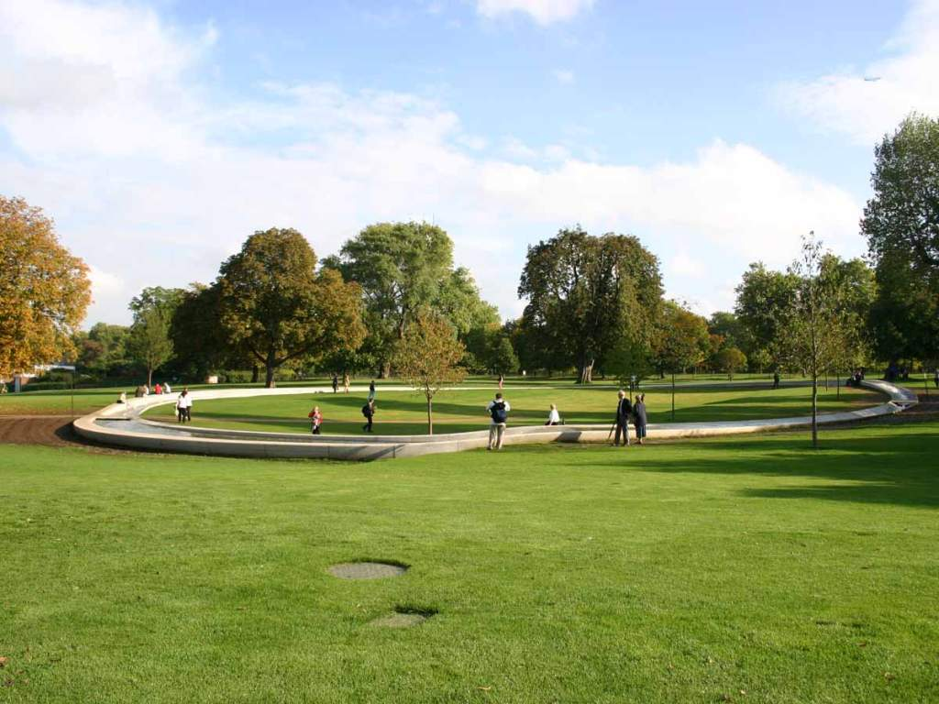
Here are the historical places as well
as the famous parks.
Hyde Park with its Speaker's Corner is also here.

Slide 19
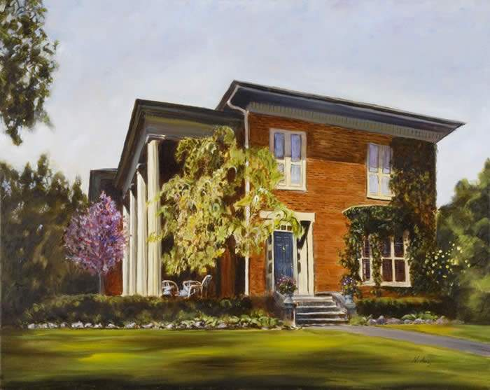
The Queen's Residence
The Queen's Residence was built in
1870 for Samuel Barnard, a vice president
of the Paper Company.

Slide 20
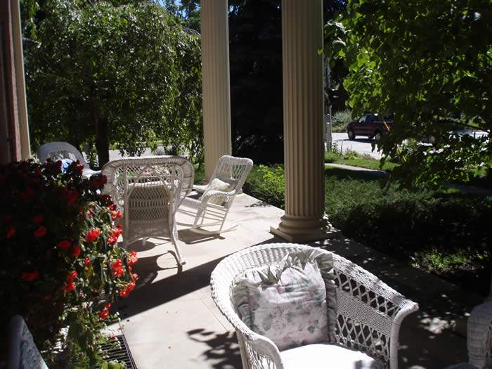
The 1700’s
the Queen's Residence was a
gift from Henry Ford.

Slide 21
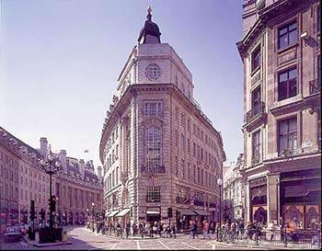
Museums and art galleries
of London.
Tate Gallery

Slide 22
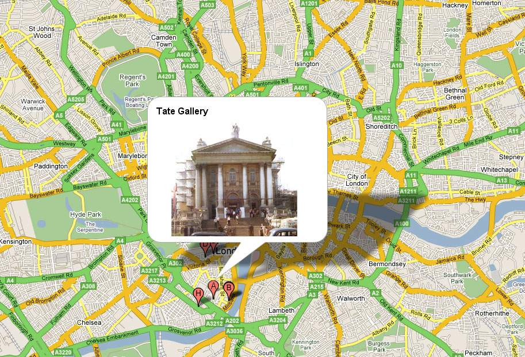
London is very rich in museums and art galleries. If you are fond of painting you'll go to the Tate Gallery.

Slide 23
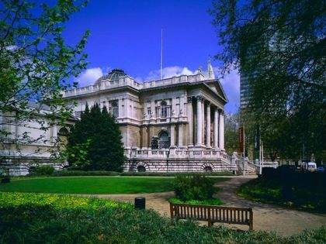
A rich sugar manufacturer Henry Tate
founded it in 1897.

Slide 24
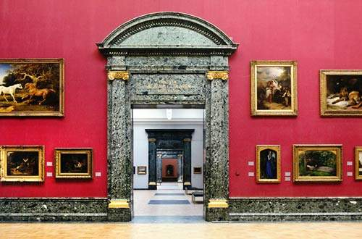
There are about 300 oils and
19000 watercolours and drawings.

Slide 25
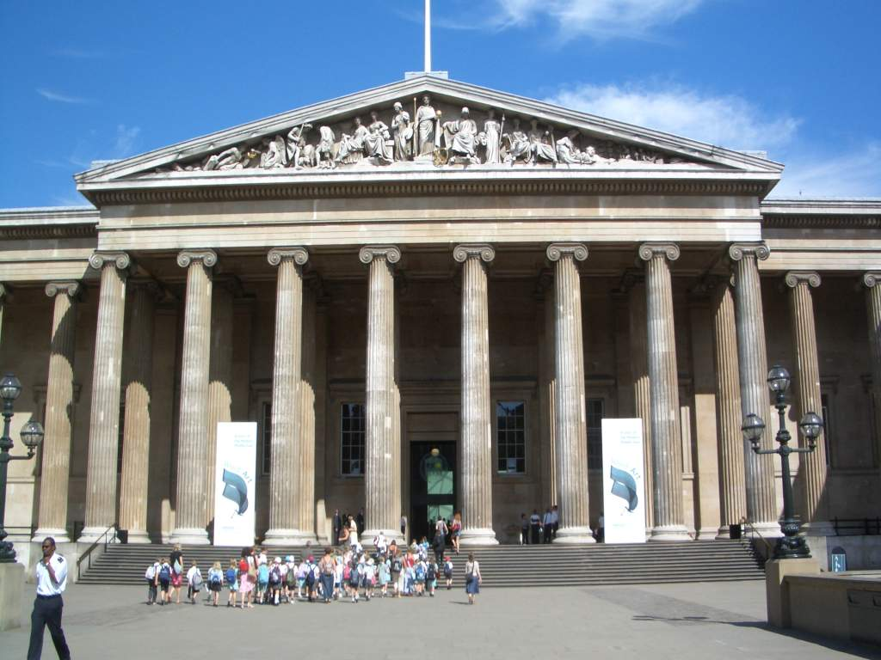
By law a copy of every book, periodical
and newspaper, published in Britain
must be presented in the British museum.

Slide 26
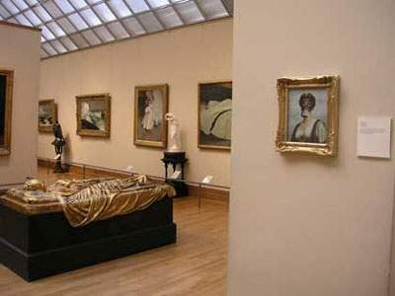
This collection is so vast that
only a very small percentage of it is
on show to the public.

Slide 27
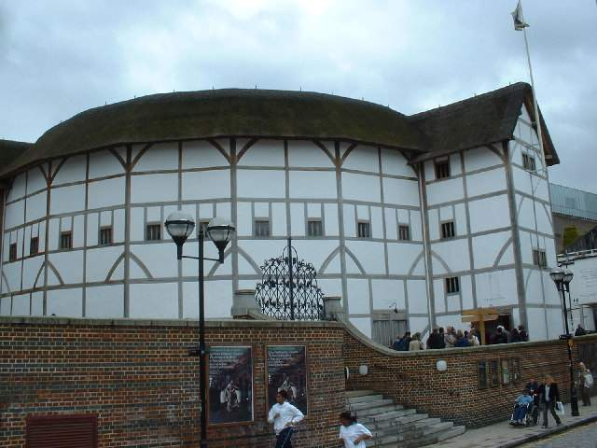
Globe Theatre
The original Globe Theatre was built
in 1599 by the playing company
to which Shakespeare belonged.

Slide 28
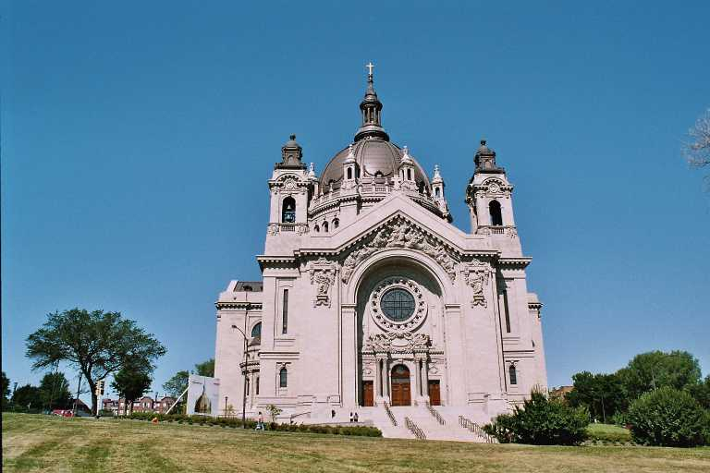
The Cathedral of Saint Paul

Slide 29
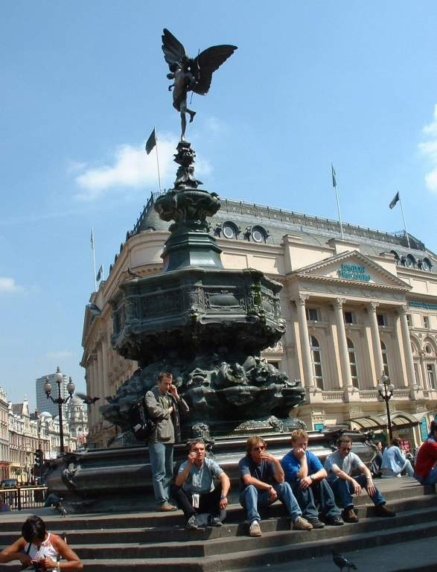
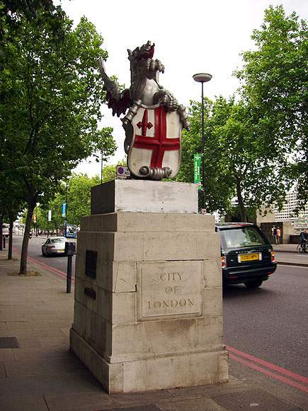
Statue on border
the city of London
Piccadilly

Slide 30
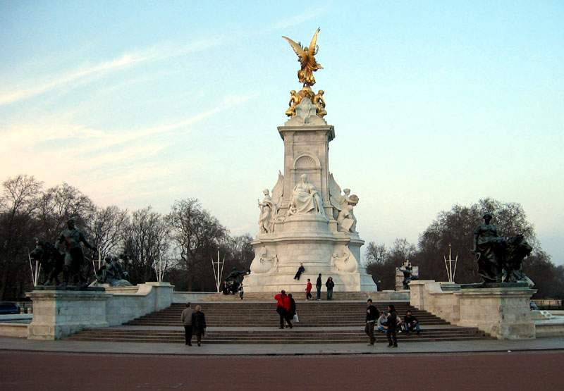
Queen Victoria Memorial

Slide 31
Thank you for
your attention!

